Slide 1

PRESENTATION OF TERM PROJECT
On the Topic
Customer Segmentation using K-Means Clustering Algorithm
Project Members: | Akher Uddin Ahmed (202102022100) Subhash Kumar Wary (202002022110)
Project Supervisor: | Dr. Ranjan Maity Assistant Professor Dept. of Computer Science & Engineering
Central Institute of Technology Kokrajhar
Computer Science & Engineering
Customer Segmentation using K-Means Algorithm
April 27, 2024

Slide 2
CONTENTS
Introduction
Problem Statement
Objectives
Block Diagram
Dataset
Methodology
Results
Conclusion
Future Work
References
Customer Segmentation using K-Means Algorithm
April 27, 2024

Slide 3
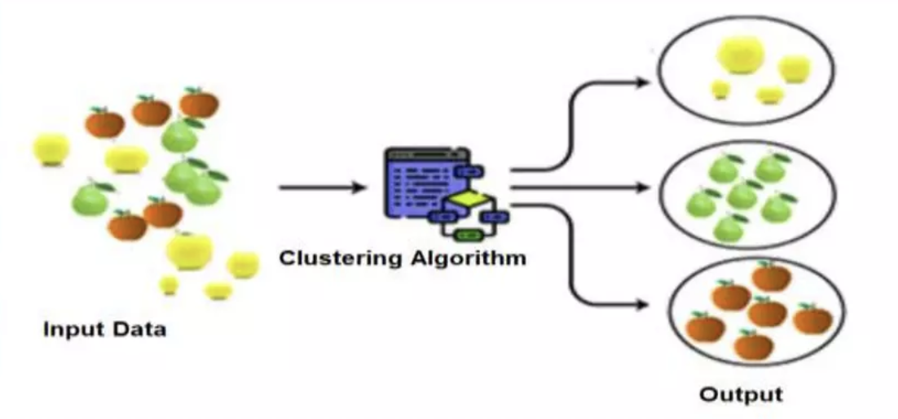
INTRODUCTION
Clustering analysis is the process of forming similar group of objects together in form of a cluster that is it categorizes the objects in unlabelled data into different categories based on their similarities.
Clustering is an unsupervised machine learning algorithm.
Clustering is done by finding some similarities or patterns from the dataset like color or shape. Then it groups the objects which have the same features into a group and others into another group like that.
Customer Segmentation using K-Means Algorithm
April 27, 2024

Slide 4
PROBLEM STATEMENT
To develop a customer segmentation using Mall Customer Dataset and performing K-Means clustering based on the data in form of optimal clusters.
We aim to enhance customer satisfaction, personalize marketing efforts, optimize product offerings and ultimately drive revenue growth.
Customer Segmentation using K-Means Algorithm
April 27, 2024

Slide 5
OBJECTIVES
To identify the different customer segments in our Customer base.
To understand the needs and preferences of each customer segment.
To increase customer satisfaction and loyalty
To increase Sales and Revenue
The proposed solution for ML based Customer Segmentation presents cost-effective and reliable solution.
Customer Segmentation using K-Means Algorithm
April 27, 2024

Slide 6
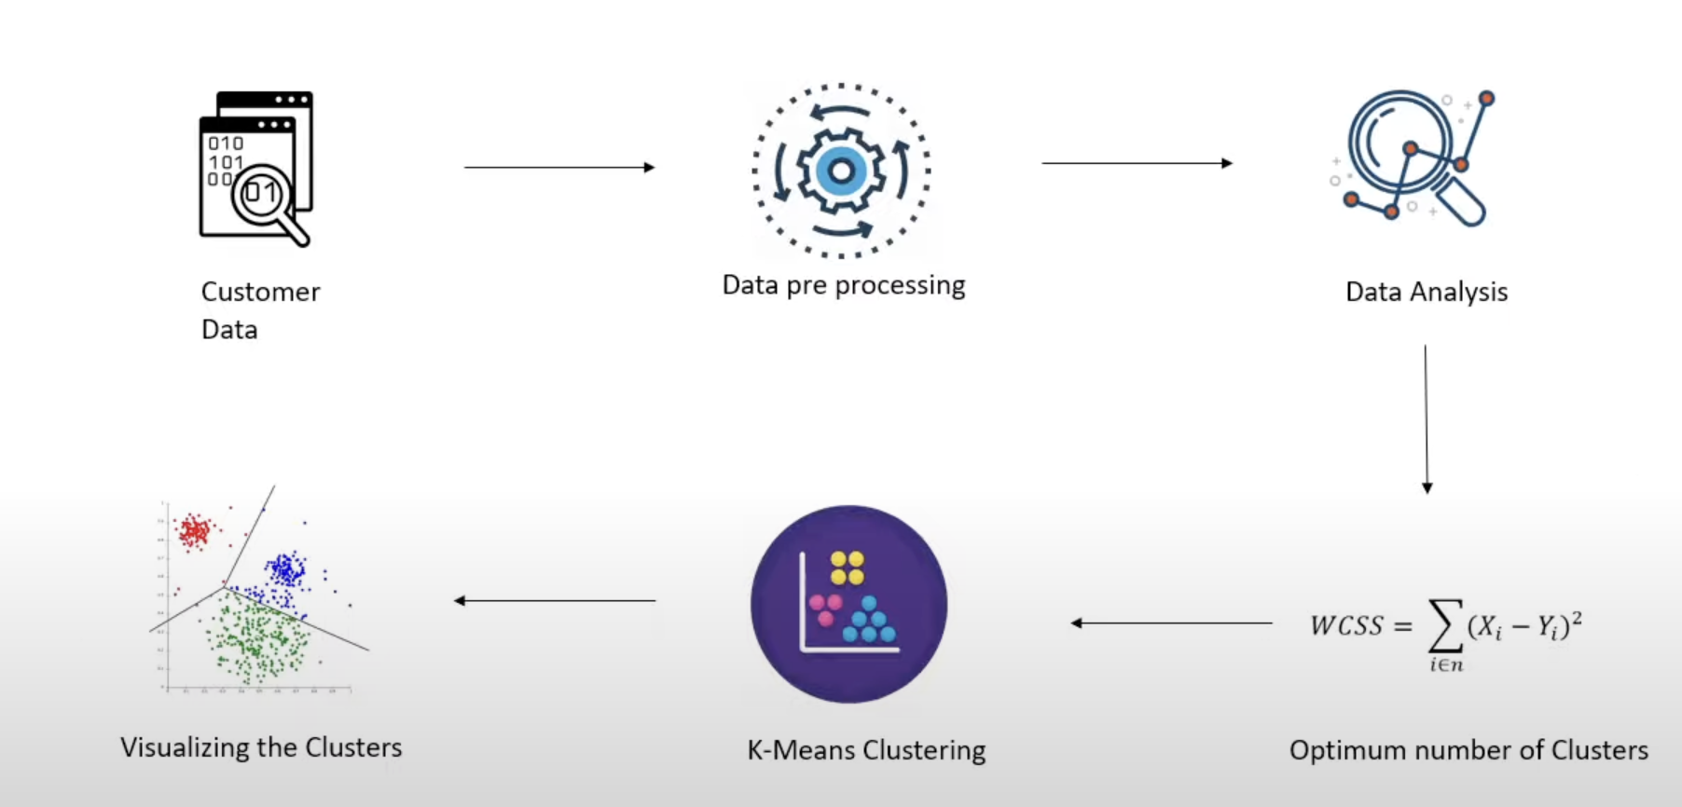
BLOCK DIAGRAM
Customer Segmentation using K-Means Algorithm
April 27, 2024

Slide 7
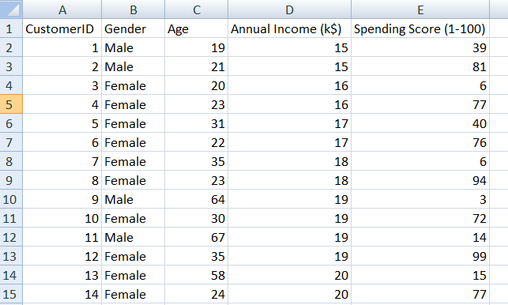
DATASET
Dataset has been taken from Kaggle containing the features CustomerID, Gender, Age, Annual Income (k$) and Spending Score (1-100)
Table 1: Mall Dataset
Customer Segmentation using K-Means Algorithm
April 27, 2024

Slide 8
METHODOLOGY
Pre-processing of data has been done before training the model.
To find optimal number of clusters we used Elbow method.
The model has been trained with k-Means Clustering algorithm.
Grouping the data depending on the similarities of the similar spending pattern and annual income of the individual.
After that we can visualize the clusters.
Customer Segmentation using K-Means Algorithm
April 27, 2024

Slide 9
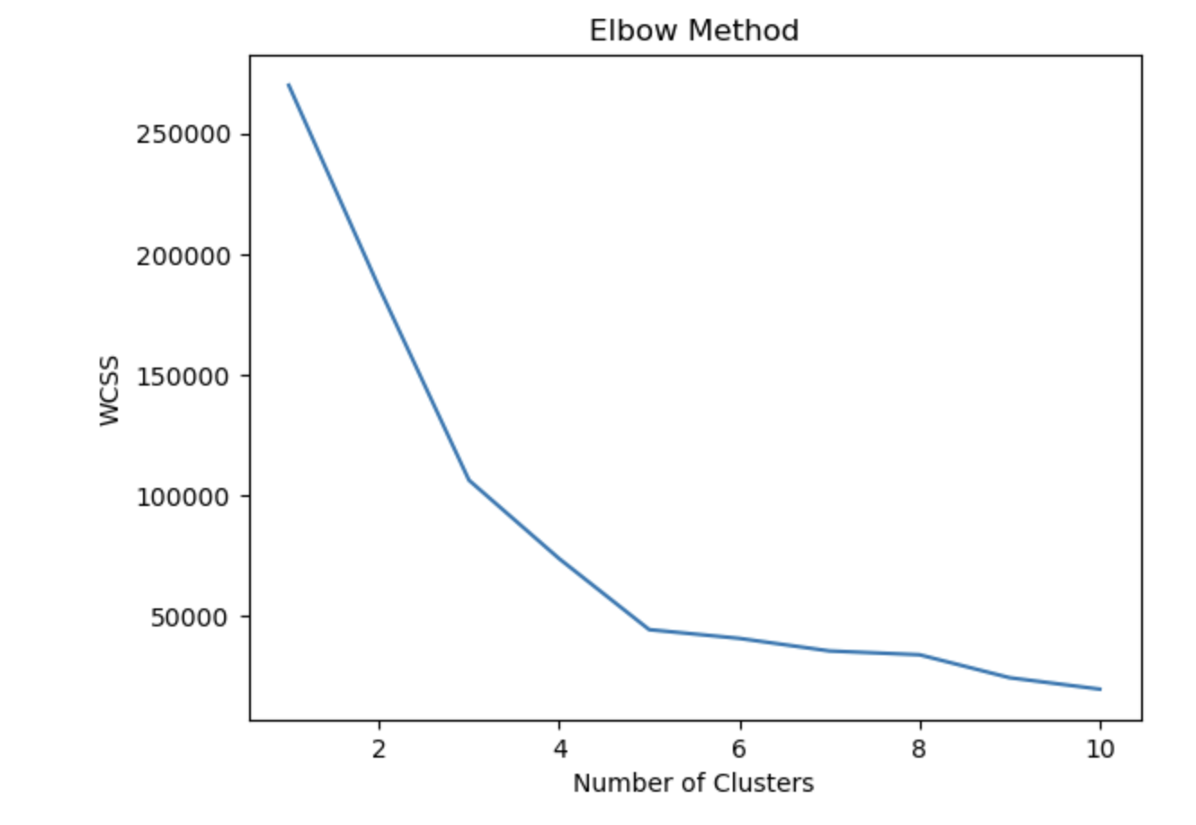
RESULTS AND ANALYSIS
Fig.: The Elbow Method
Customer Segmentation using K-Means Algorithm
April 27, 2024

Slide 10
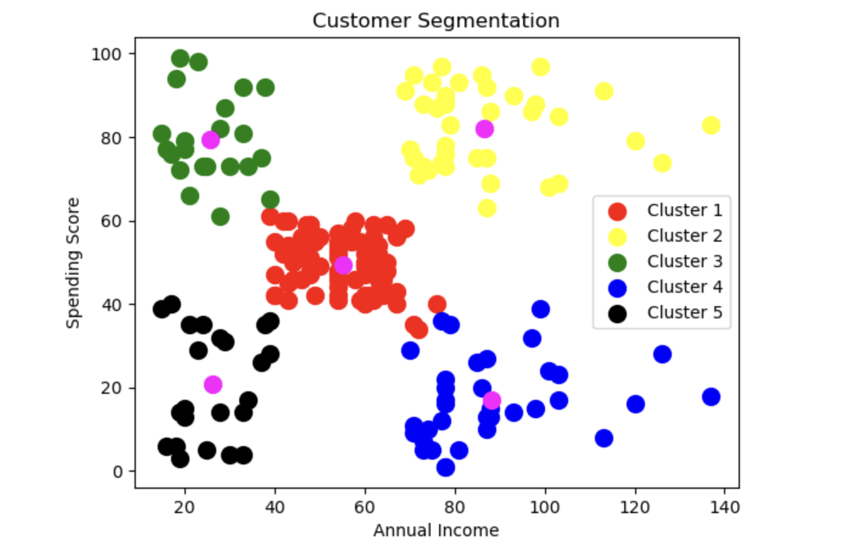
RESULTS AND ANALYSIS
Fig.: Cluster of Customer
Customer Segmentation using K-Means Algorithm
April 27, 2024

Slide 11
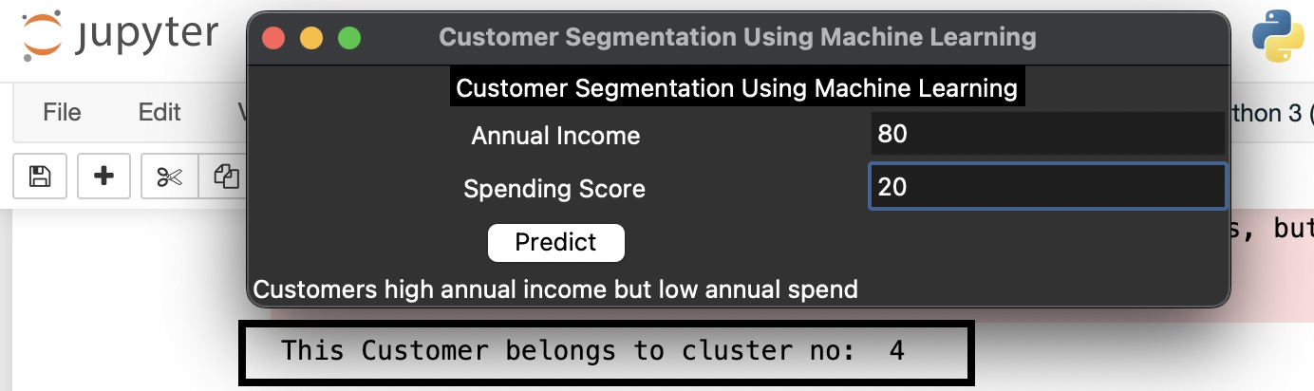
RESULTS AND ANALYSIS
Fig.: Output/Result
Customer Segmentation using K-Means Algorithm
April 27, 2024

Slide 12
CONCLUSION
,
Customers have different needs. A one-size-for-all approach to business will generally result in less engagement, lower-click through rates and ultimately fewer sales.
Customer segmentation is the cure for this problem.
Finding an optimal number of unique customer groups will help us to understand how our customers differ and help us give them exactly what they want.
Customer segmentation improves customer experience and boosts company revenue.
Customer Segmentation using K-Means Algorithm
April 27, 2024

Slide 13
FUTURE WORK
,
We can use different distance metrics: K-means clustering uses Euclidean distance as the default distance metric. However, other distance metrics such as Manhattan, Cosine and Minkowski can be used to increase the accuracy of the clustering.
We can use different initialization methods: K-means clustering uses random initialization by default. However, other initialization methods such as K-means and k-medoids can be used to increase the accuracy of the clustering.
We can use different cluster sizes: K-means clustering uses a fixed number of clusters.
Customer Segmentation using K-Means Algorithm
April 27, 2024

Slide 14
REFERENCES
,
1. https://www.qualtrics.com/au/experience-management/brand/customer-segmentation/#:~
:text=What%20is%20customer%20segmentation%3F,to%20those%20customers%20more%20effectively.
2. https://dl.acm.org/doi/abs/10.1145/1089551.1089610
3.https://www.researchgate.net/publication/349714847_MALL_CUSTOMER_SEGMENTATION_USING_CLUSTERING_ALGORITHM
4. https://think.design/user-design-research/customer-segmentation/
5. https://pubmed.ncbi.nlm.nih.gov/22177941/
6.https://www.researchgate.net/publication/51896518_Identifying_patients_in_target_customer_segments_using_a_two-stage_clustering-classification_approach_A_hospital-based_assessment
Customer Segmentation using K-Means Algorithm
April 27, 2024

Slide 15
Thank you
Customer Segmentation using K-Means Algorithm
April 27, 2024

