Slide 1

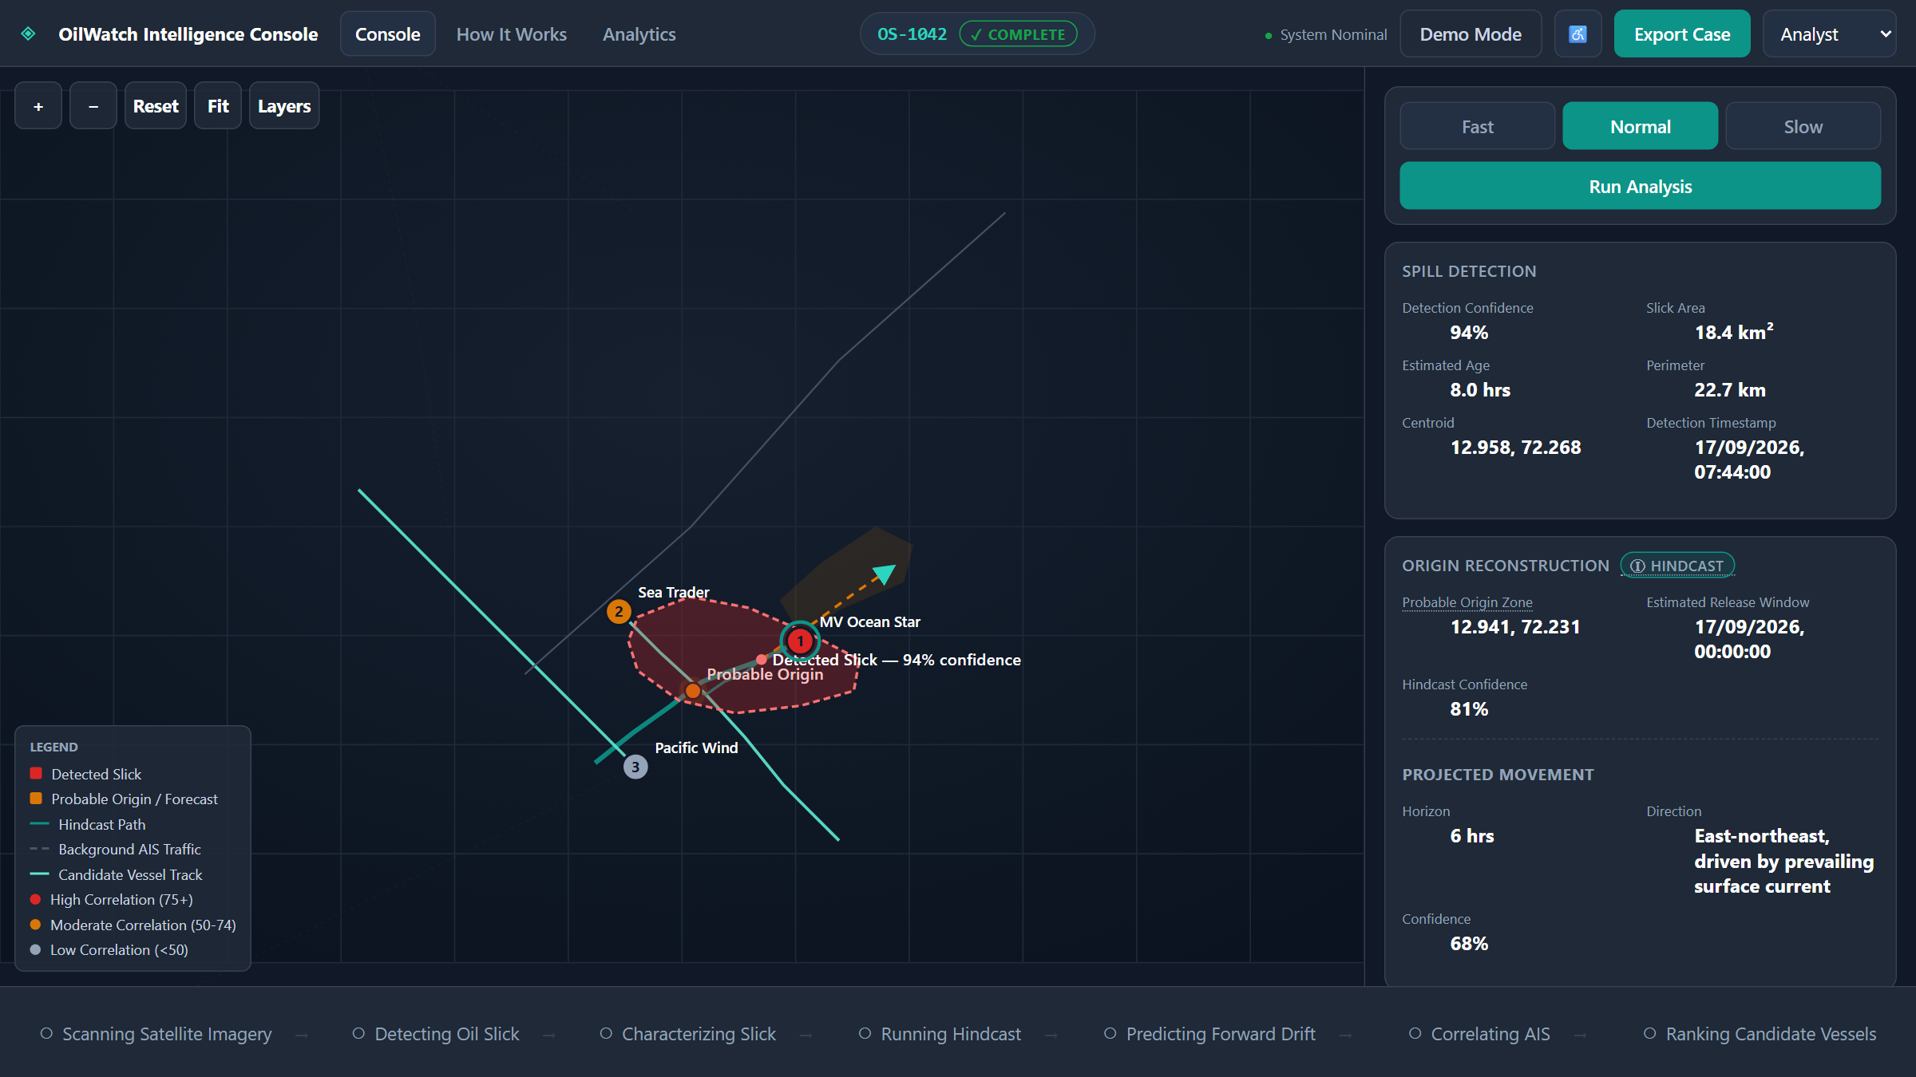
OilWatch
AI-Based Oil Spill & Vessel Detection
From a satellite image to a ranked shortlist of vessels worth investigating, with the evidence shown.
Problem Statement ID
SIH26143
Theme
Miscellaneous
PS Category
Software
Team Name
Mindforgue
The working prototype: OilWatch Intelligence Console
Team ID
____________
Notes:
Introduce the team and the problem statement (SIH26143). One line pitch: OilWatch takes a satellite spill detection, works out where it came from, and ranks the vessels that were nearby, showing the evidence behind every score. The screenshot is the real working prototype.

Slide 2




Problem, Idea & Solution
YOUR PROBLEM
OUR IDEA
One platform that spots an oil spill from satellite imagery, traces it back to its probable origin using ocean-current and wind data, and matches it against AIS vessel tracks to shortlist investigation candidates.
Kills marine life
Toxic exposure and heavy oil coating
PROPOSED SOLUTION
INNOVATION & UNIQUENESS
Damages habitats
Mangroves, coral reefs and coastal ecosystems
AI satellite analysis: detects and maps oil slicks automatically
Wind & current modelling: traces the spill to its probable origin and predicts its drift
AIS correlation: matches origin, time and track with nearby vessels
Evidence-based ranking: confidence scores investigators can inspect
Unified GIS dashboard: live view, monitoring and investigation reports
AI + SAR fusion: spots slicks and cuts false alarms from sea-surface look-alikes
Reverse drift intelligence: wind and currents run backwards to the probable source location and time
Evidence-linked AIS attribution: an explainable score per vessel, built from where, when and how it moved
Poisons the food chain
From plankton up to fish and larger animals
Hits livelihoods
Fishing waters become unsafe to use
SMART INDIA HACKATHON 2026 | SIH26143 | Team Mindforgue
2
Notes:
Problem: oil at sea harms marine life, habitats, the food chain and fishing livelihoods. Idea: connect three things investigators currently handle separately: satellite detection, drift modelling and AIS vessel history. Innovation: SAR fusion to cut false alarms, reverse drift to find the probable source, and an explainable score instead of a black box.

Slide 3
Technical Approach
1
2
3
4
5
6
7
Collect data
Clean & sync
Detect spill
Predict & hindcast
Correlate AIS
Rank vessels
Dashboard
SAR, EO, AIS, currents, wind
Normalise, filter, align in time
AI segments and measures the slick
Drift forward, origin backward
Filter and match vessel tracks
Score with the evidence shown
Spill, drift and ranked vessels
SOFTWARE TOOLS
AI & imaging
Python | OpenCV | YOLO / U-Net
Geospatial & storage
QGIS | PostgreSQL + PostGIS | Google Earth Engine
Data sources
Sentinel-1 SAR | AIS datasets | Copernicus Marine / ERA5
App
FastAPI backend | React.js dashboard
Prototype: React + TypeScript, sample data, swappable services
SMART INDIA HACKATHON 2026 | SIH26143 | Team Mindforgue
3
Notes:
The pipeline has seven stages. In production the detection step uses YOLO or U-Net on Sentinel-1 SAR, the drift step uses Copernicus Marine and ERA5 data, and AIS comes from an AIS provider. In our prototype each stage is a service interface backed by deterministic sample data, so the real models can replace them without touching the UI.

Slide 4



Feasibility and Viability
Technical feasibility
Commercial feasibility
Challenges & risks
Standard data. Satellite, AIS, wind and current data through open APIs and datasets.
Proven stack. Python, OpenCV, AI/ML and GIS for detection, drift and trajectory matching.
Runs on the web. FastAPI, PostGIS and React. No special hardware.
Already demonstrated. The full workflow runs end to end in our prototype.
Low cost. Built on existing satellite, AIS and open environmental data.
Clear buyers. Coast Guard, ports, maritime and environmental agencies, shipping and insurance firms.
Revenue. Government contracts, annual SaaS subscriptions, data-analysis APIs.
Scales. From one port to national maritime zones.
Sea look-alikes. Fuse SAR and EO, and show detection confidence.
AIS gaps or switched-off transponders. AIS continuity is part of every score.
Drift uncertainty. Report a probable origin zone, never an exact point.
Over-reading a score. Framed as investigation support, not proof.
STRATEGY
1 Detect
SAR and EO imagery plus AI find and measure suspected slicks
2 Trace
Wind and currents drift the slick backward and forward
3 Correlate
Rebuild AIS vessel movements around the origin and time
4 Filter & rank
Drop irrelevant vessels, rank by space, time and track
5 Visualize
One dashboard: spill, drift, origin, tracks, ranking
SMART INDIA HACKATHON 2026 | SIH26143 | Team Mindforgue
4
Notes:
Feasibility: everything relies on open or commercially available data and standard tooling. Risks are real, so we designed around them: false alarms are handled by SAR and EO fusion, AIS gaps show up in the continuity score, drift uncertainty is shown as a zone, and the score is explicitly investigation support.

Slide 5




Impact and Benefits
DIRECT IMPACT ON TARGET USERS
94%
11 to 3
87 / 100
Coast Guard & maritime authorities
Faster detection, source tracing and vessel screening
slick detection confidence
vessels screened down to ranked candidates
top candidate attribution score
Environmental agencies
Spill extent, drift path and probable origin for quicker response
Prototype demo case OS-1042, synthetic data
STRATEGIC IMPACT
SOCIAL & ECONOMIC
Ports & shipping authorities
Watch vessel movements with less manual checking
Faster response. Early detection and drift tracking for quick containment.
One intelligence view. Satellite, AIS, ocean and weather data together.
Accountability. Space-and-time evidence behind every candidate.
Scalable. Regional surveillance up to national monitoring.
Protects ecosystems and fishing communities.
Safer coasts and less damage to tourism.
Lower cleanup costs through earlier containment.
Less manual work as analysis is automated.
Coastal communities
Quicker action protects fisheries, beaches and coasts
Investigation & regulatory teams
Traceable evidence and standard digital reports
SMART INDIA HACKATHON 2026 | SIH26143 | Team Mindforgue
5
Notes:
Impact is felt by the authorities who investigate, and by the communities who live off clean water. The numbers in the navy panel come from our prototype's demo case and use synthetic data, so they show how the workflow narrows a problem down, not real-world accuracy.

Slide 6


Research and References
EMSA: Oil pollution response
SEE IT RUNNING
https://emsa.europa.eu/protecting-the-marine-environment/oil-pullution-response.html
EMSA: CleanSeaNet detections and feedback data
https://www.emsa.europa.eu/we-do/surveillance/earthobservationservices/item/4645-cleanseanet-detections-and-feedback-data.html
Live prototype
Source code
IMO: Pollution response
https://www.imo.org/en/ourwork/environment/pages/pollution-response.aspx
The prototype uses synthetic vessels and sample data. No real vessel is named or implicated, and scores support investigation only.
IMO: Oil spill response
https://www.imo.org/en/ourwork/environment/pages/oil-spill-response.aspx
SMART INDIA HACKATHON 2026 | SIH26143 | Team Mindforgue
6
Notes:
References are the EMSA and IMO pages on oil pollution response and satellite spill detection. The QR codes open the live prototype and the source code.

