Slide 1
CRUD in MongoDB CRUD – Create Read Update Delete
By,
Akhil m anil

Slide 2
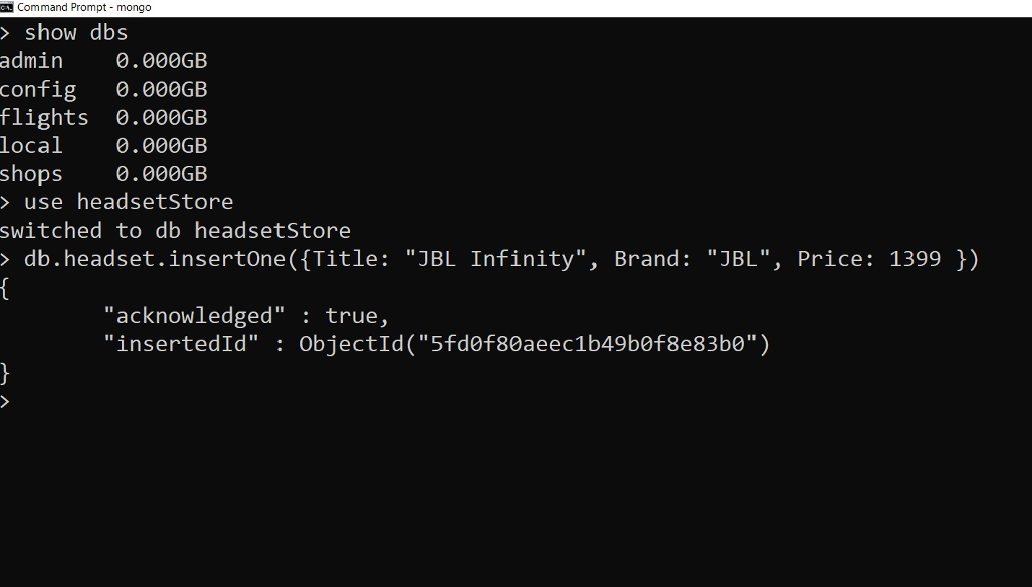
1. Show Databases 2.Create a new Database 3.Insert One item to Database

Slide 3
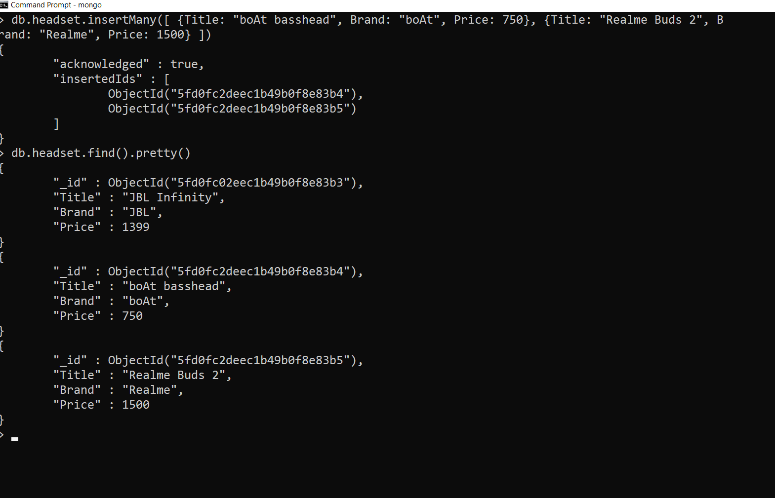
1.Insert more than one item in database 2.Print the items in database

Slide 4
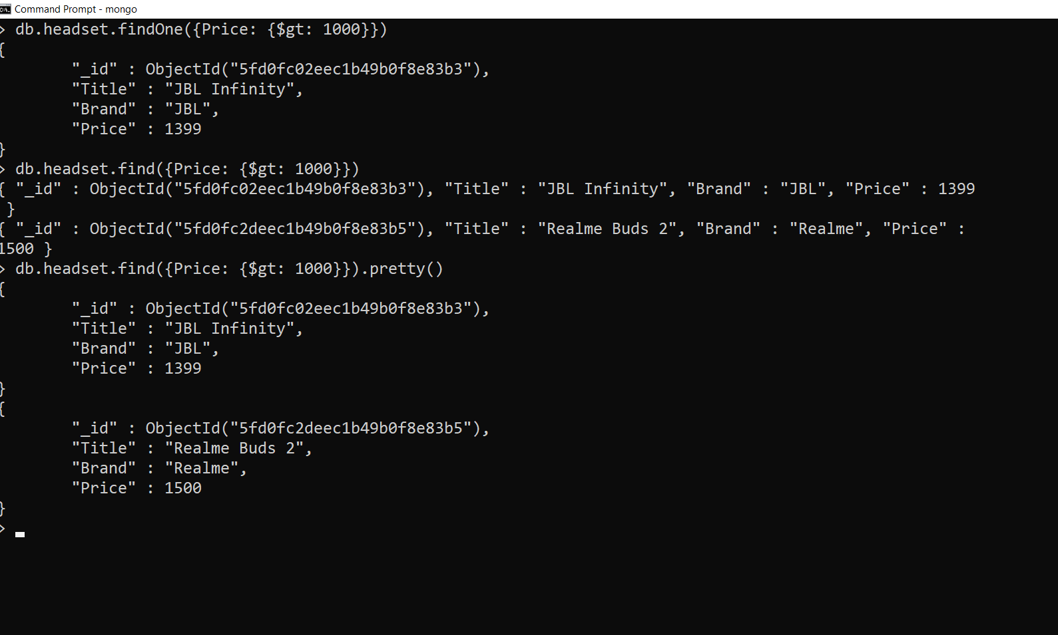
1. Find the first item whose price is greater than 1000 2. Find all the item whose price is greater than 1000

Slide 5
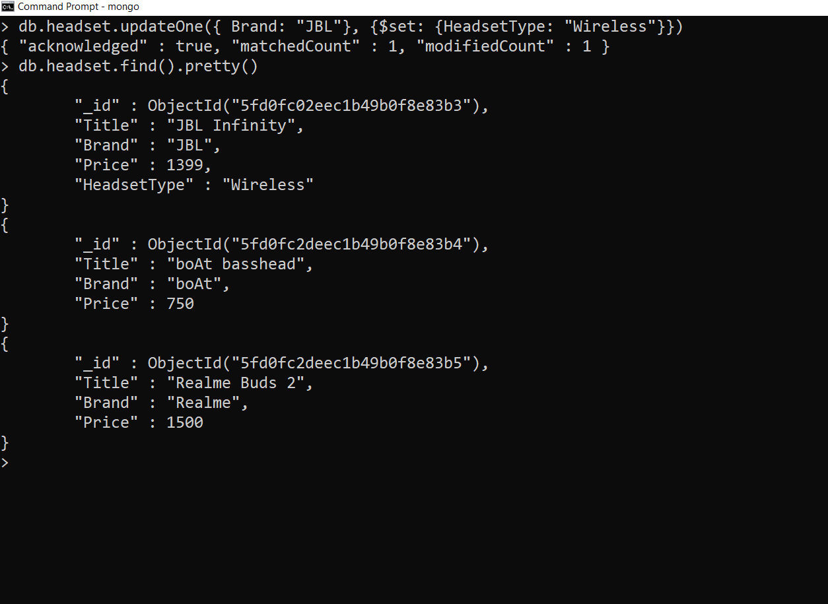
1. Update One item 2.Print all items to display the update

Slide 6
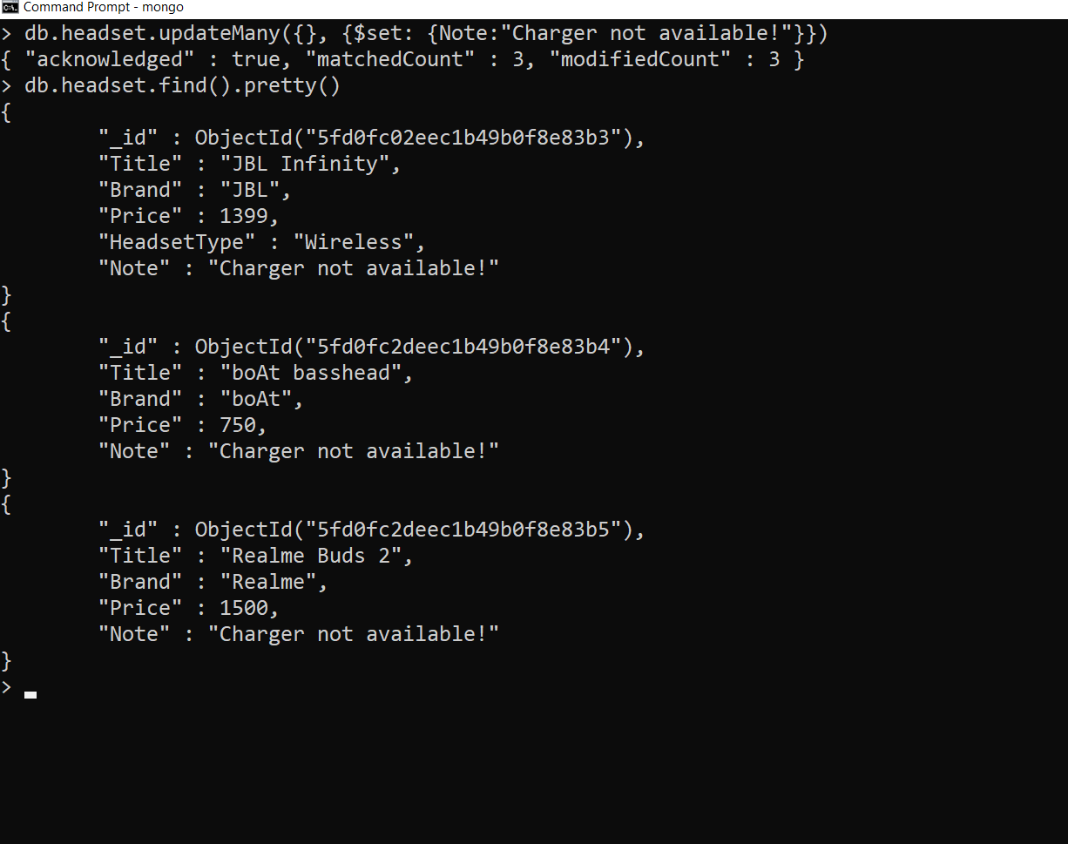
1. Update all items 2.Print all items to display the update

Slide 7
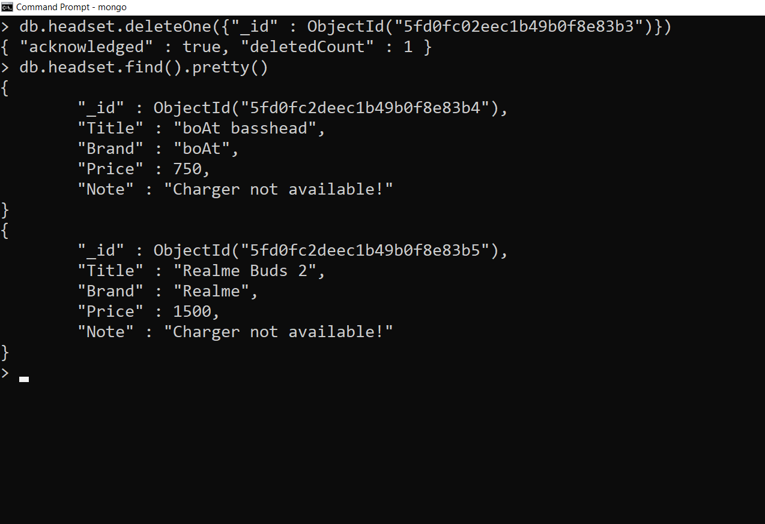
1. Delete the item whose id is given 2. Print all item to check deleteOne query

Slide 8
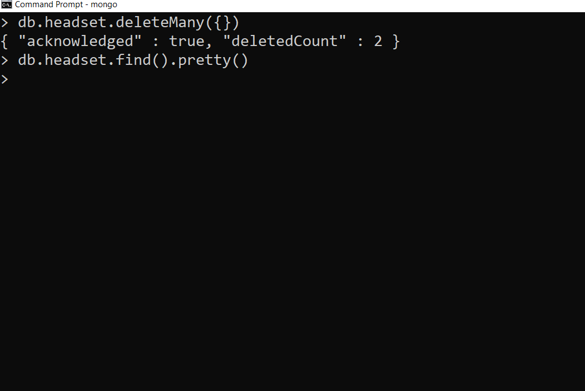
1.Delete all items 2.Print all items to check the deleteMany query

