Slide 1
JIRA STEPS
AKHIL M ANIL

Slide 2

ATLASSIAN HOME PAGE

Slide 3
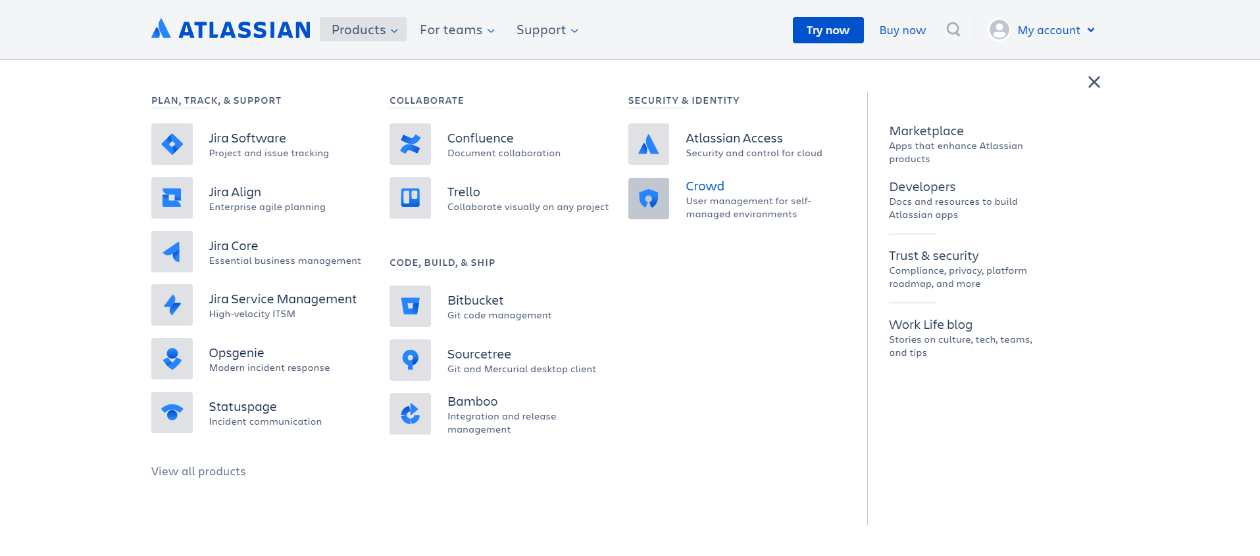
JIRA PRODUCTS

Slide 4
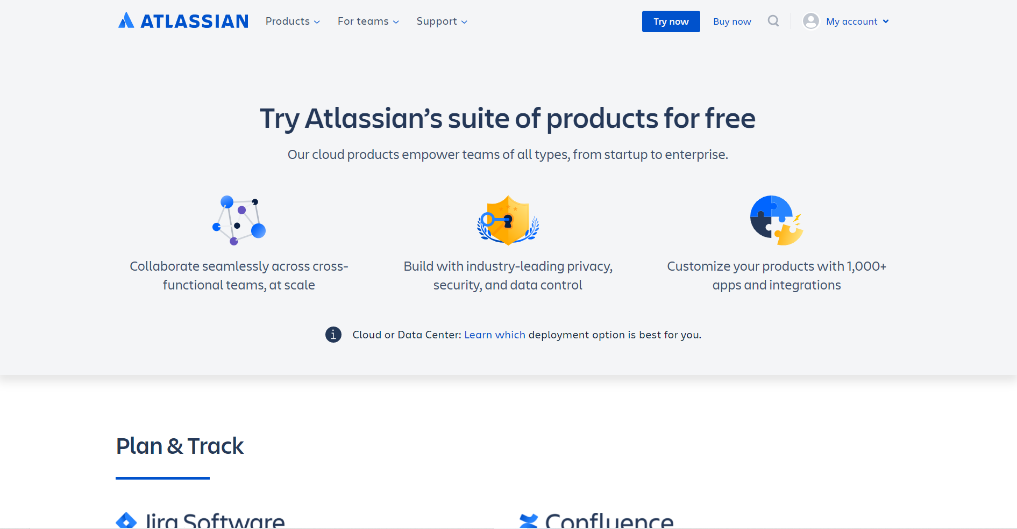
JIRA FREE TRAIL

Slide 5
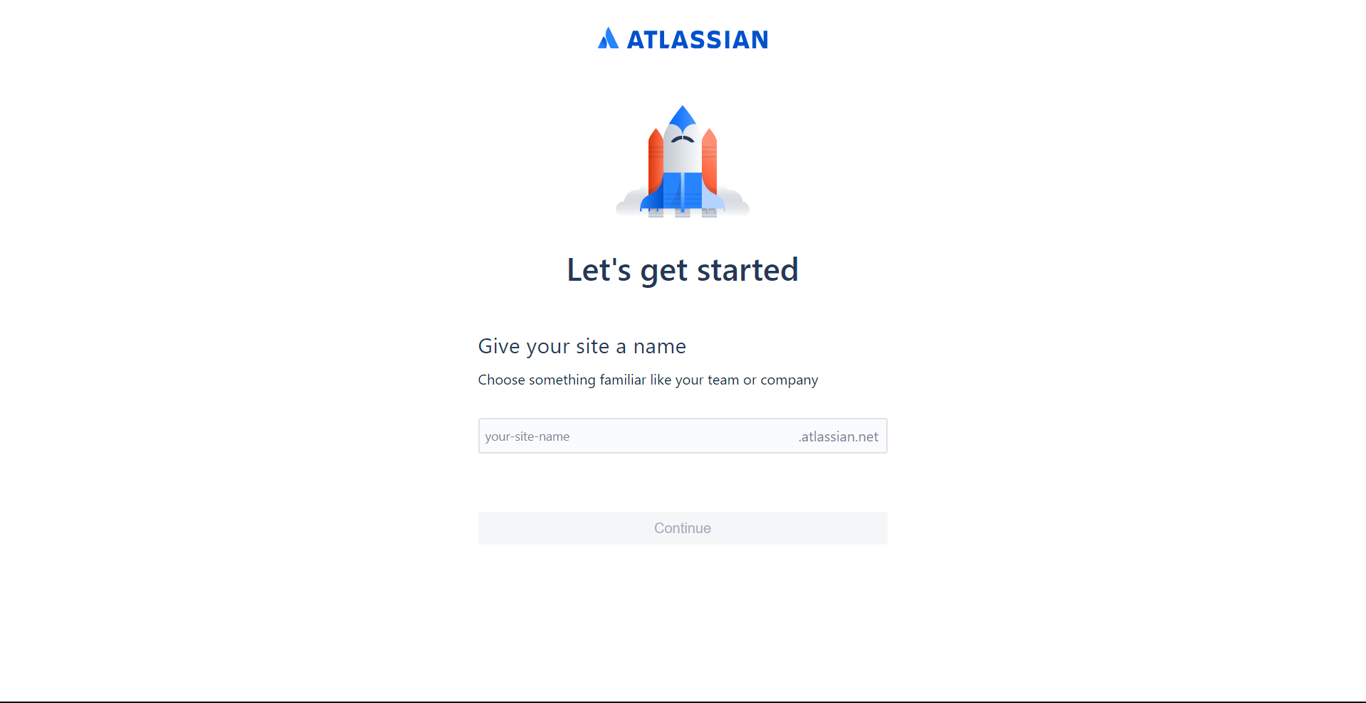
JIRA LOG-IN

Slide 6
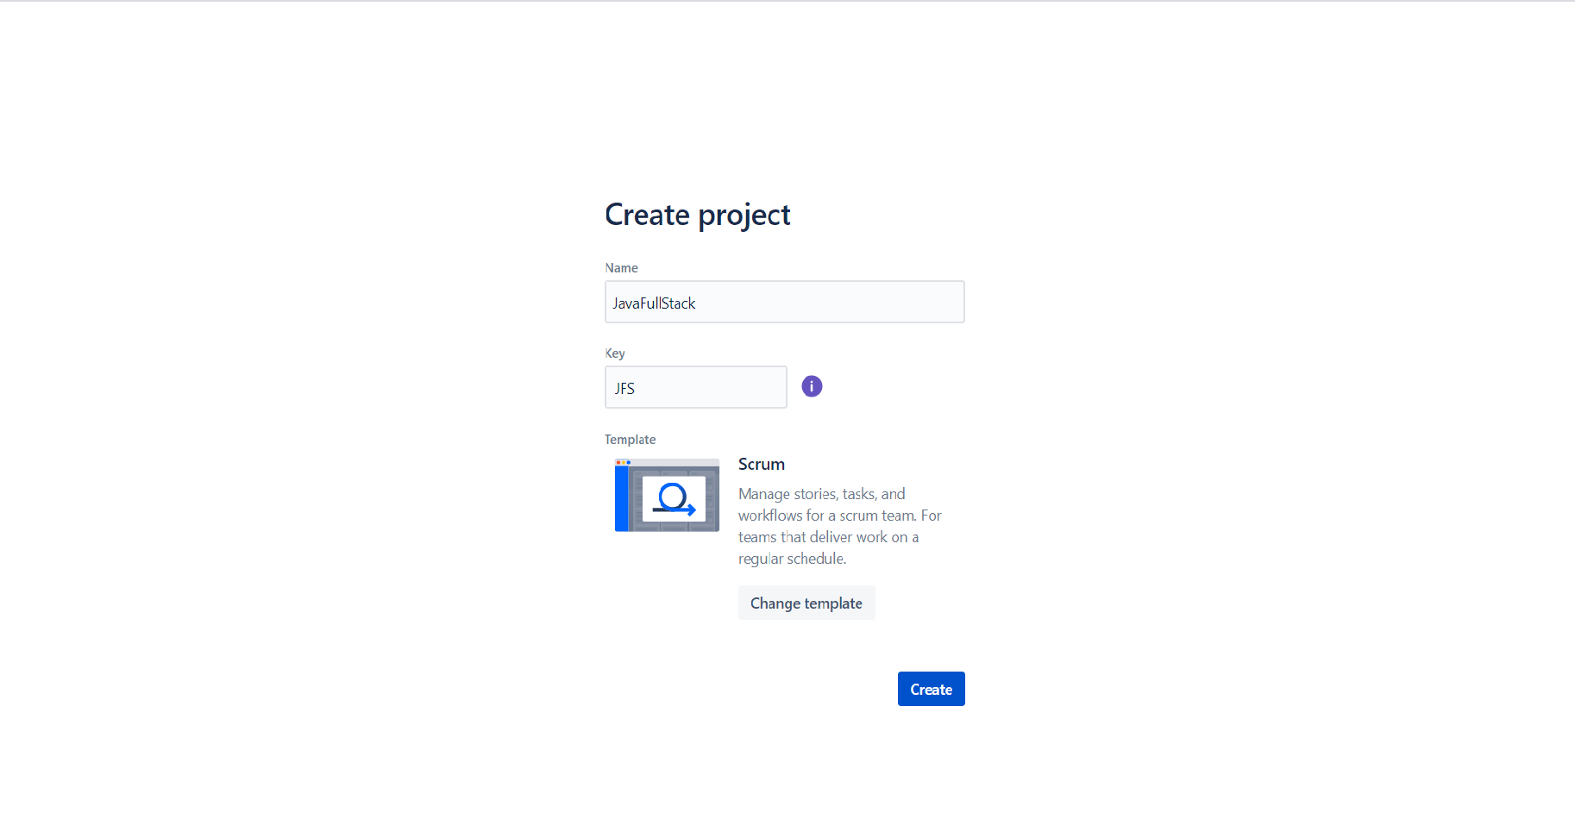
CREATE PROJECT

Slide 7
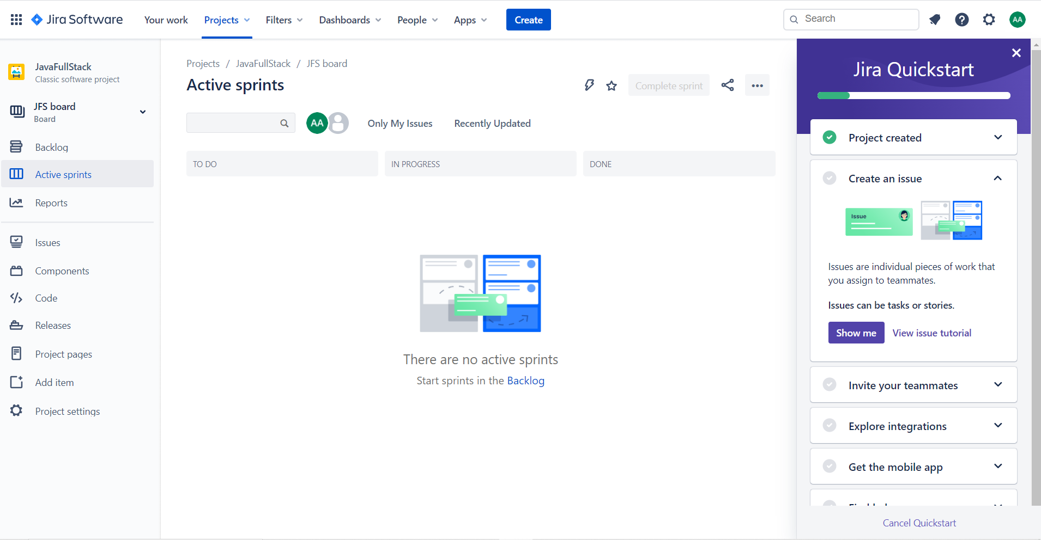
PROJECT INTERFACE

Slide 8
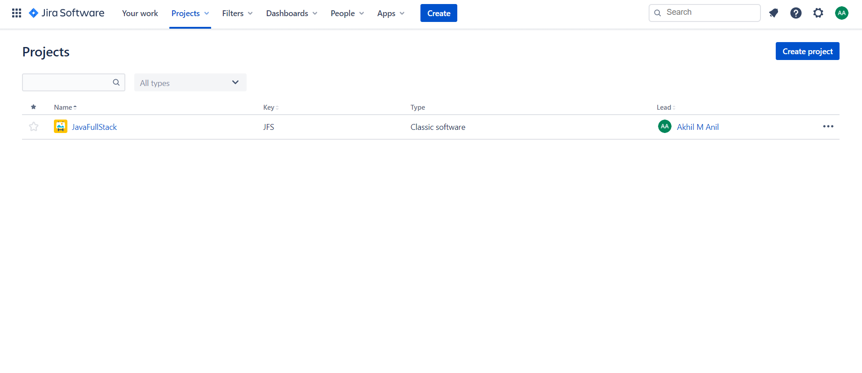
VIEW ALL PROJECT

Slide 9
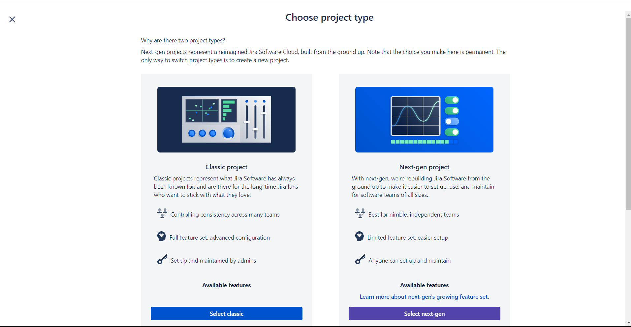
CREATE NEW PROJECT

Slide 10
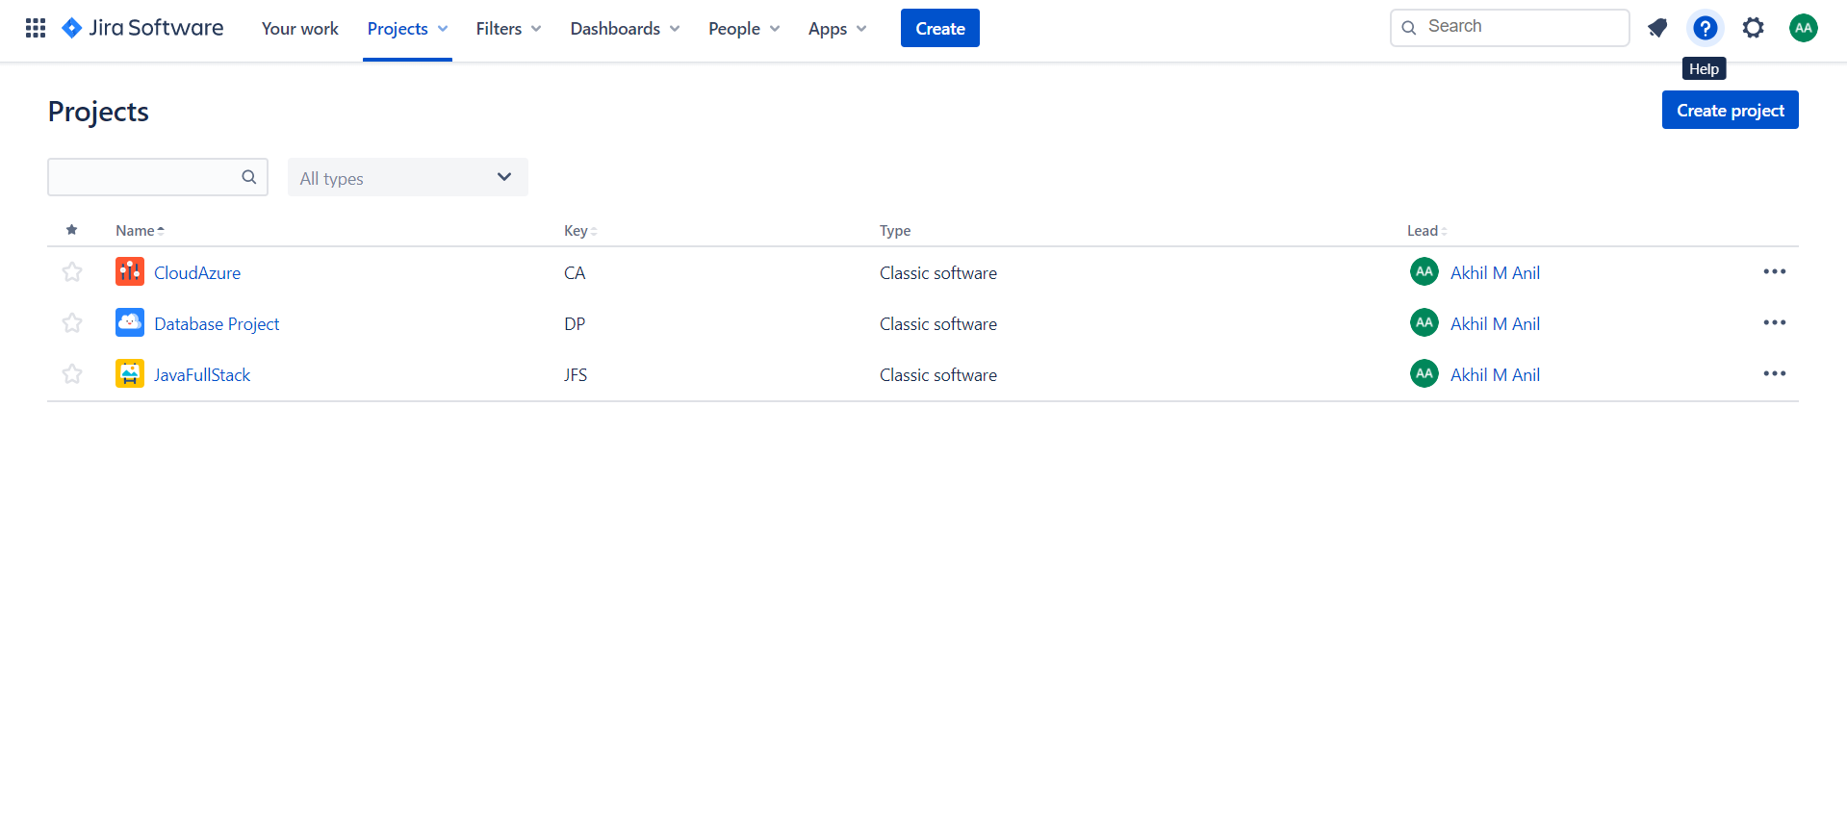
PROJECT AFTER CREATION

Slide 11
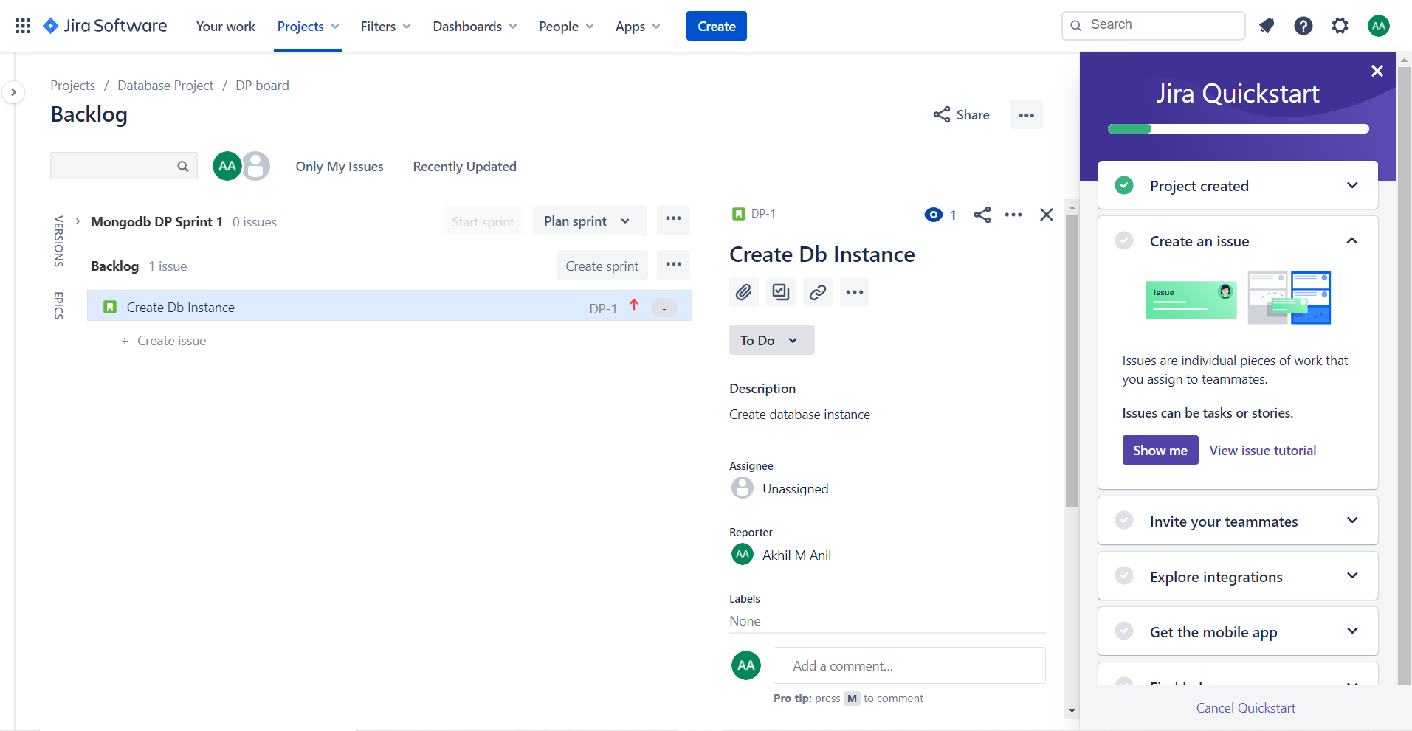
BACKLOG

Slide 12
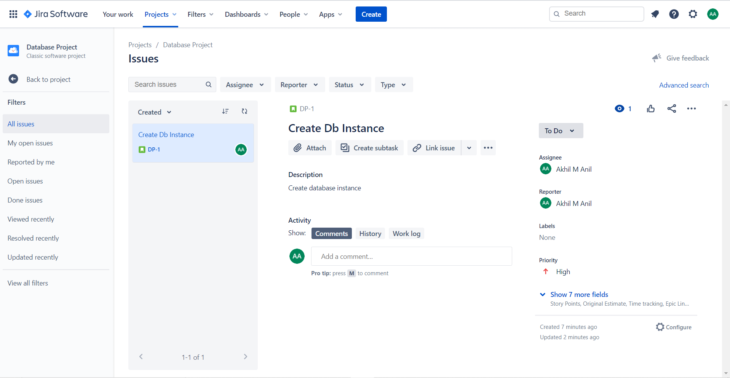
ISSUES

Slide 13
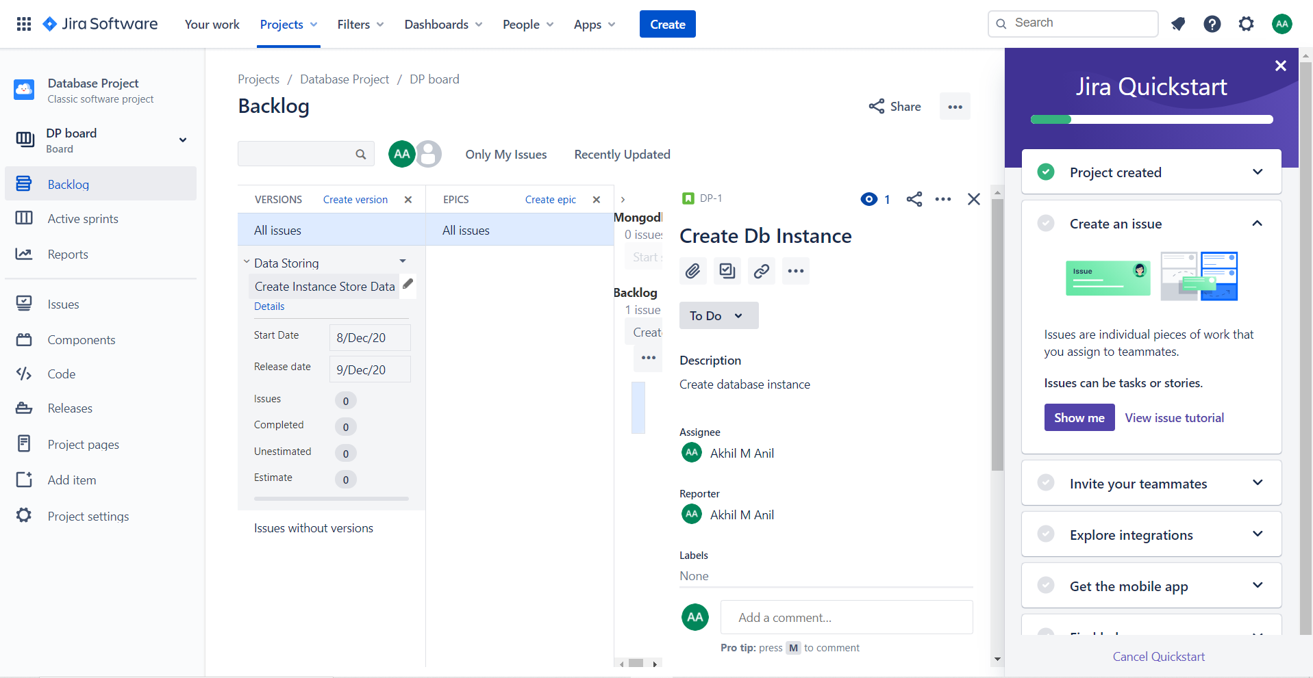
VERSION AND EPIC

Slide 14
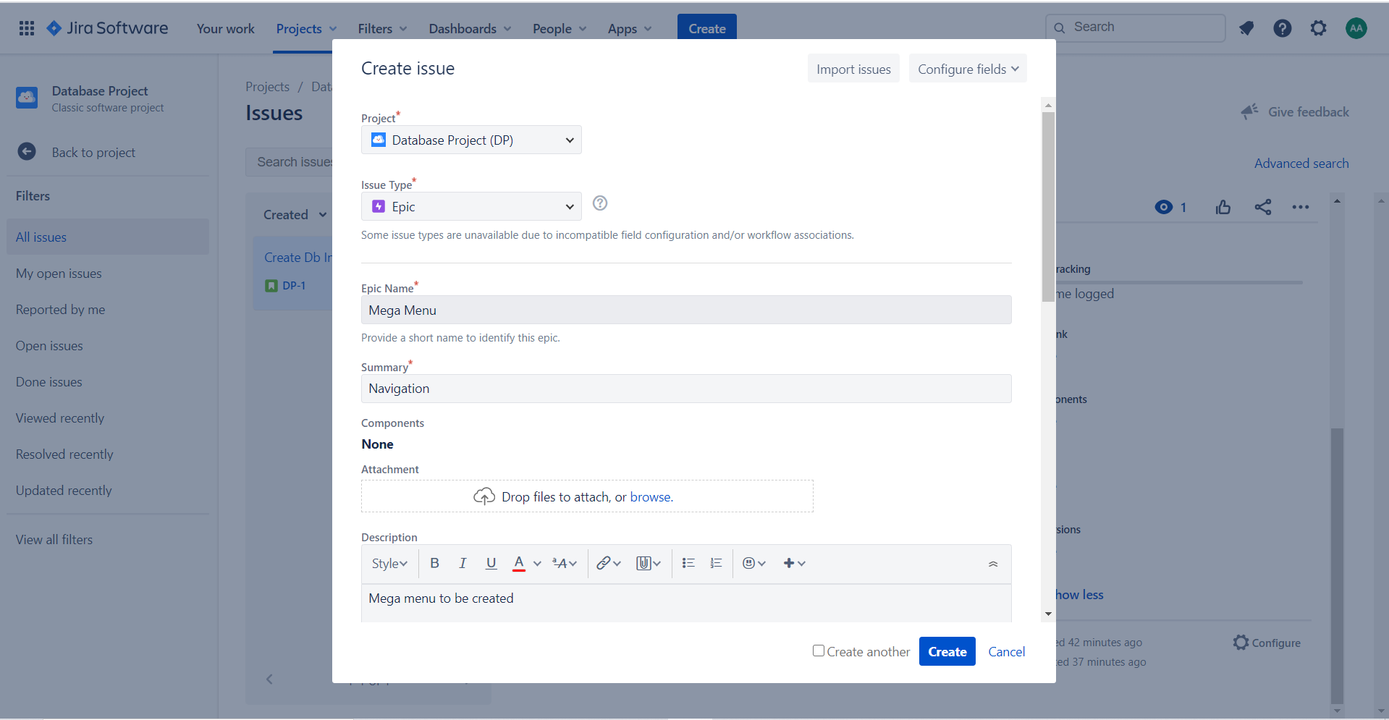
CREATE ISSUE

Slide 15
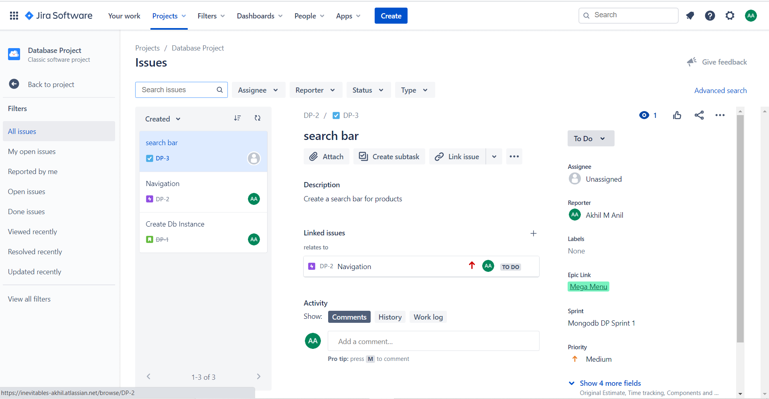
ALL ISSUES

Slide 16
ACTIVE SPRINT

Slide 17
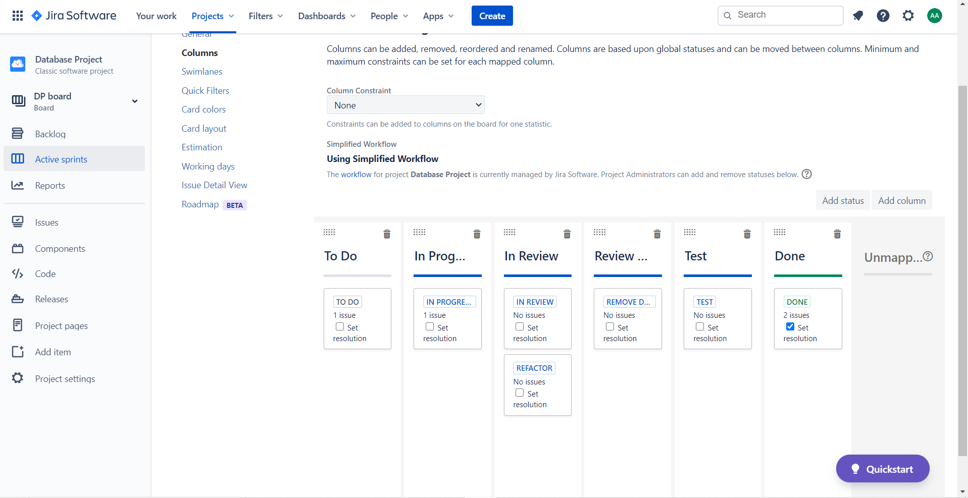
COLUMN MANAGEMENT IN SPRINT

Slide 18
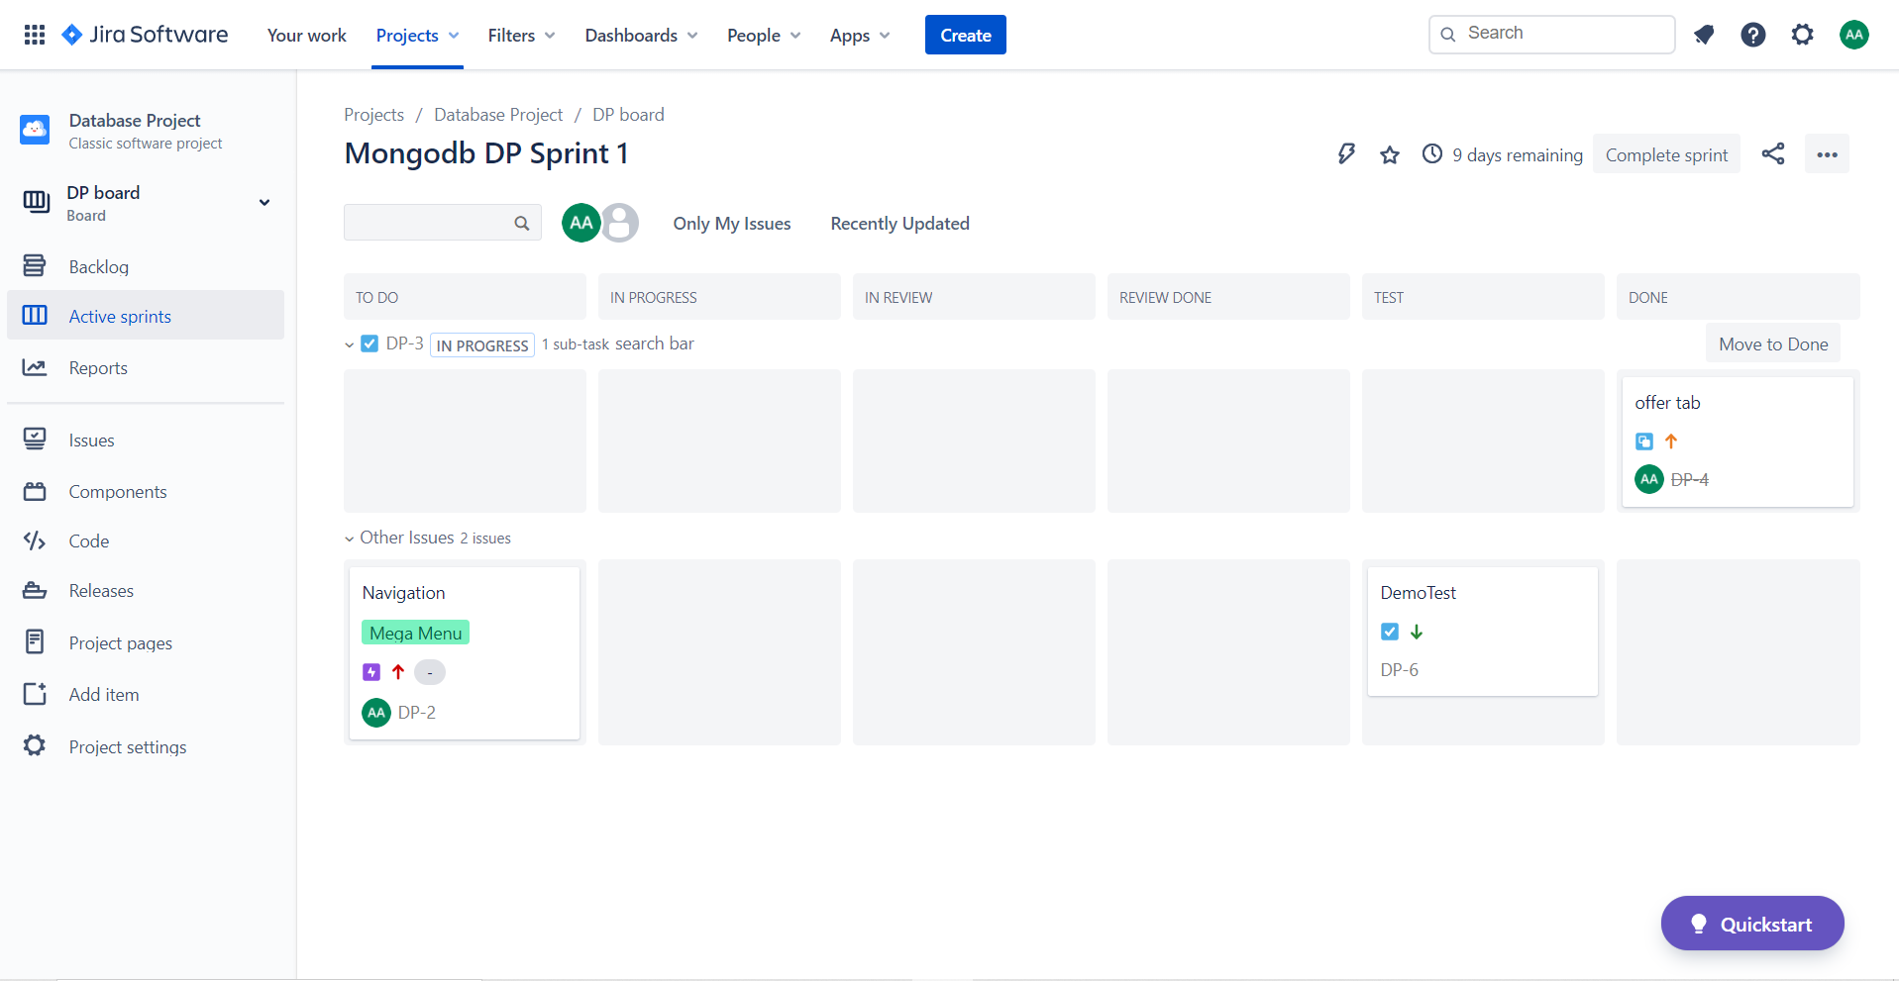
SPRINT AFTER COLUMN INSERTION

