Slide 1
Detecting fraudulent transactions using different data mining methodologies
PRESENTED
BY
A Akhil 314126510002
A Teja 314126510001
M Kamaluddin 314126510063
M Sai Chand 314126510058
Under guidance of S.V.S.S. Lakshmi (MCA, M.TECH)

Slide 2
BASE PAPER
SMALL BUSINESS CREDIT SCORING : A COMPARISON OF LOGISTIC REGRESSION, NEURAL NETWORK AND DECISION TREE MODELS
- Marijana Zekic-Susac, Natasa Sarlija, Mirta Bensic in the year 2014.
The paper compares models for small business credit scoring developed by mentioned models on a Croatian bank dataset.
The models obtained by all three methodologies were estimated, then validates on the same sample and their performance is compared.

Slide 3
ABSTRACT
The aim of this project is to test various algorithms to build a model which can make predictions with good precision and accuracy.
The fraudulent transactions looks like any ordinary claim but it doesn't follow the same pattern as the genuine ones.
We can look at the past data and create a model which can differentiate a fraud claim from genuine one called Supervised learning.
If we don't have any past data we can extract some patterns from the original data and can find out the fraudulent records called Unsupervised learning.

Slide 4
Problem statement
The Credit Card Fraud is one of the biggest threats to business establishments today. However, to combat the fraud effectively, it is important to first understand the mechanisms of executing a fraud.
Credit card fraudsters employ a large number of modus operandi to commit fraud.
While the exact amount of losses due to fraudulent activities for year 2016
probably exceeds $12.5 billion. Further internet merchants in the US alone is expected to be in the range of $15–30 billion by the year 2018.

Slide 5
INTRODUCTION
Due to the increasing number of fraudulent credit card transactions, huge financial losses are being incurred by credit card merchants.
To identify these transactions we have several machine learning algorithms
that are in use.
Until now , we have implemented Logistic Regression, Decision Trees and Random Forest algorithms to our dataset.

Slide 6
Logistic regression
Logistic regression algorithm is used to predict a binary outcome, from a given set of independent variables.
It is a special case of linear regression used to predict probability of occurrence of event by befitting data to a LOGIT FUNCTION.
p/1-p = e^y
=> log(p/1-p) = y
where p – probability of success
y – independent variable

Slide 7
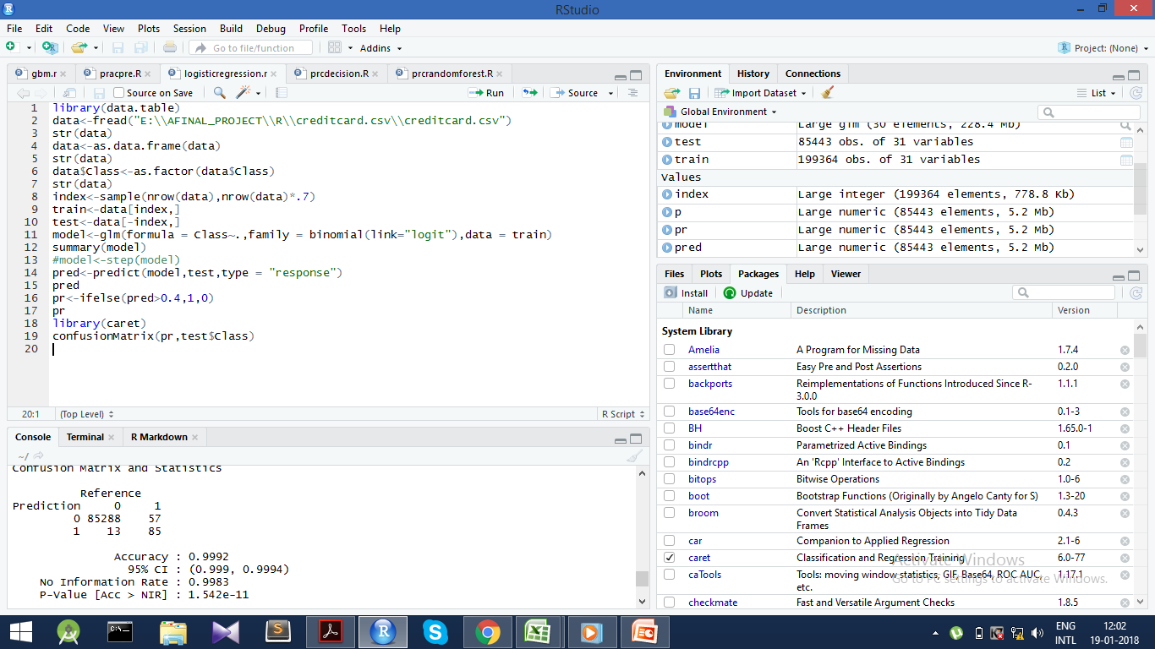

Slide 8
DECISION TREES
Decision Tree is the basic tree based algorithm, that can be used for both classification and regression.
It identify the most significant variable which will be considered as the root node.
Then it divides the data set into 2 branches ,one with the root containing 1’s and other with 0’s.
This processes is applied at each level until leaf nodes are obtained.

Slide 9
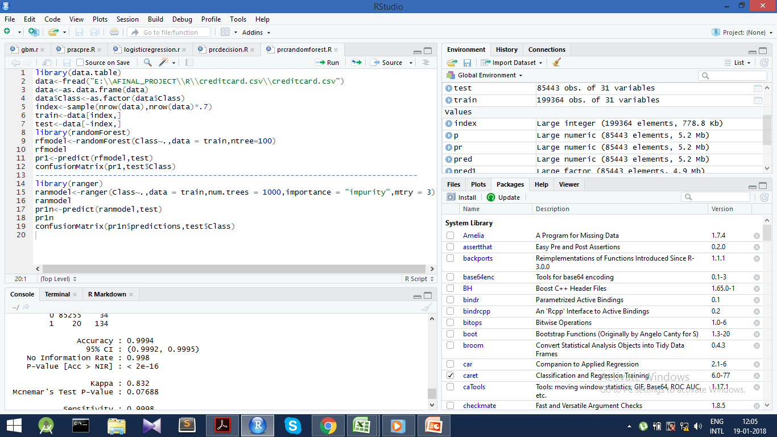

Slide 10
Random forest
Random forest is the extension of the decision trees which is also called the bagged model.
Here multiple decision trees are created using the random selection of variables .
Finding the probability of all the trees, the optimised tree is considered and is considered as the best model.

Slide 11
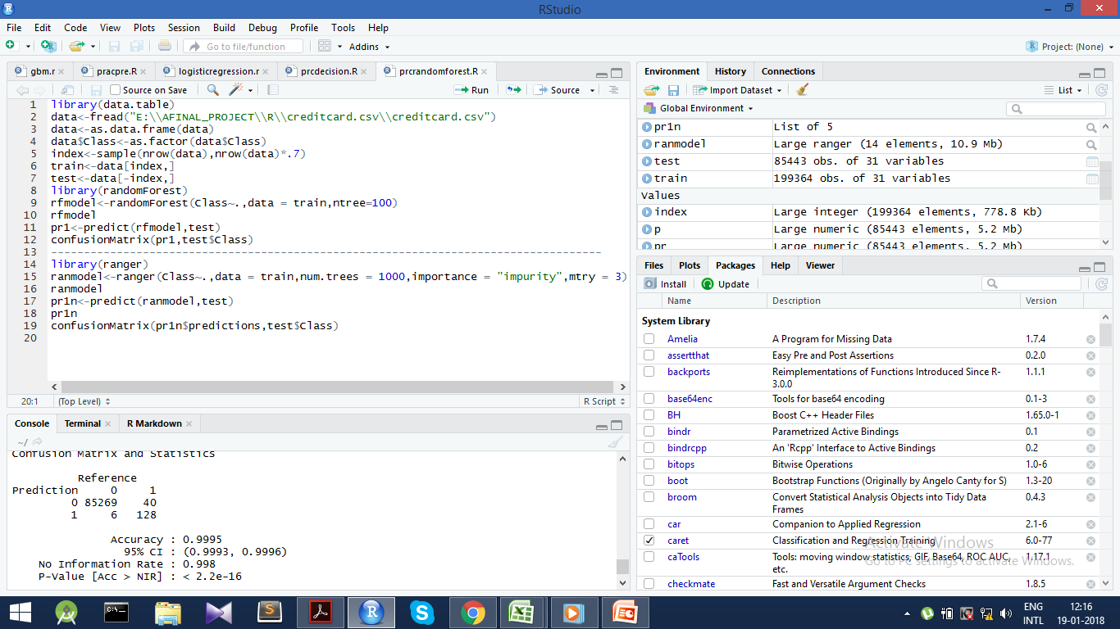

Slide 12
Neural networks
There are many machine learning models for the classification, out of these we considered the Logistic regression , Decision trees , Random forest.
We also have the advance models like neural networks and Deep learning for better accuracy.

Slide 13
Existing model
There are many machine learning models for the classification, out of these we considered the Logistic regression , Decision trees , Random forest.
We also have the advance models like neural networks and Deep learning for better accuracy.

Slide 14
proposed model
Using the models in the existing system we are developing an Ensemble model for best accuracy.

Slide 15
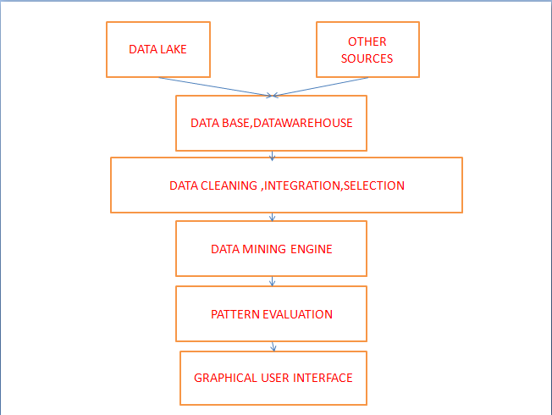
ARCHITECTURE

Slide 16
CONCLUSION
The final aim of this project is to develop a meta learner capable of detecting fraudulent transactions more accurately than the machine learning algorithms used, this is done by coding the Ensemble model in R using different methods.

Slide 17
ANY QUIRIES ?

Slide 18
THANK YOU

