Slide 1
Machine Learning model for predicting market prices of agricultural commodities based on historical data and market trends
1602-21-737-054
1602-21-737-036
1602-21-737-005

Slide 2
Problem Statement
Create a machine learning model for
predicting market prices of agricultural
commodities based on historical data and
market trends, accessible through a web
interface.

Slide 3
Motivation
Reducing the risks associated with price
fluctuations, enhancing stability and
sustainability in the industry.
Decision Support for Farmers and Traders Accurate predictions
of market prices can provide valuable insights to farmers and
traders, helping them make informed decisions about crop
selection, timing of planting and harvesting, and trading
strategies. This can ultimately lead to improved profitability and
reduced risk in agricultural operations.
Accurate price predictions can inform policy makers and
government agencies about market trends and dynamics,
enabling them to formulate effective policies and interventions to
support agricultural markets and ensure food security.

Slide 4
Abstract
Predicting and understanding agricultural commodity prices
is inherently challenging due to the various influencing
factors and market volatility.
The uncertainty in price predictions affects resource
allocation decisions and can lead to inefficiencies in the
agricultural supply chain.
The inaccurate price predictions have a direct impact on
farmers, distributors, and consumers, affecting their
livelihoods and economic activities.
The machine learning model for predicting market prices of
agricultural commodities will be developed using historical
data and market trends. This model will utilize various
algorithms such as regression and time series analysis to
forecast future prices accurately.

Slide 5
Forecast of historical market data
Opening Price
Closing Price
Maximum Price
Minimum Price
Volume Traded
Visually analyzing the Most in-demand agriculture commodity for the given forecast period.
Features

Slide 6
Technology Stack
Pandas
Scikit Learn
MatPlotLIB
HTML
CSS
Flask

Slide 7
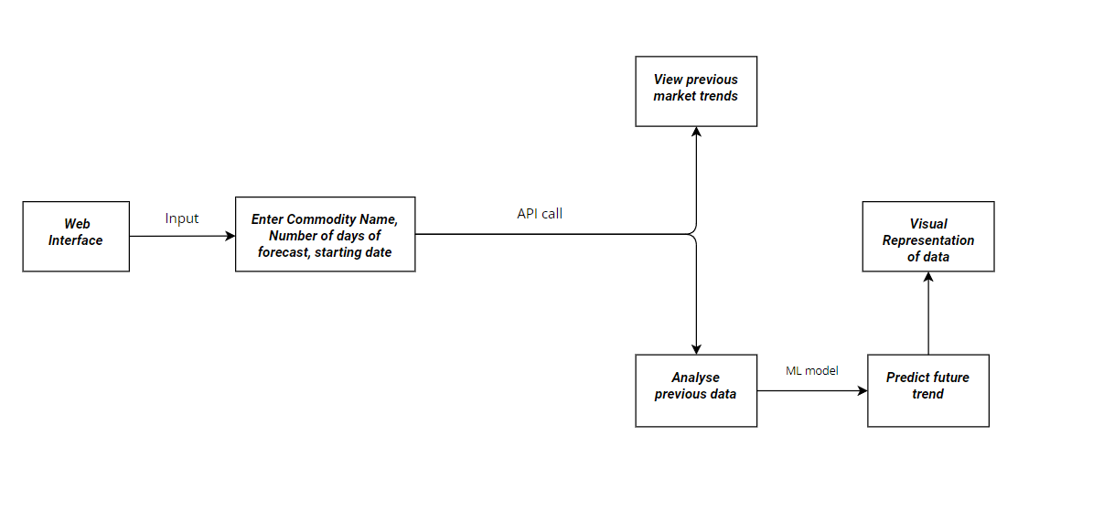
System Architecture

Slide 8
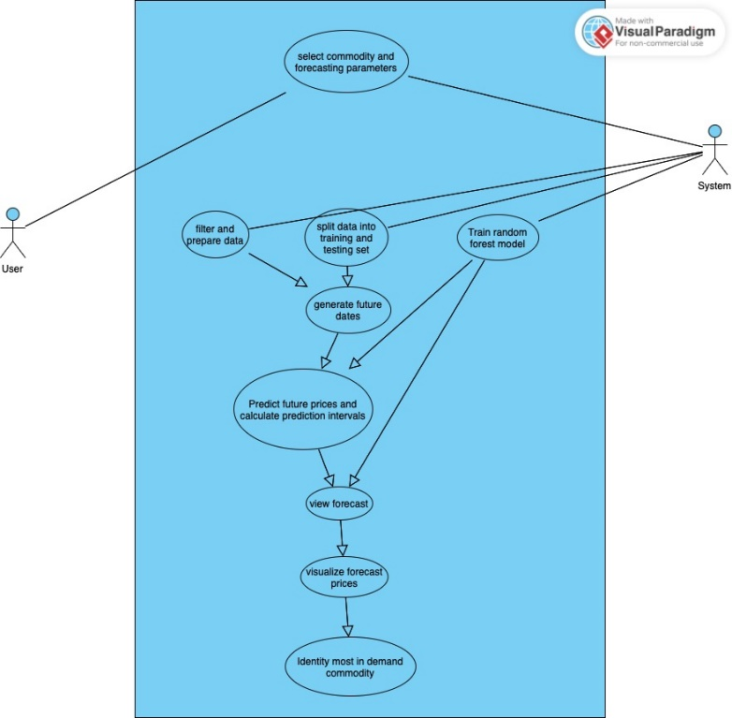
Use Case Diagram

Slide 9
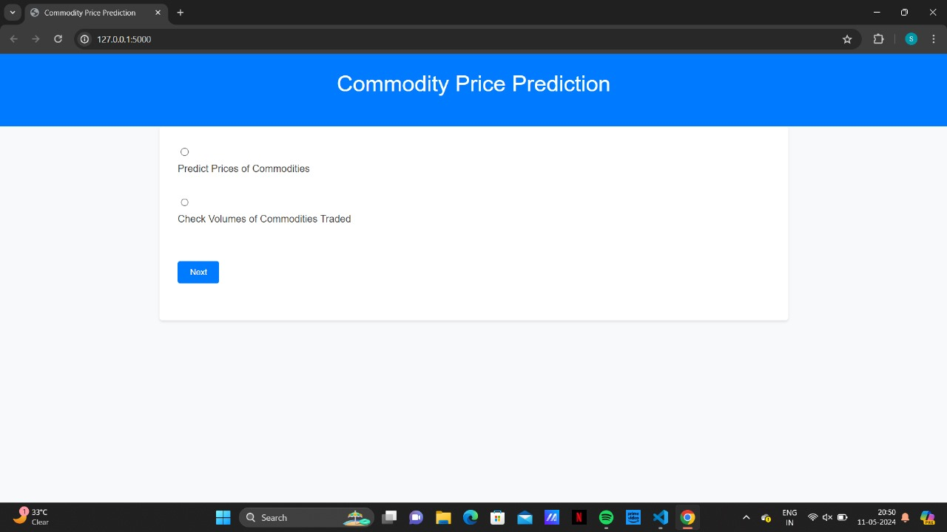
Screenshots

Slide 10
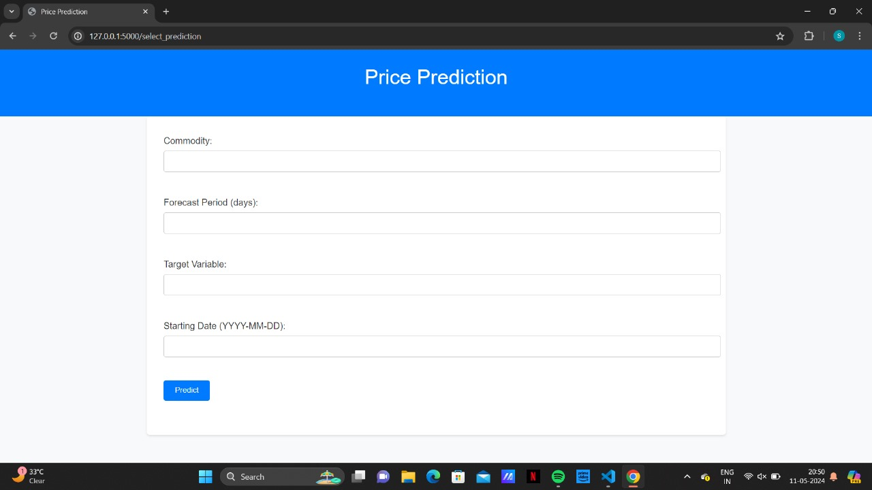

Slide 11
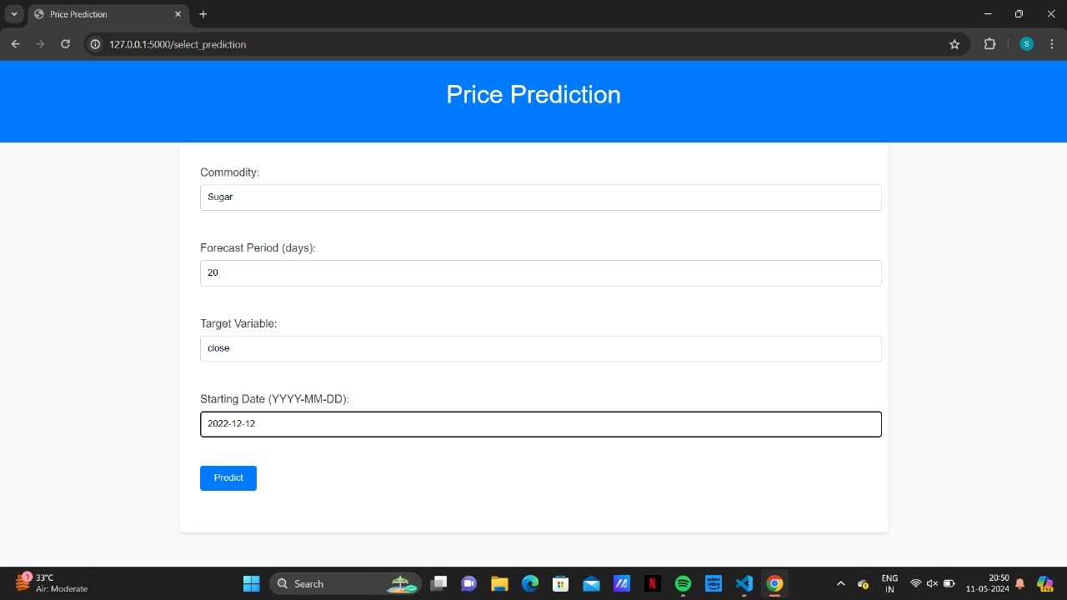

Slide 12
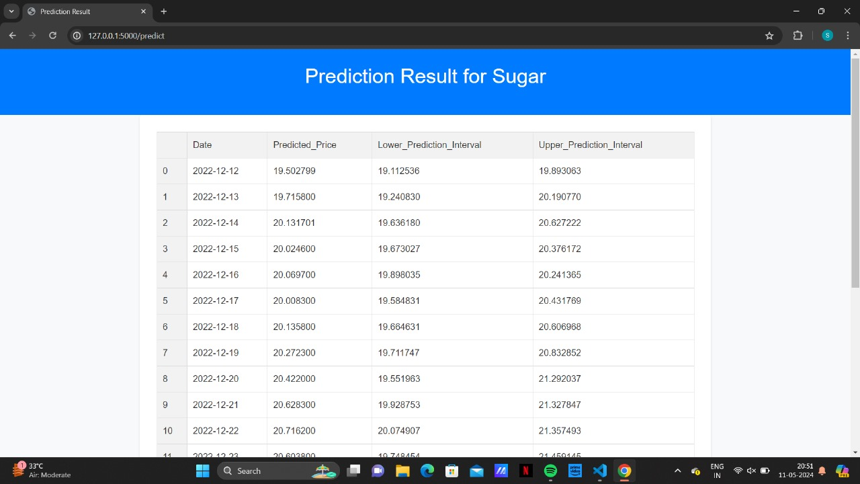

Slide 13
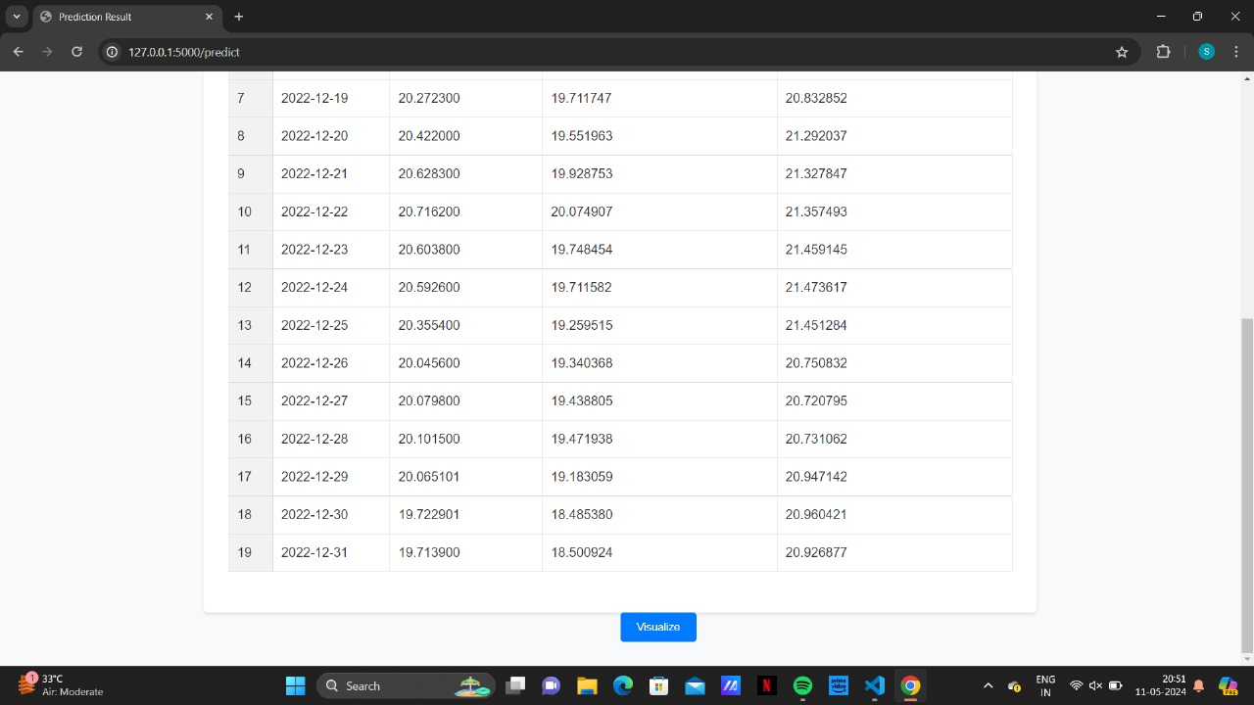

Slide 14
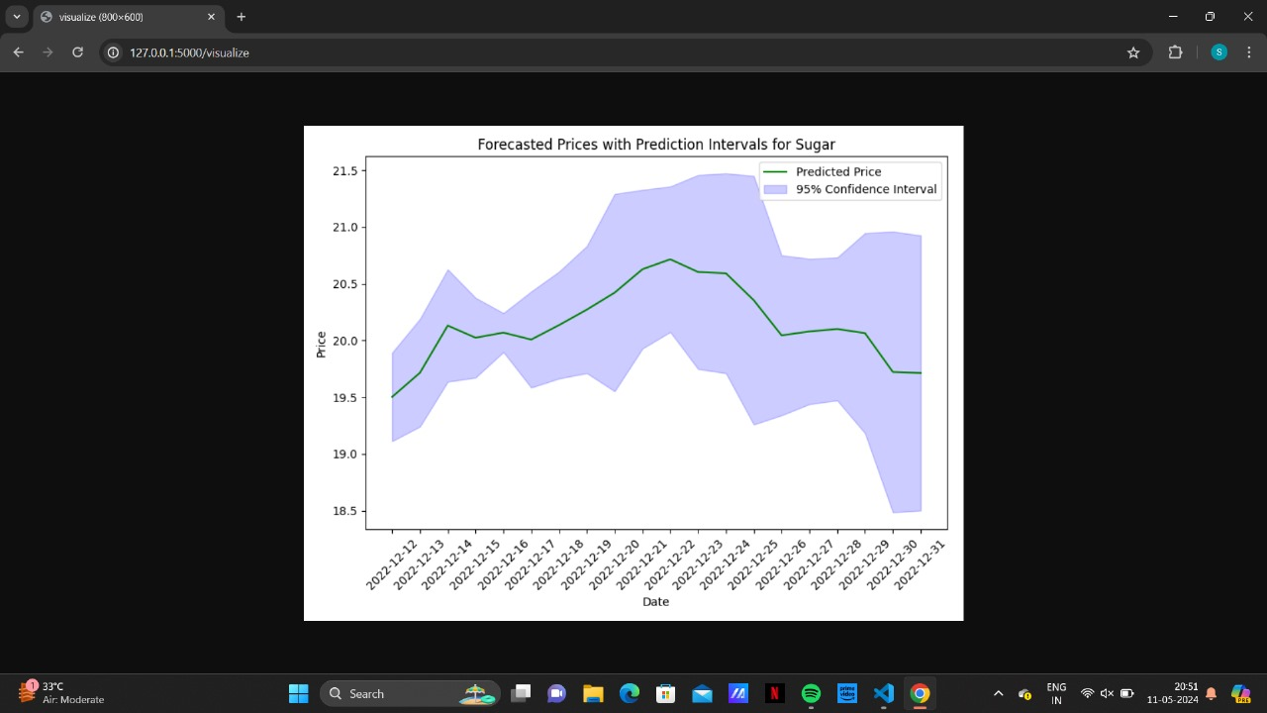

Slide 15
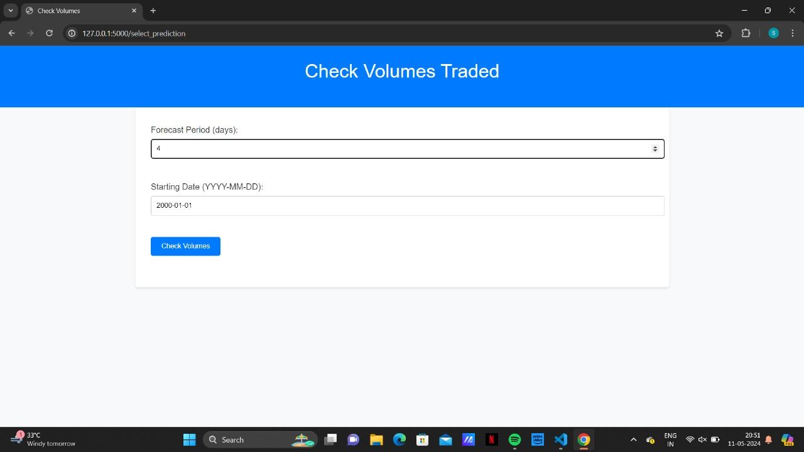

Slide 16
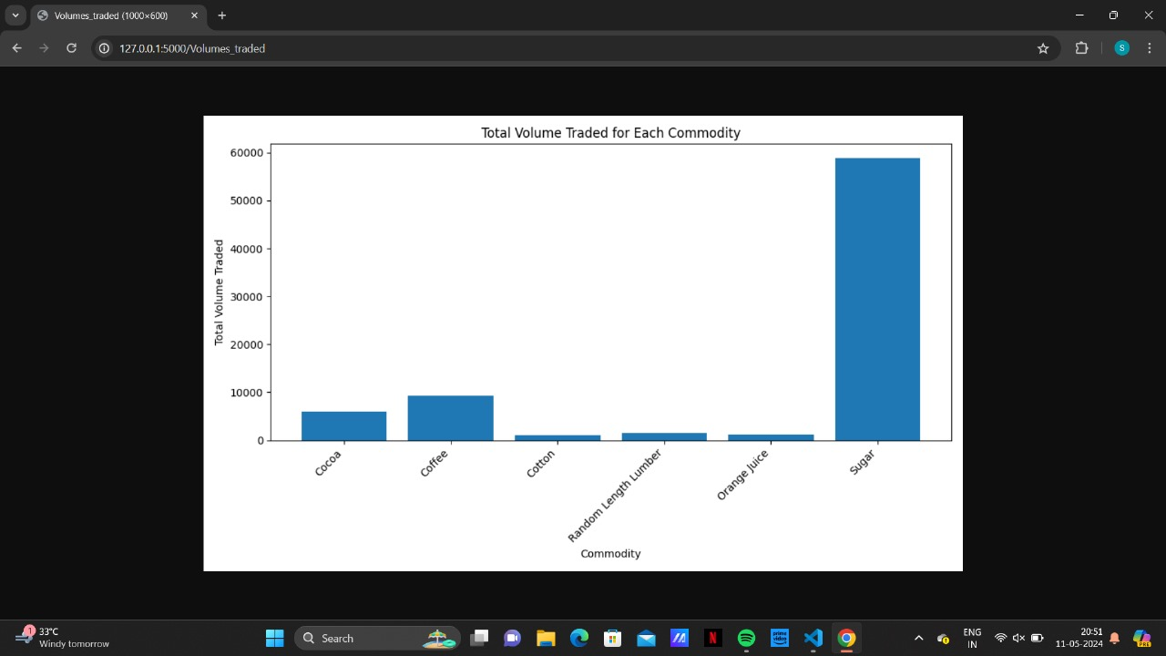

Slide 17
Conclusion
The web application allows users to input parameters such as commodity name, forecast period, target variable (price or volume), and starting date. It then generates predictions for commodity prices or analyzes trading volumes based on the selected parameters.
The project utilized Flask, a lightweight web framework for Python, to create a web application. Pandas library was used to manipulate and analyze the commodity data stored in a CSV file. scikit-learn was used to train a machine learning model (Random Forest Regressor) to predict commodity prices.
Overall, the project demonstrates how Flask can be used to build a web application that leverages machine learning models for predictive analysis. By combining Flask with libraries like Pandas and scikit-learn, it's possible to create powerful and interactive data-driven applications for various purposes, including financial forecasting and analysis.

Slide 18
Future Scope
User Authentication and Authorization: Implement user authentication and authorization to secure the application, allowing registered users to save their predictions, customize settings, and access personalized features.
Real-Time Data Integration: Integrate APIs or data streaming services to fetch real-time commodity prices and trading volumes, enabling users to make more timely and accurate predictions . Enhanced Visualization: Improve data visualization by incorporating interactive charts and graphs using libraries like Plotly or D3.js. This would provide users with a richer and more intuitive way to explore and analyze commodity data.
Advanced Machine Learning Models: Experiment with more advanced machine learning algorithms and techniques to improve prediction accuracy, such as deep learning models or ensemble methods.

Slide 19
References
Flask Documentation: https://flask.palletsprojects.com/en/2.0.x/
Pandas Documentation: https://pandas.pydata.org/docs/
scikit-learn Documentation: https://scikit-learn.org/stable/documentation

