Slide 1
VEHICLE Management System
Submitted to -
Prof. B.Nath
Submitted by –
Ayush Bajpai (CSM23043)
Akhilesh Yadav (CSM23011)

Slide 2
INTRODUCTION
The solution ensures enhanced security and convenience by providing a secure, user-friendly platform to streamline daily apartment operations and access control. It offers robust Resident & Visitor Tracking to manage apartment details, resident information (owners or tenants), and visitor records efficiently. With Vehicle Entry & Exit Control, it tracks vehicle movements to ensure secure access for both residents and visitors. The inclusion of User Roles & Permissions enables roles like Secretary and security staff to manage access and data effectively. Additionally, Centralized Data Management ensures organized record-keeping and seamless data storage, promoting operational efficiency.

Slide 3

Project Approach For Apartment Management System
The project focuses on managing tenants, family members, visitors, and vehicle entry/exit efficiently. It employs an EER diagram to define relationships among entities, ensuring a clear structure. The database is normalized to 4NF to enhance data integrity and minimize redundancy. Key features include user login/logout functionality and secure storage of tenant and family member information. With robust user management security, the system ensures safe access and data handling. Utilizing MySQL for database management and HTML for the front end, it delivers a reliable and user-friendly platform for streamlined operations.

Slide 4

Requirements
The document provides a comprehensive structure for an Vehicle Management System, detailing the management of apartments, owners, tenants, vehicles, family members and visitors. It specifies functions for adding, viewing, updating, and logically deleting records across these categories. Apartment and owner information include details like occupancy status and identification, while tenant records cover rental periods and emergency contacts. Vehicle management tracks details for owners, tenants, and visitors, with logs for entries and exits, and driver information is maintained for additional security. Visitor management includes check-in/out records and purpose of visits. Lastly, user management allows for role assignment, authentication, password recovery, and deactivation, ensuring secure access control within the system.

Slide 5
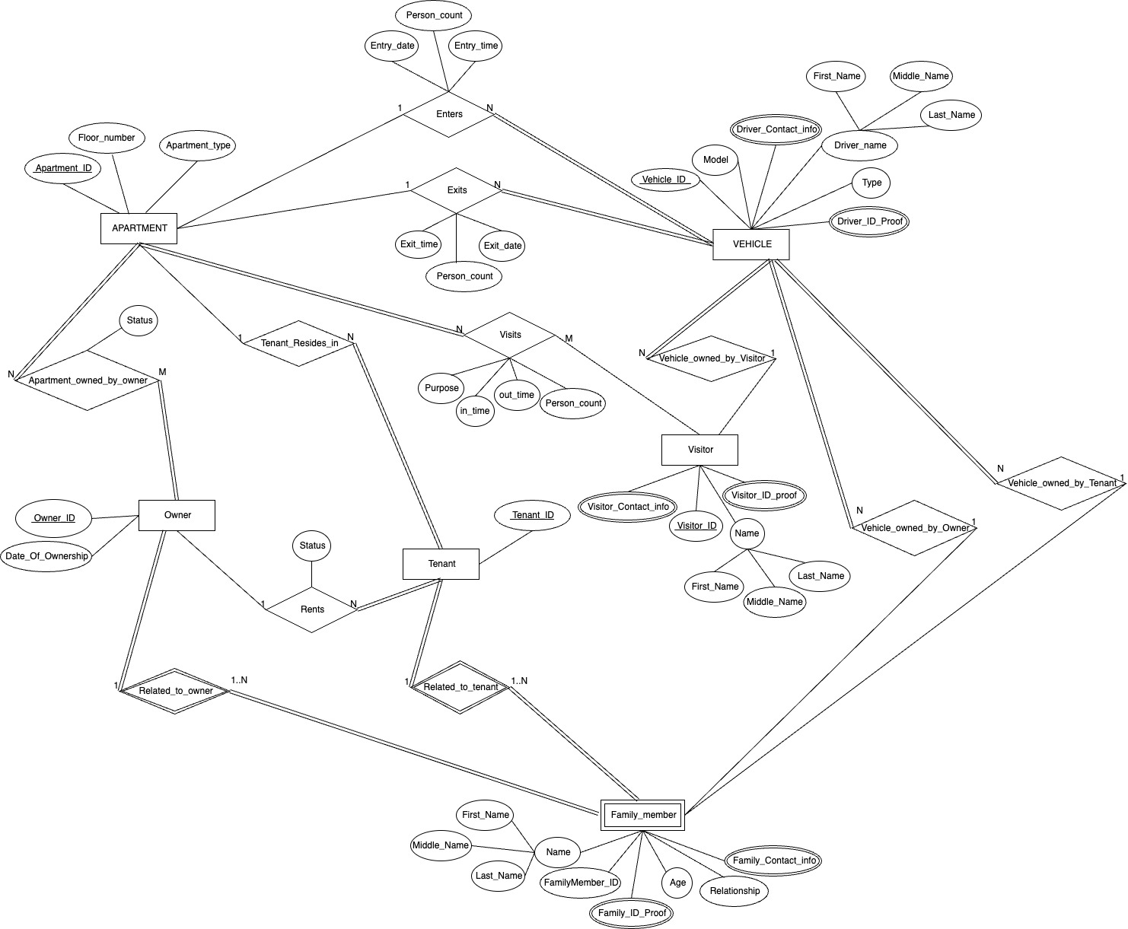
fig.1. ER-Diagram

Slide 6
ER-Diagram for Apartment Management System
The Apartment Management System ER diagram represents a structured approach to managing residential apartments, focusing on entities like Apartment, Owner, Tenant, Visitor, Vehicle, and Family Member. Each apartment can be owned by an Owner or rented by a Tenant, with details about ownership and tenancy recorded in the system. Vehicles are linked to Owners, Tenants, or Visitors, allowing tracking of vehicle entries and exits. Visitors can register their visits, specifying details like the purpose and duration. Family Members are associated with both owners and tenants, capturing personal details and relationships. The system centralizes apartment-related data, enhancing security and providing an organized, efficient way to manage apartment access, vehicle movement, and resident information.

Slide 7
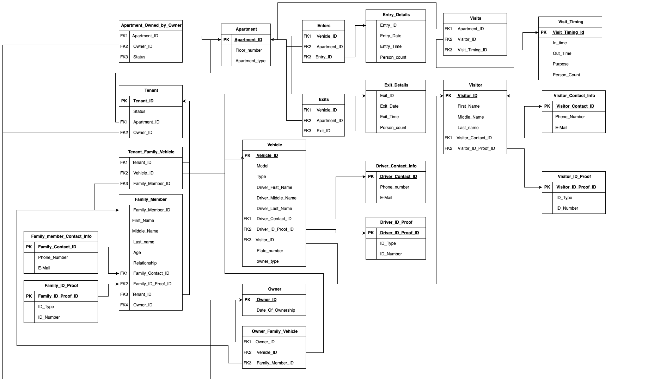
fig.2. Relational Model

Slide 8

Relational Model Structure
This Apartment Management System relational model is designed to efficiently organize and manage data related to apartments, residents, visitors, vehicles, and access control.
Apartment: Basic details for each apartment, linked to either Owner or Tenant records.
Owner and Tenant: Capture ownership and tenancy information, allowing apartments to be assigned to individuals with specific roles.
Vehicle: Manages vehicle data linked to either owners, tenants, or visitors, including driver and ID proof information.
Entry and Exit Details: Track vehicle entry and exit events with timestamps and person count, enhancing security.
Visitor and Visit Timing: Record visitor information, purpose, and visit times.
Family Member: Stores family details associated with tenants or owners.
Contact and ID Proof tables: Manage contact and identity verification information separately for enhanced data integrity.
The model uses foreign keys and linking tables to maintain relationships and avoid redundancy, achieving up to 4NF normalization, which ensures efficient data storage and retrieval while supporting complex relationships.

Slide 9
Data Dictionary
Vehicle:
Family_Member:
Attribute | Data Type | Remark | Example Value
Vehicle_ID | INT | Primary Key, unique identifier, A lot of vehicle might enters will make lots of entries . | 6001
Model | CHAR (16) | Vehicle model name | "Toyota Corolla"
Type | CHAR (12) | Type of vehicle | "Car"
Driver Name | CHAR (24) | First name of the driver | "Aniket"
Driver_Middle_Name | CHAR (12) | Middle name of the driver | "Kumar"
Driver_Last_Name | CHAR (24) | Last name of the driver | "Yadav"
Driver_Contact_ID | INT | Foreign Key to Driver_Contact_Info | 7001
Driver_ID_Proof_ID | INT | Foreign Key to Driver_ID_Proof | 8001
Visitor_ID | INT | Foreign Key to Visitor | 9001
Attribute | Data Type | Remark | Example Value
Family_Member_ID | SMALLINT | unique identifier, allowing them to be referenced individually. Auto-increment required. Ensures each family member is uniquely identifiable. | 3001
First_Name | CHAR (20) | First name of the family member Limits length to 20 characters. | ”ram"
Middle_Name | CHAR (8) | Middle name (if applicable) Limits length to 8 characters. | "Prasad"
Last_name | CHAR (20) | Last name of the family member, Limits length to 20 characters. | ”sharma"
Age | TINYINT | Age in years, range up to 256 ,Must be a positive integer. Cannot be less than 1. | 35
Relationship | CHAR (16) | Relationship to tenant or owner, Size 15 covers common relationships | "Brother in law"
Family_Contact_ID | INT | Foreign Key to Family_member_Contact_Info, | 4001
Family_ID_Proof_ID | INT | Foreign Key to Family_ID_Proof | 5001
Tenant_ID | SMALLINT | Foreign key to Tenant | 2001
Owner_ID | SMALLINT | Foreign key to Owner | 1001
Visitor:
Attribute | Data Type | Remark | Example Value
Visitor_ID | INT | Primary Key, unique identifier for visitor. Auto-increment required. Ensures each visitor is uniquely identifiable. | 9001
First_Name | CHAR (20) | First name of visitor, Should not be empty or null. Maximum length is 20 characters. Must be alphabetic. | "Akhilesh"
Middle_Name | CHAR (8) | Middle name (if applicable). must be alphabetic. Can be NULL. | "Kumar"
Last_name | CHAR (20) | Last name of visitor, Must be alphabetic. Can be NULL. | "Yadav"
Visitor_Contact_ID | INT | Foreign Key to Visitor_Contact_Info | 1301
Visitor_ID_Proof_ID | INT | Foreign Key to Visitor_ID_Proof | 1401

Slide 10
Data Dictionary
The Vehicle Table stores details about vehicles associated with apartment owners and tenants, including the vehicle ID, owner ID, vehicle number, type, and status. It helps manage and track vehicle entry and exit permissions.
The Family Member Table records information about family members linked to apartment owners or tenants, such as their ID, name, relationship, and contact details, ensuring seamless access for authorized family members.
The Visitor Table logs visitor information, including their ID, name, apartment being visited, vehicle number, and entry/exit times, ensuring secure monitoring of visitor movements and vehicle entries. These tables together support efficient and secure vehicle and visitor management within the system.

Slide 11
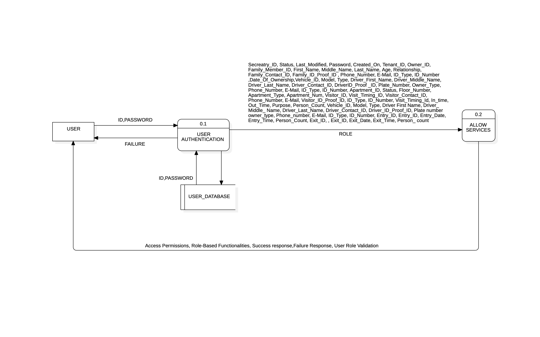
Data Flow Diagram
0-Level

Slide 12
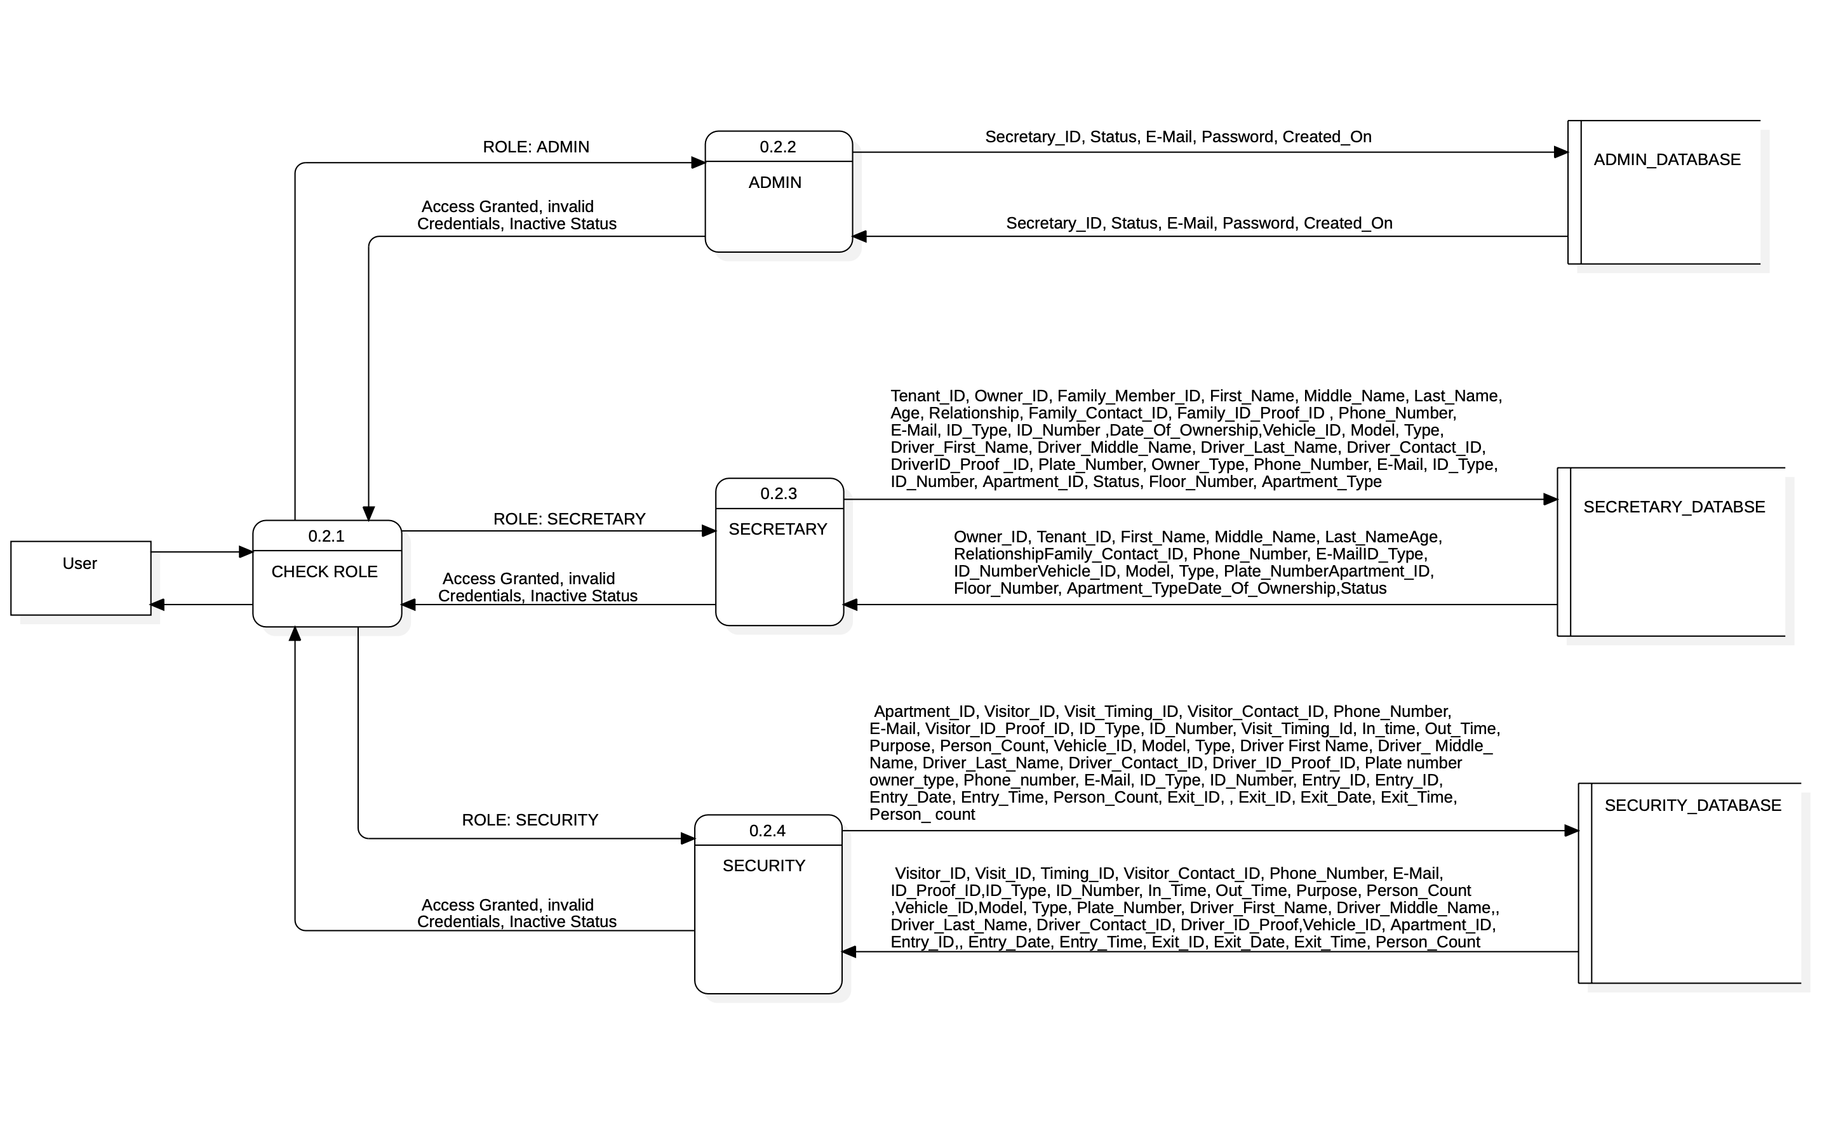
DATA FLOW Diagram

Slide 13

Data Flow Diagram
The Data Flow Diagram (DFD) provides an overall view of how data moves through the vehicle management system. It highlights the interaction between users ( secretary and security, and visitors) and system processes. At the highest level, the system processes inputs such as user login credentials, vehicle registration details, and visitor information, and generates outputs like access to role-specific dashboards, vehicle activity logs, and visitor entry/exit records.
The DFD is structured into multiple levels, with Level 0 showing the core processes of authentication, data management, and access control, while Level 1 expands these into specific modules like user management by admin, vehicle handling by the secretary, and visitor monitoring by security. The diagram ensures a clear representation of data storage, flow, and processing within the system, linking user interactions with the database tables (Users, Vehicles, Visitors). This comprehensive design enables efficient and secure system operations.

Slide 14
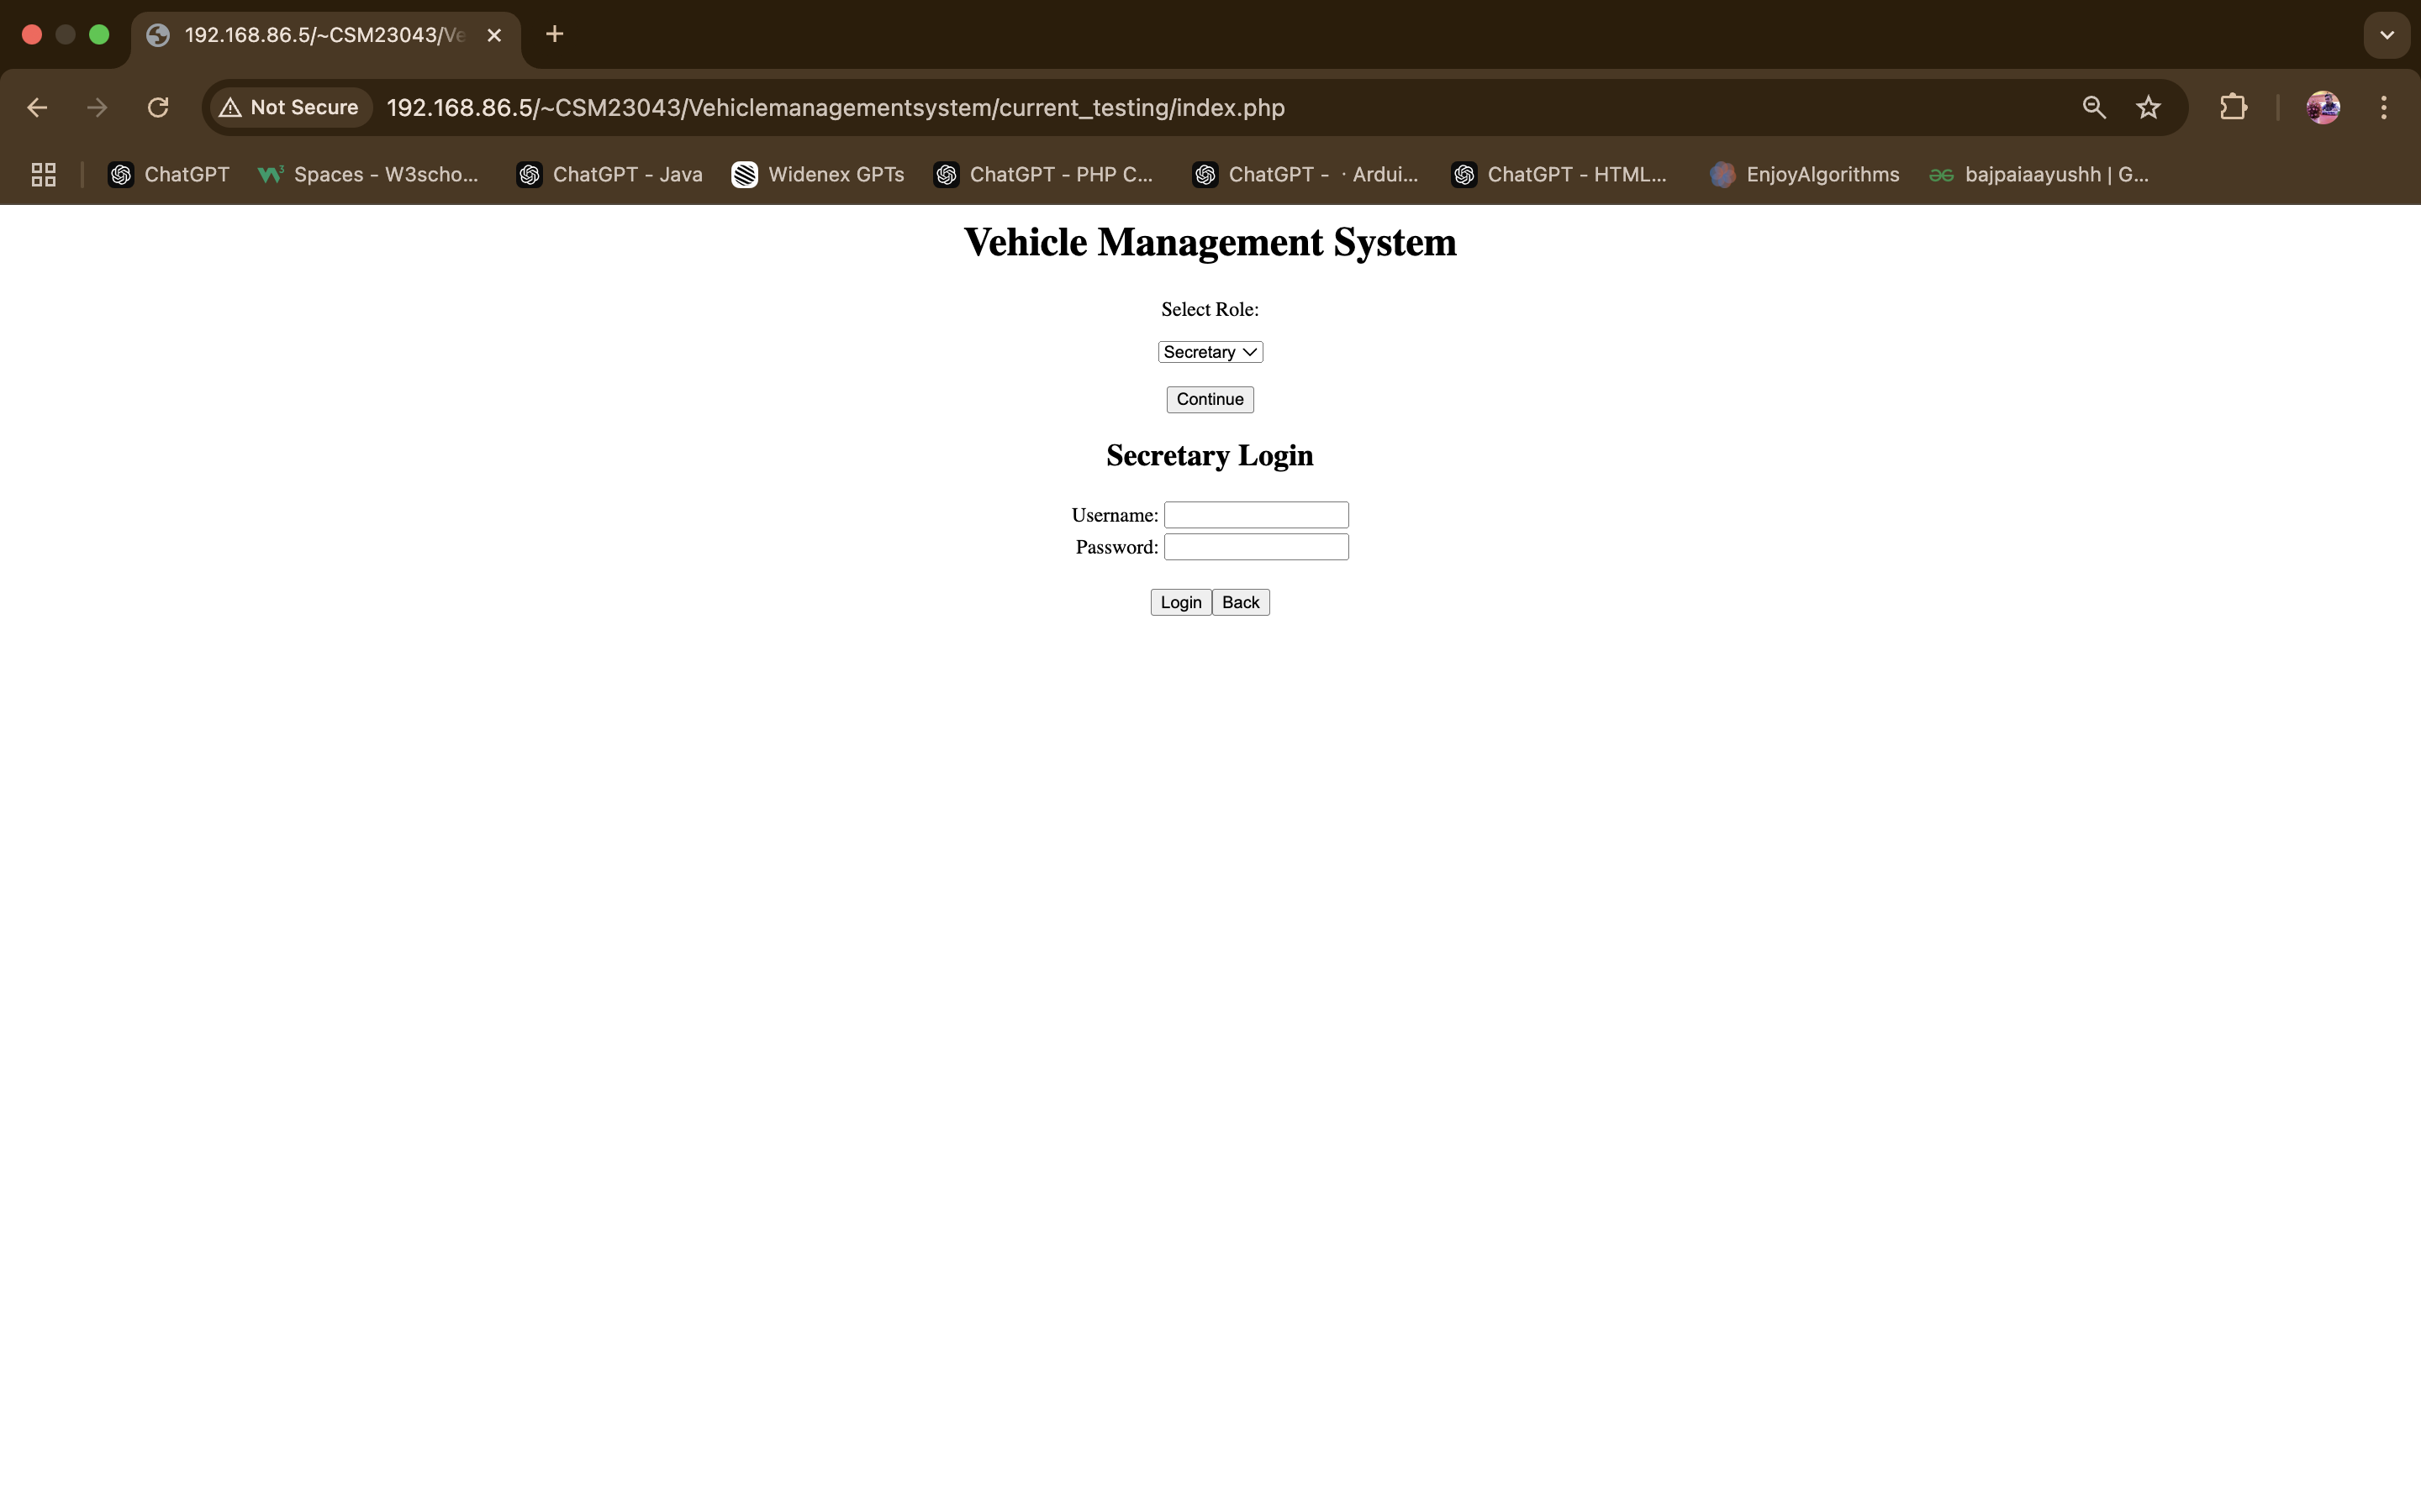
Login page

Slide 15
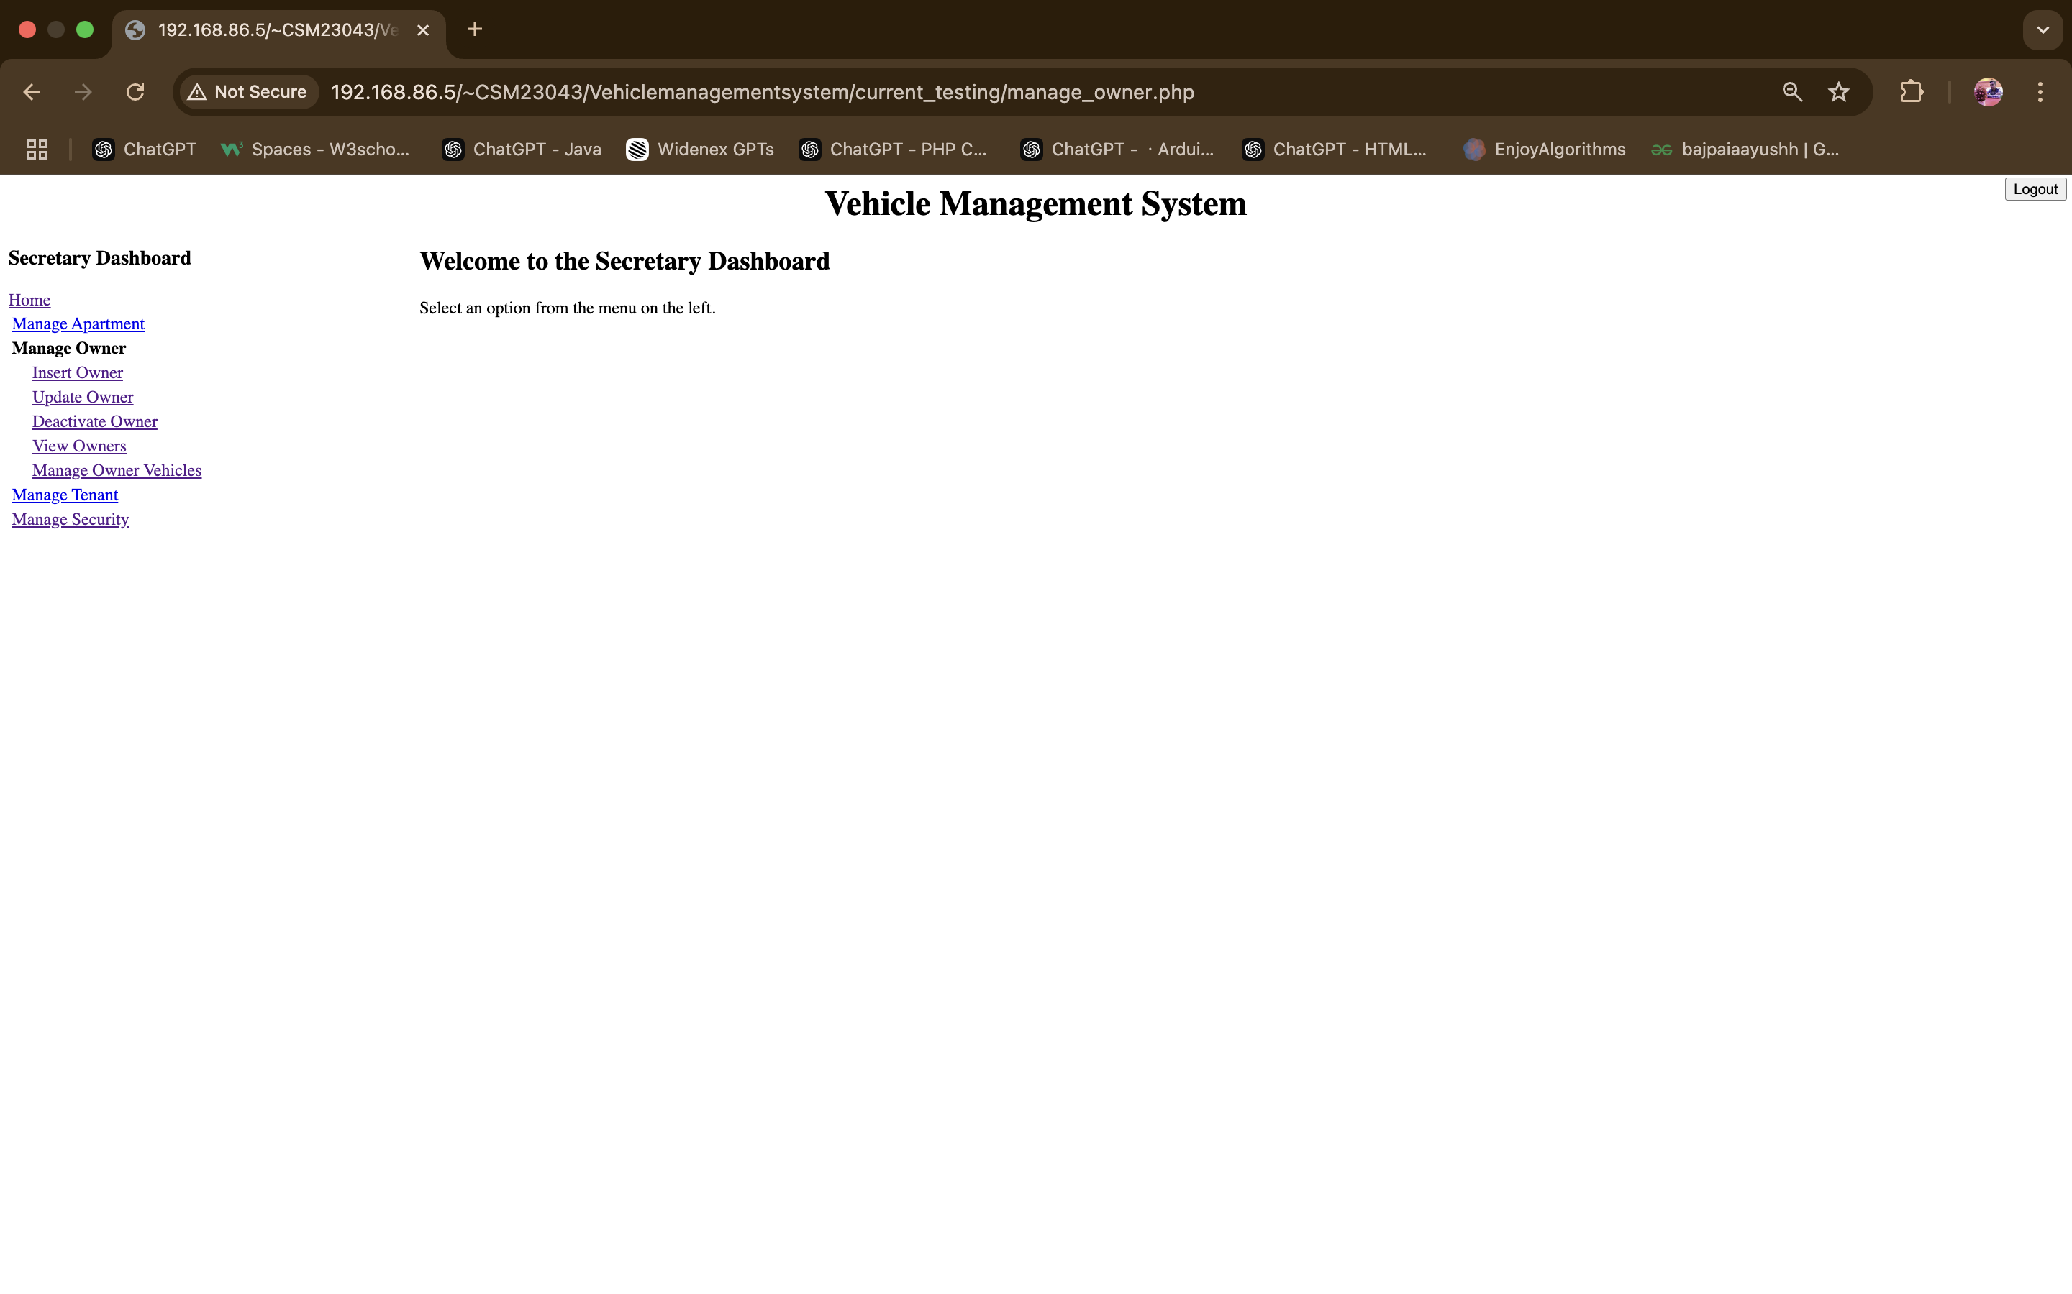
Sectretary Dashboard

Slide 16
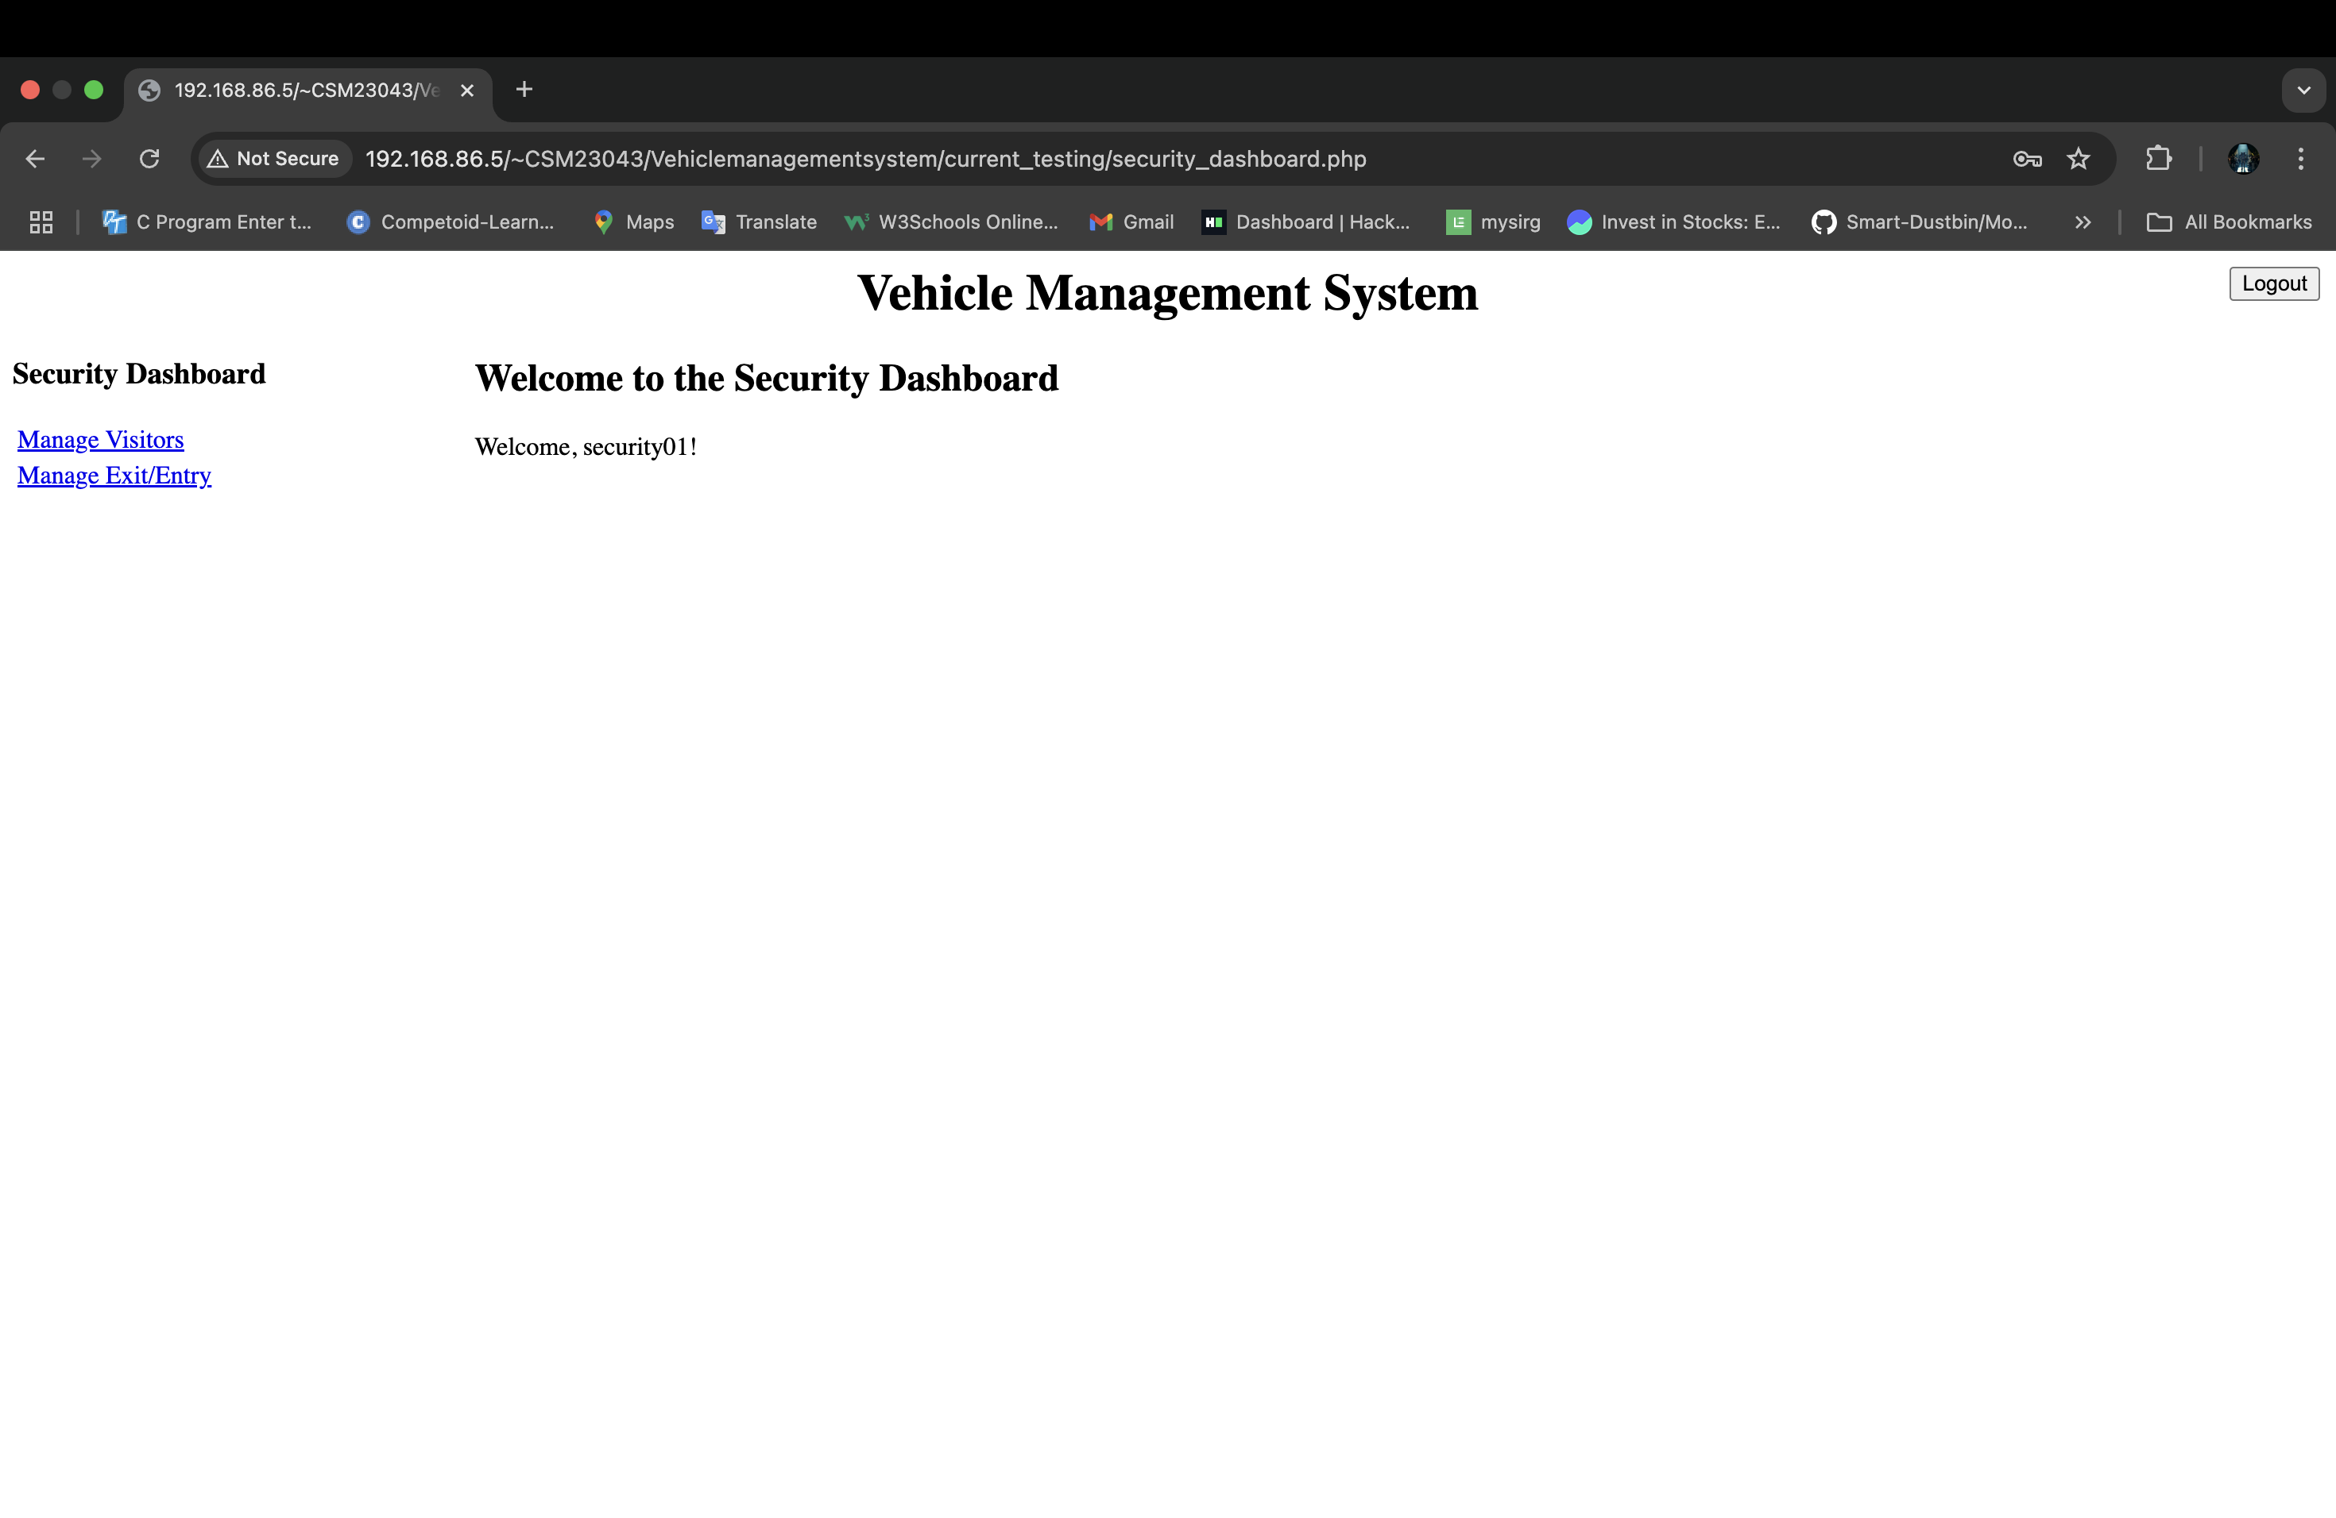
Security Dashboard

Slide 17
CONCLUSION
The Vehicle Management System is a comprehensive solution designed to streamline and secure the management of vehicles, family members, and visitors within a gated community. By incorporating role-based access for admins, secretaries, and security personnel, the system ensures efficient operations while maintaining data security. Its structured architecture, supported by a robust database design and modular functionalities, makes it scalable and easy to maintain. Through the use of advanced tools and technologies, the system enhances efficiency, reliability, and user satisfaction, addressing all core requirements effectively.

Slide 18

Thank You

