Slide 1

Options sensitivities on nifty
IE 612 – Course Project
Akhil & Aseem |31/10/2026

Slide 2
Agenda
01
Motivation
02
Theory
Why Greeks
Black-76, forward vs spot, higher-order Greeks
03
Method
04
Results
Parity forward, implied vol
Each Greek across strike, expiry and time
Notes:
Five parts. Theory and method set up the results; diagnostics shows what the code audit found and how the corrections changed the numbers.

Slide 3

Why sensitivities matter
Risk
One of the most important applications is aggregating individual instrument Greeks into portfolio-level sensitivities. Linear combination of the sensitivity provides the portfolio sensitivity.
P&L attribution and explain
Greeks can be used to explain the change in portfolio value over a period.
$$dV≈ΔdS+\frac{1}{2}Γ{\left(dS\right)}^{2}+νdσ+Θdt+ρdr+higher order$$
Hedging
Options are generally highly leveraged and they can be efficiently hedged to filter out the exposure sought. This is also used for synthetic exposure to for example volatility.
Market making / Option trading strategies
Used for inventory control by market making and other strategies by option traders.
Notes:
An option price is a function of several inputs; Greeks are the partial derivatives with respect to each. NIFTY options are European and cash settled, which makes them a clean case for Black-76.

Slide 4
OPTION TRADING
Application | Greeks Used | Objective
Directional trading | Delta | Express bullish/bearish views
Gamma trading | Gamma, Delta | Benefit from realised underlying movements
Volatility trading | Vega, Volga | Express views on implied volatility
Time decay strategies | Theta, Gamma | Earn premium through time decay
Delta hedging | Delta | Maintain market-neutral positions
Gamma scalping | Gamma, Delta, Theta | Monetise realised volatility through dynamic hedging
Volatility arbitrage | Vega, Gamma, Theta | Exploit differences between implied and realised volatility
Skew trading | Vanna, Vega | Trade relative volatility across strikes
Term structure trading | Vega, Veta | Trade relative volatility across expiries
Interest-rate hedging | Rho | Manage rate sensitivity
Notes:
Check the current lot size on the NSE website before presenting. All Greeks in this deck are per unit of index; multiply by the lot size for one contract.

Slide 5
Greeks
First-ORDER
Greek | Measure | Use
Delta (Δ) | Sensitivity to underlying price | Directional exposure, hedge ratio, synthetic positions, probability approximation
Gamma (Γ) | Sensitivity of Delta to underlying price | Convexity exposure, dynamic hedging, gamma scalping, identifying nonlinear risk
Vega (ν) | Sensitivity to implied volatility | Volatility trading, volatility hedging, volatility surface risk
Theta (Θ) | Sensitivity to passage of time | Time decay analysis, carry estimation, theta harvesting, calendar spread analysis
Rho (ρ) | Sensitivity to interest rates | Interest-rate risk, expiry-dependent rate exposure, rate hedging
Notes:
Called core rather than first-order because gamma is a second derivative. In Black-76 the natural underlying is the forward F, so delta and gamma are with respect to F; the next slides show how to map them to spot. Deep ITM delta tends to the discount factor, not to exactly plus or minus one.

Slide 6
Greeks
SECOND-ORDER and CROSS SENSITIVITIES
Greek | Measure | Use
Vanna | Change in Delta with volatility (or Vega with spot) | Spot-volatility interaction, volatility surface hedging
Volga / Vomma | Change in Vega with volatility | Volatility convexity, managing large volatility movements
Charm | Change in Delta with time | Hedge rebalancing due to time decay, expiry-related hedging
Veta | Change in Vega with time | Managing the time decay of volatility exposure
Speed | Change in Gamma with spot | Higher-order spot convexity, managing gamma instability
Color | Change in Gamma with time | Managing gamma decay and dynamic hedge frequency
Zomma | Change in Gamma with volatility | Understanding how volatility changes affect gamma exposure
Notes:
Called core rather than first-order because gamma is a second derivative. In Black-76 the natural underlying is the forward F, so delta and gamma are with respect to F; the next slides show how to map them to spot. Deep ITM delta tends to the discount factor, not to exactly plus or minus one.

Slide 7
Higher-order Greeks and units
Greek | Definition | Reported as | Greek | Definition | Reported as
Vanna | ∂Δ/∂σ | per vol point | Speed | ∂Γ/∂F | per ₹1 in F
Vomma | ∂Vega/∂σ | ₹ per vol pt² | Zomma | ∂Γ/∂σ | per vol point
Charm | ∂Δ/∂t = −∂Δ/∂τ | per calendar day | Color | ∂Γ/∂t = −∂Γ/∂τ | per calendar day
Veta | ∂Vega/∂t = −∂Vega/∂τ | ₹/vol pt per day | Ultima | ∂³V/∂σ³ | per unit σ³
Dual Δ | ∂V/∂K | per ₹1 in K | Dual Γ | ∂²V/∂K² | per ₹1² in K
Notes:
OpenGreeks returns charm, color and veta as derivatives with respect to time to expiry, per year; calendar-time decay has the opposite sign, so we report minus value divided by 365. It returns vanna, vomma and zomma per unit of sigma; we scale to per vol point, consistent with vega. Verified against finite differences.

Slide 8

Model: Black-76
$$C=e^{−rt}[FN\left(d_{1}\right)−KN\left(d_{2}\right)$$
$$P=e^{−rt}[KN\left(−d_{2}\right)−FN\left(−d_{1}\right)]$$
$$d_{1}=\frac{\ln\left(\frac{F}{K}\right)+\frac{σ^{2}T}{2}}{σ√T}$$
$$d_{2}=d_{1}−σ√T$$
Assumptions
• European exercise, which matches NIFTY options
• Lognormal forward with one constant σ per contract
• F and rate per expiry from put-call parity
Notes:
Black-76 prices options on a forward. We infer the forward and discount factor for each expiry from put-call parity, then solve for the volatility that makes the model price equal the market close.

Slide 9

Greeks (using Black 76)
$$Δ_{c}=e^{−rt}N\left(d_{1}\right), Δ_{p}=−e^{−rt}N\left(−d_{1}\right)$$
$$Γ=\frac{e^{−rT}φ\left(d1\right)}{F_{0}σ√T}$$
$$ν=e^{−rt}F_{0}φ\left(d_{1}\right)√T$$
$$Θ_{c}=rC −\frac{e^{−rt}F_{0}φ\left(d_{1}\right)σ}{2\sqrt{T}},Θ_{p}=rP −\frac{e^{−rt}F_{0}φ\left(d_{1}\right)σ}{2\sqrt{T}}$$
$$ρ_{c}=−TC, ρ_{p}=−TP$$
$$Vanna=\frac{∂ν}{∂F}=−\frac{Dφ\left(d_{1}\right)d_{2}}{σ}$$
$$charm(delta decay)=\frac{∂Δ}{∂t}=rΔ+\frac{Dφ\left(d_{1}\right)d_{2}}{2T√T}$$
Notes:
All derivatives are with respect to the forward F, holding r and σ fixed. Theta holds F fixed as calendar time passes. Rho holds F fixed, so a higher rate only increases discounting, which is why rho is negative for calls and puts alike.

Slide 10

Greeks (using Black 76)
$$Vomma\left(Volga\right)(Vega convexity)=\frac{∂^{2}ν}{∂σ^{2}}=\frac{vega .{d_{1}.d}_{2}}{σ}$$
$$Speed=\frac{∂Γ}{∂F}=\frac{Γ}{F}\left(1+\frac{d_{1}}{σ\sqrt{T}}\right)$$
$$Zomma=\frac{∂Γ}{∂σ}=\frac{Γ}{σ}\left(d_{1}d_{2}−1\right)$$
$$Color(Gamma Decay)=\frac{∂Γ}{∂t}=Γ\left(r+\frac{{1−d}_{1}d_{2}}{2T}\right)$$
$$Veta \left(Vega Decay\right)=\frac{∂ν}{∂t}=ν\left(r−\frac{{1+d}_{1}d_{2}}{2T}\right)$$
Notes:
All derivatives are with respect to the forward F, holding r and σ fixed. Theta holds F fixed as calendar time passes. Rho holds F fixed, so a higher rate only increases discounting, which is why rho is negative for calls and puts alike.

Slide 11
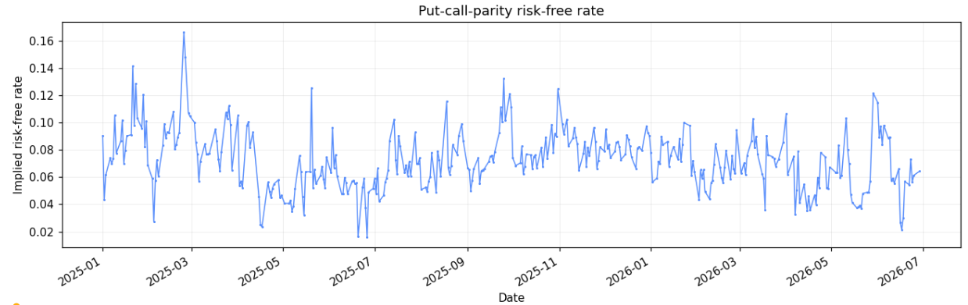
Parity forward and discount factor
Forward from parity
C − P = $e^{−rt}$(F − K)
Notes:
For each date and expiry, regress C − P on strike for non-stale pairs within 5 percent of spot, trimming outliers. The forward embeds expected dividends, so no dividend assumption is needed. The parity discount rate has median 10.3 percent, above money-market rates and noisy, but replacing it with 6.5 percent moves near-ATM IVs by under 0.1 vol point for expiries up to 90 days and Greeks by about 1 percent.

Slide 12
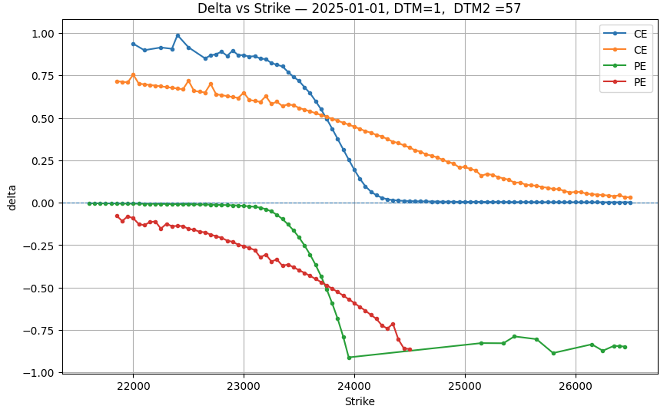
Delta across strikes
Limits
Steeper near expiry
With 3 days left the curve is almost a step: the option is either in or out.
NIFTY options, 3 Mar 2025 (spot 22,119). Forward F per expiry from put-call parity; IV from the OTM leg at each strike.
Notes:
Black-76 call delta is D·N(d1), so deep in the money it tends to the discount factor e^(−rT), not one; the put tends to minus the discount factor. At every strike call delta minus put delta equals D. With 3 days left D is 0.999, so the difference from one is invisible here; at 52 days it is 0.983.

Slide 13
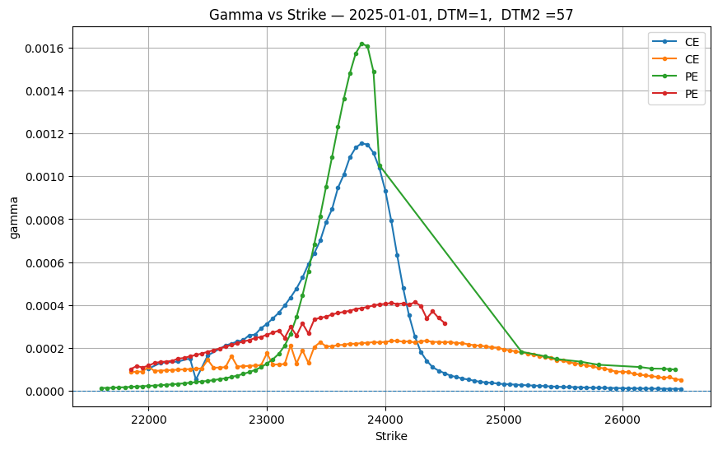
Gamma peaks near the forward
Sharp near expiry
Flat for long dates
Long-dated options spread gamma over a wide band of strikes.
NIFTY options, 3 Mar 2025 (spot 22,119). Forward F per expiry from put-call parity; IV from the OTM leg at each strike.
Notes:
Gamma is the curvature of price in the forward. Short-dated near-ATM options carry the most gamma, which is why weekly expiries are risky for option sellers.

Slide 14
Theta: the cost of waiting
Notes:
Theta here holds the forward fixed and is in rupees per calendar day per unit of index. See the forward vs spot slide for how theta changes if spot is held fixed instead.

Slide 15
Vega grows with time
Notes:
Vega scales roughly with the square root of time, so longer expiries are much more exposed to changes in implied volatility.

Slide 16
Rho: small for short expiries
Notes:
In Black-76 the forward is an input, so a rate change only alters discounting: rho equals minus T times the option value, for calls and puts. A spot-based model would show positive call rho because the forward rises with r; that effect is already inside our parity forward.

Slide 17
Vanna and vomma
Vanna flips sign near the forward.
Vomma is near zero ATM.
Notes:
Units now match vega: vanna is the change in delta for a 1 vol point rise, vomma the change in vega (₹ per vol point) for a 1 vol point rise. The previous version plotted OpenGreeks raw values per unit sigma, 100 and 10,000 times larger.

Slide 18
One expiry, followed to the end
Notes:
Each trading day we take the strike nearest that day’s parity forward for the 27 Mar 2025 expiry, skipping stale closes, and compute forward gamma and theta from its implied vol. Wiggles reflect day-to-day changes in implied vol.

Slide 19
Volatility is not constant
Notes:
Before the fix, puts and calls were priced off different forwards, creating a jump at the money of 2 to 19 vol points. With the parity forward the smile is continuous. Black-76 Greeks hold each contract’s IV fixed as F moves, which is a sticky-strike assumption; under sticky moneyness the smile moves with F and effective delta adds vega times dσ/dF. At 24 days ATM, the skew of about −0.16 vol pt per 100 points raises call delta from 0.508 to about 0.545. Far OTM 3-day IVs are inflated by the minimum price tick.

Slide 20
Option Combinations: long ATM straddle
Notes:
A straddle isolates the gamma theta trade-off: it profits if NIFTY moves more than about 2.7 percent either way by expiry. The model curve shifts the forward with IVs held fixed (sticky strike). The portfolio_greek_analyzer in the notebook builds these combinations.

Slide 21
Next steps
Intraday Sensitivity
Sensitivity linked with strategy
Hedging backtest
Strategy backtest
Theoretical P&L
Trading Cost
Notes:
Volume filtering is the quickest win. Futures closes would give an independent check of the parity forward. The backtest tests whether the Greeks explain realised profit and loss.

Slide 22

Thank You
Questions? | Code: github.com/akhil-cv/IE612

