Slide 1
OPTIMIZATION TECHNIQUES
PortfolioPilot
RETURN
Multi-objective portfolio
allocation and rebalancing
RISK
COST
A hybrid evolutionary and convex approach
to Indian-stock portfolio decisions
Akhil / 241070004
Ridhima / 241071062
Notes:
Introduce PortfolioPilot as a decision-support project for an investor who already owns stocks and needs to rebalance. The output is a set of feasible trade-offs rather than one promised best investment. Team details follow the repository README. Core evidence snapshot: main 482fe84. Interface and deployment preparation: frontend 96aa4d5. Deployment is awaiting confirmation. Source: https://github.com/akhil-gitcoder/PortfolioPilot/blob/main/README.md Homepage and example rebalancing verified on 14 November 2026 at https://portfolio-pilot-deploy.vercel.app/.

Slide 2
The rebalancing problem
An investor owns six stocks. Which holdings should change?
01
02
03
Higher return
Lower risk
Lower cost
Choose allocations with
higher estimated
annual returns.
Limit volatility through
portfolio diversification.
Account for buying
and selling when
changing holdings.
Output: a Pareto set of feasible trade-offs
Each portfolio offers a different compromise between return, volatility and one-off trading cost.
02
Notes:
An investor starts with six holdings: RELIANCE 20%, TCS 20%, HDFCBANK 20%, ITC 15%, SBIN 15%, LT 10%. Increasing expected return can increase volatility, while changing holdings incurs trading costs. No-trade is an important feasible zero-cost alternative. A portfolio dominates another only if it is no worse on all three objectives and better on at least one. The goal is an approximate Pareto set. Source: https://github.com/akhil-gitcoder/PortfolioPilot/blob/main/formulation/formulation.md

Slide 3
Data and investment constraints
30
8
1,729
Three objectives
NSE stocks
sectors
daily price rows
Return
maximize μᵀx
2019–2025 data / 756-row estimation window
Volatility
minimize √(xᵀΣx)
Portfolio rules
Fully invested, long-only
At most 10 holdings
At least 3% per held stock
≤ 20% per stock
≤ 40% per sector
Buy / sell costs included
Trading cost
minimize buy + sell fees
03
Notes:
The committed Yahoo Finance adjusted-price snapshot contains 1,729 rows from 1 January 2019 to 30 December 2025 across 30 NSE stocks and eight project-defined sectors. The static experiment estimates from the first 756 price rows, yielding 755 daily returns. Annual mean is daily mean times 252. Annual covariance is Ledoit-Wolf covariance times 252. Objective vectors minimize negative expected return, volatility, and proportional cost. Buy and sell rates are assumptions rather than a verified broker tariff. Cardinality and minimum positions make the feasible set non-convex. Sources: data/DATA.md, config/default.json, formulation/formulation.md at https://github.com/akhil-gitcoder/PortfolioPilot

Slide 4
System workflow
A feasible portfolio at every stage of the search
01
Inputs
02
Estimation
03
Feasible search
Prices, holdings
and limits
Expected return
and covariance
NSGA-II, repair
and archive
06
Portfolio choices
05
Pareto filtering
04
Convex refinement
Weights, explanations
and stock-level trades
Keep non-dominated
alternatives
Optimize weights
on selected stocks
Implementation: data loader, constraint model, NSGA-II, convex polish, metrics and frontend engine.
04
Notes:
Explain the flow in order. The data loader reads prices and holdings, estimates mu and Sigma, and builds the constrained problem. Random keys decode into feasible allocations using support repair and water-filling. NSGA-II evolves the population and a bounded archive retains non-dominated discoveries. Fixed-support convex polish improves weights. The frontend selects three to six representative options and explains changes and trade amounts. The static experiment uses the first estimation window; the frontend uses the most recent window in its frozen snapshot. The same backend also supports comparison experiments and a rolling walk-forward evaluator. Sources: src/data_loader.py, src/problem.py, src/algorithms/nsga2.py, src/hybrid/polish.py; frontend/engine.py on frontend branch at https://github.com/akhil-gitcoder/PortfolioPilot

Slide 5
Methods implemented
Method | How it works | Role
Random search | Sample and repair random portfolios | Sampling baseline
Weighted sum | Convex relaxation, support rounding, polish | Solver baseline
NSGA-II | Non-dominated sorting, crowding, evolution | Main search algorithm
30
10,000
100
independent seeds
candidate evaluations per run
population size
05
Notes:
Random search generates 10,000 candidates using the same decoder as NSGA-II. The weighted-sum baseline solves 66 preference triples on a 0.1 simplex grid. It relaxes cardinality and minimum weights, selects a support, then solves again on that support. Plain NSGA-II uses a population of 100, rank and crowding tournaments, SBX crossover and polynomial mutation, with an elitist survivor step. NSGA-II and metrics are implemented in project code, not a multi-objective framework. All stochastic methods use seeds 1000–1029. Hybrid uses extra convex solves beyond its candidate budget, so it is not a matched-runtime comparison. References: Deb et al. (2002), doi:10.1109/4235.996017; https://github.com/akhil-gitcoder/PortfolioPilot/blob/main/experiments/run_experiments.py

Slide 6
Implemented
innovations
01
Current-portfolio injection
Preserves the zero-trade-cost option.
02
Sparse starts + support mutation
Evolutionary
search
+
convex polish
Explores different stock combinations.
03
External archive
Retains up to 200 non-dominated discoveries.
04
Fixed-support convex polish
Explore which stocks to hold.
Then refine their weights.
Refines weights with three solver passes.
06
Notes:
These are project-specific combinations and adaptations of established optimization techniques, not claims of inventing NSGA-II or convex optimization. Injecting the initial portfolio preserves the zero-cost reference. Sparse initialization covers five-to-ten-stock supports. Support-reset mutation changes which stocks can enter the portfolio, rather than relying entirely on small key perturbations. An external archive retains up to 200 feasible non-dominated discoveries. For each evolved support, the hybrid separately minimizes variance, maximizes return and minimizes cost while bounding the other objectives by the original candidate. The originals remain in the combined set, and the code rechecks feasibility and dominance after numerical solves. Sources: src/algorithms/nsga2.py and src/hybrid/polish.py at https://github.com/akhil-gitcoder/PortfolioPilot

Slide 7
Hybrid improves Pareto-front quality
+3.37%
mean hypervolume
vs weighted sum
30 / 30
runs beat the baseline
4.68 s vs 0.60 s
7.74× recorded runtime
Mean normalized hypervolume, higher is better. 30 seeds. Source: results/real/summary.csv.
07
Notes:
The chart uses the committed mean hypervolume values from results/real/summary.csv. HV uses pooled min-max scaling and reference point 1.1 in all dimensions; higher is better only within this comparison. The final hybrid has HV 0.90659 ± 0.00345 versus 0.87705 for deterministic weighted sum. Relative gain = 3.37%. It exceeds the baseline in 30/30 seeds. Mean IGD falls from 0.06779 to 0.02546. Mean runtime rises from 0.60481 seconds to 4.68151 seconds, a 7.74x increase. Plain NSGA-II and all pure evolutionary variants do not beat the solver baseline here. Sparse initialization and reset mutation are bundled in the tuned variant, so their individual contributions are not isolated. Source: https://github.com/akhil-gitcoder/PortfolioPilot/blob/main/results/real/summary.csv and per_seed_metrics.csv

Slide 8
Backtest: equal weighting finished ahead
15 quarters, rolling estimation, trading costs deducted
Equal weight holds 30 stocks; optimized portfolios allow 10.
Optimistic
return estimates
32.29%
predicted annual return
18.69%
realised quarter return*
Final wealth from unit starting capital
Balanced selection rule. *Mean annualized quarter return, not CAGR.
08
Notes:
A rolling window uses 756 prior price rows, then holds the selected portfolio for 63 trading days. Fifteen periods cover 21 January 2022 to 20 November 2025. Costs reduce wealth before each holding period and holdings drift. Stochastic results average five algorithmic paths on the same market history. Values shown use the balanced ideal-distance selection rule. NSGA-II here is tuned with archive, and Hybrid includes archive. Equal weight holds 30 stocks, so it does not obey the ten-stock limit. The chart is a benchmark comparison rather than proof of a constrained optimum. Hybrid mean predicted annual return is 32.29%, versus mean annualized subsequent-quarter return 18.69%. This realised-quarter measure differs from the 12.78% full-path CAGR. Better optimization of noisy sample means did not deliver better realised wealth. Source: https://github.com/akhil-gitcoder/PortfolioPilot/tree/main/results/real/walkforward_knee

Slide 9
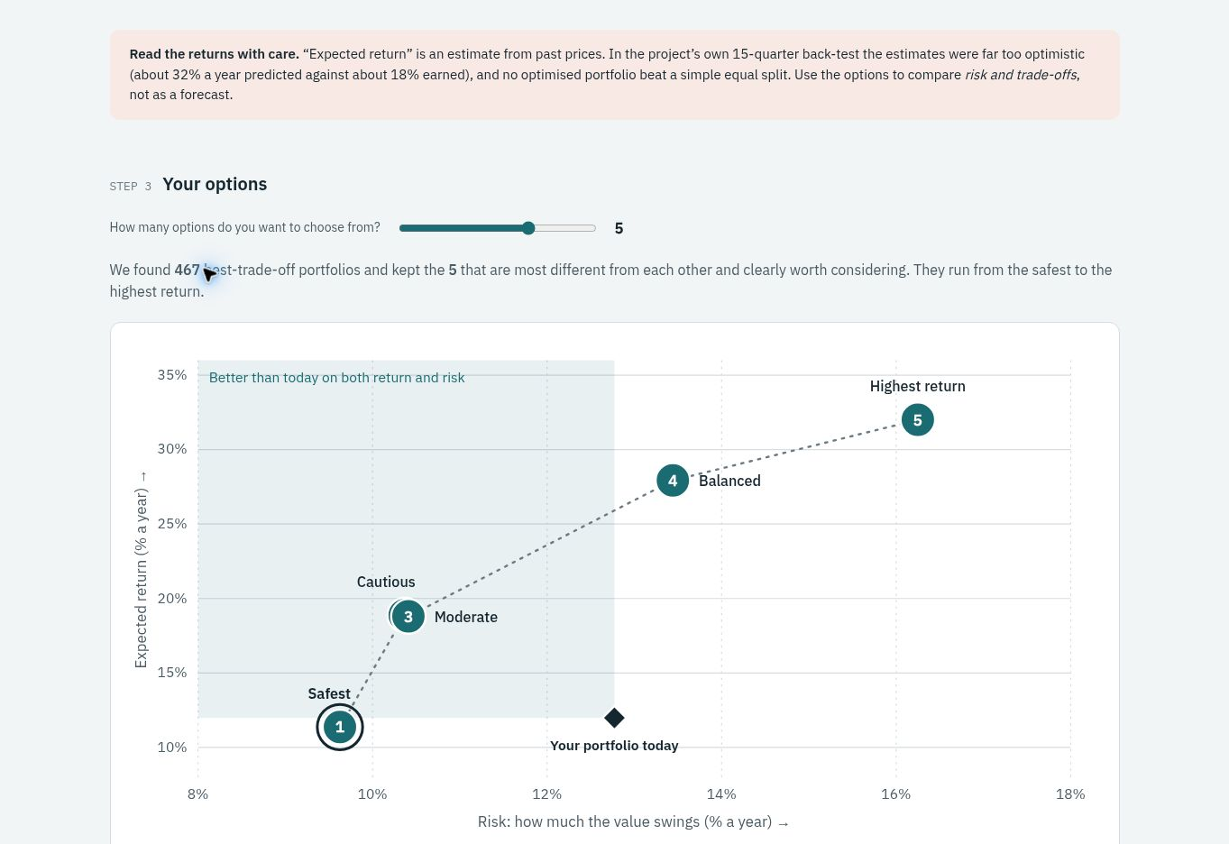
The deployed portfolio comparison
3–6
representative options
Editable holdings
and invested capital
Risk–return comparison
Explanations and
stock-level trades
portfolio-pilot-deploy.vercel.app
09
Notes:
Screenshot of the actual deployed application captured on 14 November 2026 from https://portfolio-pilot-deploy.vercel.app/. The default holdings are a made-up example with capital ₹10,00,000. Clicking Rebalance generated 467 trade-off portfolios and selected five options in this run. This screenshot is a UI demonstration, not the static experimental result on slide 7. The app estimates from its most recent 756-row frozen price window ending 30 December 2025. Expected returns are estimates, not forecasts. Users can edit holdings, compare 3–6 options and inspect explanations and stock-level trades. The deployment URL is live and a rebalance completed successfully.

Slide 10
Conclusions and Future Scope
Stronger Pareto fronts.
Future work
Shrinkage or factor-based
return estimates
The hybrid improves optimization quality.
Historical returns still depend on the quality
of the estimates used by the model.
Robust models for
estimation uncertainty
Stock-specific costs
and execution effects
Matched-time and
ten-stock benchmarks
PortfolioPilot
Live demo: portfolio-pilot-deploy.vercel.app
10
Notes:
The frontend is implemented on the frontend branch. Users edit holdings and capital, request a rebalance and compare three to six representative alternatives with expected return, volatility, one-off cost, explanations and stock-level trades. It includes an evidence view backed by saved experiment results. The deployed application completed a demonstration rebalance on 14 November 2026 at https://portfolio-pilot-deploy.vercel.app/. Conclude that the demonstrated contribution is a constrained, interpretable trade-off exploration system with empirical validation. Proposed extensions are future work: shrinkage or factor-based expected returns, robust uncertainty-aware models, stock-specific trading costs, matched-time experiments and a ten-stock equal-weight benchmark. Team contributions and AI assistance disclosure are in report/contributions.md. Sources: https://github.com/akhil-gitcoder/PortfolioPilot/blob/frontend/frontend/README.md and https://github.com/akhil-gitcoder/PortfolioPilot/blob/main/report/final_report.md

