Slide 1
Blackberrys

Slide 2
Initial Understanding of customers segments
Long term goals
If the proposed segmentations are implemented in campaigns , we want to study the outcome
Fine tune our approach based on the outcome and introduce some new approaches based on propensity models like transaction propensity, response propensity , Lapsation propensity
Product Persona and Behavioral Traits (Proposed)
To identify based on specific time they buy like festival month, or during salary week . To identify customers based on product combinations they bought for example ladies wear buyers can be pushed for beauty care etc
RFM Segmentation (Completed) This would be critical to do during initial phase of implementation to access if our strategies are working and do possible course correction

Slide 3
Initial Understanding of customers segments
Customer
Keeping active repeat customer engaged – High value customers who have started showing signs of Lapsation can be one example
Converting One timer to a repeat – Lifecycle proposal, some additional suggestion on existing flow
Frequency
Maintaining the shopping frequency of high value customers – Customer segment will tell us whom to target more frequently then others
Nudging not so frequent repeat customers into making more visits- Identify via segmentation the customers who can migrate from base to mid and finally to top tier
Average Basket Size
Average Price Point
Push for more products in a single visit- Identify customers who have bought only a single product and can purchase one more item that goes well with it.
Market basket analysis to identify which product to push- Identify if a Ladies wear buyers is a good candidate for kids wear . Beauty care etc.
Identify customers who can be nudged for a higher amount purchase – Identify customers whose ATV has been low but has potential to increase it based on the segment the customer belongs to.
Bringing back Lapsed customers – RFM will tell us which segment is most valuable and should be targeted , Lifecycle proposal
Bringing back lapsed customers- Same Strategy using RFM segmentation
Make unique offers to push for the product in same or next visit- Offer type can be decided segment wise

Slide 4
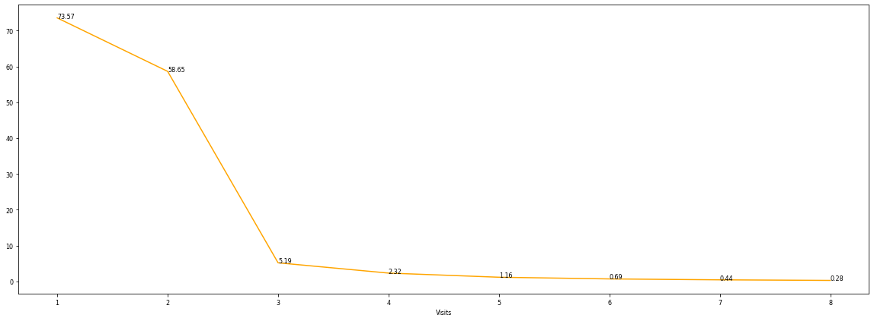

Drop Rate Curve
5.19% of customers do not repeat after their 3rd visit.
58.6% of customers do not repeat after their 2nd visit. It is an opportunity for the brand to increase repeat percentage
Date period : 1st August, 2019 – 1st August, 2022

Slide 5
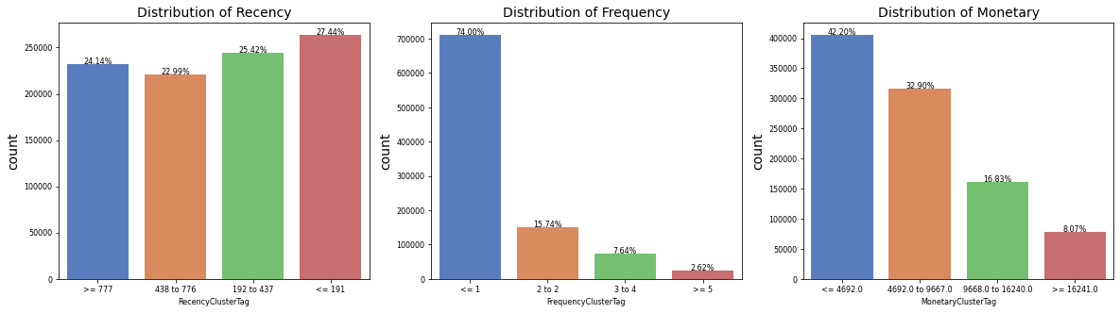
RFM Distribution
27.4% of customer have recency <=191
~74% of customers have only made 1 visit. It is an opportunity for the brand to target these customers using Lifecycle campaigns to increase repeat conversion
Around 8% of customers have ABV more than 16k. These customers can be targeted for repeat visits.
Date period : 1st August, 2019 – 1st August, 2022

Slide 6
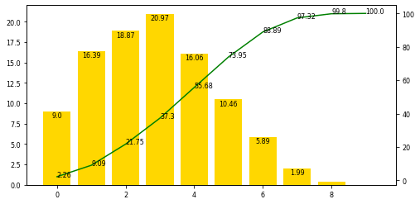
RFM Distribution
The x-axis is the overall score after combining R, F and M clusters. Each bar represents the % share of customers present under each overall score. Whereas, the line represents the cumulative sales contribution.
~21% customers have a combined RFM score of 3, which holds a majority of customer base.
~1% customers have the best combined RFM score of 8, and are most valuable to the brand.
Date period : 1st August, 2019 – 1st August, 2022

Slide 7
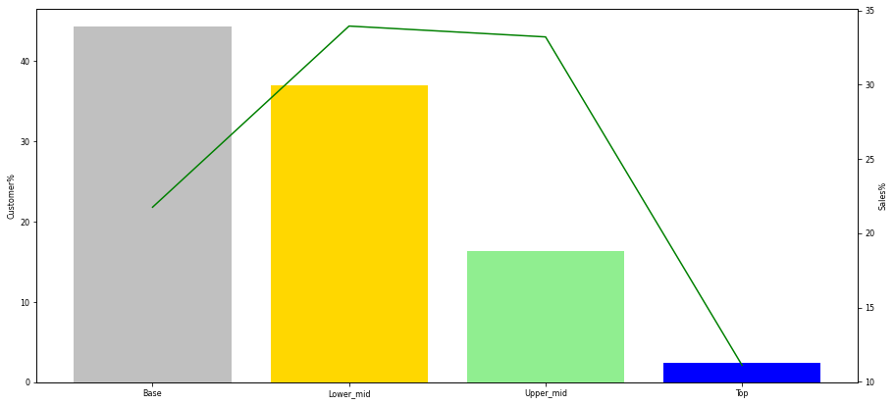
RFM Distribution
Segments | Customers | Sales | Recency | Frequency | Monetary | Customer% | Sales%
Base | 4,25,491 | 2,33,37,01,078 | 728 | 1 | 4,700 | 44 | 22
Lower mid | 3,55,872 | 3,64,19,79,961 | 308 | 1.4 | 7,500 | 37 | 34
Upper mid | 1,57,207 | 3,56,38,98,727 | 175 | 2.3 | 11,000 | 16 | 33
Top | 22,700 | 1,19,24,99,223 | 101 | 4.6 | 11,500 | 2 | 11
The Top segment is the best performing segments among all segments.
2% of total customer base have contributed to 11% of total sales.
44% customers have a frequency of around 1
The Top segment have the best average recency among all segments for repeaters over the last three years.
Date period : 1st August, 2019 – 1st August, 2022

Slide 8
RFM
Premium
3% Customer contribute to 19% sales
Frequency of 12 visits with latency of 126 days with 250 ATV
Top
14% Customer contribute to 39% sales
Frequency of 7 visits with latency of 212 days with 200 ATV
Mid
50% Customer contribute to 34% sales
Frequency of 3 visits with latency of 320 days with 136 ATV
Base
37% Customer contribute to 8% sales
Frequency of 1.5 visits with latency of 244 days with 71 ATV
The segmentations are consistent with the purchase pattern desired
Hit rate and redemption rate are highest among premium and top
K means algorithm applied on recency, frequency and monitory
Elbow curve suggested cut to be 4*
Initial 64 segments finally merged into 4 based on RFM score given*

Slide 9
One Timer Engagement – An addition to already configured flow
Customer Registers
500 BP Validity 1 month
1500 BP Validity 14 days and Announce a monthly draw of 10 among the top 1000 spenders for a substantial reward
2500 BP Validity 30 days and announce a gamification which a customer will be eligible to participate if they make a purchase
Day 1
1st Friday
2nd Friday
4th Friday
6th Friday
1000 BP
Validity 7 days
2000 BP Validity 14 days d and Announce the top 10 winners
Bonus point and coupon reminder Another push for purchase by giving bonus points

Slide 10
Active Repeat Engagement
Customer Purchase with at least for 2nd time
Bonus points to Top and Premium segment We want to increase the loyalty by giving punts since these customers have high potential to repeat
20% off coupon in case of no show to top and premium segment and 15% for others We are getting aggressive to bring back the loyal customers
Day 1
Day 30
Day 45
Day 90
Day 150
Base and Mid segment Pushing a product recommendation with 10% discount Based on product purchased and market basket learning we can come up with a recommendation
SMS asking feedback on purchased product An nps survey on purchase experience would be good
Coupon reminder To send a reminder that they have a coupon to redeem

Slide 11
Lapsed win back Engagement
Bringing back 1% lapsed customer for a single visit from top and premium lapsed segment would earn 2.9M revenue
Top and Premium Lapsed Identify customers who are lapsed under top and premium
2000 Bonus points to Top and Premium segment and discount reminder Discount reminder and bonus point
15% off coupon in case of no show 15% flat discount on any product
Day 1
Day 1
Day 15
Day 45
Day 60
Day 90
Give 20% discount on their favorite product Most purchased product personalized at a customer level
“We miss you” communication Reminder of points and discount code
Pushing product recommendation with some bonus point Running product recommendation model AIRA and bonus points

Slide 12
Customer Basket Analysis
Ladieswear and Kidswear driving more than 50% of sales
It was analyzed that Men’s wear stand alone is about 6% where as with Ladies and Kids its about 17% which indicates a strong family segment
We will look for customers who exclusively bought a product P and is a likely candidate for product Q because P and Q has gone together very well. Looking for a possible increase in ATV and ABS

