Slide 1
Exploratory Data Analysis
Mining Uber Dataser
By:
Satya Akhil Chowdary Kuchipudi
Sanil Jain
Abhilash Mysore Somashekar
Ravi Raj Wani

Slide 2
Project: Mining Uber Data Set
What do we have ?
4.5 million pickup locations, date and time over 6 months for NYC
Continuous Data in time (Proof later!)
What do we intend to do with it ?
Density Estimation (Probablity of a pickup given location and time)
Gaussian Process Regression
Look for patterns in ride distribution over weekdays

Slide 3
Exploratory Analysis: Objective
Preprocessing of data
To find out whether 4.5 million data points over 6 months are continuous or not
To plot counts in histograms as well as plot Uber pickups on actual map and look at the coverage of NYC
Analysis Uber pickup data over various months

Slide 4
Pre-processing of raw data
Command to fetch the float values of lat, long, number of pick ups per lat - long

Slide 5
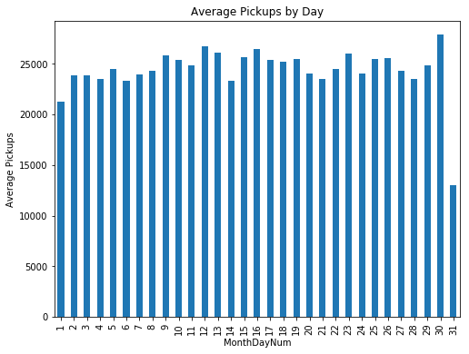
Average Pickups by Day (April)

Slide 6
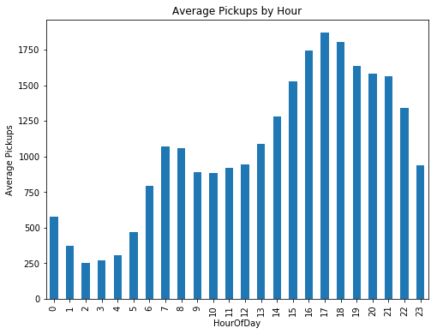
Average Pickups by Hour

Slide 7
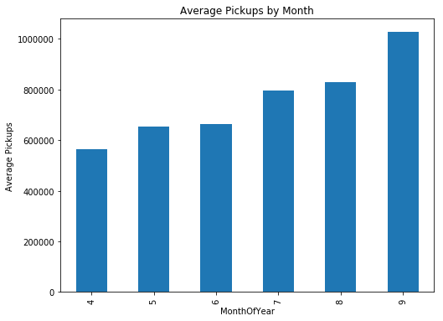
Average Pickups by Month

Slide 8
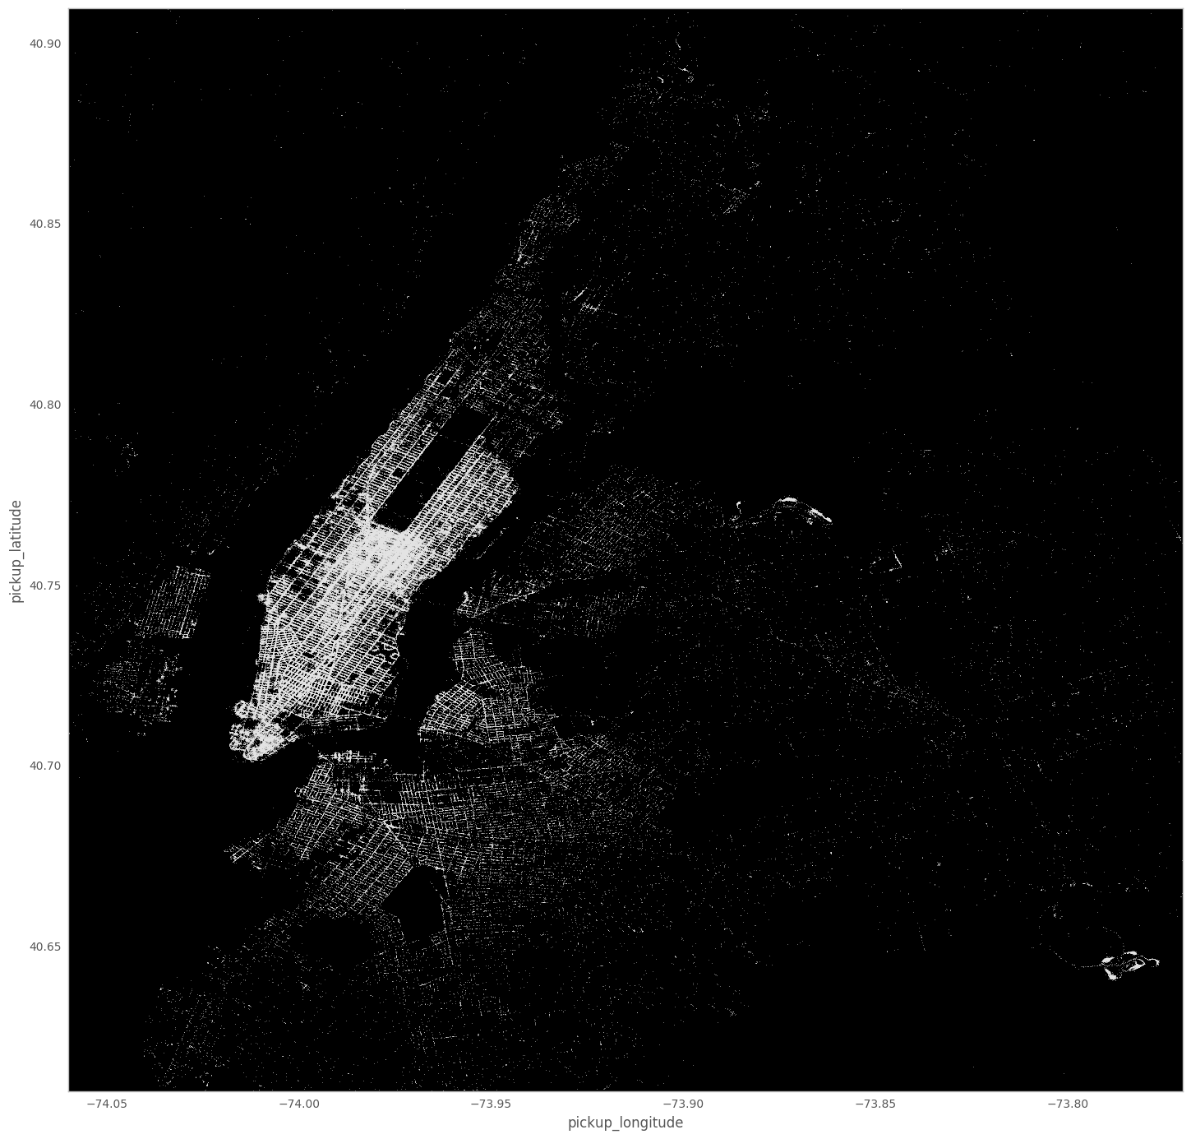

April
May

Slide 9

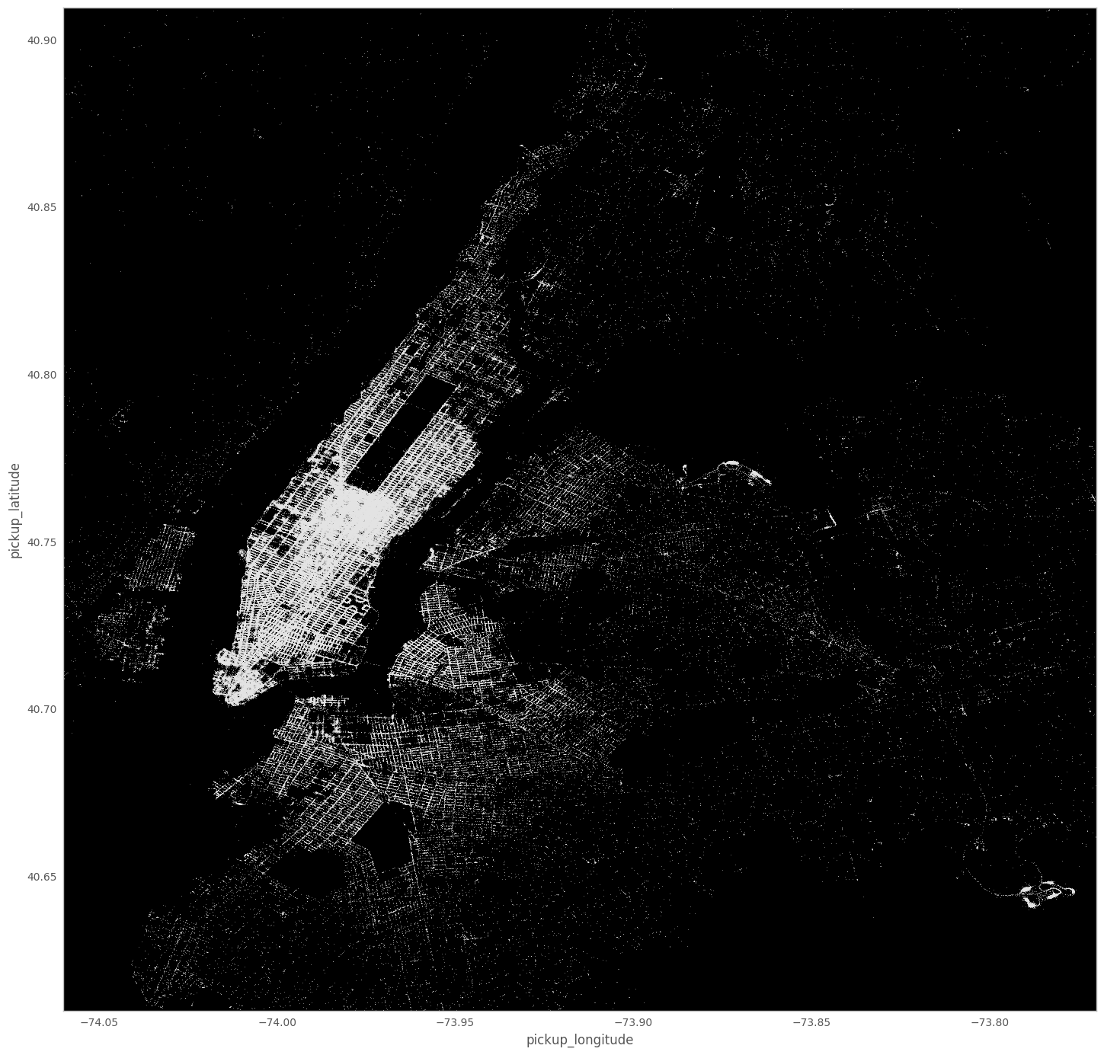
June
July

Slide 10


August
September

Slide 11
Density Plot of 4.5 million Pickups

Slide 12
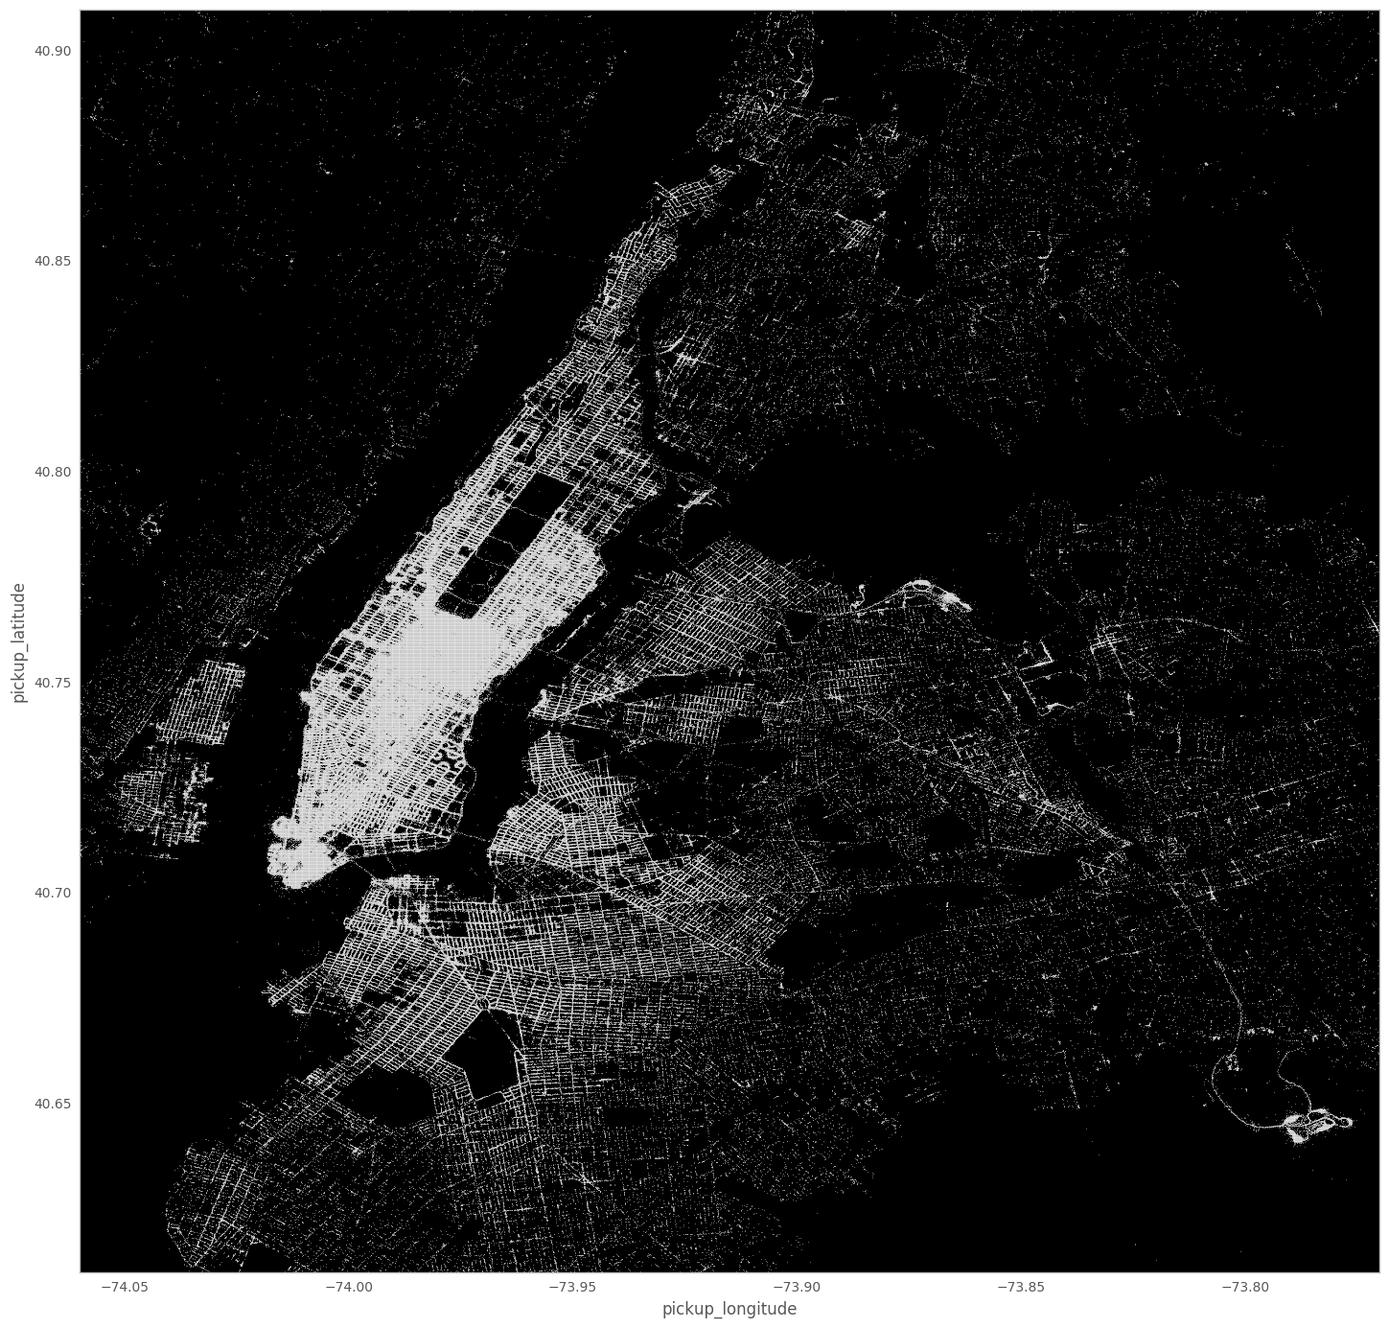
Complete Density plot for 6 months

Slide 13
Conclusions
We have sufficient data and it is continues in time
Geographic plot actually carves out the map of NYC on a black canvas so the data set covers New York cities with its outer boroughs
Plot of pickups over months suggest that monthly pickups are comparable and can be relatively analyzed to mine patterns

