Slide 1
Exploratory Data Analysis
Uber Mining
By:
Satya Akhil Chowdary Kuchipudi
Sanil Jain
Abhilash Mysore Somashekar
Ravi Raj Wani (no effort)

Slide 2
Pre-processing of raw data
Command to fetch the float values of lat, long, number of pick ups per lat - long

Slide 3
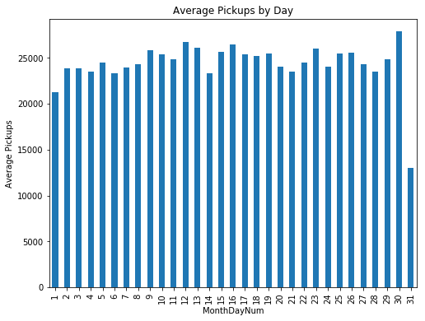
Average Pickups by Day

Slide 4
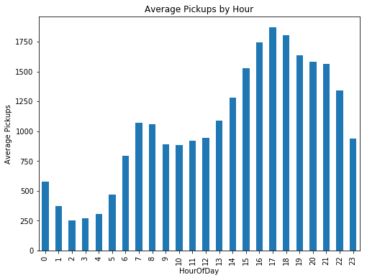
Average Pickups by Hour

Slide 5
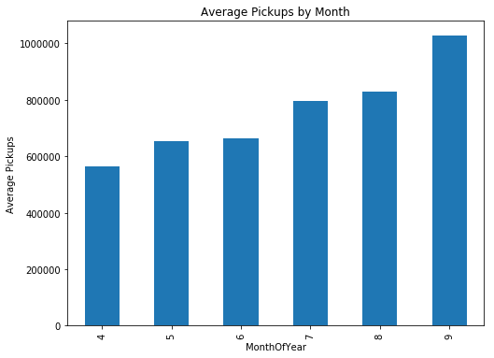
Average Pickups by Month

Slide 6
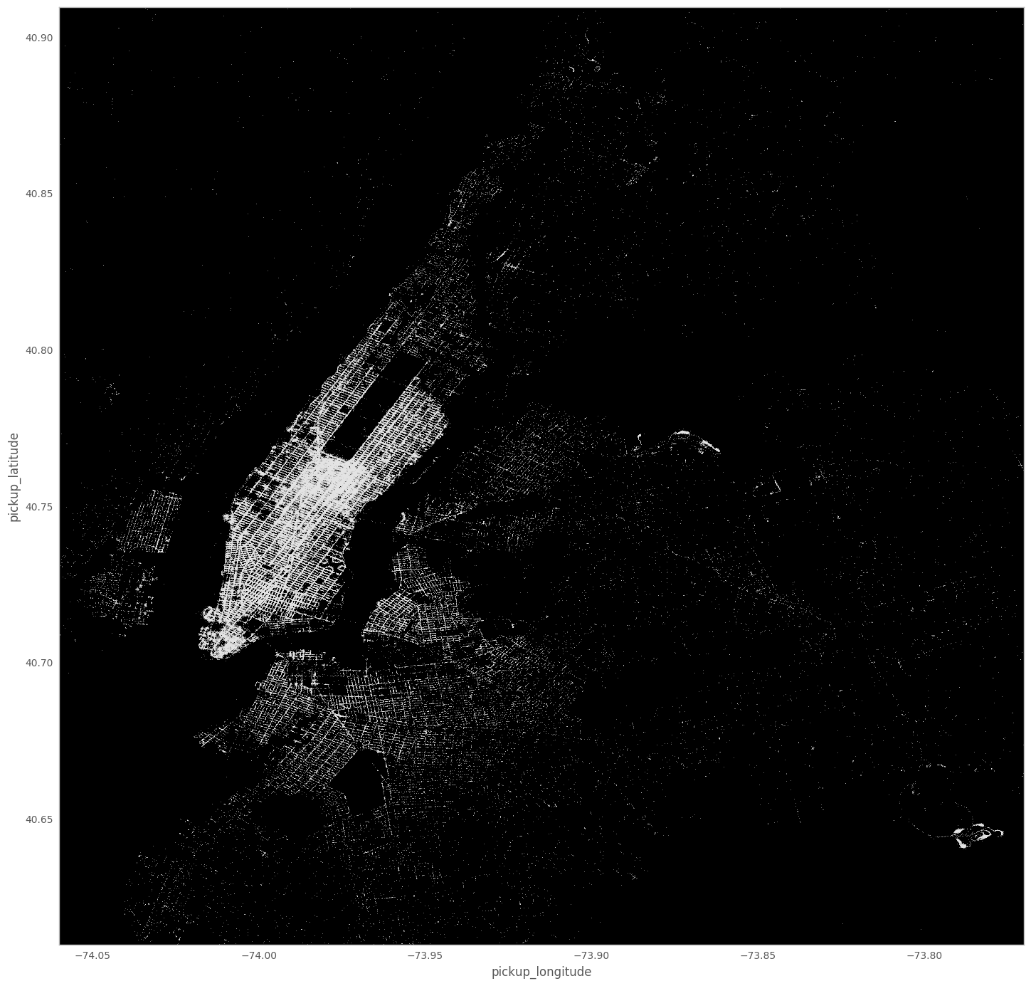

April
May

Slide 7

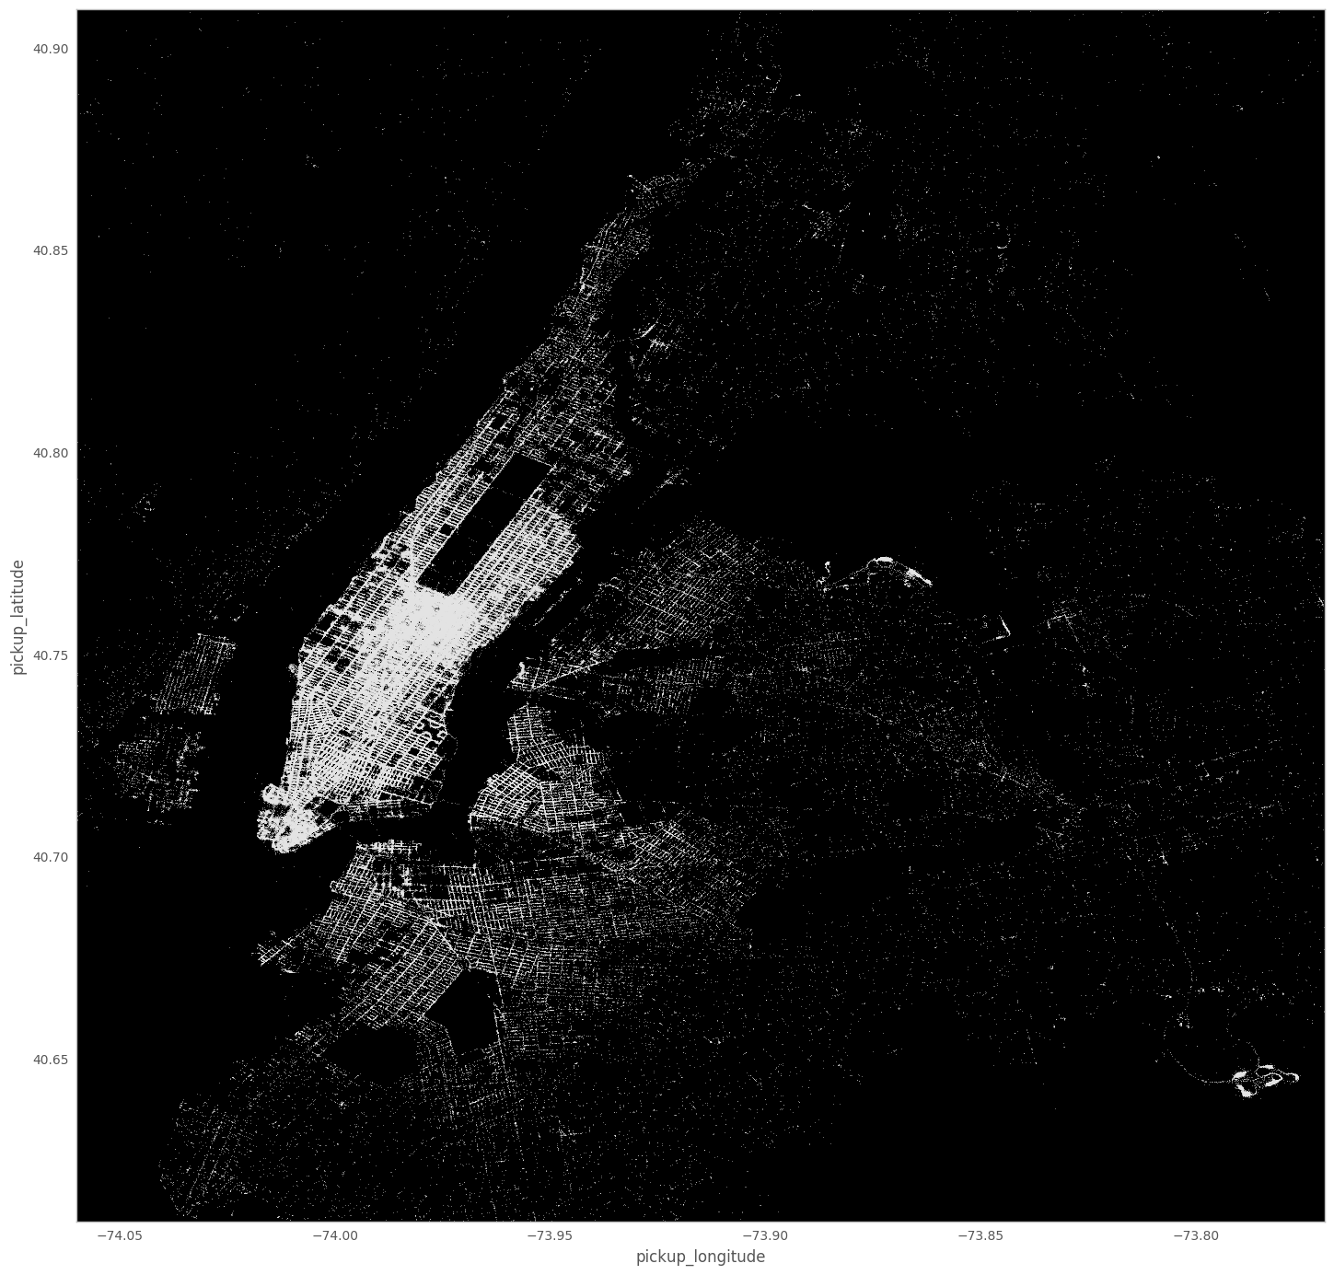
June
July

Slide 8


August
September

Slide 9
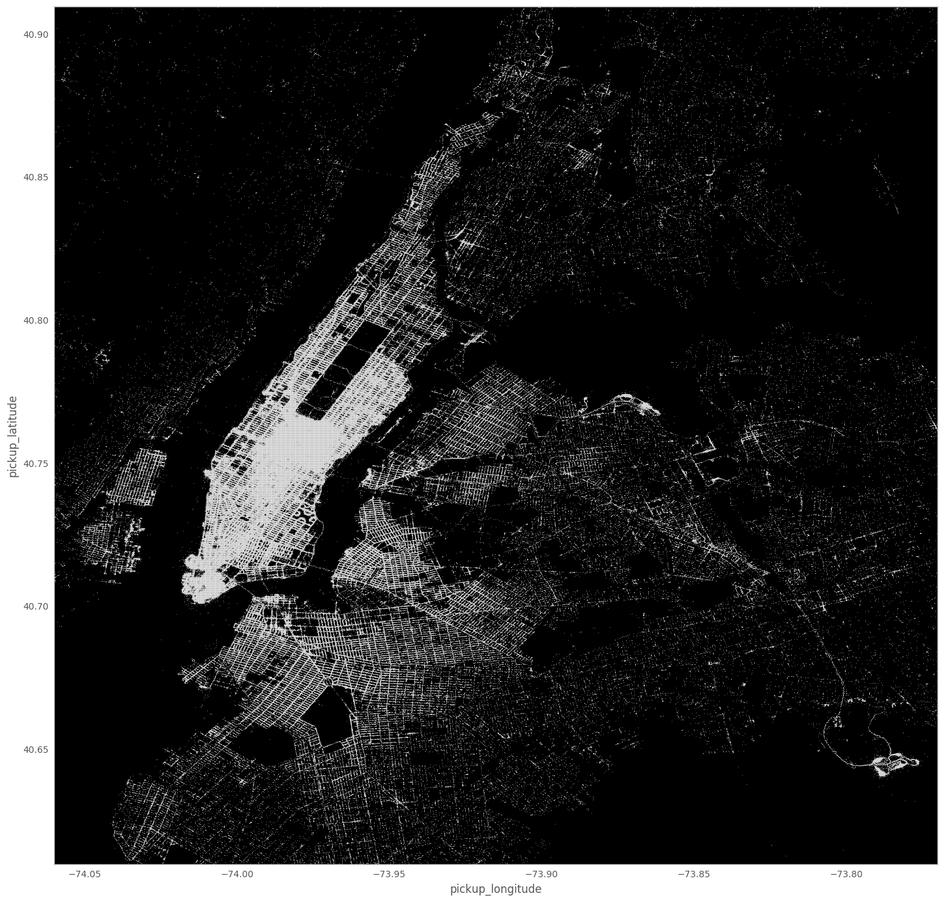
Complete Density plot for 6 months

