Slide 1

DEPARTMENT OF COMPUTER SCIENCE AND ENGINEERING
SOA PROJECT REVIEW – 2
SkillGrow – Student Skill Development & Progress Tracking Platform
PROJECT TEAM
P Akhil Kumar Reddy — 2420030496
G Rohan Chowdary — 2420030564
K. Sai Pranav Reddy — 2420030224
Guide: Venkateswari Ketineni
Course: SOA Programming and Microservices – (24SDCS03)
24 September 2026

Slide 2
Outline of Review–2 Work
01
Recap of Objectives
02
Work Completed So Far
What SkillGrow set out to build
Backend data layer implemented
03
Data Model & Entities
04
Layered Backend Architecture
User, Skill, Project, Certification
Controller → Service → Repository → MySQL
05
REST API Endpoints
06
Cross-Cutting Concerns
16 endpoints across 4 controllers
Validation, error handling, CORS
07
Progress vs. Plan
08
Next Steps – Phase 2
Status against the 12-week timeline
Auth, frontend, ML and deployment
A.Y. 2026–2027
SOA Programming and Microservices
Review–2 | 2

Slide 3
Recap & Progress Summary
Phase 1 of SkillGrow's development is complete: the core data model and REST API layer are implemented in Spring Boot and running against MySQL, giving the frontend and future ML service a working foundation to build on.
Data Layer
API Layer
Dev Environment
4 JPA entities (User, Skill, Project, Certification) with validated fields and mapped relationships.
16 REST endpoints across 4 controllers, backed by a service + repository layer and DTOs.
Spring Boot 3.3.4 on Java 17, Maven build, MySQL via Hibernate, CORS opened for the React client.
Next up: connect the React client to these APIs, add JWT-based auth, and begin the ML recommendation service.
A.Y. 2026–2027
SOA Programming and Microservices
Review–2 | 3

Slide 4
Objectives – Implementation Status
01
Unified Skill Tracking
Skill, Project and Certification entities record milestones, coursework and certifications for each user.
Done
02
Progress Monitoring
Skill carries a validated 0–100 progressPercent field; the visual dashboard consumes it next.
In Progress
03
Personalized Recommendations
Project/Skill data will feed the Python ML service planned for Phase 4.
Planned
04
Secure Role-Based Access
Role enum (STUDENT/MENTOR/ADMIN) is modelled; JWT authentication lands in Phase 2.
In Progress
05
Scalable Architecture
Controller–Service–Repository layering on Spring Boot + MySQL is live and ready to extend.
Done
A.Y. 2026–2027
SOA Programming and Microservices
Review–2 | 4

Slide 5
Data Model & Entities
Four JPA entities implemented in Phase 1 form the persistent core of the platform; all are mapped to MySQL via Hibernate.
Entity
Key Fields
Relationship
Purpose
User
fullName, email, password, role, createdAt
1 — * Skill / Project / Certification
Central account & role record
Skill
name, category, progressPercent (0–100), updatedAt
* — 1 User
Powers dashboard growth tracking
Project
title, description, techStack, repoUrl, createdAt
* — 1 User
Portfolio evidence & ML input signal
Certification
name, issuer, dateIssued, credentialUrl
* — 1 User
Verified external achievement record
A.Y. 2026–2027
SOA Programming and Microservices
Review–2 | 5

Slide 6
Layered Backend Architecture
LAYER
RESPONSIBILITY (IMPLEMENTED)
Controller (REST)
→
Routes HTTP requests, triggers @Valid bean validation on request DTOs.
Service
→
Holds business logic and maps between entities and DTOs.
Repository (Spring Data JPA)
→
Provides database access via typed repository interfaces.
Entity / MySQL
→
Persists data; schema auto-managed with ddl-auto=update.
Clean separation between layers means Phase 2 (JWT security) and Phase 4 (ML scoring) can be added without reworking the existing code.
A.Y. 2026–2027
SOA Programming and Microservices
Review–2 | 6

Slide 7
REST API & Cross-Cutting Concerns
Global Exception Handling
Bean Validation
CORS Configuration
@RestControllerAdvice returns structured JSON for 404 (not found), 400 (bad request) and field-level validation errors.
@NotBlank, @Email, @Min/@Max on request DTOs reject bad input before it reaches business logic.
The React dev server origin (localhost:3000) is explicitly allowed with credentials for cross-origin calls.
IMPLEMENTED ENDPOINTS — 16 ACROSS 4 CONTROLLERS
Users
POST / GET / GET {id} / DELETE {id}
/api/users
Skills
POST / GET / PATCH progress / DELETE
/api/users/{userId}/skills
Projects
POST / GET / DELETE
/api/users/{userId}/projects
Certifications
POST / GET / DELETE
/api/users/{userId}/certifications
A.Y. 2026–2027
SOA Programming and Microservices
Review–2 | 7

Slide 8
Progress vs. Plan & Next Steps
The backend data and API layer was prioritized ahead of the original schedule so frontend and ML work have a stable foundation to build on.
Requirements & Design
W1 – W2
Done
Spring Boot + REST APIs (Data Layer)
W3 – W4
Done
React Frontend
W5 – W6
In Progress
Python ML Recommendations
W7 – W8
Planned
Integration & Testing
W9 – W10
Planned
Docker + Evaluation
W11 – W12
Planned
NEXT STEPS — PHASE 2
JWT Auth & Security
React Frontend Integration
ML Recommendation Service
Docker & Deployment
A.Y. 2026–2027
SOA Programming and Microservices
Review–2 | 8

Slide 9
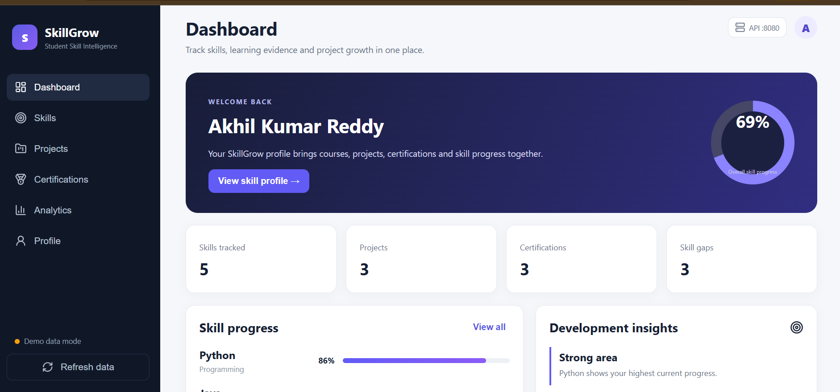

Slide 10
