Slide 1

LOGINSIGHT AI
AI-Powered Enterprise
Log Analysis
Gemini 3.1 Flash Lite + Model Context Protocol
An autonomous log intelligence layer that parses, detects, predicts, and converts enterprise noise into a ranked action plan.
Team Details:
Shaik Mohammad AP23110011178
Akhil Babu AP23110011185
Abhiram AP23110011166
Krishna Chaitanya AP23110010966
01
/ 10
Notes:
Title: LogInsight AI Subtitle: AI-Powered Enterprise Log Analysis. Gemini 3.1 Flash Lite. Model Context Protocol. Stats: 5 ML Engines, 4 Parsers, 6 Compliance Standards, Python 3.10+.

Slide 2








PROBLEM AND SOLUTION
From log chaos to autonomous intelligence
A single pipeline replaces fragmented search, manual triage, and disconnected compliance checks.
Problem
Solution
One-click upload
Millions of daily lines
AI runs a complete 5-step pipeline from raw logs to final report.
Manual analysis misses cascading failures and weak early signals.
Agentic orchestration
AI
The LLM decides what to analyze and in what order.
Search is not reasoning
grep and ELK retrieve matches, but do not infer root cause or predict next impact.
Independent engines
Five ML/DL/rule engines avoid a single point of failure.
Tool fragmentation
Parsing, detection, prediction, and compliance live in separate workflows.
Actionable outputs
Root cause, severity, trends, compliance score, and fix list.
02
/ 10
Notes:
Problem: Millions of daily log lines, manual analysis misses cascading failures. grep and ELK search but do not reason: no root cause, no prediction. No single tool unifies parsing, detection, prediction, and compliance. Solution: One-click upload triggers an AI-run 5-step pipeline. LLM chooses what to analyze and in what order. Five independent engines reduce single-point failure. Auto-generates root cause, severity, trends, compliance score, and fix list.

Slide 3

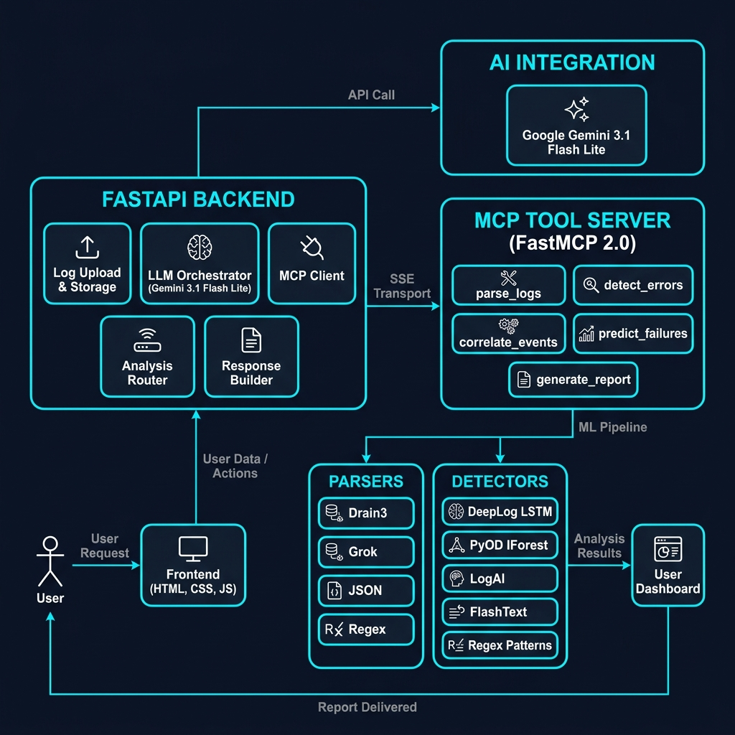
SYSTEM OVERVIEW
Three-tier architecture with an MCP intelligence layer
Two servers: FastAPI on 8000 and MCP tool server on 8001. Frontend static files are served from FastAPI.
03
/ 10
Notes:
Data flow: User -> Frontend SPA (port 8000) -> REST API -> FastAPI Backend (Pydantic v2 schemas) -> Google GenAI function calling -> Gemini 3.1 Flash Lite -> MCP Protocol over SSE -> MCP Tool Server on port 8001 using FastMCP 2.0 -> 5 tools -> parsers, detectors, ML engines -> Gemini synthesis -> AI Report -> User. Three tiers: Presentation, Application, Intelligence. Two servers: Backend on 8000, MCP on 8001. Frontend served as static files from FastAPI.

Slide 4







MCP IMPLEMENTATION
A clean protocol boundary between the LLM and tools
Anthropic's MCP works like USB-C for AI: one standard channel lets any model connect to any tool server.
What MCP gives us
Server side
Client side
mcp_server/server.py on port 8001
backend/services/mcp_client.py
FastMCP("LogInsightMCP")
Official SDK sse_client session
Decoupled tools, independent scaling, testable modules, and a protocol that can move off-machine without changing the AI brain.
5 tools registered with @mcp.tool()
Per-call connect, invoke, disconnect
Each tool returns JSON through SSE
Startup health warning, backend still runs
Open standard
SSE transport
Gemini
Orchestrator
MCP Client
Tool
Gemini
function_call
injects full log
SSE call
5 detectors
next step/report
JSON tools
Swappable
04
/ 10
Notes:
What is MCP? Open standard by Anthropic for LLM-to-tool communication. Like USB-C for AI: one protocol connects any LLM to any tool server. Server side: mcp_server/server.py on port 8001. Initialized with FastMCP("LogInsightMCP") from fastmcp library. Five tools are registered using @mcp.tool(); each wraps a dedicated analysis module. Each accepts log_content and config params, then returns JSON string. Runs standalone with mcp.run(transport="sse"). Client side: backend/services/mcp_client.py. MCPClient connects with from mcp.client.sse import sse_client. Per-call session connects to http://127.0.0.1:8001/sse, initializes, calls tool, parses text content block, and returns dict. Health check logs warning if unreachable, while backend still starts. Tool flow: Gemini returns function_call; LLMOrchestrator intercepts; full original log_content is injected; MCPClient.call_tool routes over SSE; MCP server executes tool; results return to Gemini for the next iteration. Architecture reason: tools are decoupled. Any tool can be swapped, scaled, or tested independently without touching AI logic.

Slide 5


GEMINI AGENTIC INTELLIGENCE
The AI brain chooses the analysis path
Gemini sees the tool schemas, calls tools autonomously, and synthesizes the final report after iterative evidence gathering.
Orchestration Loop
Design Decisions
1
2
Backend sends logs + system prompt to Gemini
Temperature
1
0.3 — deterministic, factual
Gemini sees 5 tool declarations (function schemas)
2
Log Injection
3
Full original always injected
Gemini autonomously decides which tool to call
4
Context Cap
Backend intercepts → routes to MCP Server → result
50K chars per tool result
5
3 Modes
6
4
Result fed back → Gemini decides next tool
Full AI · Parse-only · Detect-only
6
Repeats until all tools called (max 8 iterations)
Output
7
System prompt enforces structure
Gemini synthesizes → 9-section AI report
05
/ 10
Notes:
Gemini orchestration flow: Backend sends log content and system prompt to Gemini 3.1 Flash Lite. Gemini sees five tool declarations as function schemas and autonomously chooses which tool to call first. Backend intercepts each function call, routes it to MCP server, gets the result, feeds it back, and lets Gemini choose the next tool. Repeats until all tools are called, with max 8 iterations. Report sections: Log Overview, Key Findings, Error Analysis, Anomaly Detection, Event Correlation, Predictive Analysis, Compliance, Recommended Actions, Health Assessment. Design decisions: temperature 0.3, full original log injected, tool results capped at 50K chars, three modes: full, parse, detect, and structured output enforced by system prompt.

Slide 6
MULTI-ENGINE INTELLIGENCE
Four parsers + five detectors
Independent engines reduce blind spots, deduplicate evidence, merge severity, and classify health from CRITICAL to HEALTHY.
4 PARSERS (parse_logs)
5 DETECTORS (detect_errors)
Drain3
Template mining · clusters messages · masks IPs/paths/timestamps
Salesforce LogAI
ML
Drain + Isolation Forest anomaly scoring
Grok (PyGrok)
Logstash-style field extraction for 6 log formats
DeepLog LSTM
Deep Learning
2-layer LSTM predicts next template
JSON
NDJSON parsing with 10+ field alias normalization
PyOD IForest
Statistical
7-feature vector → Isolation Forest
Regex
Fallback — timestamps (6 formats), levels (12 types), components
FlashText
Keyword
Aho-Corasick O(n), 50+ keywords, 5 tiers
Regex Patterns
Rule-Based
11 compiled: HTTP, disk, memory, auth, SSL
06
/ 10
Notes:
4 parsers run by parse_logs: Drain3: template mining, clusters messages, masks IPs, paths, timestamps. Grok/PyGrok: Logstash-style extraction for six log formats. JSON: NDJSON parsing with 10+ field alias normalization. Regex: fallback parser for six timestamp formats, twelve level types, and components. 5 detectors run by detect_errors: Salesforce LogAI: Drain parsing plus Isolation Forest anomaly scoring. DeepLog LSTM: two-layer LSTM predicts next template and flags deviations. PyOD IForest: seven-feature vector per line through Isolation Forest. FlashText: Aho-Corasick O(n) scan with 50+ keywords and five severity tiers. Regex Patterns: eleven compiled patterns for exceptions, HTTP, disk, memory, auth, SSL. Aggregation: all five run independently, error lines are deduplicated, severity is merged, and health is assessed from CRITICAL to HEALTHY.

Slide 7

COMPLIANCE AND SECURITY ENGINE
Risk scoring built into the analysis pipeline
PII detection, security rule checks, audit trail validation, and standards-aligned fix recommendations.
Security rules
Unencrypted protocols
SOC2 / HIPAA
http, ftp, telnet
Auth failure bursts
SOC2
>=5 failed passwords
PII detection
Privilege escalation
ISO27001
sudo, root, admin
Certificate errors
PCI-DSS
expired or invalid SSL/TLS
Email
IPv4
Debug data exposure
OWASP
stack traces in production
SSN
Cards
Phone
API Keys
Service accounts
SOC2
failed system identity actions
Audit trail: session IDs + user identity + timestamps + action types
07
/ 10
Notes:
PII detection covers six patterns: email, IPv4, SSN, credit cards, phone, API keys. Security rules: Unencrypted protocols for SOC2/HIPAA, catches http, ftp, telnet. Auth failure bursts for SOC2, catches five or more failed passwords as brute force. Privilege escalation for ISO27001, catches sudo, root, admin events. Certificate errors for PCI-DSS, catches expired or invalid SSL/TLS. Debug data exposure for OWASP, catches production stack traces. Service account issues for SOC2, catches failed system identity actions. Audit trail checks: session IDs, user identity, timestamps, action types. Scoring: passed over total times 100 minus severity penalty, then grade A/B/C/F with fix recommendations per violation.

Slide 8




TECH STACK
A compact, production-ready Python AI system
16 packages, about 2500 LOC, 25 source files, and Python 3.10+.
Frontend
Vanilla JS, HTML, CSS, Vanta.js, AOS, Typed.js
Backend
FastAPI, Uvicorn, Pydantic v2, aiofiles
AI / LLM
Google Gemini 3.1 Flash Lite, google-genai SDK
Protocol
MCP, FastMCP 2.0, SSE transport
Parsing
Drain3, PyGrok
Detection
PyTorch LSTM, PyOD, scikit-learn, LogAI, FlashText
Python
08
/ 10
Notes:
Tech stack: Frontend: Vanilla JS, HTML, CSS, Vanta.js, AOS, Typed.js. Backend: FastAPI, Uvicorn, Pydantic v2, aiofiles. AI/LLM: Google Gemini 3.1 Flash Lite using google-genai SDK. Protocol: MCP plus FastMCP 2.0 and SSE transport. Parsing: Drain3, PyGrok. Detection: PyTorch LSTM, PyOD, scikit-learn, LogAI, FlashText. Data: NumPy, Pandas. Project size: 16 packages, about 2500 LOC, 25 source files, Python 3.10+.

Slide 9
RESULTS AND CAPABILITIES
A complete enterprise log analysis command center
The final report surfaces root cause, line numbers, severity ranking, failure chains, trend direction, compliance grade, and a numbered fix list.
7
log formats
5
engines
6
standards
Syslog, Apache x2, HDFS, Zookeeper, JSON, Generic
ML + DL + statistical + keyword + rule
SOC2, HIPAA, PCI-DSS, ISO27001, OWASP, GDPR
3
modes
comparison
10MB
max file
Full AI, parse-only, detect-only
2-up
Side-by-side before/after deployment analysis
Up to 5000 lines per upload
AI report delivers
Root cause with line numbers
Severity ranking
Cascading failure chains
Error trend direction
Compliance grade
Numbered fix list
09
/ 10
Notes:
Capabilities: Log formats: seven - Syslog, Apache access/error, HDFS, Zookeeper, JSON, Generic. Detection engines: five - ML, DL, statistical, keyword, rule. Compliance standards: six - SOC2, HIPAA, PCI-DSS, ISO27001, OWASP, GDPR. Analysis modes: three - Full AI, parse-only, detect-only. Comparison: side-by-side before/after deployment analysis. Max file size: 10 MB / 5000 lines. AI report delivers root cause with line numbers, severity ranking, cascading failure chains, error trend direction, compliance grade, and a numbered fix list.

Slide 10



Future scope
From batch analysis
to real-time
observability AI
Roadmap
Real-time log streaming
WebSocket
Cross-service correlation
multi-file
Custom rule builder
security + ops
Historical dashboard
trend insight
PDF/JSON export
alerts
Thank you
LogInsight AI
10
/ 10
Notes:
Future enhancements: Real-time log streaming using WebSocket. Multi-file cross-service correlation. Custom detection rule builder. Historical trend dashboard. PDF/JSON export and alerting. Thank you.

