Slide 1

An android app for Sentiment Analysis in Twitter
Source Code: https://github.com/vivek-singh-rathore/Ricerca
RICERCA
Developed by:TECH ARMY
Rohit Sharma (frontend Developer)
Vivek Singh Rathore (backend Developer)
Akhil Chandail (frontend Developer)
Parush Gupta (backend Developer)
Institute: Model Institute of Engineering and Technology ,Jammu

Slide 2
Problem Statement
Help me with my Mood- With Social-media Health Analysis and Display Engine (SHADE):
With the advances in technology about sentiment analysis and predictive analytics, it has opened many avenues for researchers and enterprises to understand human mental state better. The proposed challenge is to know the
emotion/mood of a person, to help in eliminating any negative state of mind that might have adverse effect on his/her daily life.

Slide 3
Our Solution: Ricerca
An android app that will:
Get a person’s social tweets for a duration from tweets.
Perform sentiment analysis using IBM Watson on the content of tweet which does classification of a given text in the document,sentence or phrase
Display the person name and determine his/her most prominent sentiment(joy,sadness,anger or fear) expressed in the tweet.
Boosts or calm down the mood of the person by suggesting some curated playlist of songs.

Slide 4
What is Sentiment Analysis?
It is classification of the polarity of a given text in the document, sentence or phrase
The goal is to determine the most prominent sentiment expressed in the text.

Slide 5
Sadness
Joy
happy

Slide 6
SCOPE OF WORK:
Microblogging has become popular communication tool
Opinion of the mass is important
Political party may want to know whether people support their program or not.
Before investing into a company, one can leverage the sentiment of the people for the company to find out where it stands.
A company might want find out the reviews of its products

Slide 7
Why Twitter for Sentiment Analysis:
Popular microblogging site
Short Text Messages of 140 characters
240+ million active users
500 million tweets are generated everyday
Twitter audience varies from common man to celebrities
Users often discuss current affairs and share personal views on various subjects
Tweets are small in length and hence unambiguous

Slide 8
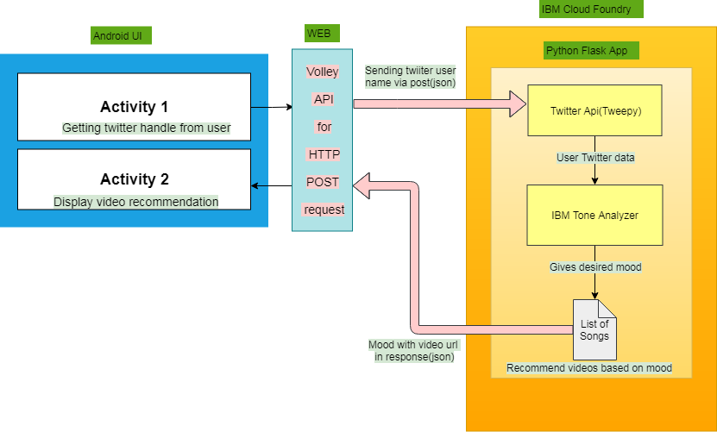
ARCHITECTURE DIAGRAM

Slide 9
Approach
1. Validation of twitter user handle:
sent via http post request using android volley API to python flask running on IBM cloud foundry.
2. Fetching tweets:
using Twitter API (tweepy) for past 24 hrs tweets.
3. Classification of content:
determine most prominent sentiment expressed in the text by using tone analyzer API.
determines four emotional tones (joy, fear, anger, joy).
In case, no emotional tone is detected;the default tone is ‘JOY’
4. Recommendation:
recommending youtube songs in response to emotional sentiment sent back to android app as response in json format.

Slide 10
TECHNOLOGIES & APIs used:
IBM Watson (Tone Analyzer API)
Android Studio (App development framework)
tweepy (twitter’s API)
flask (python’s microframework)
android volley API
THANK YOU

