Slide 1


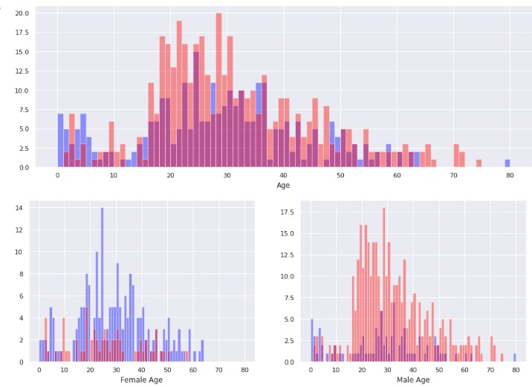
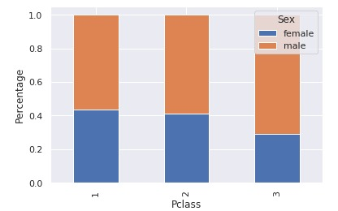
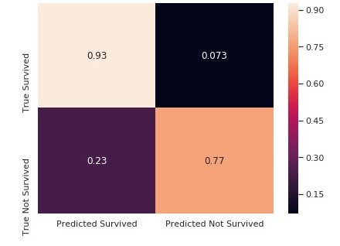
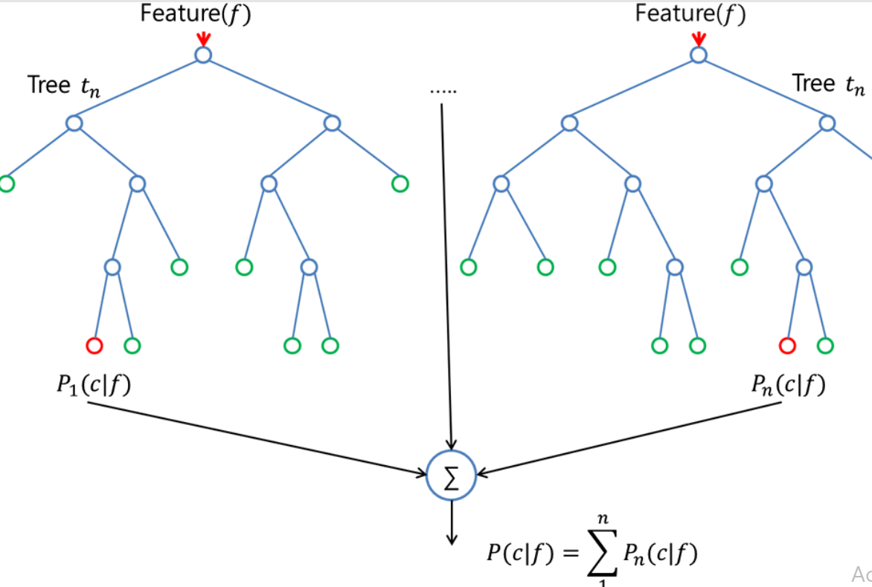
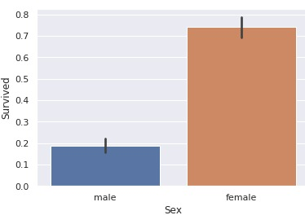
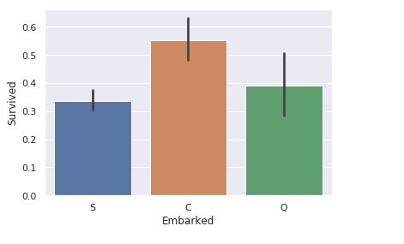

Predicting Survival on Titanic Disaster
Akhil Chandail, Namitha Mariyam George,
Shibin Varghese, Yash Chaudhary
Ms.Shambhavi, Ms.Surbhi
Abstract
This project is about predicting survivors of Titanic disaster using different machine-learning and feature engineering techniques.
The objective is to explore unknown information by applying exploratory data analytics on available dataset to determine the correlation between factors to find how many survived. After the results of applying, machine-learning models are compared on the basis of their accuracy.
Introduction
With a dataset of 891 individuals containing features like sex, age, cabin,etc, we attempt to predict the survival of 418 individuals [1]. Correlations between various features are created. We apply five machine learning models which are DenseNet model, SVM, Logisitic Regression, Random Forest and Decision Tree.
Proposed Method
Fig 4. Comparison of survivors from different age groups
Random forest algorithm is supervised classification algorithm which can be used for both classification and regression problems. The algorithm basically makes forest with large number of trees [2]. The accuracy of result can be improved by increasing the number of trees in the forest. Final prediction is a function (mean) of each prediction.
Fig 5. Comparison of male and female survivors
Fig 6. Confusion Matrix
By preprocessing we created a new dataset containing 8 feature columns of 891 passengers. Five machine-learning models are applied Algorithms are evaluated according to accuracy and Kaggle score.
TABLE. COMPARISON OF ACCURACY AND KAGGLE SCORES OF ALGORITHMS
Fig 1. Random Forest algorithm
Algorithm | Accuracy | Kaggle Score
Random Forest | 0.86 | 0.81
SVM | 0.83 | 0.78
Decision Tree | 0.86 | 0.79
Logistic Regression | 0.84 | 0.79
DenseNet | 0.85 | 0.80
Experimental Results and Discussion
In preprocessing, PassengerId, Name and Ticket features are removed. Passengers are grouped by different ranges of fare and age. Missing fields are replaced by median value of specific group of that feature [3].
Conclusions
Different models are applied which can predict the survival of passengers but the highest Kaggle score (0.81) is obtained with Random Forest.
References
[1] Kaggle, Titanic: Machine Learning form Disaster [Online].
Available: http://www.kaggle.com/
[2] L.Breiman, “Random Forests”, Machine Learning, vol.45, pp.5-32, 2001
[3] Vyas, KE., Zheng, Z. and Lil, “Titanic-Machine Learning From Disaster” , pp.6, 2015.
Fig 2. Comparison of male and female survivors
Fig 3. Survivors from different ports
Team No. - X

