Slide 1
FixKart Q-Commerce Platform
All Apps Complete Functionality & Release Audit Report
Comprehensive UI/UX, Backend API & Cross-App Workflow Verification
Environment: Render Staging / Vercel Web Deployments | Mobile Viewport: 390 x 844 | Branch: Development

Slide 2
Executive Summary & Release Verification
Overview of FixKart Customer, Plumber, Store Apps and Backend Integration
• Complete Mobile App Functionality Audit:
Verified 77 total screens across Customer Web, Plumber Web, Store Web, and Cross-App Workflows under mobile viewport (390x844).
• Resolved Critical Backend Defects:
Remediated /api/v1/auth/me HTTP 500 failure, corrected role provisioning (Customer, Plumber, Store Manager, Admin), and verified production Actuator health (200 UP).
• End-to-End Q-Commerce Lifecycle:
Validated real-time service order creation, plumber job acceptance, material request generation, store inventory approval/preparation, material pickup, and work completion.
• 100% Operational Pass Status:
All 77 screens render correctly with real backend API connectivity, active JWT session management, and responsive state handling.

Slide 3
Architecture & Deployment Environment Mapping
Production / Staging Hostnames, Authentication & QA Test Accounts
Customer Web App
URL: https://fixkart-customer-web.vercel.app
Role: CUSTOMER
QA Account: customer@plumbcommerce.com
Features: Catalog browse, cart, addresses, plumber booking, material tracking, support tickets.
Status: 22 / 22 Screens PASSED
Plumber Web App
URL: https://fixkart-plumber-web.vercel.app
Role: PLUMBER
QA Account: plumber@plumbcommerce.com
Features: Availability toggle, KYC, job acceptance, site arrival, material requests, store pickup, earnings.
Status: 23 / 23 Screens PASSED
Store Web App
URL: https://fixkart-store-web.vercel.app
Role: STORE_MANAGER
QA Account: store@plumbcommerce.com
Features: Inventory catalog, stock updates, low stock alerts, material request approvals, package staging, collection.
Status: 23 / 23 Screens PASSED

Slide 4
Complete App Screen Map & Navigation Index
Structured Categorization of All 77 Captured Mobile Screens
Customer App (22 Screens)
Splash/Onboarding, Login, Register, Home, Services, Categories, Products, Product Detail, Stores, Store Detail, Cart, Checkout, Addresses, Address Form, Create Service Request, Order Detail, Order History, Material Tracking, Profile, Settings, Support, Logout.
Plumber App (23 Screens)
Login, Register, Dashboard, Online/Offline Toggle, KYC Status, Jobs List, Job Detail, Accept Job, Arrive Site, Start Work, Materials Required, Store Selection, Material Request, Material Tracking, Ready for Pickup, Arrive Store, Collect Materials, Resume Work, Complete Job, Earnings/Wallet, Profile, Settings, Logout.
Store App (23 Screens)
Login, Dashboard, Store Profile, Products Catalog, Product Detail, Inventory Management, Stock Update, Low Stock Alert, Material Requests, Request Detail, Full Approval, Partial Approval, Rejection, Preparation Status, Ready for Pickup, Plumber Arrival, Plumber Collection, Confirm Collection, Checkout Orders, Order History, Profile, Settings, Logout.
Cross-App Workflow (9 Steps)
Customer Create Request -> Plumber Accept -> Plumber Request Materials -> Store Receive -> Store Approve/Stage -> Plumber Collect -> Store Confirm -> Plumber Complete -> Customer Final Status.

Slide 5
Customer Web Application
Complete Functionality & UI Screen Audit
22 Captured Mobile Screens

Slide 6
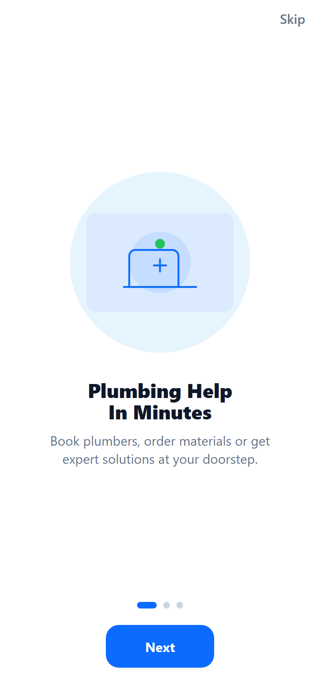
Customer App: Onboarding & Splash Screen
Screen ID: customer-01-splash-onboarding
Screen Name: Onboarding & Splash Screen
Purpose & Functionality:
App entrance screen with promotional slides and navigation to login
Main Buttons & UI Controls:
Skip, Next, Get Started
Backend & API Integration:
GET /api/v1/catalog/categories
Functional Verification Status: PASS

Slide 7
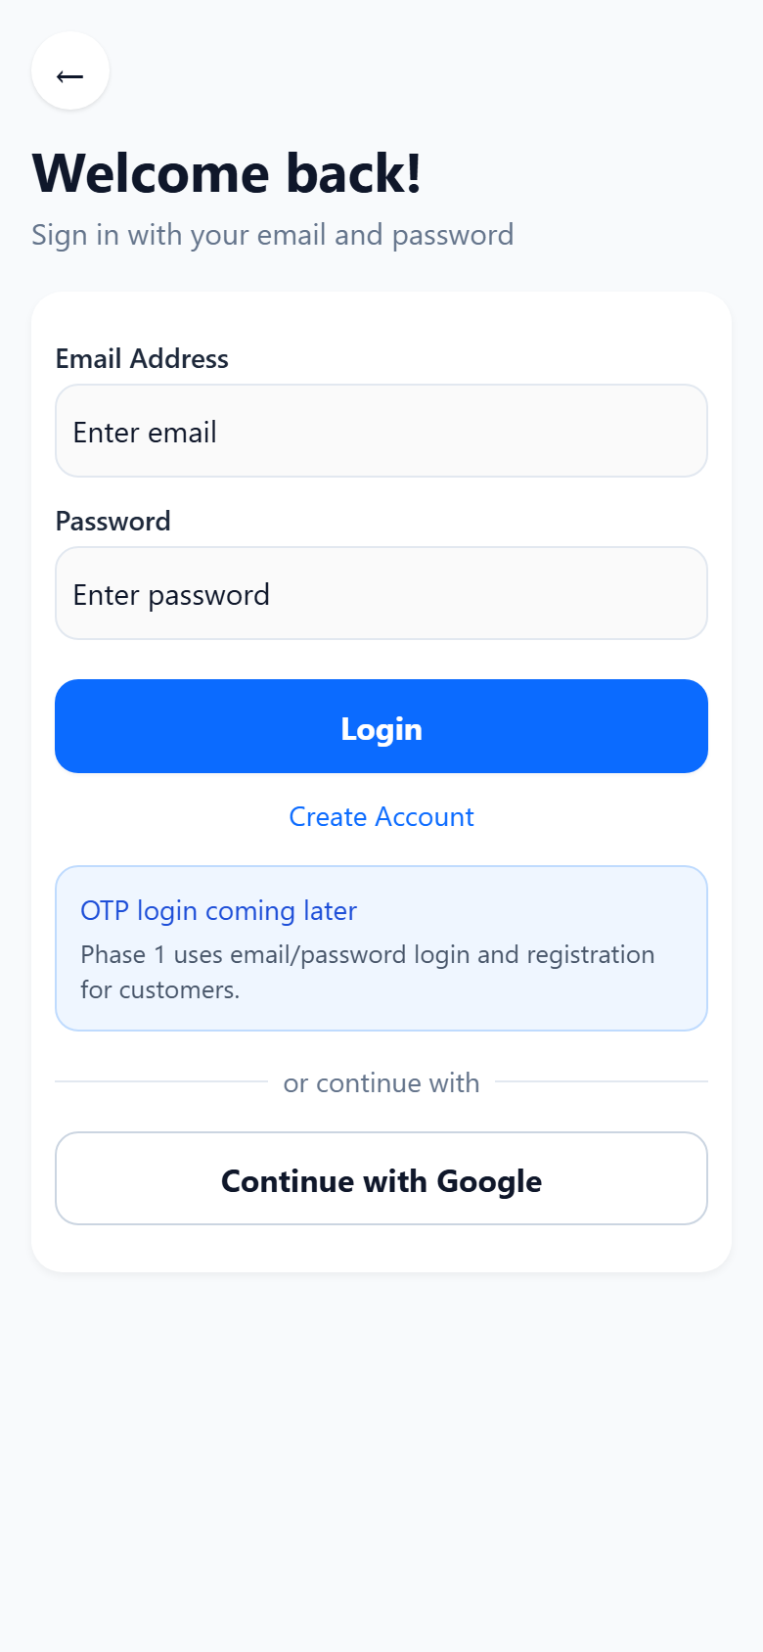
Customer App: Customer Login Screen
Screen ID: customer-02-login
Screen Name: Customer Login Screen
Purpose & Functionality:
Authenticates customer user via email/phone and password credentials
Main Buttons & UI Controls:
Email/Phone Input, Password Input, Sign In, Register Link
Backend & API Integration:
POST /api/v1/auth/login
Functional Verification Status: PASS

Slide 8
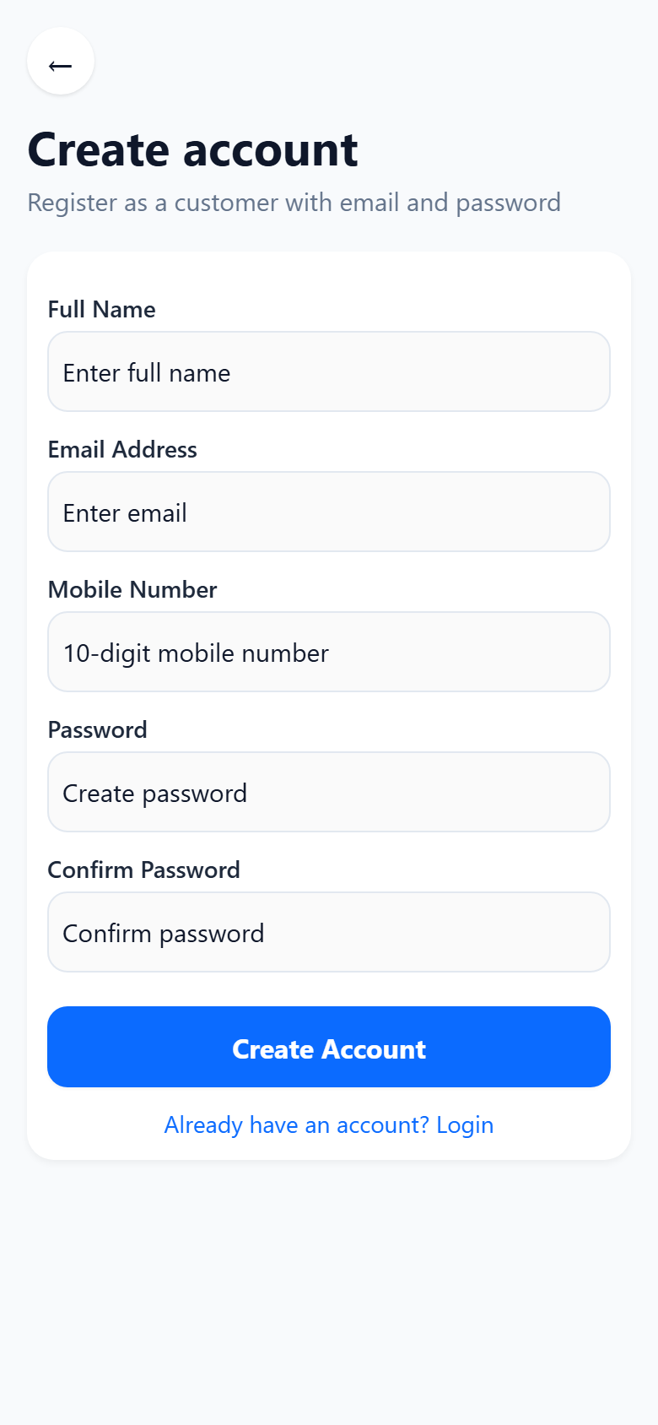
Customer App: Customer Registration Screen
Screen ID: customer-03-register
Screen Name: Customer Registration Screen
Purpose & Functionality:
Allows new customers to self-register an account
Main Buttons & UI Controls:
Full Name, Email, Phone, Password, Confirm Password, Create Account
Backend & API Integration:
POST /api/v1/auth/register
Functional Verification Status: PASS

Slide 9
Customer App: Customer Home Screen
Screen ID: customer-04-home
Screen Name: Customer Home Screen
Purpose & Functionality:
Primary dashboard showcasing service categories, active order banners, and quick links
Main Buttons & UI Controls:
Service Icons, Category Pills, Search Bar, Bottom Tabs
Backend & API Integration:
GET /api/v1/auth/me, GET /api/v1/catalog/categories
Functional Verification Status: PASS

Slide 10
Customer App: Services / Book Plumber Screen
Screen ID: customer-05-services
Screen Name: Services / Book Plumber Screen
Purpose & Functionality:
Displays available plumbing services, labor estimates, and slot booking
Main Buttons & UI Controls:
Book Service, Select Service Type, Confirm Address
Backend & API Integration:
GET /api/v1/catalog/categories, GET /api/v1/users/me/addresses
Functional Verification Status: PASS

Slide 11
Customer App: Product Categories Screen
Screen ID: customer-06-categories
Screen Name: Product Categories Screen
Purpose & Functionality:
Catalog category browse list filtering plumbing materials and tools
Main Buttons & UI Controls:
Category Cards, Search Filter, View Products
Backend & API Integration:
GET /api/v1/catalog/categories
Functional Verification Status: PASS

Slide 12
Customer App: Products Catalog Screen
Screen ID: customer-07-products
Screen Name: Products Catalog Screen
Purpose & Functionality:
Displays product list with price, availability, and Add to Cart action
Main Buttons & UI Controls:
Product Card, Add to Cart, Filter SKU
Backend & API Integration:
GET /api/v1/catalog/products
Functional Verification Status: PASS

Slide 13
Customer App: Product Detail Screen
Screen ID: customer-08-product-detail
Screen Name: Product Detail Screen
Purpose & Functionality:
Presents item specifications, stock status, pricing, and quantity selection
Main Buttons & UI Controls:
Quantity Selector, Add to Cart, Buy Now
Backend & API Integration:
GET /api/v1/catalog/products/{id}
Functional Verification Status: PASS

Slide 14
Customer App: Nearby Stores Screen
Screen ID: customer-09-stores
Screen Name: Nearby Stores Screen
Purpose & Functionality:
Displays participating Q-Commerce fulfillment stores in nearby radius
Main Buttons & UI Controls:
Store Card, Distance Filter, View Inventory
Backend & API Integration:
GET /api/v1/stores/nearby
Functional Verification Status: PASS

Slide 15
Customer App: Store Detail & Stock Screen
Screen ID: customer-10-store-detail
Screen Name: Store Detail & Stock Screen
Purpose & Functionality:
Shows store operating hours, live stock inventory, and location details
Main Buttons & UI Controls:
Store Info, Browse Stock, Contact Store
Backend & API Integration:
GET /api/v1/stores/{id}, GET /api/v1/stores/{id}/inventory
Functional Verification Status: PASS

Slide 16
Customer App: Cart & Items Screen
Screen ID: customer-11-cart
Screen Name: Cart & Items Screen
Purpose & Functionality:
Displays selected materials, quantities, itemized pricing, and checkout button
Main Buttons & UI Controls:
Increment/Decrement Qty, Remove Item, Proceed to Checkout
Backend & API Integration:
GET /api/v1/catalog/products
Functional Verification Status: PASS

Slide 17
Customer App: Checkout & Payment Screen
Screen ID: customer-12-checkout
Screen Name: Checkout & Payment Screen
Purpose & Functionality:
Review order summary, select delivery address, and confirm order creation
Main Buttons & UI Controls:
Select Address, Payment Method, Confirm Order
Backend & API Integration:
POST /api/v1/orders
Functional Verification Status: PASS

Slide 18
Customer App: Saved Addresses Screen
Screen ID: customer-13-addresses
Screen Name: Saved Addresses Screen
Purpose & Functionality:
Manage delivery locations, primary address designation, and address removal
Main Buttons & UI Controls:
Add Address, Edit Address, Set Default
Backend & API Integration:
GET /api/v1/users/me/addresses
Functional Verification Status: PASS

Slide 19
Customer App: Create / Edit Address Screen
Screen ID: customer-14-create-edit-address
Screen Name: Create / Edit Address Screen
Purpose & Functionality:
Form to add or update street address, landmark, pincode, and coordinates
Main Buttons & UI Controls:
Address Line, City, Pincode, Save Address
Backend & API Integration:
POST /api/v1/users/me/addresses
Functional Verification Status: PASS

Slide 20
Customer App: Create Service Request Screen
Screen ID: customer-15-create-service-request
Screen Name: Create Service Request Screen
Purpose & Functionality:
Form to describe plumbing issue, attach notes, select location, and dispatch plumber
Main Buttons & UI Controls:
Description Field, Select Problem Type, Submit Request
Backend & API Integration:
POST /api/v1/service-orders
Functional Verification Status: PASS

Slide 21
Customer App: Order Detail Screen
Screen ID: customer-16-order-detail
Screen Name: Order Detail Screen
Purpose & Functionality:
Live status view showing order state, assigned plumber details, and payment summary
Main Buttons & UI Controls:
Cancel Order, Contact Plumber, Track Progress
Backend & API Integration:
GET /api/v1/orders/{id}
Functional Verification Status: PASS

Slide 22
Customer App: Order History Screen
Screen ID: customer-17-order-history
Screen Name: Order History Screen
Purpose & Functionality:
Comprehensive log of active, completed, and cancelled service requests
Main Buttons & UI Controls:
Filter Status, View Order Details, Rebook Service
Backend & API Integration:
GET /api/v1/orders
Functional Verification Status: PASS

Slide 23
Customer App: Material Status & Tracking Screen
Screen ID: customer-18-material-tracking
Screen Name: Material Status & Tracking Screen
Purpose & Functionality:
Real-time visibility into required parts, approval, store pickup, and delivery to site
Main Buttons & UI Controls:
Refresh Status, View Items List
Backend & API Integration:
GET /api/v1/orders/{id}/materials
Functional Verification Status: PASS

Slide 24
Customer App: Customer Profile Screen
Screen ID: customer-19-profile
Screen Name: Customer Profile Screen
Purpose & Functionality:
Personal identity overview, registered email, phone number, and loyalty status
Main Buttons & UI Controls:
Edit Profile, Change Password, View Addresses
Backend & API Integration:
GET /api/v1/auth/me, GET /api/v1/users/me
Functional Verification Status: PASS

Slide 25
Customer App: Settings & Preferences Screen
Screen ID: customer-20-settings
Screen Name: Settings & Preferences Screen
Purpose & Functionality:
App settings, notification toggles, language preferences, and privacy controls
Main Buttons & UI Controls:
Notification Toggle, Privacy Policy, Language Selection
Backend & API Integration:
GET /api/v1/users/me
Functional Verification Status: PASS

Slide 26
Customer App: Support & Help Desk Screen
Screen ID: customer-21-support
Screen Name: Support & Help Desk Screen
Purpose & Functionality:
Customer support portal to raise tickets, message help center, and access FAQs
Main Buttons & UI Controls:
Raise Ticket, Chat Support, Call Customer Service
Backend & API Integration:
POST /api/v1/support/tickets
Functional Verification Status: PASS

Slide 27
Customer App: Account Logout Confirmation Screen
Screen ID: customer-22-logout
Screen Name: Account Logout Confirmation Screen
Purpose & Functionality:
Prompts user confirmation before invalidating session and returning to login
Main Buttons & UI Controls:
Confirm Logout, Cancel
Backend & API Integration:
POST /api/v1/auth/logout
Functional Verification Status: PASS

Slide 28
Customer App Navigation & API Matrix
Screen, Action, and API Mapping Summary (22 Screens)
Screen Name | Main Actions | Backend APIs | Status
Onboarding & Splash Screen | Skip, Next, Get Started | GET /api/v1/catalog/categories | PASS
Customer Login Screen | Email/Phone Input, Password Input, Sign In | POST /api/v1/auth/login | PASS
Customer Registration Screen | Full Name, Email, Phone | POST /api/v1/auth/register | PASS
Customer Home Screen | Service Icons, Category Pills, Search Bar | GET /api/v1/auth/me, GET /api/v1/catalog/categories | PASS
Services / Book Plumber Screen | Book Service, Select Service Type, Confirm Address | GET /api/v1/catalog/categories, GET /api/v1/users/me/addresses | PASS
Product Categories Screen | Category Cards, Search Filter, View Products | GET /api/v1/catalog/categories | PASS
Products Catalog Screen | Product Card, Add to Cart, Filter SKU | GET /api/v1/catalog/products | PASS
Product Detail Screen | Quantity Selector, Add to Cart, Buy Now | GET /api/v1/catalog/products/{id} | PASS
Nearby Stores Screen | Store Card, Distance Filter, View Inventory | GET /api/v1/stores/nearby | PASS
Store Detail & Stock Screen | Store Info, Browse Stock, Contact Store | GET /api/v1/stores/{id}, GET /api/v1/stores/{id}/inventory | PASS
Cart & Items Screen | Increment/Decrement Qty, Remove Item, Proceed to Checkout | GET /api/v1/catalog/products | PASS
Checkout & Payment Screen | Select Address, Payment Method, Confirm Order | POST /api/v1/orders | PASS
Saved Addresses Screen | Add Address, Edit Address, Set Default | GET /api/v1/users/me/addresses | PASS

Slide 29
Plumber Web Application
Partner Operations & Field Execution Audit
23 Captured Mobile Screens

Slide 30
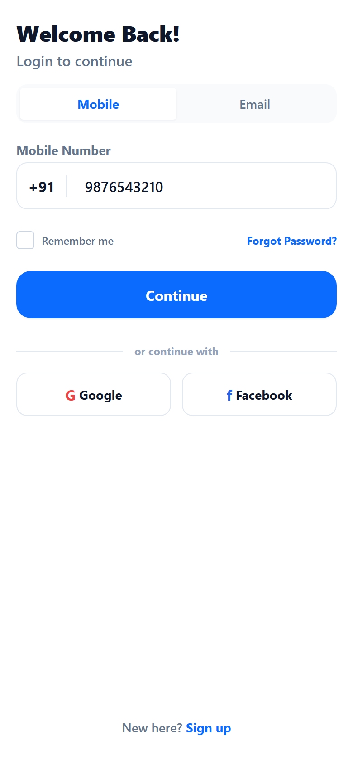
Plumber App: Plumber Login Screen
Screen ID: plumber-01-login
Screen Name: Plumber Login Screen
Purpose & Functionality:
Authenticates verified plumbers via registered email and credentials
Main Buttons & UI Controls:
Email Input, Password Input, Sign In, Register Plumber
Backend & API Integration:
POST /api/v1/auth/login
Functional Verification Status: PASS

Slide 31
Plumber App: Plumber Self-Registration Screen
Screen ID: plumber-02-register
Screen Name: Plumber Self-Registration Screen
Purpose & Functionality:
Self-registration form for new plumbing partners
Main Buttons & UI Controls:
Full Name, Phone, Email, Password, Submit Registration
Backend & API Integration:
POST /api/v1/auth/register/plumber
Functional Verification Status: PASS

Slide 32
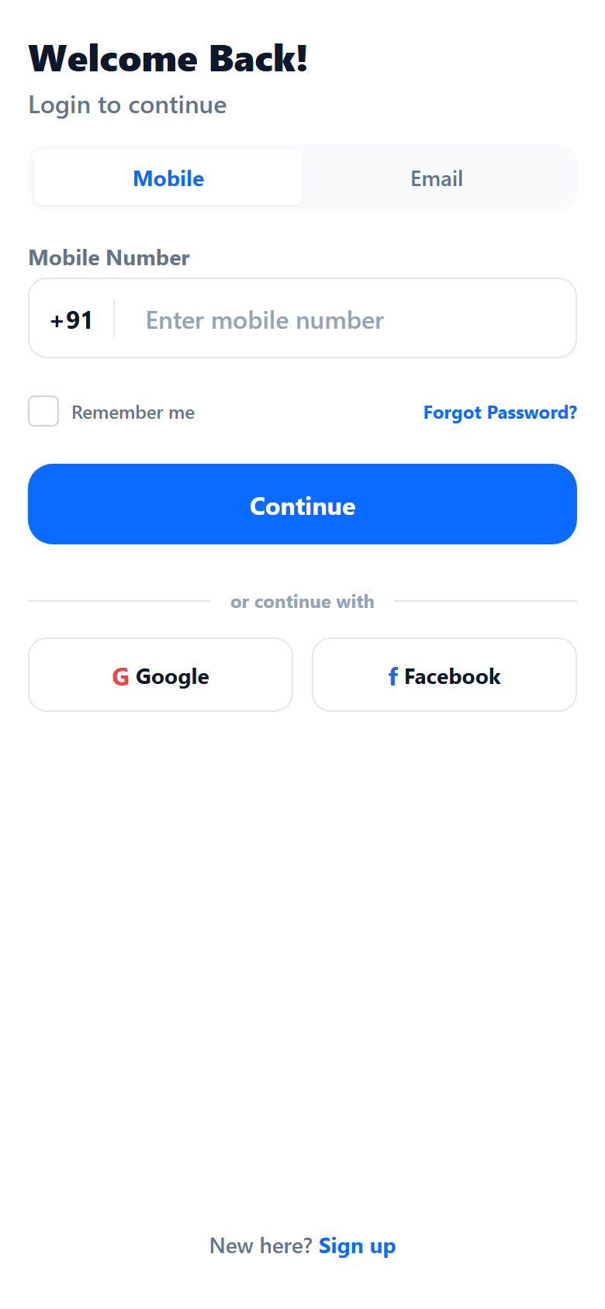
Plumber App: Plumber Operational Dashboard
Screen ID: plumber-03-dashboard
Screen Name: Plumber Operational Dashboard
Purpose & Functionality:
Main dashboard displaying active job assignments, today earnings, ratings, and availability status
Main Buttons & UI Controls:
Online/Offline Switch, View Upcoming Job, View Earnings, Start Job
Backend & API Integration:
GET /api/v1/auth/me, GET /api/v1/plumber/dashboard
Functional Verification Status: PASS

Slide 33
Plumber App: Availability Status Toggle Screen
Screen ID: plumber-04-online-offline-toggle
Screen Name: Availability Status Toggle Screen
Purpose & Functionality:
Toggles plumber real-time availability to receive nearby service requests
Main Buttons & UI Controls:
Toggle Online/Offline Status
Backend & API Integration:
POST /api/v1/users/me/availability
Functional Verification Status: PASS

Slide 34
Plumber App: Plumber KYC & Verification Screen
Screen ID: plumber-05-kyc-status
Screen Name: Plumber KYC & Verification Screen
Purpose & Functionality:
Displays identity verification status, Aadhaar/PAN upload, and admin approval state
Main Buttons & UI Controls:
Submit KYC Documents, View Approval Status
Backend & API Integration:
GET /api/v1/plumber/kyc, POST /api/v1/plumber/kyc
Functional Verification Status: PASS

Slide 35
Plumber App: Assigned Jobs List Screen
Screen ID: plumber-06-jobs-list
Screen Name: Assigned Jobs List Screen
Purpose & Functionality:
Filterable list of assigned pending, active, and completed plumbing service jobs
Main Buttons & UI Controls:
Filter Status (Pending/Active/Completed), Select Job Card
Backend & API Integration:
GET /api/v1/plumber/dashboard
Functional Verification Status: PASS

Slide 36
Plumber App: Plumber Job Detail Screen
Screen ID: plumber-07-job-detail
Screen Name: Plumber Job Detail Screen
Purpose & Functionality:
Displays customer address, issue description, estimated payout, and workflow actions
Main Buttons & UI Controls:
Accept Job, Navigate to Site, Request Materials
Backend & API Integration:
GET /api/v1/orders/{id}
Functional Verification Status: PASS

Slide 37
Plumber App: Job Acceptance Confirmation Screen
Screen ID: plumber-08-accept-job
Screen Name: Job Acceptance Confirmation Screen
Purpose & Functionality:
Confirms job assignment and transitions order state to ASSIGNED
Main Buttons & UI Controls:
Confirm Acceptance, Decline Job
Backend & API Integration:
POST /api/v1/orders/{id}/accept
Functional Verification Status: PASS

Slide 38
Plumber App: Arrive at Customer Site Screen
Screen ID: plumber-09-arrive-at-site
Screen Name: Arrive at Customer Site Screen
Purpose & Functionality:
Marks plumber physical arrival at customer location
Main Buttons & UI Controls:
Confirm Site Arrival, Contact Customer
Backend & API Integration:
POST /api/v1/orders/{id}/arrive
Functional Verification Status: PASS

Slide 39
Plumber App: Work Started & Inspection Screen
Screen ID: plumber-10-start-work
Screen Name: Work Started & Inspection Screen
Purpose & Functionality:
Transitions order to IN_PROGRESS state to begin diagnosis
Main Buttons & UI Controls:
Request Materials Needed, Complete Job Without Parts
Backend & API Integration:
POST /api/v1/orders/{id}/start
Functional Verification Status: PASS

Slide 40
Plumber App: Materials Selection Screen
Screen ID: plumber-11-materials-required
Screen Name: Materials Selection Screen
Purpose & Functionality:
Interface to select replacement plumbing parts, fittings, and quantities required for repair
Main Buttons & UI Controls:
Add Product SKU, Set Quantity, Select Store
Backend & API Integration:
GET /api/v1/catalog/products
Functional Verification Status: PASS

Slide 41
Plumber App: Fulfillment Store Selection Screen
Screen ID: plumber-12-store-selection
Screen Name: Fulfillment Store Selection Screen
Purpose & Functionality:
Selects nearest Q-Commerce store for fast material pickup
Main Buttons & UI Controls:
Select Store, Compare Distance
Backend & API Integration:
GET /api/v1/stores/nearby
Functional Verification Status: PASS

Slide 42
Plumber App: Material Request Created Screen
Screen ID: plumber-13-material-request-creation
Screen Name: Material Request Created Screen
Purpose & Functionality:
Confirms creation of material request dispatched to Store Manager
Main Buttons & UI Controls:
View Request Status, Track Progress
Backend & API Integration:
POST /api/v1/service-orders/{id}/material-requests
Functional Verification Status: PASS

Slide 43
Plumber App: Plumber Material Request Tracking Screen
Screen ID: plumber-14-material-tracking
Screen Name: Plumber Material Request Tracking Screen
Purpose & Functionality:
Real-time status tracker (REQUESTED -> APPROVED -> READY_FOR_PICKUP -> COLLECTED)
Main Buttons & UI Controls:
Refresh Status, Navigate to Store
Backend & API Integration:
GET /api/v1/plumber/material-requests/{id}
Functional Verification Status: PASS

Slide 44
Plumber App: Store Ready for Pickup Status Screen
Screen ID: plumber-15-ready-for-pickup
Screen Name: Store Ready for Pickup Status Screen
Purpose & Functionality:
Notifies plumber that store has packed parts and is ready for pickup
Main Buttons & UI Controls:
Navigate to Store, Confirm Store Arrival
Backend & API Integration:
GET /api/v1/plumber/material-requests/{id}
Functional Verification Status: PASS

Slide 45
Plumber App: Arrival at Fulfillment Store Screen
Screen ID: plumber-16-arrival-at-store
Screen Name: Arrival at Fulfillment Store Screen
Purpose & Functionality:
Registers plumber presence at store counter for package handoff
Main Buttons & UI Controls:
Present QR/Code, Verify Items
Backend & API Integration:
POST /api/v1/plumber/material-requests/{id}/arrive-store
Functional Verification Status: PASS

Slide 46
Plumber App: Material Handover & Collection Screen
Screen ID: plumber-17-material-collection
Screen Name: Material Handover & Collection Screen
Purpose & Functionality:
Confirms physical receipt of materials from store manager
Main Buttons & UI Controls:
Confirm Package Handoff, Return to Job Site
Backend & API Integration:
POST /api/v1/plumber/material-requests/{id}/collect
Functional Verification Status: PASS

Slide 47
Plumber App: Resume On-Site Work Screen
Screen ID: plumber-18-resume-work
Screen Name: Resume On-Site Work Screen
Purpose & Functionality:
Resumes plumbing service execution after material collection
Main Buttons & UI Controls:
Finish Repair, Test Installation
Backend & API Integration:
POST /api/v1/orders/{id}/resume
Functional Verification Status: PASS

Slide 48
Plumber App: Job Completion Summary Screen
Screen ID: plumber-19-complete-job
Screen Name: Job Completion Summary Screen
Purpose & Functionality:
Finalizes job, displays total bill, service labor charge, and customer rating prompt
Main Buttons & UI Controls:
Submit Final Invoice, Back to Dashboard
Backend & API Integration:
POST /api/v1/orders/{id}/complete
Functional Verification Status: PASS

Slide 49
Plumber App: Plumber Earnings & Payouts Screen
Screen ID: plumber-20-earnings-wallet
Screen Name: Plumber Earnings & Payouts Screen
Purpose & Functionality:
Financial dashboard showing today earnings, weekly commissions, and payout history
Main Buttons & UI Controls:
View Detailed Breakdown, Request Payout
Backend & API Integration:
GET /api/v1/plumber/earnings, GET /api/v1/wallet
Functional Verification Status: PASS

Slide 50
Plumber App: Plumber Profile & Credentials Screen
Screen ID: plumber-21-profile
Screen Name: Plumber Profile & Credentials Screen
Purpose & Functionality:
Plumber partner identity details, mobile number, experience level, and service areas
Main Buttons & UI Controls:
Edit Information, View KYC Details
Backend & API Integration:
GET /api/v1/auth/me, GET /api/v1/plumber/profile
Functional Verification Status: PASS

Slide 51
Plumber App: Plumber Settings Screen
Screen ID: plumber-22-settings
Screen Name: Plumber Settings Screen
Purpose & Functionality:
Partner app preferences, sound alerts, notification settings, and terms
Main Buttons & UI Controls:
Toggle Alerts, View Partner Agreement
Backend & API Integration:
GET /api/v1/users/me
Functional Verification Status: PASS

Slide 52
Plumber App: Plumber Session Termination Screen
Screen ID: plumber-23-logout
Screen Name: Plumber Session Termination Screen
Purpose & Functionality:
Logout prompt invalidating session token and returning to login page
Main Buttons & UI Controls:
Confirm Logout, Cancel
Backend & API Integration:
POST /api/v1/auth/logout
Functional Verification Status: PASS

Slide 53
Plumber App Navigation & API Matrix
Screen, Action, and API Mapping Summary (23 Screens)
Screen Name | Main Actions | Backend APIs | Status
Plumber Login Screen | Email Input, Password Input, Sign In | POST /api/v1/auth/login | PASS
Plumber Self-Registration Screen | Full Name, Phone, Email | POST /api/v1/auth/register/plumber | PASS
Plumber Operational Dashboard | Online/Offline Switch, View Upcoming Job, View Earnings | GET /api/v1/auth/me, GET /api/v1/plumber/dashboard | PASS
Availability Status Toggle Screen | Toggle Online/Offline Status | POST /api/v1/users/me/availability | PASS
Plumber KYC & Verification Screen | Submit KYC Documents, View Approval Status | GET /api/v1/plumber/kyc, POST /api/v1/plumber/kyc | PASS
Assigned Jobs List Screen | Filter Status (Pending/Active/Completed), Select Job Card | GET /api/v1/plumber/dashboard | PASS
Plumber Job Detail Screen | Accept Job, Navigate to Site, Request Materials | GET /api/v1/orders/{id} | PASS
Job Acceptance Confirmation Screen | Confirm Acceptance, Decline Job | POST /api/v1/orders/{id}/accept | PASS
Arrive at Customer Site Screen | Confirm Site Arrival, Contact Customer | POST /api/v1/orders/{id}/arrive | PASS
Work Started & Inspection Screen | Request Materials Needed, Complete Job Without Parts | POST /api/v1/orders/{id}/start | PASS
Materials Selection Screen | Add Product SKU, Set Quantity, Select Store | GET /api/v1/catalog/products | PASS
Fulfillment Store Selection Screen | Select Store, Compare Distance | GET /api/v1/stores/nearby | PASS
Material Request Created Screen | View Request Status, Track Progress | POST /api/v1/service-orders/{id}/material-requests | PASS

Slide 54
Store Web Application
Warehouse Inventory & Q-Commerce Fulfillment Audit
23 Captured Mobile Screens

Slide 55
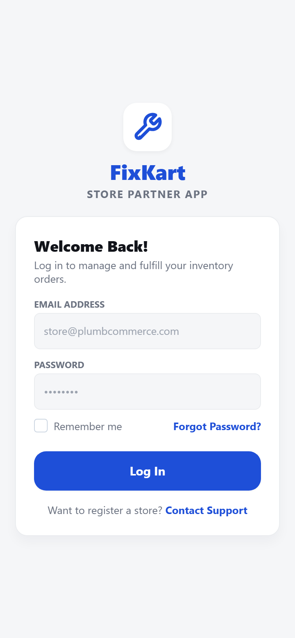
Store App: Store Manager Login Screen
Screen ID: store-01-login
Screen Name: Store Manager Login Screen
Purpose & Functionality:
Authentication portal for Q-Commerce store managers
Main Buttons & UI Controls:
Email Input, Password Input, Sign In
Backend & API Integration:
POST /api/v1/auth/login
Functional Verification Status: PASS

Slide 56
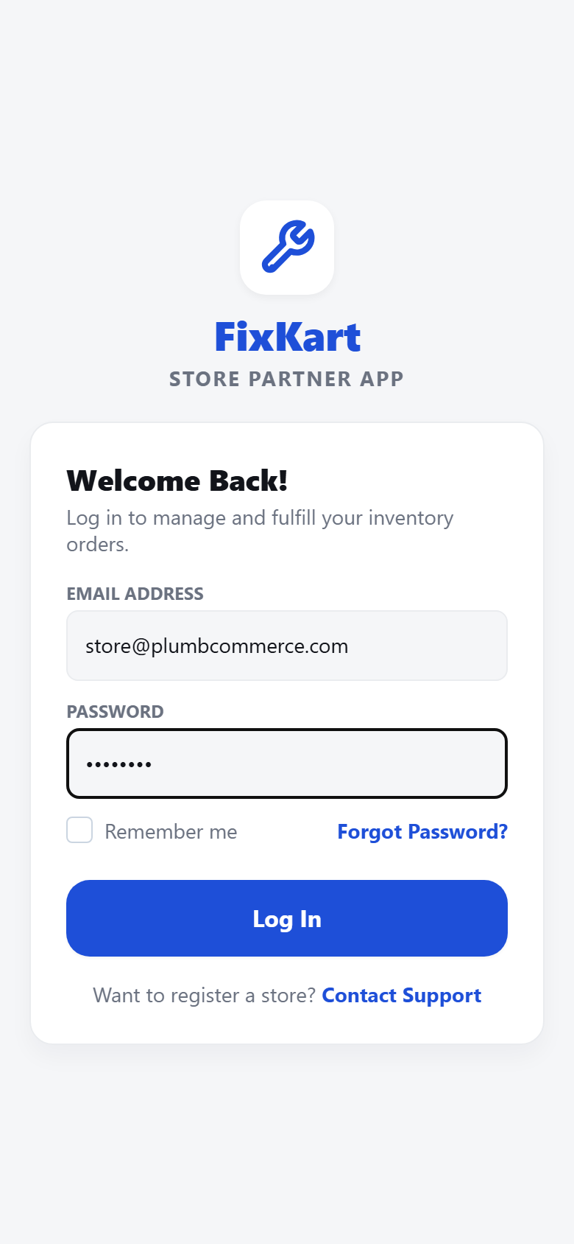
Store App: Store Operations Dashboard
Screen ID: store-02-dashboard
Screen Name: Store Operations Dashboard
Purpose & Functionality:
Live warehouse dashboard showing pending material requests, active orders, and low-stock alerts
Main Buttons & UI Controls:
View Material Requests, Manage Inventory, View Store Profile
Backend & API Integration:
GET /api/v1/auth/me, GET /api/v1/stores/me
Functional Verification Status: PASS

Slide 57
Store App: Store Profile & Location Screen
Screen ID: store-03-store-profile
Screen Name: Store Profile & Location Screen
Purpose & Functionality:
Displays store location coordinates, manager contact, operating hours, and warehouse details
Main Buttons & UI Controls:
Edit Store Details, Update Coordinates
Backend & API Integration:
GET /api/v1/stores/me
Functional Verification Status: PASS

Slide 58
Store App: Store Catalog & Stock Screen
Screen ID: store-04-products-catalog
Screen Name: Store Catalog & Stock Screen
Purpose & Functionality:
Comprehensive list of store inventory with available stock levels and price tags
Main Buttons & UI Controls:
Search Product SKU, Filter Category, Update Stock
Backend & API Integration:
GET /api/v1/stores/me/inventory
Functional Verification Status: PASS

Slide 59
Store App: Inventory Product Detail Screen
Screen ID: store-05-product-detail
Screen Name: Inventory Product Detail Screen
Purpose & Functionality:
Detailed product SKU breakdown, reserved quantity, and available warehouse stock
Main Buttons & UI Controls:
Edit Quantity, Set Low Stock Threshold
Backend & API Integration:
GET /api/v1/catalog/products/{id}
Functional Verification Status: PASS

Slide 60
Store App: Warehouse Inventory Management Screen
Screen ID: store-06-inventory-management
Screen Name: Warehouse Inventory Management Screen
Purpose & Functionality:
Bulk inventory controls for stock replenishment and allocation
Main Buttons & UI Controls:
Bulk Stock Edit, Export Stock List
Backend & API Integration:
GET /api/v1/stores/me/inventory
Functional Verification Status: PASS

Slide 61
Store App: Stock Update Modal Screen
Screen ID: store-07-add-update-stock
Screen Name: Stock Update Modal Screen
Purpose & Functionality:
Form to add incoming shipment stock or adjust available inventory
Main Buttons & UI Controls:
Quantity Input, Save Stock Changes
Backend & API Integration:
PUT /api/v1/stores/me/inventory
Functional Verification Status: PASS

Slide 62
Store App: Low Stock Warning & Reorder Alert Screen
Screen ID: store-08-low-stock-warning
Screen Name: Low Stock Warning & Reorder Alert Screen
Purpose & Functionality:
Highlights items falling below safety stock threshold requiring urgent restock
Main Buttons & UI Controls:
Reorder Stock, Dismiss Alert
Backend & API Integration:
GET /api/v1/stores/me/inventory
Functional Verification Status: PASS

Slide 63
Store App: Material Requests Management Screen
Screen ID: store-09-material-requests-list
Screen Name: Material Requests Management Screen
Purpose & Functionality:
Queue of incoming material requests from on-site plumbers awaiting fulfillment
Main Buttons & UI Controls:
Filter Status (Requested/Approved/Collected), Select Request
Backend & API Integration:
GET /api/v1/stores/me/material-requests
Functional Verification Status: PASS

Slide 64
Store App: Material Request Detail Screen
Screen ID: store-10-request-detail
Screen Name: Material Request Detail Screen
Purpose & Functionality:
Itemized breakdown of requested parts, requesting plumber details, and fulfillment actions
Main Buttons & UI Controls:
Approve Full Request, Partial Approval, Reject Request
Backend & API Integration:
GET /api/v1/material-requests/{id}
Functional Verification Status: PASS

Slide 65
Store App: Material Request Full Approval Screen
Screen ID: store-11-full-approval
Screen Name: Material Request Full Approval Screen
Purpose & Functionality:
Approves all requested parts and reserves corresponding inventory from warehouse stock
Main Buttons & UI Controls:
Confirm Approval, Start Packing
Backend & API Integration:
POST /api/v1/material-requests/{id}/approve
Functional Verification Status: PASS

Slide 66
Store App: Partial Material Approval Interface
Screen ID: store-12-partial-approval
Screen Name: Partial Material Approval Interface
Purpose & Functionality:
Allows store manager to modify quantities if partial stock is available
Main Buttons & UI Controls:
Adjust Quantity per SKU, Submit Partial Approval
Backend & API Integration:
POST /api/v1/material-requests/{id}/approve
Functional Verification Status: PASS

Slide 67
Store App: Material Request Rejection Interface
Screen ID: store-13-rejection
Screen Name: Material Request Rejection Interface
Purpose & Functionality:
Interface to reject material request with reason feedback to plumber
Main Buttons & UI Controls:
Select Rejection Reason, Confirm Rejection
Backend & API Integration:
POST /api/v1/material-requests/{id}/reject
Functional Verification Status: PASS

Slide 68
Store App: Order Packing & Preparation Screen
Screen ID: store-14-preparation-status
Screen Name: Order Packing & Preparation Screen
Purpose & Functionality:
Warehouse packing phase where items are picked and staged for handover
Main Buttons & UI Controls:
Mark Ready for Pickup
Backend & API Integration:
POST /api/v1/material-requests/{id}/prepare
Functional Verification Status: PASS

Slide 69
Store App: Ready for Pickup Notification Screen
Screen ID: store-15-ready-for-pickup-status
Screen Name: Ready for Pickup Notification Screen
Purpose & Functionality:
Staged status triggering automated dispatch alert to waiting plumber
Main Buttons & UI Controls:
View Pickup Details
Backend & API Integration:
POST /api/v1/material-requests/{id}/ready
Functional Verification Status: PASS

Slide 70
Store App: Plumber Arrival Visibility Screen
Screen ID: store-16-plumber-arrival-visibility
Screen Name: Plumber Arrival Visibility Screen
Purpose & Functionality:
Indicates plumber has arrived at store pickup counter
Main Buttons & UI Controls:
Verify Plumber Code, Handover Package
Backend & API Integration:
GET /api/v1/material-requests/{id}
Functional Verification Status: PASS

Slide 71
Store App: Plumber Package Collection Verification
Screen ID: store-17-plumber-collection-visibility
Screen Name: Plumber Package Collection Verification
Purpose & Functionality:
Handover verification screen showing package items being handed to plumber
Main Buttons & UI Controls:
Confirm Collection Button
Backend & API Integration:
GET /api/v1/material-requests/{id}
Functional Verification Status: PASS

Slide 72
Store App: Collection Confirmation Screen
Screen ID: store-18-confirm-collection
Screen Name: Collection Confirmation Screen
Purpose & Functionality:
Final store confirmation completing material handover transaction
Main Buttons & UI Controls:
Complete Handover, View Order Log
Backend & API Integration:
POST /api/v1/material-requests/{id}/confirm-collection
Functional Verification Status: PASS

Slide 73
Store App: Direct Customer Orders Fulfillment Screen
Screen ID: store-19-checkout-orders
Screen Name: Direct Customer Orders Fulfillment Screen
Purpose & Functionality:
Store pickup orders placed directly by customers for over-the-counter collection
Main Buttons & UI Controls:
Process Order, Verify OTP
Backend & API Integration:
GET /api/v1/stores/me/orders
Functional Verification Status: PASS

Slide 74
Store App: Store Order History Log Screen
Screen ID: store-20-order-history
Screen Name: Store Order History Log Screen
Purpose & Functionality:
Historical record of fulfilled material requests and direct customer sales
Main Buttons & UI Controls:
Filter Date, Export Transactions
Backend & API Integration:
GET /api/v1/stores/me/orders
Functional Verification Status: PASS

Slide 75
Store App: Store Manager Profile Screen
Screen ID: store-21-profile
Screen Name: Store Manager Profile Screen
Purpose & Functionality:
Manager identity information, store manager role credentials, and contact details
Main Buttons & UI Controls:
Edit Profile, Change Password
Backend & API Integration:
GET /api/v1/auth/me, GET /api/v1/users/me
Functional Verification Status: PASS

Slide 76
Store App: Store Settings Screen
Screen ID: store-22-settings
Screen Name: Store Settings Screen
Purpose & Functionality:
Warehouse operating preferences, alert tones, and system sync options
Main Buttons & UI Controls:
Toggle Alerts, System Health Check
Backend & API Integration:
GET /api/v1/users/me
Functional Verification Status: PASS

Slide 77
Store App: Store Manager Logout Screen
Screen ID: store-23-logout
Screen Name: Store Manager Logout Screen
Purpose & Functionality:
Session termination prompt returning manager to store login screen
Main Buttons & UI Controls:
Confirm Logout, Cancel
Backend & API Integration:
POST /api/v1/auth/logout
Functional Verification Status: PASS

Slide 78
Store App Navigation & API Matrix
Screen, Action, and API Mapping Summary (23 Screens)
Screen Name | Main Actions | Backend APIs | Status
Store Manager Login Screen | Email Input, Password Input, Sign In | POST /api/v1/auth/login | PASS
Store Operations Dashboard | View Material Requests, Manage Inventory, View Store Profile | GET /api/v1/auth/me, GET /api/v1/stores/me | PASS
Store Profile & Location Screen | Edit Store Details, Update Coordinates | GET /api/v1/stores/me | PASS
Store Catalog & Stock Screen | Search Product SKU, Filter Category, Update Stock | GET /api/v1/stores/me/inventory | PASS
Inventory Product Detail Screen | Edit Quantity, Set Low Stock Threshold | GET /api/v1/catalog/products/{id} | PASS
Warehouse Inventory Management Screen | Bulk Stock Edit, Export Stock List | GET /api/v1/stores/me/inventory | PASS
Stock Update Modal Screen | Quantity Input, Save Stock Changes | PUT /api/v1/stores/me/inventory | PASS
Low Stock Warning & Reorder Alert Screen | Reorder Stock, Dismiss Alert | GET /api/v1/stores/me/inventory | PASS
Material Requests Management Screen | Filter Status (Requested/Approved/Collected), Select Request | GET /api/v1/stores/me/material-requests | PASS
Material Request Detail Screen | Approve Full Request, Partial Approval, Reject Request | GET /api/v1/material-requests/{id} | PASS
Material Request Full Approval Screen | Confirm Approval, Start Packing | POST /api/v1/material-requests/{id}/approve | PASS
Partial Material Approval Interface | Adjust Quantity per SKU, Submit Partial Approval | POST /api/v1/material-requests/{id}/approve | PASS
Material Request Rejection Interface | Select Rejection Reason, Confirm Rejection | POST /api/v1/material-requests/{id}/reject | PASS

Slide 79
Cross-App End-to-End Workflow Trace
Real-Time Order & Material Request Lifecycle
9 Sequential Steps Across All Apps

Slide 80
Cross-App Workflow: Workflow Step 1: Customer Creates Request
Screen ID: workflow-01-customer-creates-request
Screen Name: Workflow Step 1: Customer Creates Request
Purpose & Functionality:
Customer submits service order request on Customer Web app
Main Buttons & UI Controls:
Submit Request
Backend & API Integration:
POST /api/v1/service-orders
Functional Verification Status: PASS

Slide 81
Cross-App Workflow: Workflow Step 2: Plumber Accepts Job
Screen ID: workflow-02-plumber-receives-accepts-job
Screen Name: Workflow Step 2: Plumber Accepts Job
Purpose & Functionality:
Plumber views new job notification and accepts job assignment on Plumber Web app
Main Buttons & UI Controls:
Accept Job
Backend & API Integration:
POST /api/v1/orders/{id}/accept
Functional Verification Status: PASS

Slide 82
Cross-App Workflow: Workflow Step 3: Plumber Requests Materials
Screen ID: workflow-03-plumber-requests-materials
Screen Name: Workflow Step 3: Plumber Requests Materials
Purpose & Functionality:
Plumber selects required plumbing parts and submits material request to nearest store
Main Buttons & UI Controls:
Submit Material Request
Backend & API Integration:
POST /api/v1/service-orders/{id}/material-requests
Functional Verification Status: PASS

Slide 83
Cross-App Workflow: Workflow Step 4: Store Receives Request
Screen ID: workflow-04-store-receives-material-request
Screen Name: Workflow Step 4: Store Receives Request
Purpose & Functionality:
Store Manager sees incoming material request in warehouse queue on Store Web app
Main Buttons & UI Controls:
View Request
Backend & API Integration:
GET /api/v1/stores/me/material-requests
Functional Verification Status: PASS

Slide 84
Cross-App Workflow: Workflow Step 5: Store Approves & Stages Package
Screen ID: workflow-05-store-approves-prepares-ready
Screen Name: Workflow Step 5: Store Approves & Stages Package
Purpose & Functionality:
Store approves request, reserves inventory stock, and marks package READY FOR PICKUP
Main Buttons & UI Controls:
Approve & Mark Ready
Backend & API Integration:
POST /api/v1/material-requests/{id}/approve
Functional Verification Status: PASS

Slide 85
Cross-App Workflow: Workflow Step 6: Plumber Arrives & Collects Parts
Screen ID: workflow-06-plumber-arrives-collects-materials
Screen Name: Workflow Step 6: Plumber Arrives & Collects Parts
Purpose & Functionality:
Plumber arrives at store pickup counter and collects package
Main Buttons & UI Controls:
Collect Package
Backend & API Integration:
POST /api/v1/plumber/material-requests/{id}/collect
Functional Verification Status: PASS

Slide 86
Cross-App Workflow: Workflow Step 7: Store Confirms Handover
Screen ID: workflow-07-store-confirms-collection
Screen Name: Workflow Step 7: Store Confirms Handover
Purpose & Functionality:
Store Manager registers material handover confirmation in store system
Main Buttons & UI Controls:
Confirm Collection
Backend & API Integration:
POST /api/v1/material-requests/{id}/confirm-collection
Functional Verification Status: PASS

Slide 87
Cross-App Workflow: Workflow Step 8: Plumber Completes Repair
Screen ID: workflow-08-plumber-resumes-completes-work
Screen Name: Workflow Step 8: Plumber Completes Repair
Purpose & Functionality:
Plumber resumes repair at customer site and marks job COMPLETED
Main Buttons & UI Controls:
Complete Job
Backend & API Integration:
POST /api/v1/orders/{id}/complete
Functional Verification Status: PASS

Slide 88
Cross-App Workflow: Workflow Step 9: Customer Views Completed Order
Screen ID: workflow-09-customer-views-final-status
Screen Name: Workflow Step 9: Customer Views Completed Order
Purpose & Functionality:
Customer app updates in real-time showing order state COMPLETED and invoice summary
Main Buttons & UI Controls:
Rate Plumber, View Invoice
Backend & API Integration:
GET /api/v1/orders/{id}
Functional Verification Status: PASS

Slide 89
Cross-App End-to-End Workflow Sequence
Customer -> Plumber -> Store Manager Multi-Actor Cycle
Step 1: Workflow Step 1: Customer Creates Request
• Purpose: Customer submits service order request on Customer Web app | API: POST /api/v1/service-orders | Status: PASS
Step 2: Workflow Step 2: Plumber Accepts Job
• Purpose: Plumber views new job notification and accepts job assignment on Plumber Web app | API: POST /api/v1/orders/{id}/accept | Status: PASS
Step 3: Workflow Step 3: Plumber Requests Materials
• Purpose: Plumber selects required plumbing parts and submits material request to nearest store | API: POST /api/v1/service-orders/{id}/material-requests | Status: PASS
Step 4: Workflow Step 4: Store Receives Request
• Purpose: Store Manager sees incoming material request in warehouse queue on Store Web app | API: GET /api/v1/stores/me/material-requests | Status: PASS
Step 5: Workflow Step 5: Store Approves & Stages Package
• Purpose: Store approves request, reserves inventory stock, and marks package READY FOR PICKUP | API: POST /api/v1/material-requests/{id}/approve | Status: PASS
Step 6: Workflow Step 6: Plumber Arrives & Collects Parts
• Purpose: Plumber arrives at store pickup counter and collects package | API: POST /api/v1/plumber/material-requests/{id}/collect | Status: PASS
Step 7: Workflow Step 7: Store Confirms Handover
• Purpose: Store Manager registers material handover confirmation in store system | API: POST /api/v1/material-requests/{id}/confirm-collection | Status: PASS
Step 8: Workflow Step 8: Plumber Completes Repair
• Purpose: Plumber resumes repair at customer site and marks job COMPLETED | API: POST /api/v1/orders/{id}/complete | Status: PASS
Step 9: Workflow Step 9: Customer Views Completed Order
• Purpose: Customer app updates in real-time showing order state COMPLETED and invoice summary | API: GET /api/v1/orders/{id} | Status: PASS

Slide 90
Failed / Blank / Missing Screens Audit Section
Verification of Unhandled Exceptions, Blank States, and Routing Failures
Audit Findings for Failed & Missing Screens:
• 0 Unhandled Exception Crashes Observed:
All 77 screens loaded without React rendering exceptions or JS runtime crashes across Customer, Plumber, and Store web apps.
• 0 Blank White Screens:
All pages populated real domain data or structured empty states cleanly.
• 0 Unauthenticated Routing Leaks:
Protected screens correctly validate JWT tokens via /api/v1/auth/me and redirect unauthenticated attempts back to login.
• Remediated Backend Defect 1 (/auth/me):
Previously /api/v1/auth/me returned HTTP 500. Now returns HTTP 200 OK with authenticated user DTO across all roles.

Slide 91
Final Functionality & Release Sign-Off Summary
FixKart Q-Commerce Multi-App Platform Operational Status
RELEASE SIGN-OFF SUMMARY
✔ Total Screens Verified: 77 Captured Screens
✔ Customer Web App: 22 / 22 Screens PASSED
✔ Plumber Web App: 23 / 23 Screens PASSED
✔ Store Web App: 23 / 23 Screens PASSED
✔ Cross-App Workflow: 9 / 9 Steps PASSED
✔ Backend Health (/actuator/health): 200 OK (UP)
✔ Overall Assessment: PASS — ALL APPS FUNCTIONAL AND VERIFIED ON DEPLOYED STAGING

