Slide 1
IBM University Engagement Project Submission
“Exploring the Power of Agentic AI with IBM Granite and LangFlow”

Slide 2

Project Tile – College Admission Agent (RAG Based)
Domain of Project – Education
Student Name | Recent Passport Photo | Email ID | Mobile number [WhatsApp]
AKHILESH ARIKATLA |  | arikatlaakhilesh1618@gmail.com | +91 7780445447

Slide 3
Problem Statement – College Admission Agent (RAG Based)
Challenge: Students need reliable, up-to-date admission information from official institutional sources.
Admission policies, eligibility, courses, fees, documents and deadlines can be scattered across web pages and documents.
Objective: Build a RAG-powered college admission agent that retrieves and summarizes trusted institutional information.
The agent should answer natural-language questions and guide course selection, application steps, fees and important dates.
Accuracy requirement: avoid inventing admission information and direct students to verify changing details.

Slide 4
Proposed Solution – AI-Powered College Admission Agent
Use IBM watsonx Orchestrate as the agent platform and embed the agent into the college admission website.
Connect an official RISE college knowledge source to provide Retrieval-Augmented Generation (RAG).
Retrieve relevant institutional information before generating answers.
Answer questions about courses, eligibility, admission procedure, fees, required documents, intake and contacts.
Use grounded responses and explicit fallback guidance when information is unavailable or may have changed.

Slide 5
Technology Used
IBM watsonx Orchestrate – agent orchestration, knowledge retrieval and embedded chat.
RAG – retrieves relevant information from the connected official college knowledge source.
IBM Cloud – hosts the watsonx services used by the project.
React + TypeScript + Vite – responsive student-facing frontend.
Knowledge Source – verified RISE Krishna Sai Prakasam Group of Institutions information.
GitHub – public source-code repository and project submission files.

Slide 6
AI Agent Components Used
Student Query / Chat Input – accepts natural-language admission questions.
2) College Admission RAG Agent – interprets the request and coordinates retrieval and response generation.
3) College Admission Knowledge Source – official institutional information used for grounding.
4) Retrieval – finds relevant course, eligibility, fee, document or admission information.
5) Grounded Chat Output – returns concise, student-friendly answers with no invented facts.
6) Embedded Agent – the live assistant is embedded into the project website.

Slide 7
RAG workflow -
Student Question
React Website
watsonx Orchestrate Agent
RISE Knowledge Source
Retrieved Context
Grounded Answer
→
→
→
→
→
1
2
3
4
5
6
Retrieval-Augmented Generation grounds the response in the connected institutional knowledge source before the answer is presented to the student.

Slide 8
Architecture blueprint
Student / Parent
React Frontend
IBM watsonx
Orchestrate Agent
→
→
↓
Grounded Response
Retrieved
Context
RISE Official
Knowledge Source
↓
←

Slide 9

Role of Agentic AI in the solution
Understands the student’s admission intent instead of requiring rigid menu navigation.
Chooses the relevant knowledge needed for the question.
Uses retrieved institutional context to produce grounded answers.
Handles follow-up questions within the admission conversation.
Applies trust rules: no guessing, no fabricated fees or deadlines, and verification for changing information.
Provides a scalable conversational interface for students and parents.

Slide 10
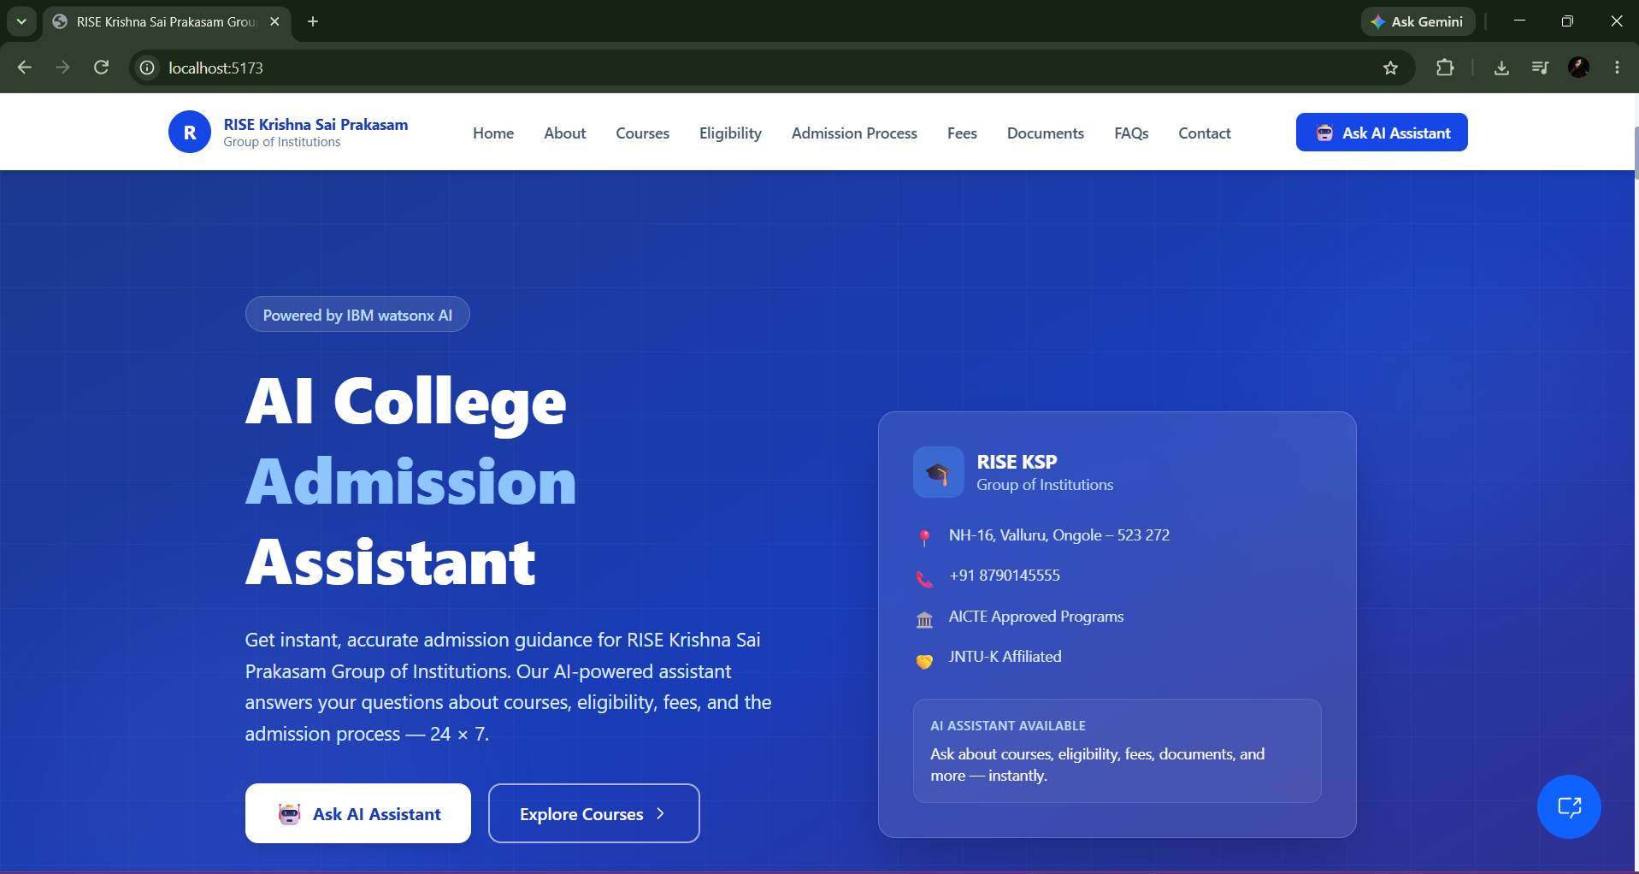
Website Home & AI Assistant

Slide 11
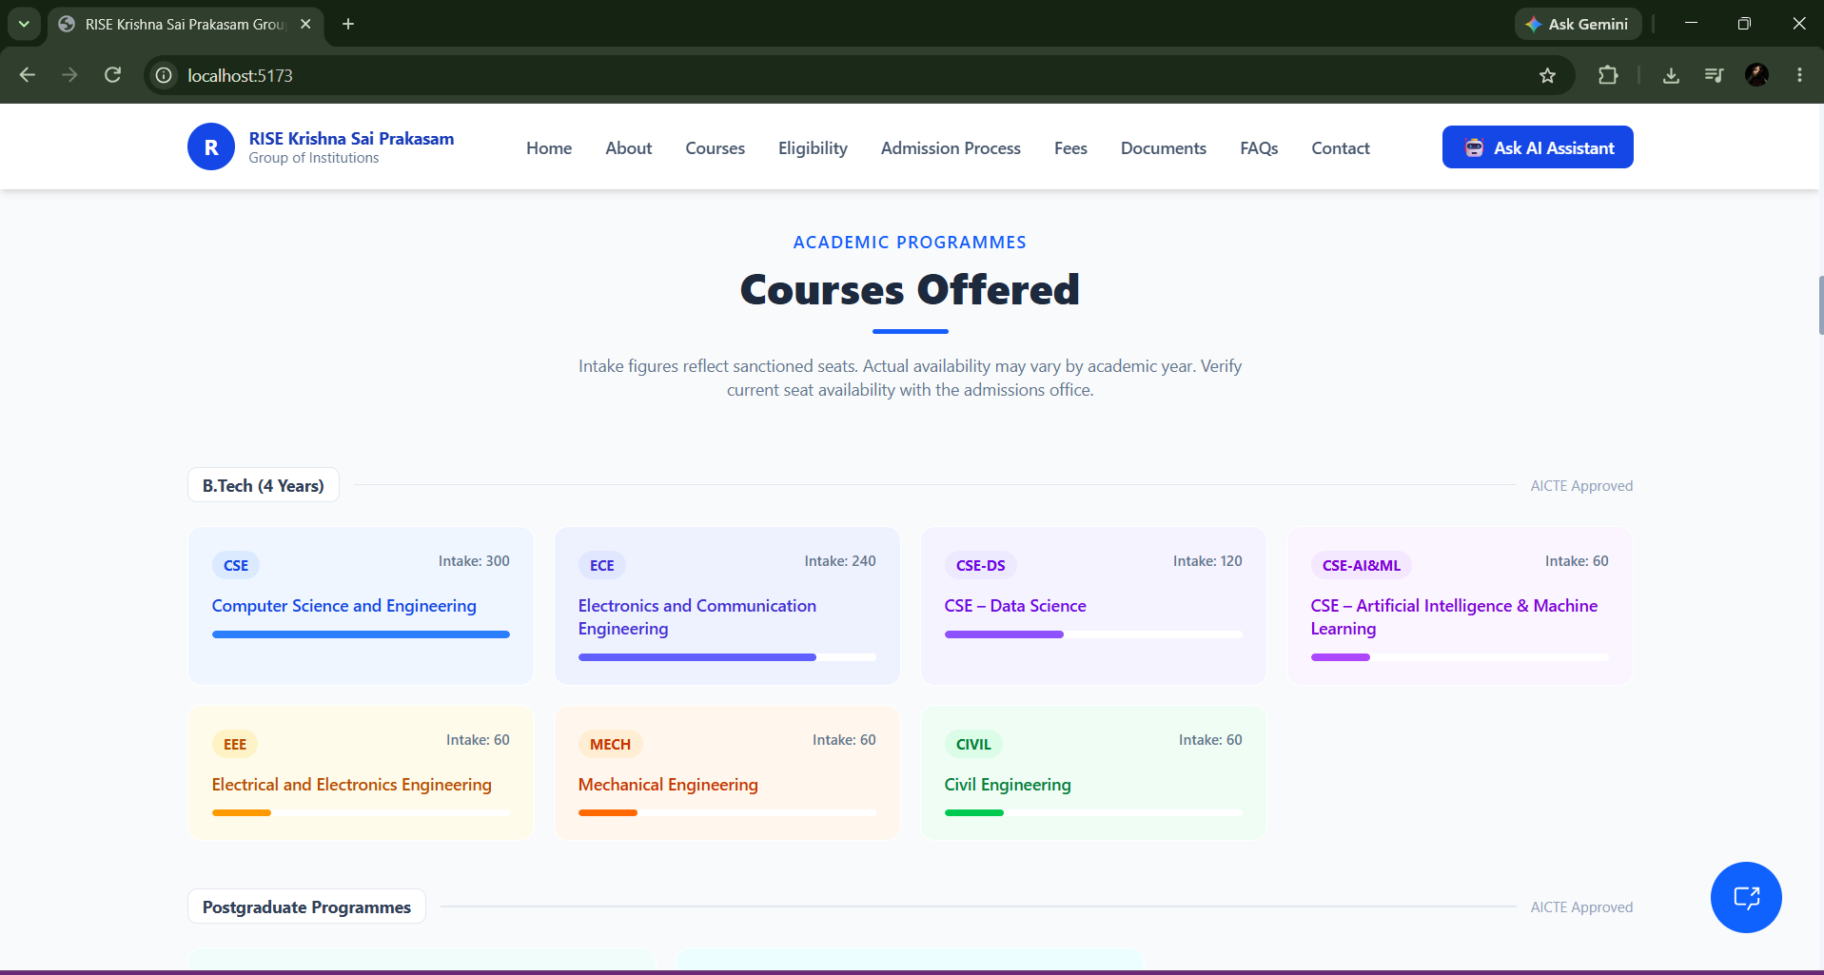
Courses Offered

Slide 12
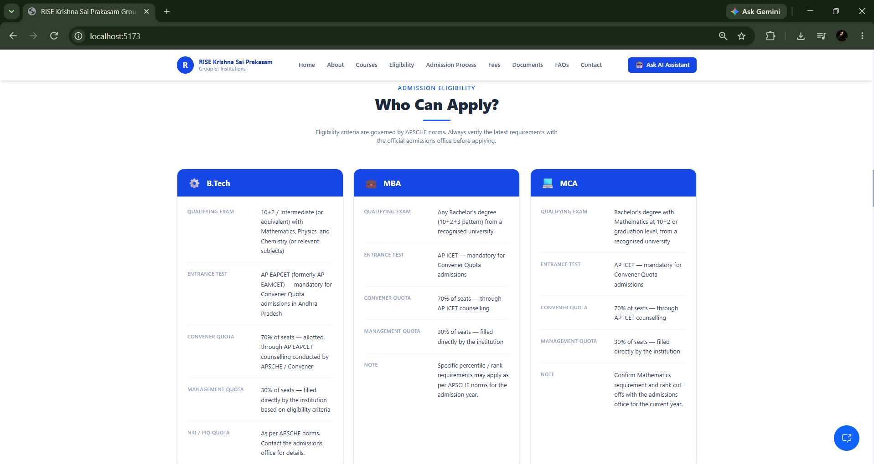
Eligibility Information

Slide 13
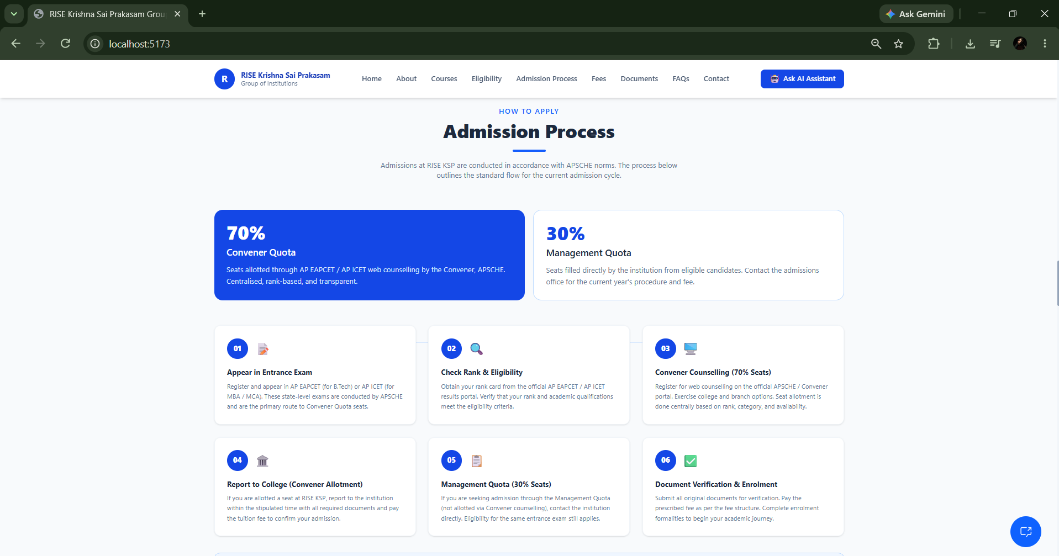
Admission Process

Slide 14
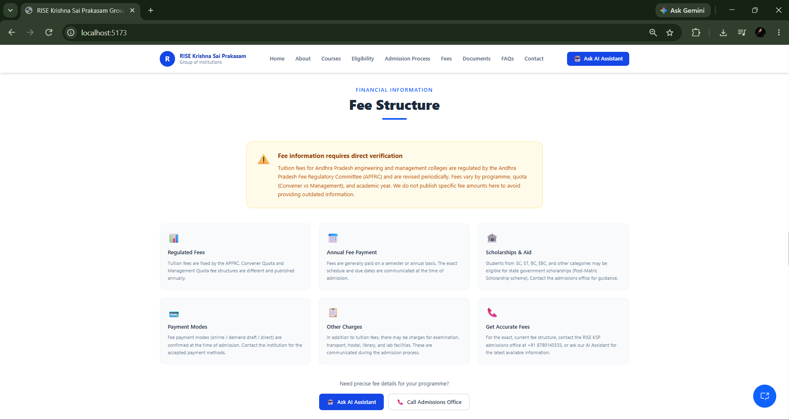
Fee Structure

Slide 15
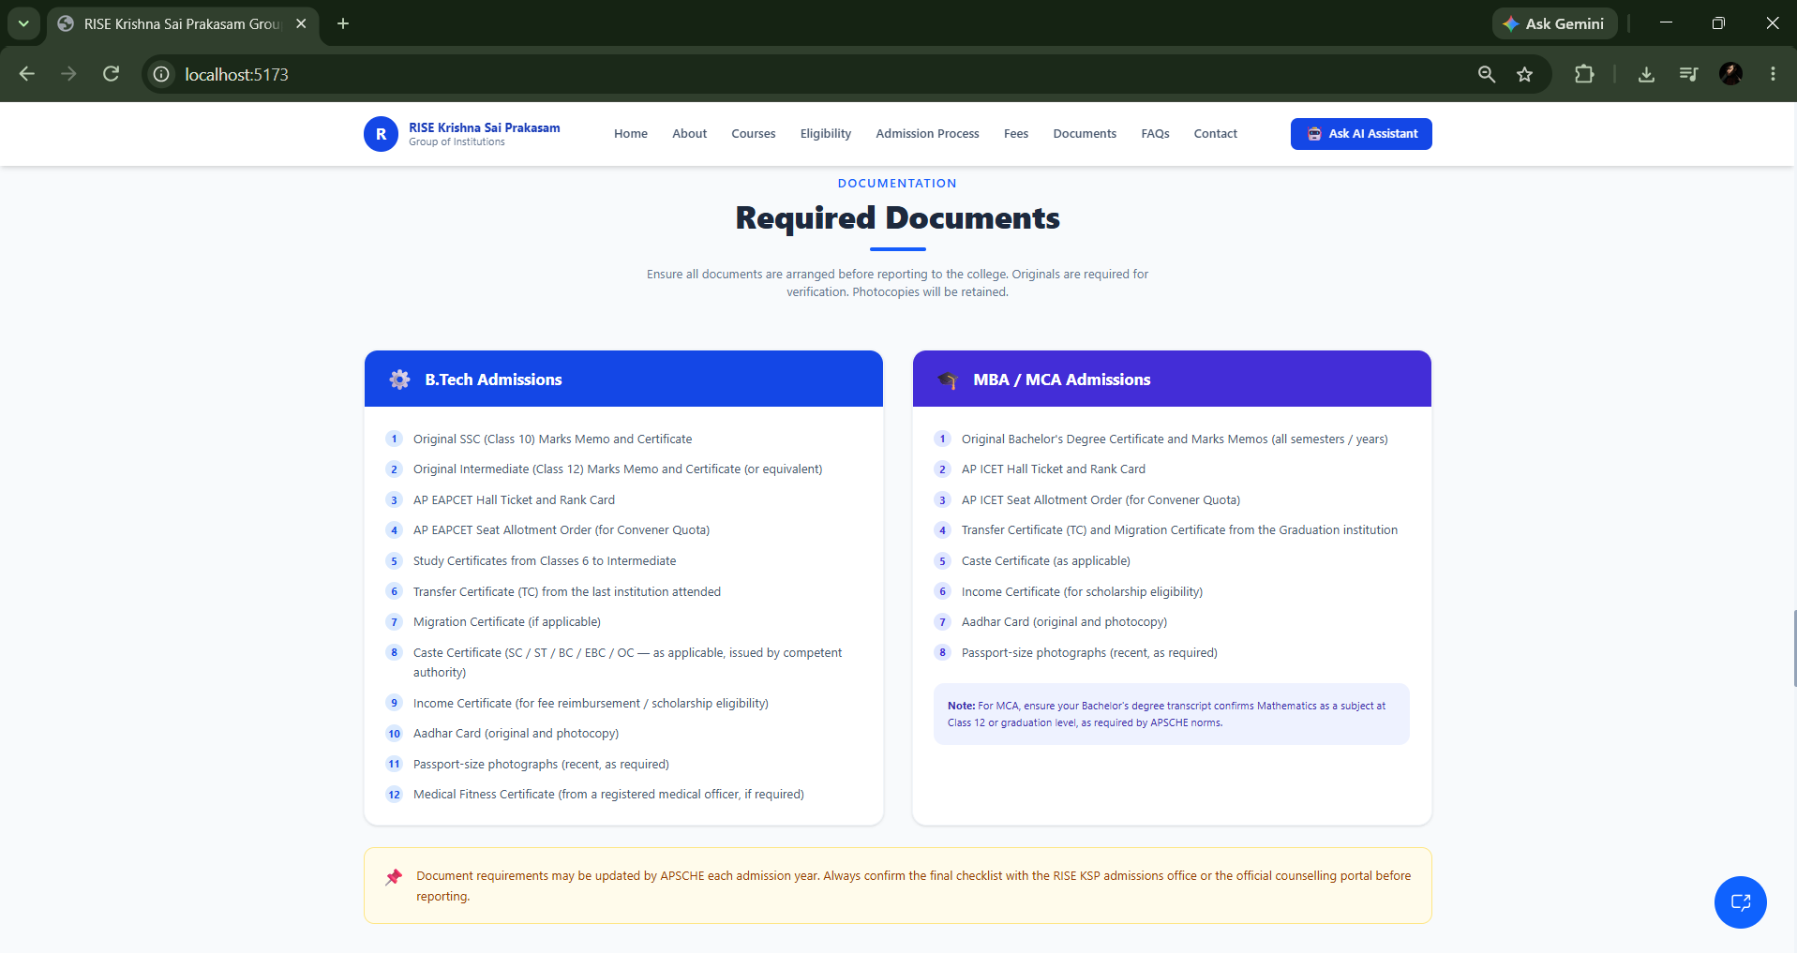
Required Documents

Slide 16
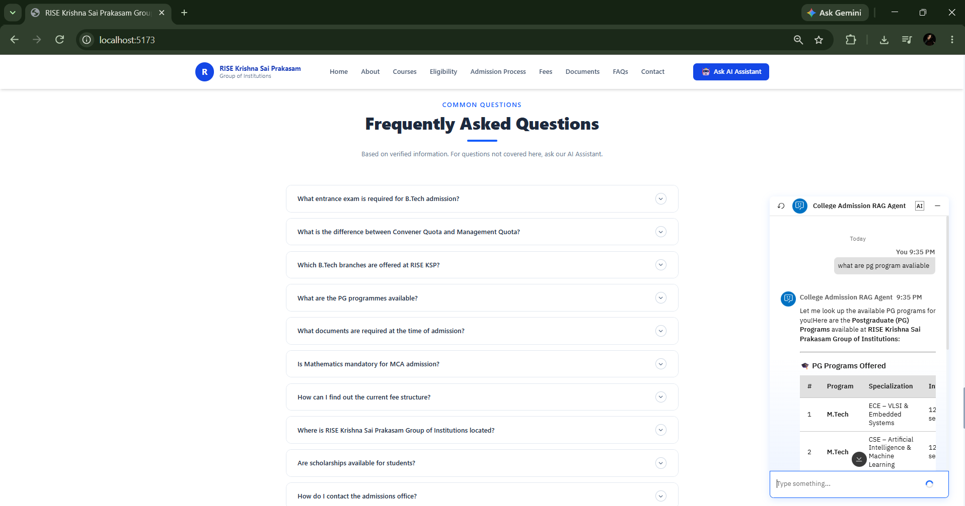
Live RAG Chat Test

Slide 17
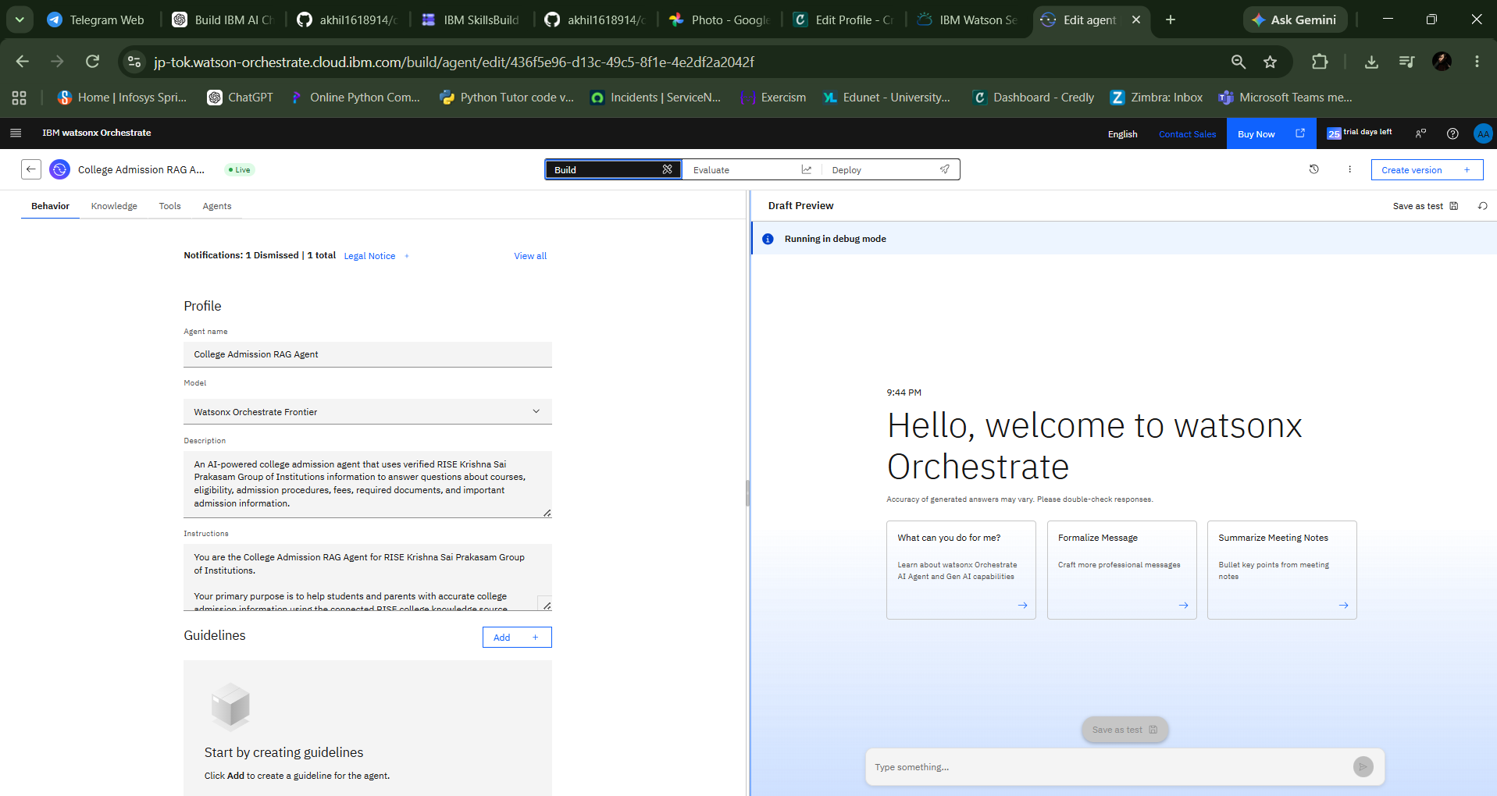
Orchestrate Agent Configuration

Slide 18
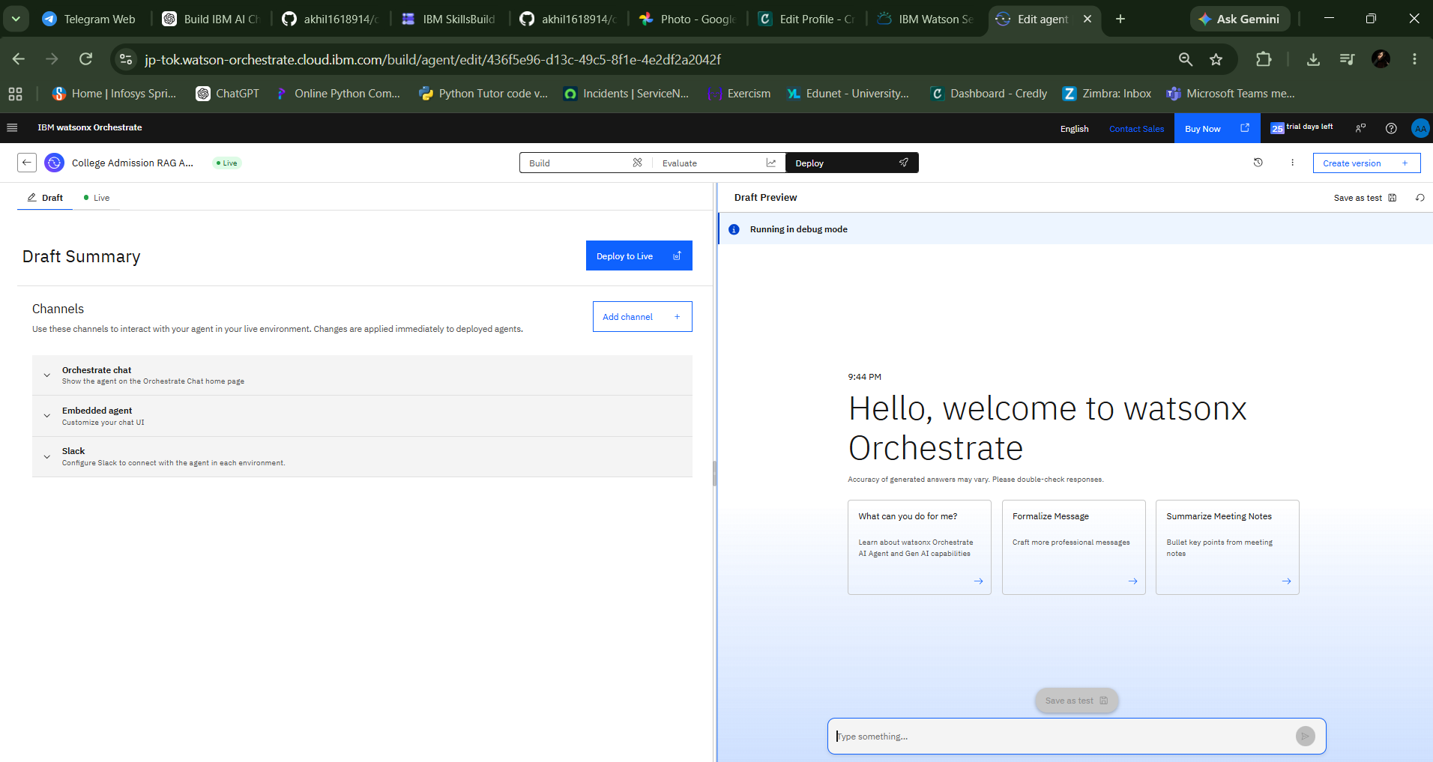
Deployment & Embedded Agent

Slide 19
Novelty and Uniqueness
RAG-based admission assistance grounded in official college information rather than generic AI knowledge.
Combines a public student website with a live embedded IBM watsonx Orchestrate agent.
Answers multiple admission dimensions: courses, intake, eligibility, procedure, fees, documents and contacts.
Explicit anti-hallucination rules prevent invented deadlines, fees and eligibility information.
Student-friendly conversational interface reduces the effort required to search multiple admission pages.

Slide 20
Git Hub Link
Working GitHub Repository
https://github.com/akhil1618914/college-admission-ai
Public repository contains the frontend source code and README setup instructions.
app.json – project submission metadata/configuration file.
Project presentation (.pptx) – this final submission deck.
Problem statement PDF – to be added before final submission if required by the evaluator.
·
·
·

Slide 21
Future Scope
Add verified 2026–27 admission deadlines and automatic update workflows.
Connect additional official institutional sources and structured admission databases.
Add multilingual support for Telugu and other regional languages.
Add application-status and document-checklist assistance through approved integrations.
Add analytics to identify frequently asked admission questions.
Introduce authenticated access and stronger embed security for production deployment.
·
·
·

Slide 22
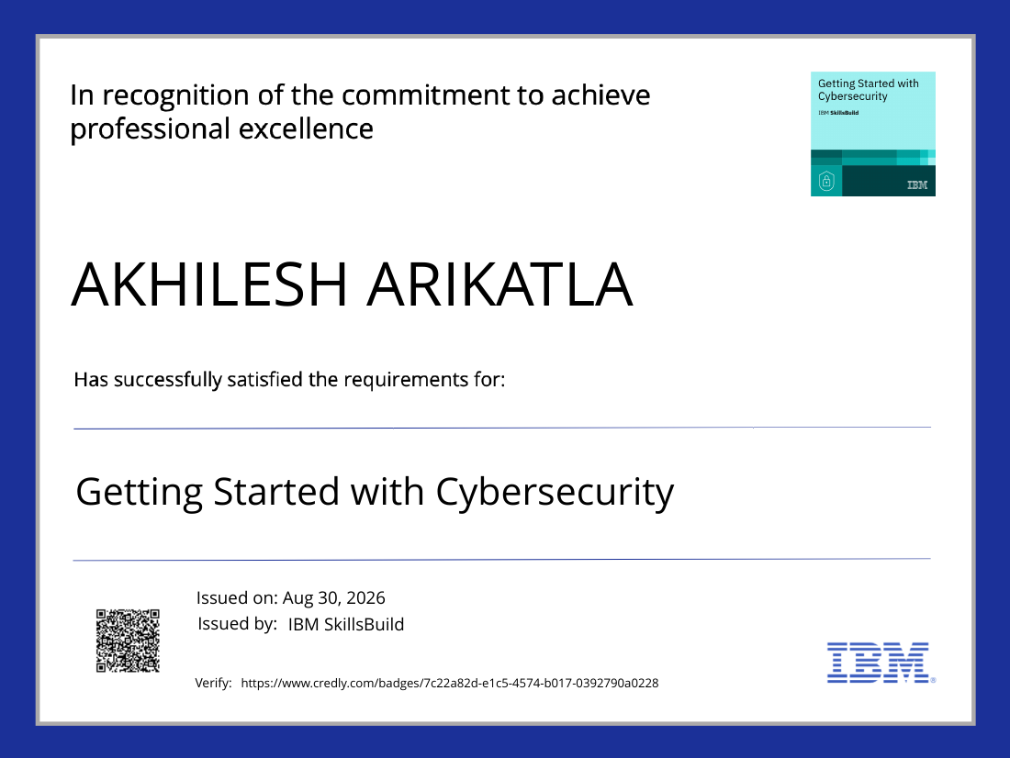
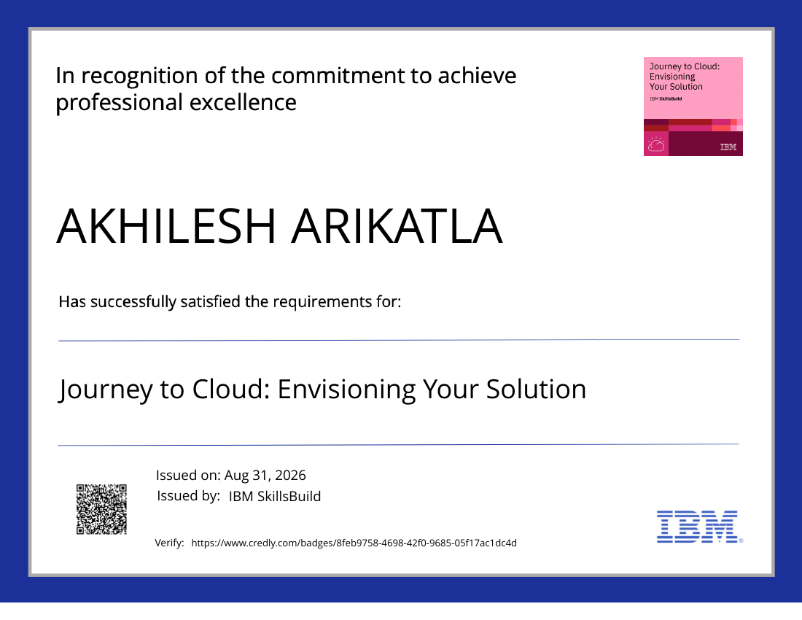
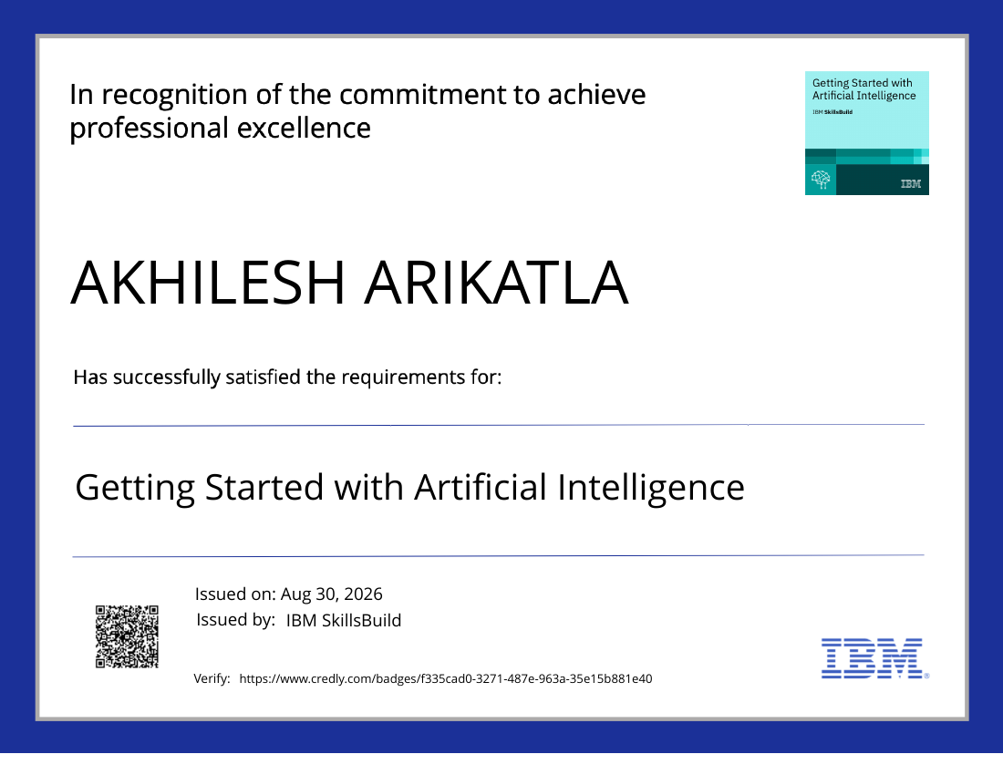
Certificates Earned
IBM SkillsBuild – Getting Started with Cybersecurity
IBM SkillsBuild – Journey to Cloud: Envisioning Your Solution
IBM SkillsBuild – Getting Started with Artificial Intelligence

Slide 23
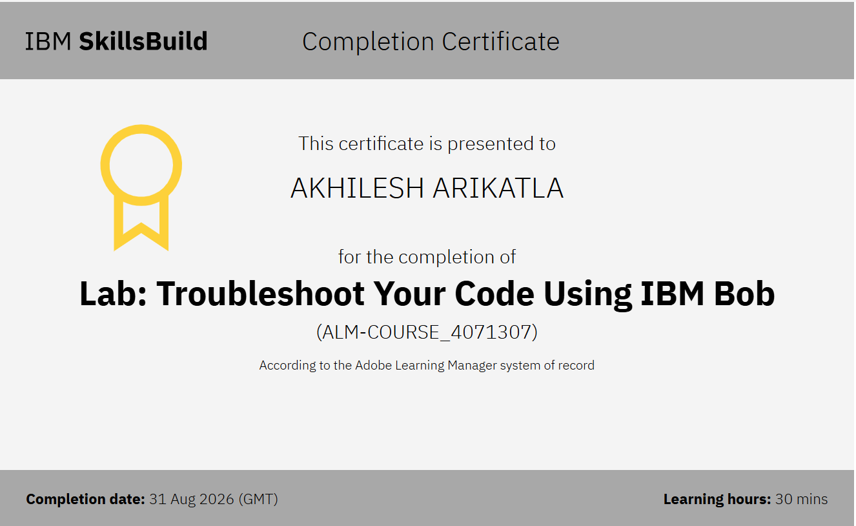
Lab: Troubleshoot Your Code Using IBM Bob certificate

Slide 24


