Slide 1
IE-6200 - Project
Data Analysis with
Wine Dataset
PowerPoint asdf
Group 2:
Sai Akhilesh Ande
Karan Paresh
Arun Sai Chettipally

Slide 2
Dataset Description
12 Attributes (11 Numerical and 1 Categorical)
2 Derived Attributes (Categorical)
1. fixed acidity - Measure of amount of tartaric acid
2. volatile acidity - Excess of volatile acids are undesirable and lead to unpleasant flavor
3. citric acid - Added for freshness
4. residual sugar - Measure of sweetness
5. chlorides - Measure of salinity
6. free sulfur dioxide - Naturally available and also manually added to prevent the growth of undesirable yeasts and oxidation

Slide 3
Dataset Description
7. total sulfur dioxide - Total amount of bound and free SO2
8. density - Measure of conversion of sugar to alcohol
9. pH - Actual acidity of the wine on pH scale
10. sulphates - Measure of sulphur containing salts. Naturally present in wine.
11. alcohol - Measure of Alcohol, formed as a result of sugar
converted by yeast
12. quality (score between 0 and 10) - A score given on evaluation by the wine experts.

Slide 4
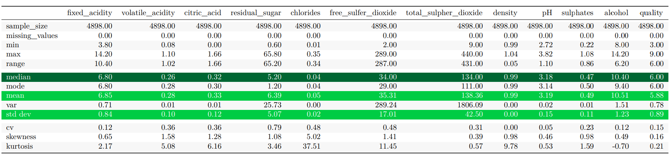
Descriptive Statistics

Slide 5
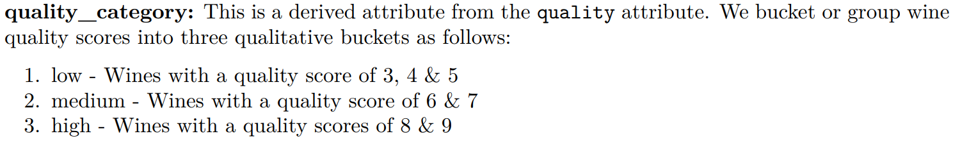
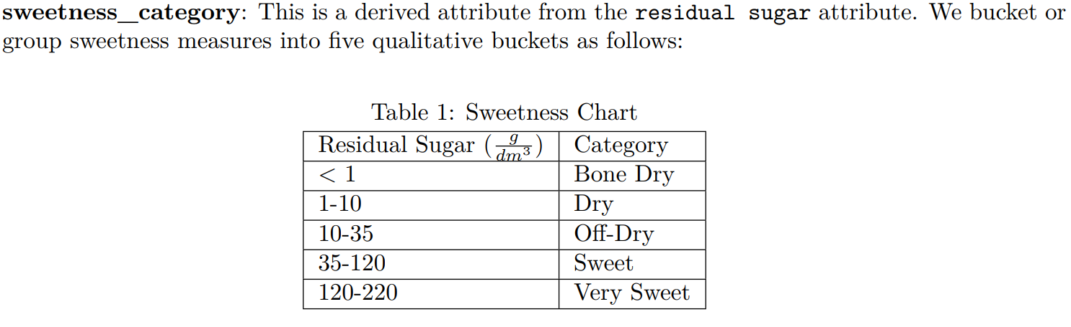
Adding two Categorical Columns

Slide 6
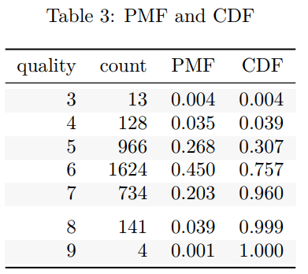
PMF and CDF
X: The R.V. of quality of Dry Wines

Slide 7
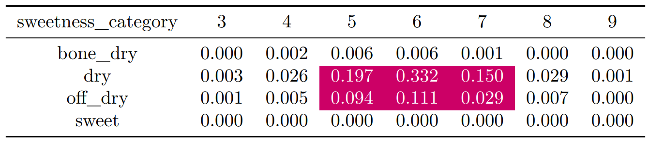
Joint Probability Distribution -
Quality and Sweetness Category

Slide 8
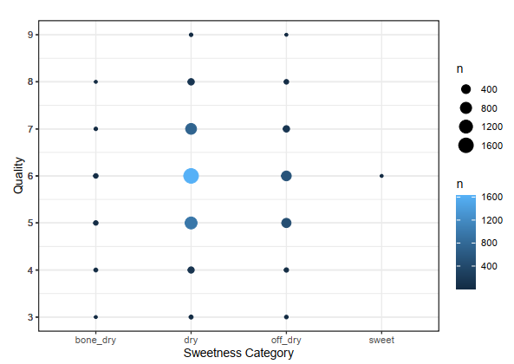
Scatter
Plot

Slide 9
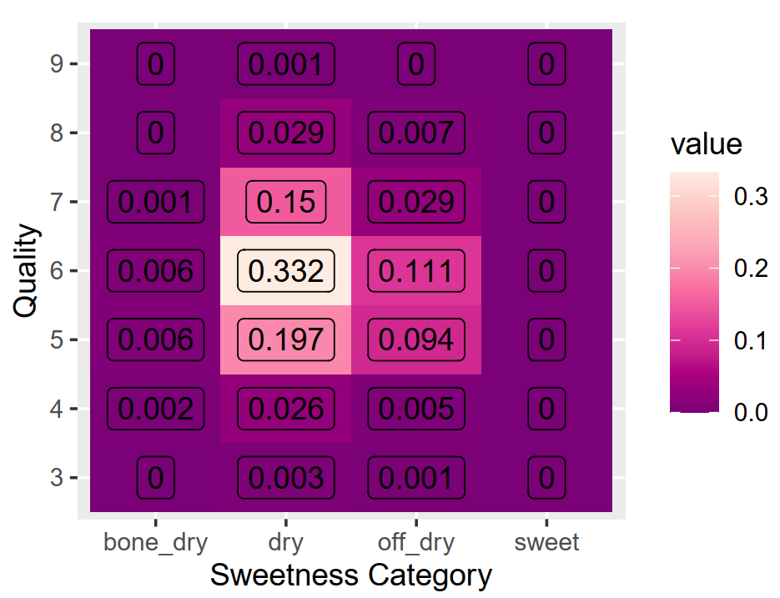
Heat Map
Quality vs Sweetness Category

Slide 10
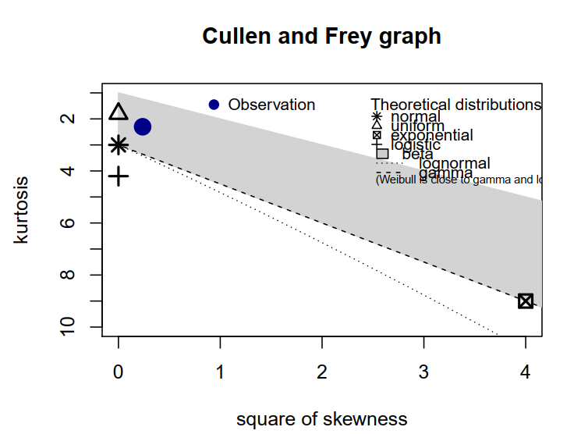
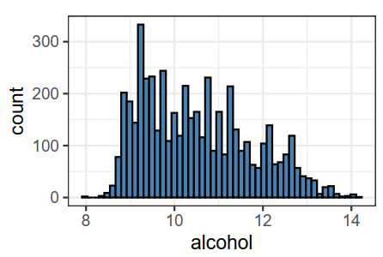
Goodness of Fit Test
Alcohol - Continuous Variable

Slide 11
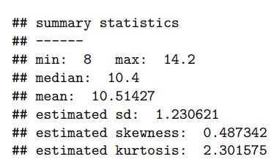

Slide 12
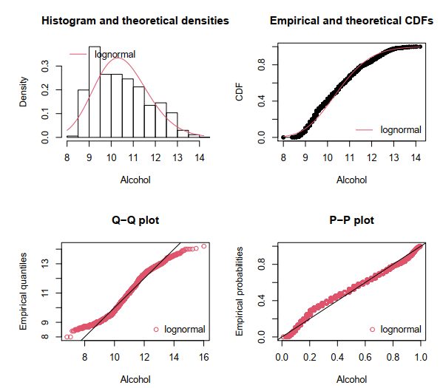

Slide 13
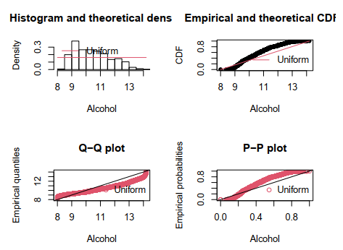

Slide 14
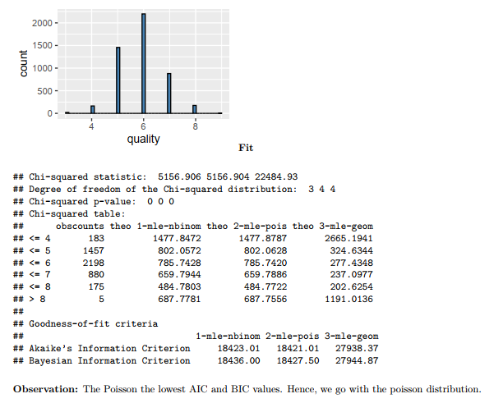
Quality - Discrete Variable

Slide 15
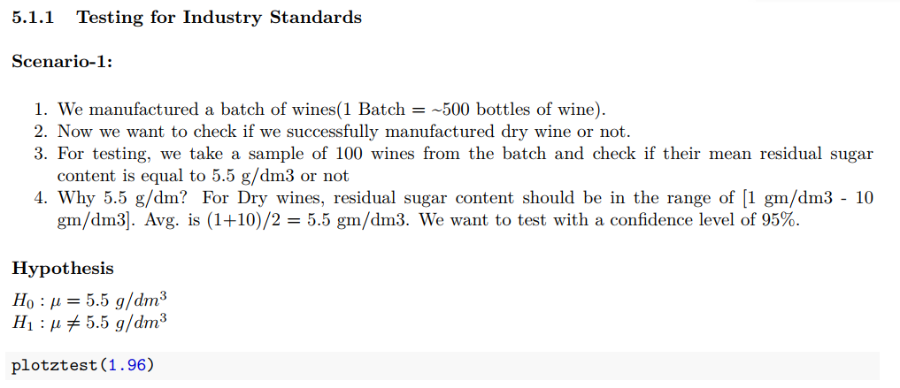
Hypothesis Testing - Z Test (Industry Standard)

Slide 16
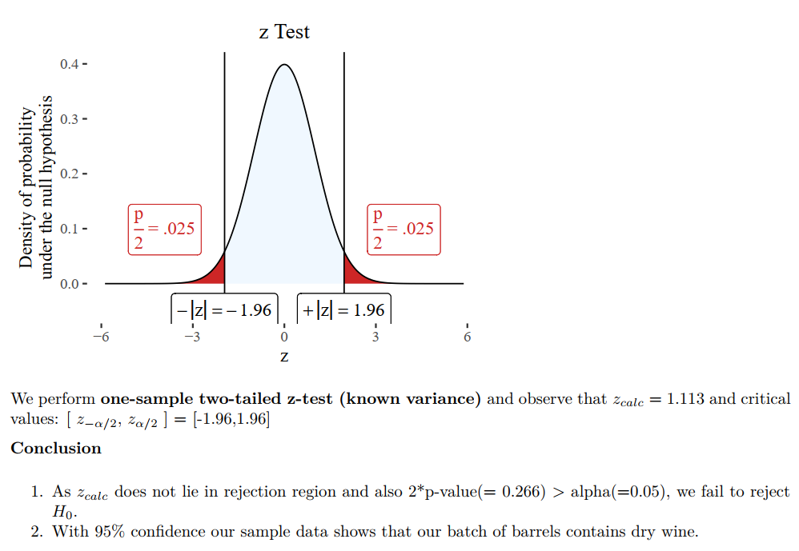
Hypothesis Testing - Z Test (Industry Standard)

Slide 17
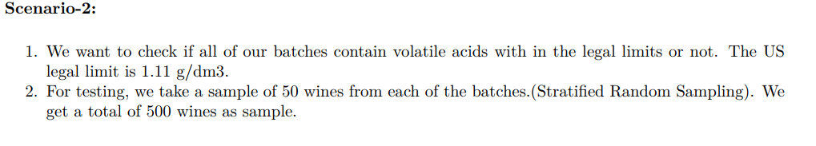
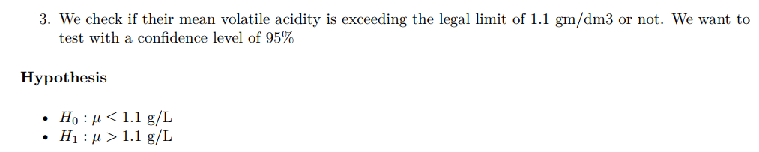
Hypothesis Testing - T Test ( Legal Limits)

Slide 18
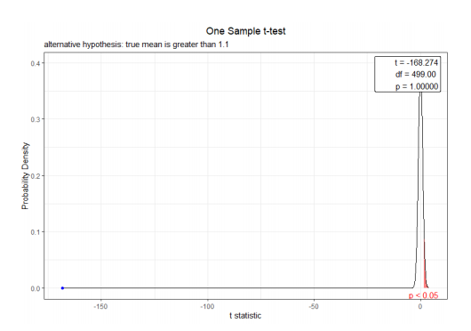
Hypothesis Testing - T Test

Slide 19
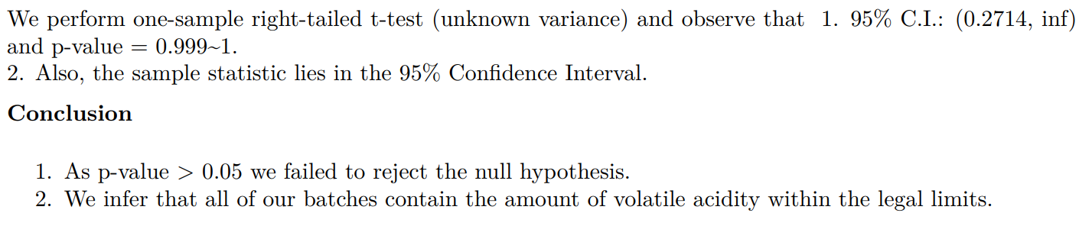
Hypothesis Testing - T Test

Slide 20
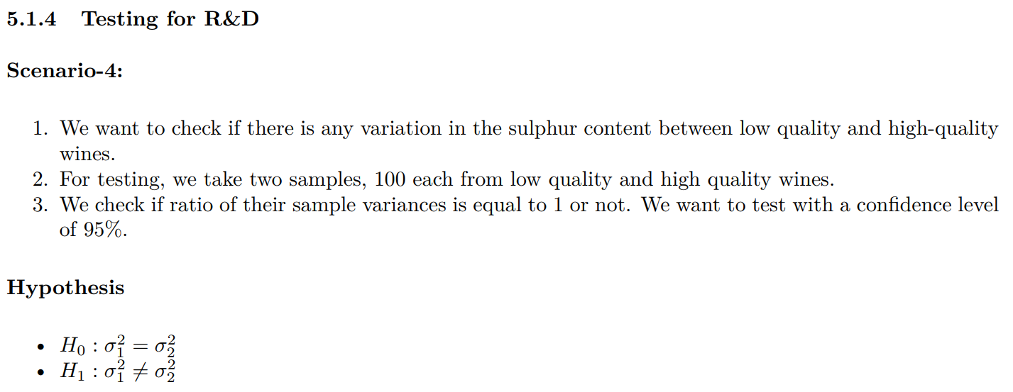
Hypothesis Testing - F Test (Quality Assurance)

Slide 21
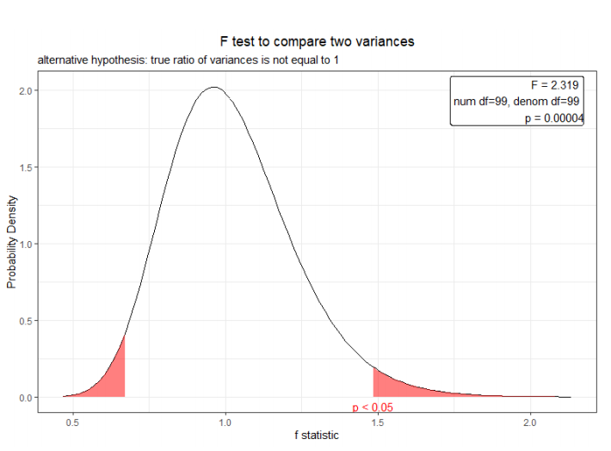
Hypothesis Testing - F Test

Slide 22
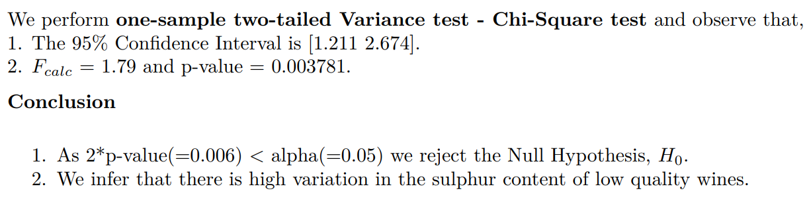
Hypothesis Testing - F Test

Slide 23
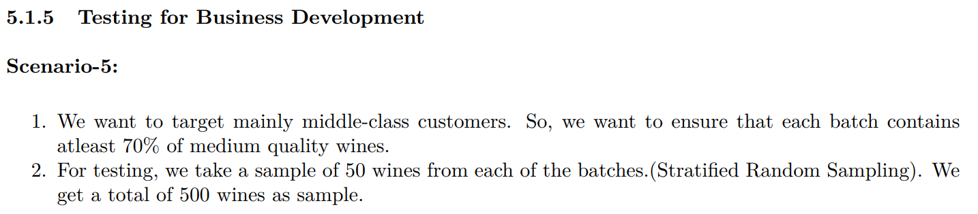
Hypothesis Testing - Proportion Test (Business Development)

Slide 24
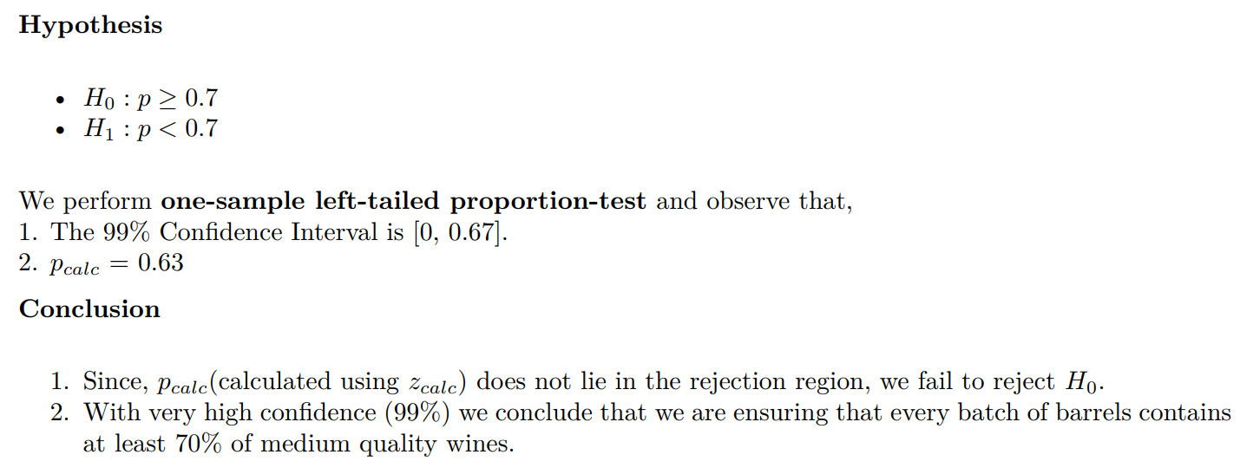
Hypothesis Testing - Proportion Test

Slide 25
Thank you

