Slide 1
ENCRYPTION/DECRYPTION SYSTEM USING VIGENERE CIPHER
I
Team Members -
Hemant Pratap Singh (19BCY10068)
Sakshi Tiwari (19BCY10152)
Akhil Sahukaru (19BCY10015)
Jayant Verma (19BCY10106)
Project Guide - Dr. Nidhi Mishra

Slide 2
INTRODUCTION (1/2)
Recent improvements in information technology, like the internet and electronic mail has made it possible for individual to exchange sensitive information across the globe with security.
However, in spite of all the benefits that these advances in IT offer for information exchange, there are attendant challenges. Messages on transit can be intercepted and accessed by an unauthorized agent.
This phenomenon is known as loss of confidentiality

Slide 3
INTRODUCTION (2/2)
When the information is altered without necessary authorization, we say there is a loss of integrity.
The effect of disruption, loss, or damage to information and information systems are often invaluable to their proprietors.
In many situations, the continuous survival of a business entity depends to a large extent on the security of its proprietary data and information.
Therefore to overcome this problem we use encryption and decryption systems which helps in securing the data.

Slide 4

OBJECTIVE & PROBLEM STATEMENT
Problem Statement -
Intercepted information on transit would make little or no sense to an interceptor if he is not able to decipher the content of the information.
This explains why it is very necessary to ensure that even when an intruder or unauthorised user successfully obtains access to some information the confidentiality and integrity of the information remain uncompromised.
Objective -
To design and implement an application that encrypts and decrypts plain text files using Vigenere Cipher.

Slide 5
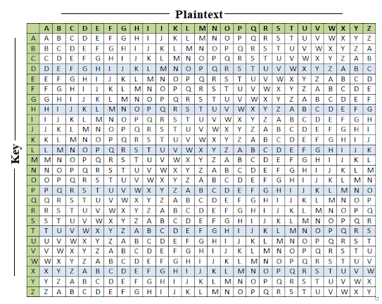
LITERATURE REVIEW
Vigenere Cipher - Vigenere Cipher is a method of encrypting alphabetic text. It uses a simple form of polyalphabetic substitution.
The encryption of the original text is done using the Vigenère square or Vigenère table.
This CIpher will be converted into an algorithm with the help of mathematical formulae and then be put into an Encryption and Decryption System

Slide 6
PROPOSED WORK
Automation of encryption and decryption which will consume less time in comparison to the existing method
Building a user friendly GUI for the Encryption System which will require minimum amount of inputs.
Implementation of knowledge of Cryptography (Vigenere Cipher)

Slide 7
HARDWARE & SOFTWARE REQUIREMENTS
HARDWARE REQUIREMENTS:
Modern Operating System:
Windows 7 or 10
Mac OS X 10.11 or higher, 64-bit
Linux: RHEL 6/7, 64-bit (almost all libraries also work in Ubuntu)
x86 64-bit CPU (Intel / AMD architecture)
4 GB RAM
5 GB free disk space
SOFTWARE REQUIREMENTS:
Visual Studio Code
Python & Tkinter (Library):
Tkinter is the Python interface to the Tk GUI toolkit shipped with Python.

Slide 8
ARCHITECTURE AND FLOWCHART
START
MESSAGE / CIPHER TEXT
KEY
VIGENERE CIPHER PROCESS
ENCRYPTED OUTPUT / DECRYPTED OUTPUT
STOP

Slide 9


MODULES AND THEORY
Encryption:
The main letter of the plaintext, alphabet S is that is in a row combined with alphabet L is the key that is a column, the primarily given letter of the sender and receiver side key that results in the output as D.
Similarly, other letters will be processed in the same format and will result in encoded message. The plaintext (P) and key (K) is added to the modulus of 26.
The plaintext (P) and key (K) are added to modulus of 26.
Decryption:
Decryption is resulted by systematically heading off to the row in the table comparing to key, finding the situation of the ciphertext letter that is in this row, and afterward utilizing the column’s name as plaintext.
Similarly, the other alphabets will be seen in row and column and then the exact plaintext will come as output.
The simpler and easier approach is to view Vigenere logarithmically and changing over alphabets [A-Z] into numerically as [0-25].
Tkinter:
Tkinter is a Python binding to the Tk GUI toolkit.
It is the standard Python interface to the Tk GUI toolkit, and is Python's de facto standard GUI.

Slide 10
MODULE WORKFLOW
Import the Tkinter module.
Create Algorithm for Vigenere Cipher
Enter the main event loop to take action against each event triggered by the user
First Step
Third Step
Fifth Step
Second Step
Fourth Step
Sixth Step
Create the GUI application main window and adding of widgets
Add Algorithm Created for Vigenere Cipher
Testing of Application

Slide 11
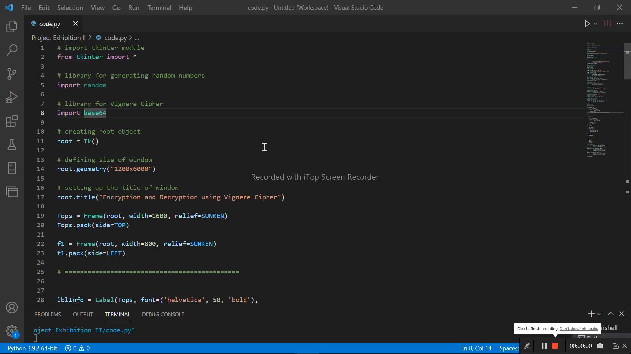
IMPLEMENTATION & DEMO
VIDEO

Slide 12
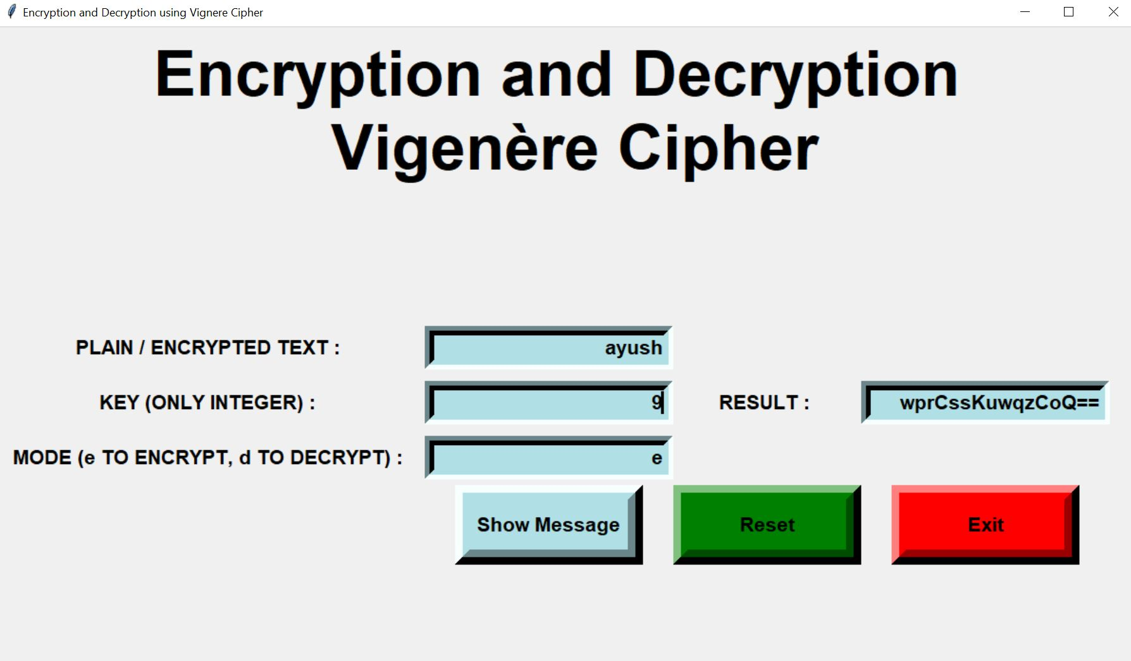
RESULTS AND DISCUSSION
There are two modes in this system –
Encryption
Decryption
According to the respective mode the plain or encrypted text is taken as an input
The key is very important for both the modes
The result will be shown as a plain text or as an encrypted text according to the mode of the system

Slide 13
CONCLUSION
We successfully developed an Encryption and Decryption System using Vignere Cipher and Base 64 algorithms
Sensitive information can be passed from one place to another without getting compromised

Slide 14
REFERENCES
Madji, A. and Lin, Y. H. (2007). Simple Encryption/Decryption Application. Internation Journal of Computer Science and Security, Vol. 1, Issue (1), pp. 33 – 40.
Stallings, W. (2011). Cryptography and Network Security: Principles and Practice (5th ed.). NY, US: Prentice Hall.
Henry, D. (n.d.) RSA: Asymmetric Cryptography and Algorithm Analysis for a Secure Computing Environment. Retrieved from www.dwhenry.com/files/RSA. pdf

Slide 15
THANK YOU

