Slide 1
USER AUTHENTICATION USING KEYSTROKE DYNAMICS
NAME – AKHIL SAHUKARU
Mentor – RAJESH S IYER
Notes:
This presentation makes use of the speaker notes to capture the 2 or 3 key points for each slide

Slide 2
USER AUTH BASED ON KEYSTROKES(BEHAVIORAL PATTERNS)
Problem Statement
Brute Force attacks allows an attacker to guess a person's user name, password, credit card number, or cryptographic key by using an automated process of trial and error. Such attacks have been in raise by over 80% since Covid-19 pandemic
Imposters trying to authenticate using compromised passwords need to be identified and promptly blocked
Typing biometrics can extensively be used in cyber and computer security
Solution & Approach
Keystroke dynamics refers to detailed timing information which describes exactly when each key was pressed and when it was released
Typing patterns of users typing a same password will be recorded into a dataset
The sets of timing features are extracted, which will be fed into user detection algo
Step 1 –
ML model will be trained with the keystroke patterns of the users
Step 2 –
Test data with keystroke patterns of authorized and unauthorized users (imposters) will be provided
Step 3 –
Model will be able to distinguish authorized users from imposters based on the test data
Use of One-Class models
Outcome
The model will be able to detect if an imposter is trying to authenticate based on the his/her typing pattern of the password
The detection will be based on the data of authentic users whose typing patterns have already been collected

Slide 3
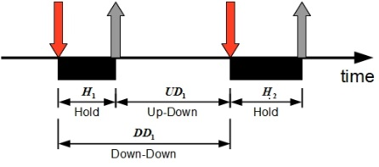
DATASET AND TIMING INFORMATION
[Keystroke timing-info of 50 Subjects each typing a same password (tie5Roanl) 400 times]
TIMING INFORMATION
COLUMN NAME | ACTION | DESCRIPTION
H.key | Hold Time for Named Key | Time from when key was pressed to when it was released
DD.key1.key2 | KeyDown-KeyDown time for the named digraph | Time from when key1 was pressed to when key2 was pressed
UD.key1.key2 | KeyUp-KeyDown time for the named digraph | Time from when key1 was released to when key 2 was pressed
PICTORIAL REPRESENTATION

Slide 4
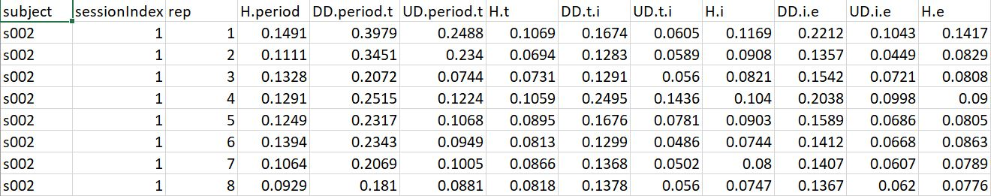
DATASET

Slide 5
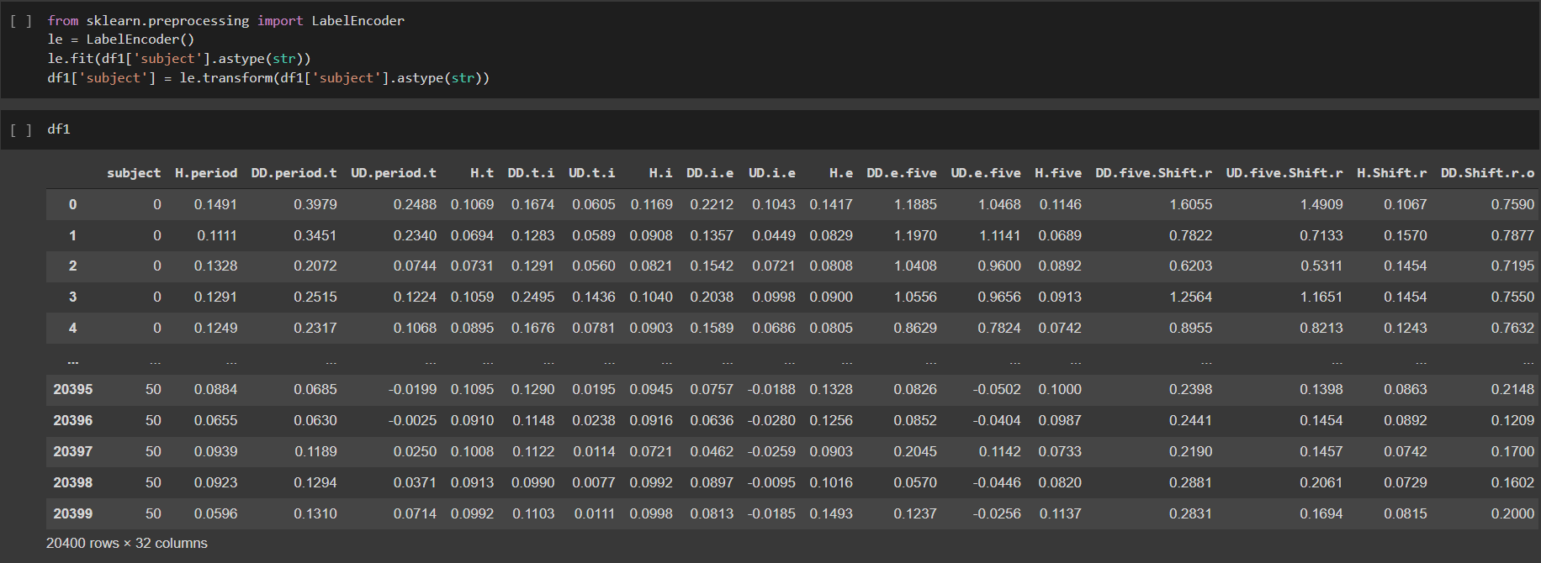
MACHINE LEARNING MODEL & TRAINING
ML MODEL
ONE CLASS SUPPORT VECTOR MACHINE
The dataset has all the users classified as authorized
Therefore there is only One-Class present for training
One-class SVM is an unsupervised algorithm that learns a decision function for novelty detection: classifying new data as similar or different to the training set.
LABEL ENCODING & TRAINING
The feature ‘Subject’ has a datatype – string
Use of LabelEncoder() for converting string to integer
Model will be trained after LabelEncoding
TRAINING
LABEL ENCODING

Slide 6
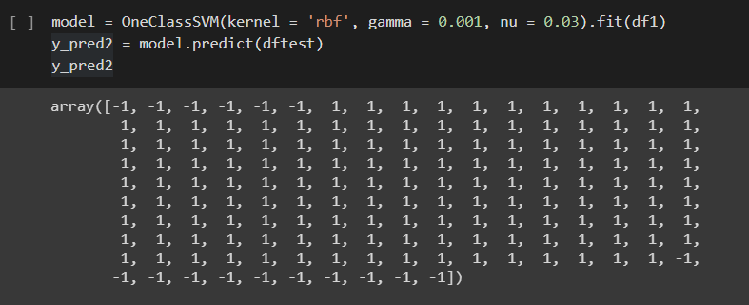
MODEL TESTING
A separate dataset – ‘Test Dataset’ is created having information of the existing users, on which the model is trained, and some modified information to consider as unauthorized users.
The model is able to detect these authorized and unauthorized users as ‘inliers’ and ‘outliers’, in terms of ‘1’ and ‘-1’ respectively
TESTING ON TEST DATA

Slide 7
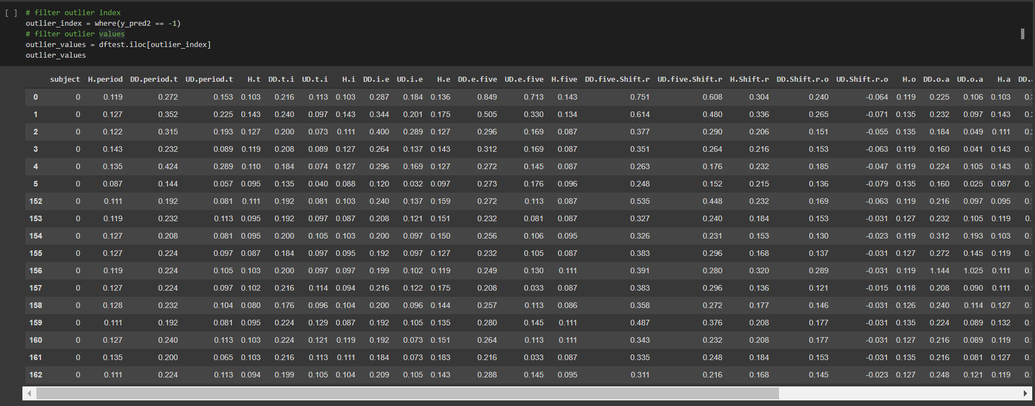
FILTERING OUTLIERS (UNAUTHORIZED USERS) FROM TEST DATA
The outliers, represented as -1, can be filtered
Information of the unauthorized user can be acquired
Actions and precautions can then be taken
OUTLIER DATA AFTER FILTERING ‘-1’

Slide 8


Thank you
Notes:
We really appreciate your time, thoughts and collaboration

