Slide 1
MOBILE PROCESSOR ONTOLOGY
Presented by:
AKHIL REDDY

Slide 2
Introduction:
The performance of your smart phone is influenced by many factors, but there’s one essential element Important for your smart phone—the processor.
The processor is the central hub of your smart phone. It receives and executes every command, performing billions of calculations per second.

Slide 3
The CPU, GPU, audio and video engine, connectivity features (GPS, WiFi, FM), and 3G/4G modem are the major components of a processor that control the operation of your smart phone.
An all-in-one processor brings all of your smart phone’s major components together, improving performance and efficiency

Slide 4
HISTORY:
In 1970, Intel introduced the first single chip microprocessor, the Intel 4004.
It had 2,600 manually placed transistors and clocking frequency of 100 KHz.
The mobile processors are responsible for the typical mobile phones of 1990’s to modern smart phones.

Slide 5
TYPES OF PROCESSORS:
There are many types of the processors depending upon their specifications . Some of the most widely used processors are:
Qualcomm Snapdragon Processors
Nvidia Tegra Processors
Mediatek processors
Samsumg exynos processor
Apple mobile processors
Hisilicon Kiran
Intel Atom

Slide 6
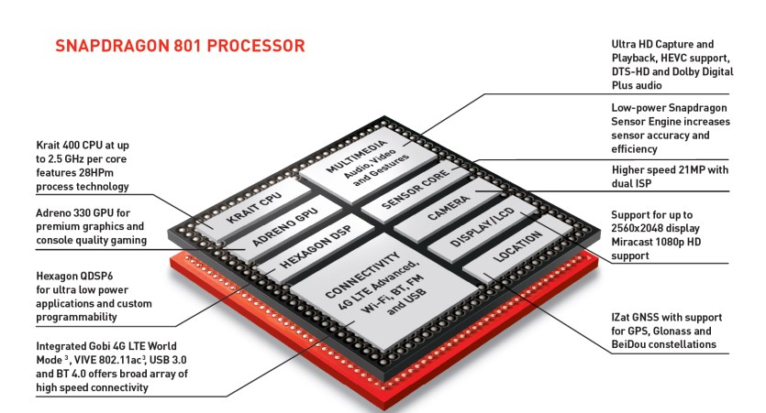
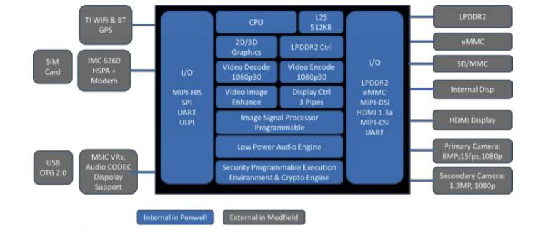
BLOCK DIAGRAM

Slide 7
COMPONENTS OF MOBILE PROCESSOR:
Some of the important components mobile processor are:
CPU
GPU
Audio and video engine
Connectivity features (GPS, WiFi, FM)
3G/4G modem

Slide 8
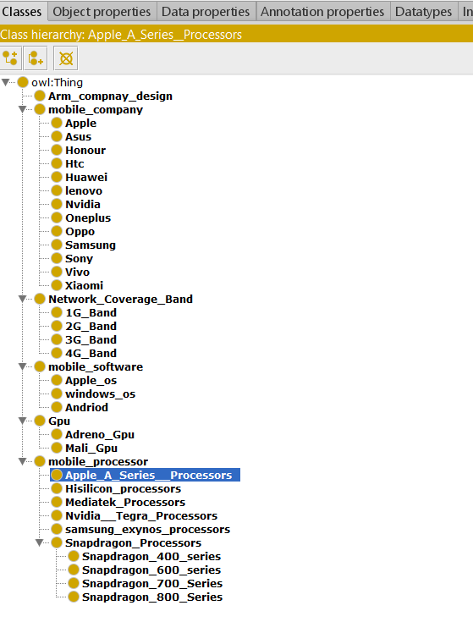
Ontology: Class Hierarchy The classes are of different types, namely, subclass, superclass, intersection class, union class, and complement class.

Slide 9
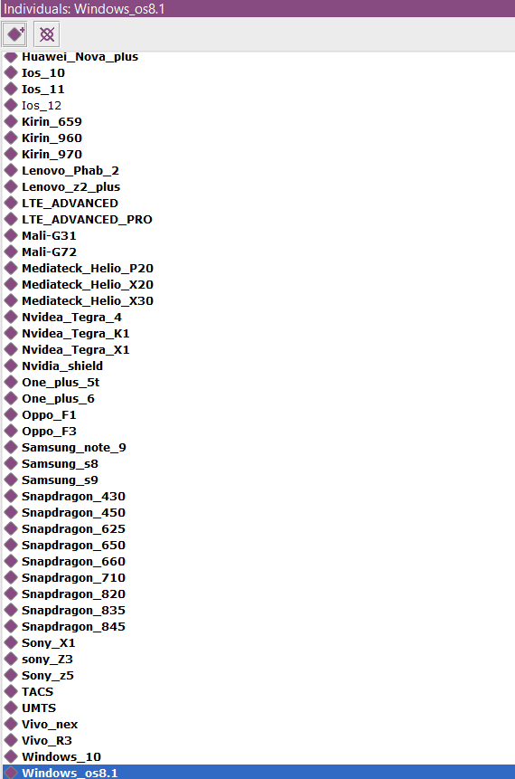
Individual: Instances for all classes and sub classes

Slide 10
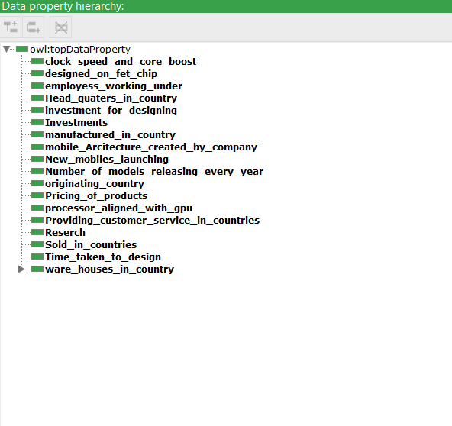
Data Properties:
Describes relationships between instances and data values.

Slide 11
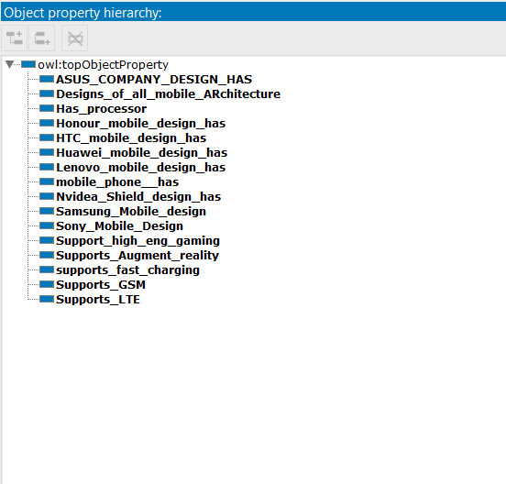
Object Properties:
Describes the relationship between two classes or two instances.
Characteristics:
Functional
Inverse Functional
Transitive
Symmetric
Asymmetric
Reflexive
Irreflexive

Slide 12
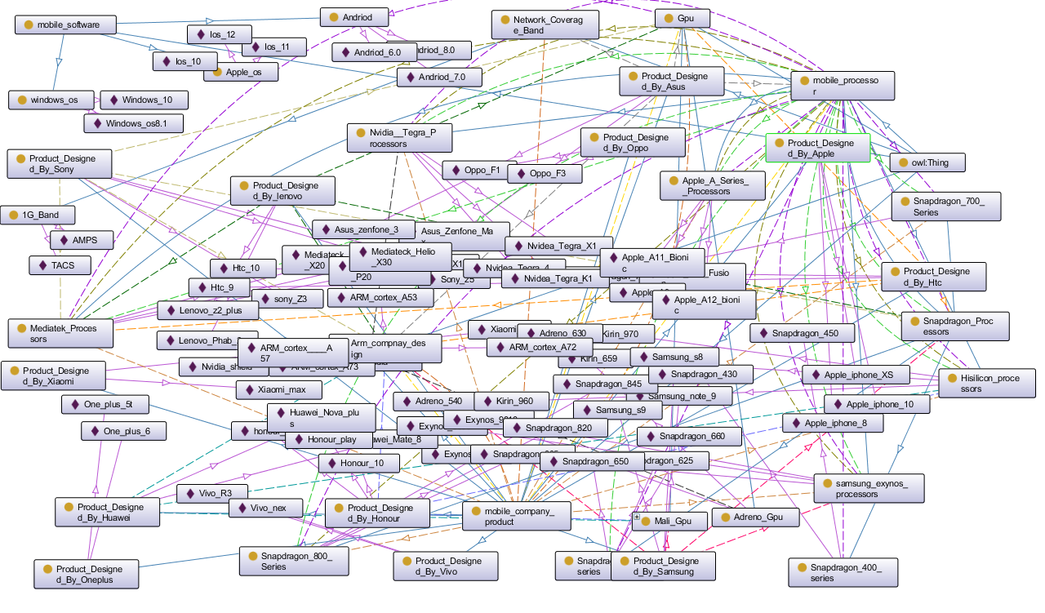
ONTO GRAPH:

Slide 13
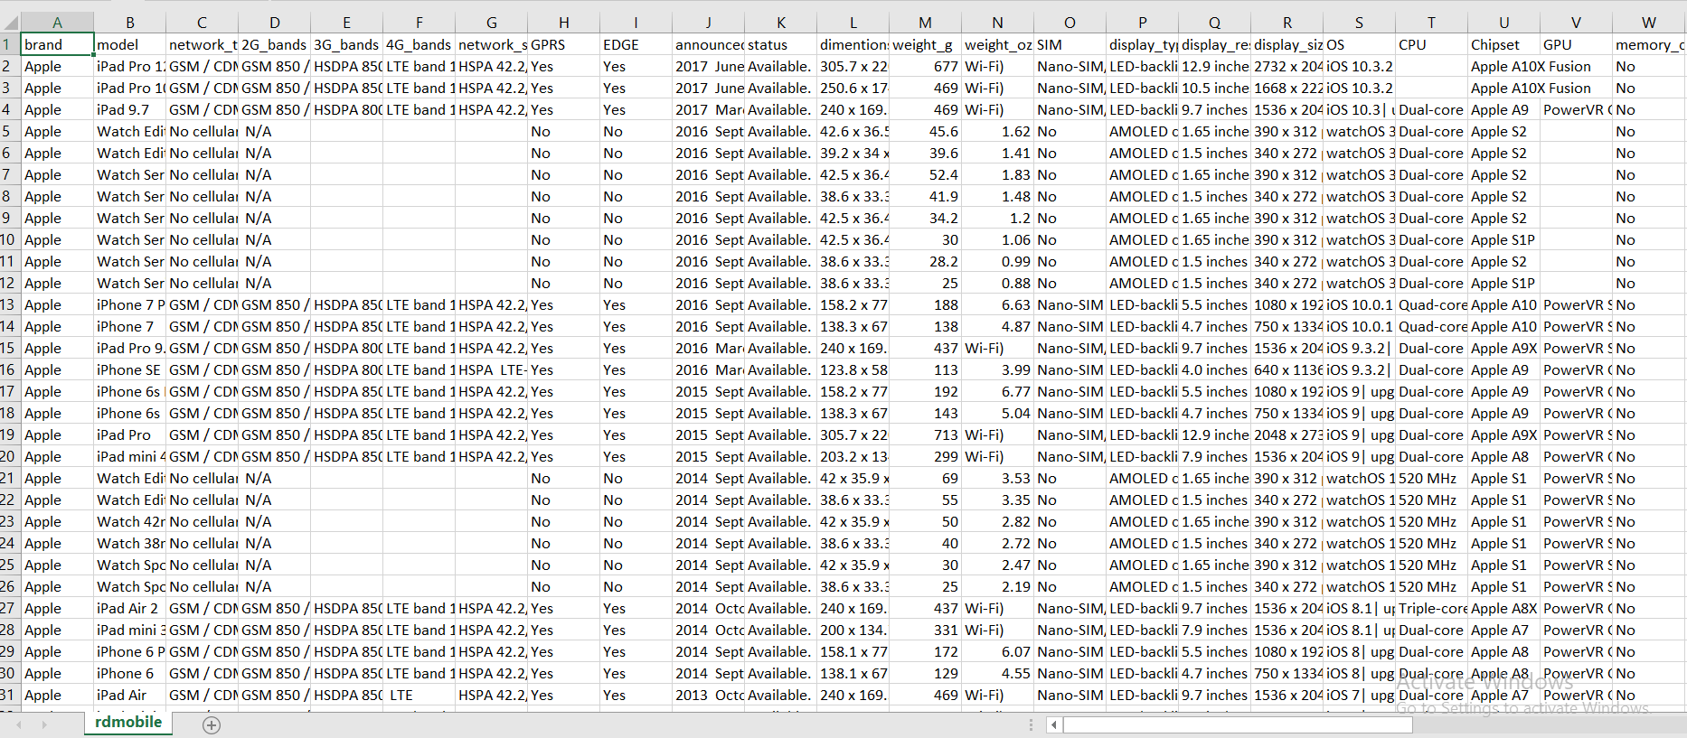
DATA SHEET :

Slide 14
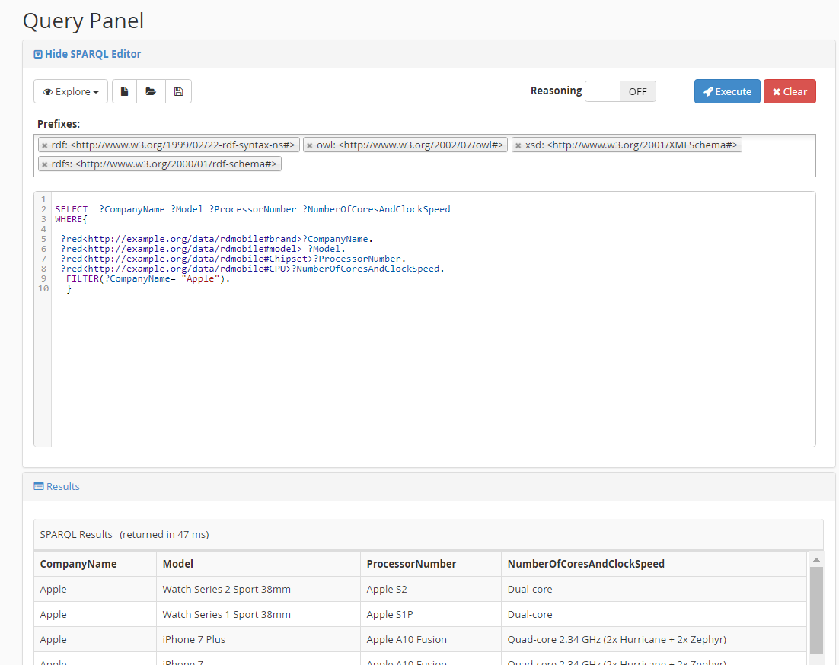
RESULT FROM STARDOGS :

Slide 15
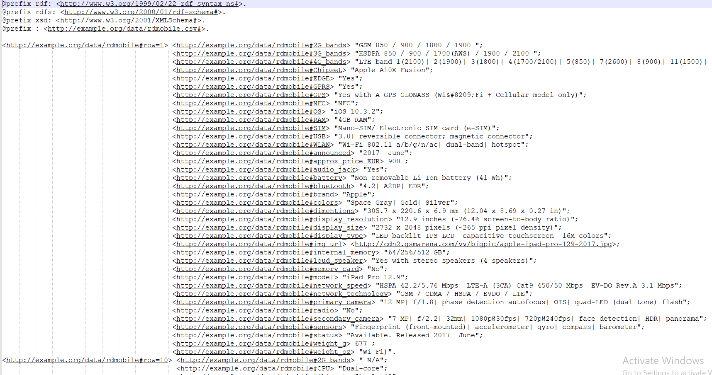
TURTLE FORMAT CONVETED FILE :

Slide 16
THANK YOU

