Slide 1
Data Pre-Processing Team
Akriti Saxena
Jhansi Ponnada
R Venkat Rao

Slide 2
Data Pre-Processing Steps
Reading the grocery data
Understanding the data
Identifying the Target variable
Looking at the distribution of Target variable
Basic Data Exploration
Visual Exploratory Data Analysis
Feature Selection
Outlier treatment
Missing Values treatment
Visual correlation analysis
Feature Scaling
Sampling and K-fold cross validation

Slide 3
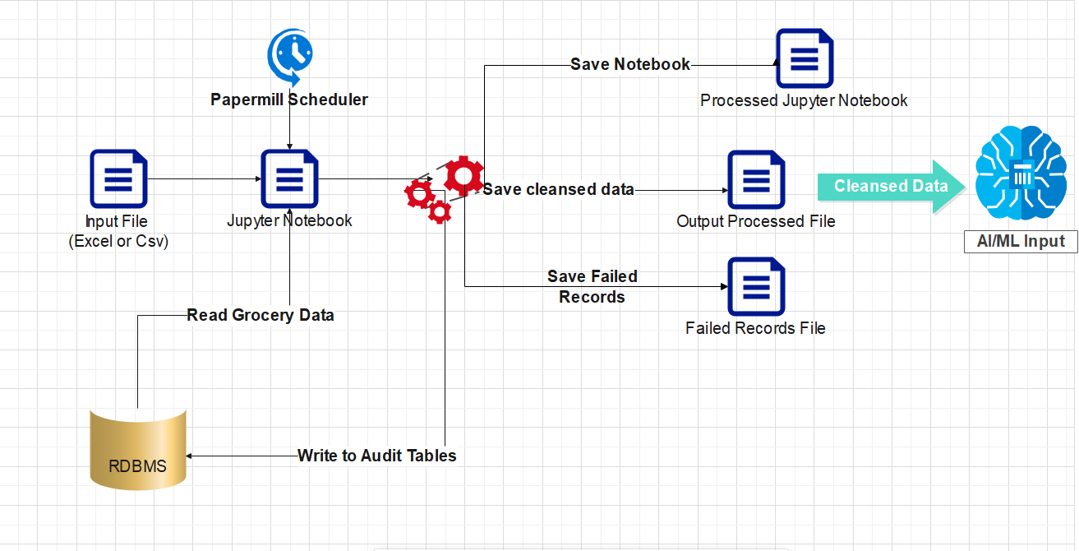
High Level Flow of Data Pre-processing

Slide 4
Tools and Technologies
Technology
Libraries
Pandas
Matplotlib
Seaborn
Numpy
MySQL Connector
Tools
Python 3.8
My SQL
Papermill for Scheduling Notebooks
Jupyter Notebook
Storage (S3 or File Structure)

Slide 5
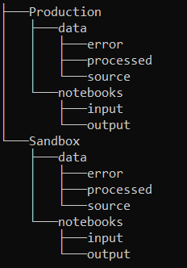
S3/File Structure

Slide 6
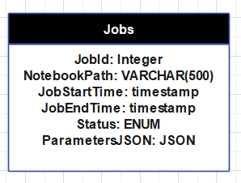
RDBMS Jobs Audit Table

Slide 7
Security
Read Access to AI/ML Team on the Production S3 Bucket
Read/Write Access to Data Pre-Processing Team on the Sandbox S3 Bucket
Read Access to AI/ML Team on the RDBMS Audit Tables
Read Access to Data Pre-Processing Team on the RDBMS Audit Tables

