Slide 1
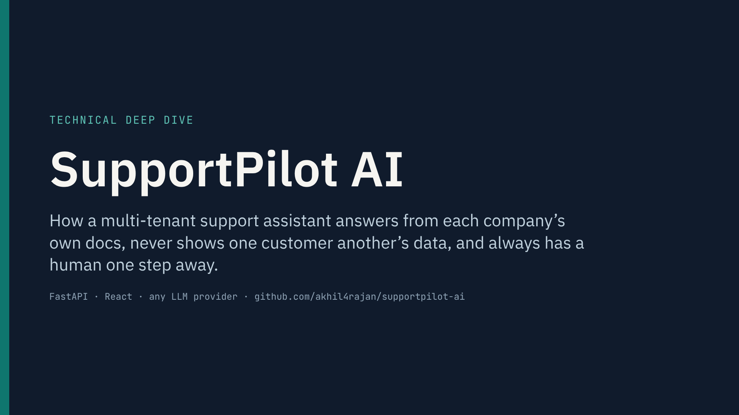
Notes:
Hi, I’m Akhil. This is SupportPilot AI, a customer-support assistant I built that any company can drop onto its website with one script tag.
In this video I’ll go under the hood: the architecture, what happens on a single customer message, the four problems that make support AI hard (grounding, identity, human handoff and failure handling), and how I test that it’s ready for production, including the parts that aren’t ready yet.
Everything you’ll see runs locally from the public repo.

Slide 2
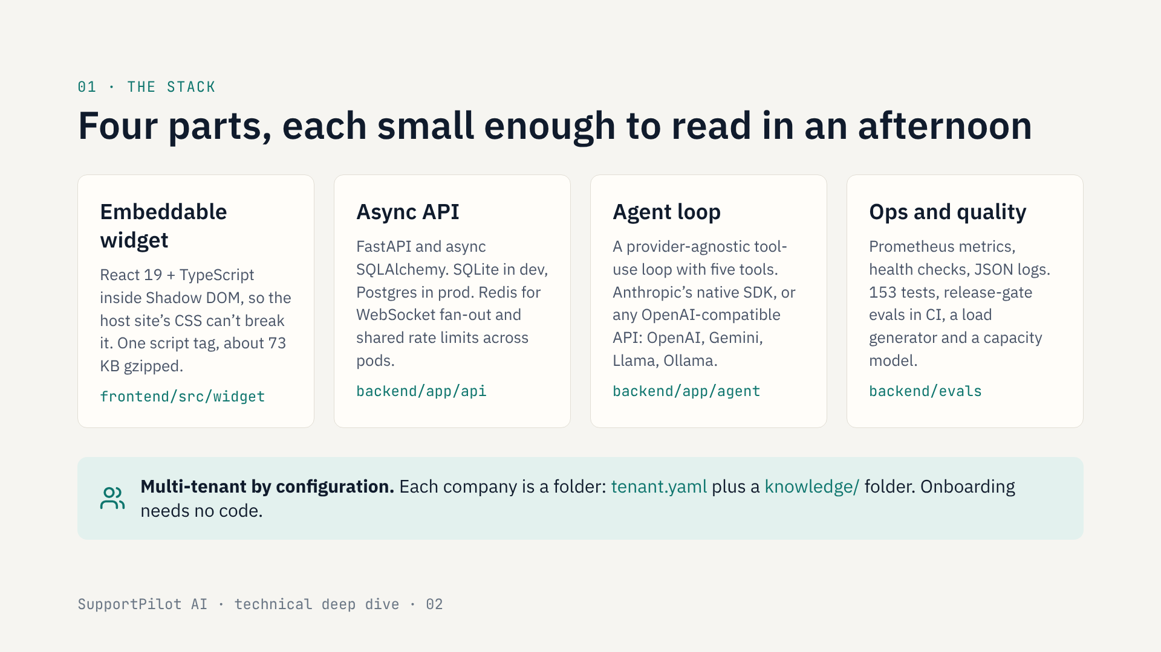
Notes:
The system has four parts.
The widget is a React app rendered inside Shadow DOM. That matters because it lives on someone else’s website, and their CSS must not leak in and break it. A company adds it with one script tag.
The backend is an async FastAPI service. It runs on SQLite locally and Postgres in production, with Redis for anything that has to be shared between replicas, like live chat messages and rate limits.
The heart of it is the agent loop: a tool-use loop that works with any model provider. You switch from Anthropic to OpenAI to a self-hosted Llama with one environment variable.
And there’s a quality layer: metrics, tests, evaluation gates that run in CI, and a load tester.
One design choice to call out: it’s multi-tenant by configuration. A new company is a folder with a YAML file and their documents. No code changes.

Slide 3
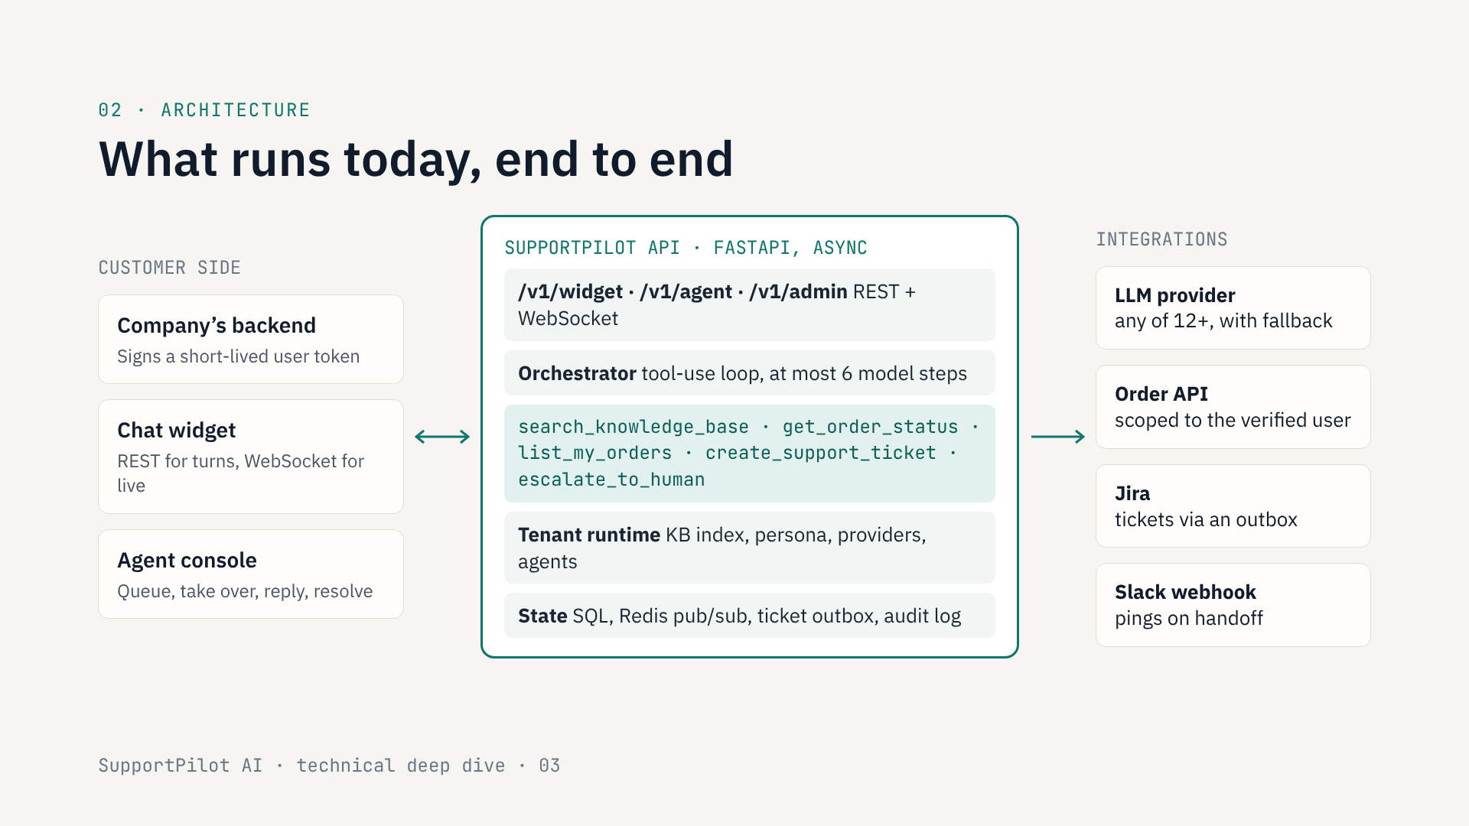
Notes:
Here’s the whole system as it runs today.
On the left is everything on the customer’s side. The company’s own backend signs a short-lived token saying who the logged-in user is. The widget talks to my API over REST for each message and a WebSocket for live updates. The agent console is where human support staff pick up conversations.
In the middle is the SupportPilot API. Three route groups: widget, agent and admin. The orchestrator runs a tool-use loop, capped at six model steps. The model can call exactly five tools: search the knowledge base, look up an order, list my orders, create a ticket, or escalate to a human.
Each tenant has its own runtime: its own knowledge-base index, persona, providers and agents.
On the right are integrations: the LLM provider, which can be any of a dozen with a fallback, the company’s order API, Jira for tickets, and an optional Slack webhook.
Next I’ll trace a single customer message through this.

Slide 4
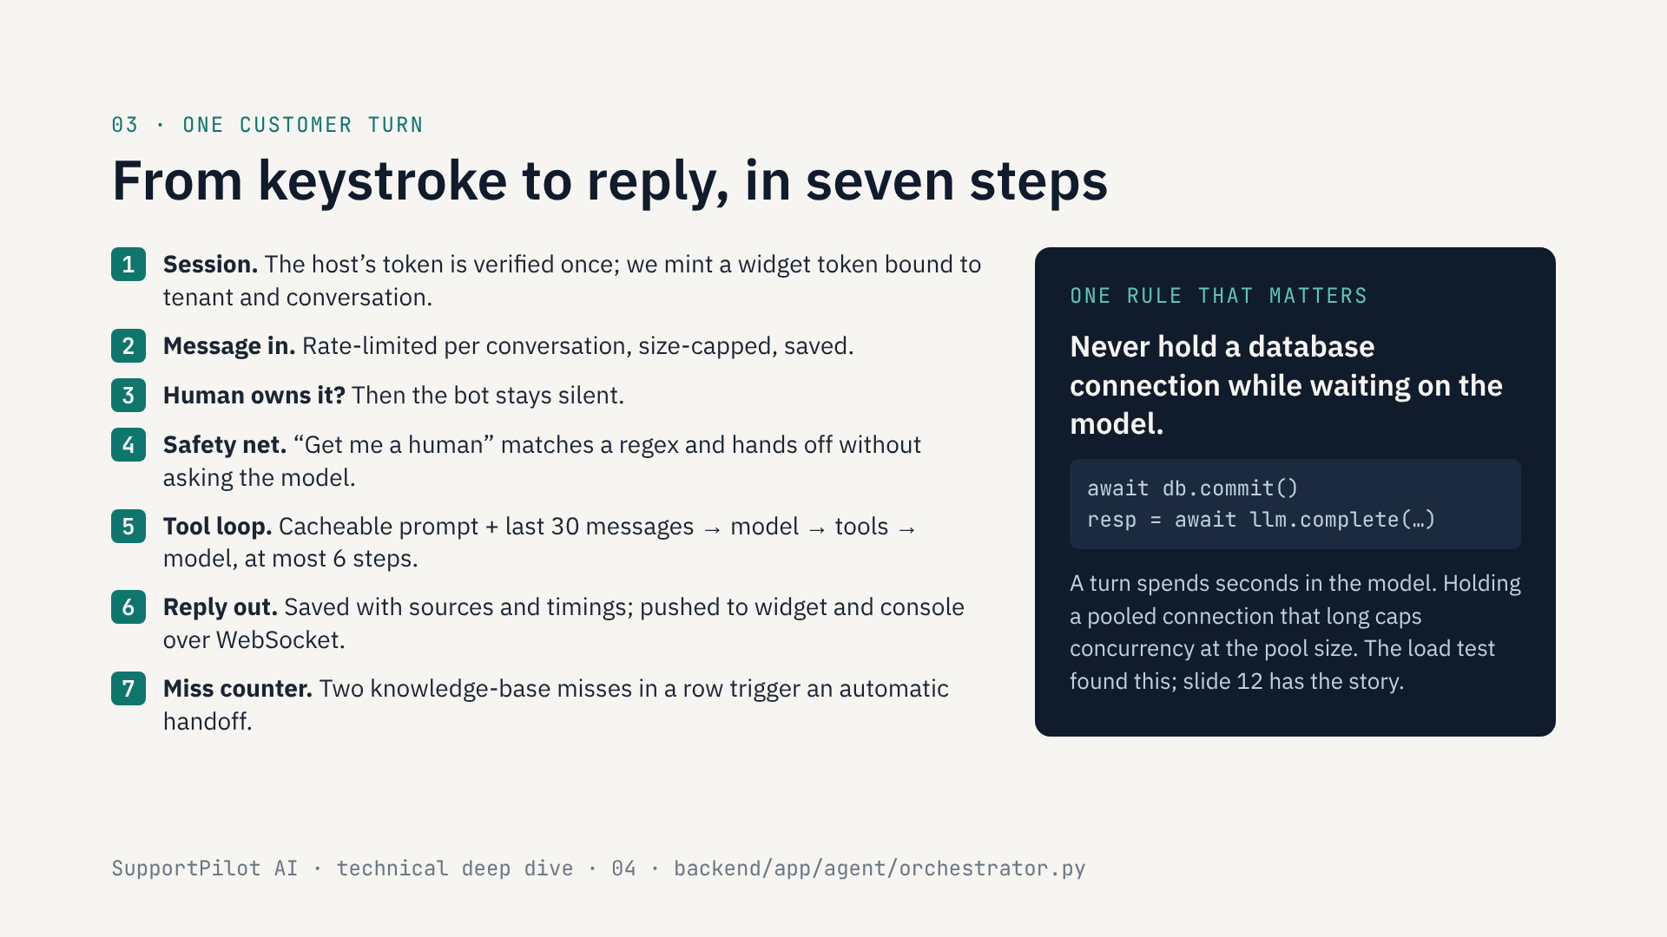
Notes:
Let’s follow one message.
Step one happens once per conversation: the widget hands over the token the company’s backend signed. I verify signature, audience and expiry, and mint my own widget token bound to this tenant and this conversation. From then on the user’s identity is stored on the conversation server-side.
Two: the message comes in. It’s rate-limited per conversation and size-capped, then saved.
Three: if a human agent currently owns the conversation, the bot does nothing.
Four: a deterministic safety net. If someone types something like “let me talk to a person”, a regex catches it and hands off immediately. An explicit request for a human should never depend on model behaviour.
Five is the tool loop. The system prompt is split into a static part, identical for every conversation of a tenant so the provider can cache it, and a small dynamic part. The model can call tools, get results, and call more, up to six steps.
Six: the reply is saved with its sources, and pushed over WebSocket to the widget and the console.
Seven: if the knowledge base had nothing relevant twice in a row, the conversation automatically goes to a human.
The box on the right is one line of code that turned out to matter a lot. I’ll come back to it on the load-testing slide.

Slide 5
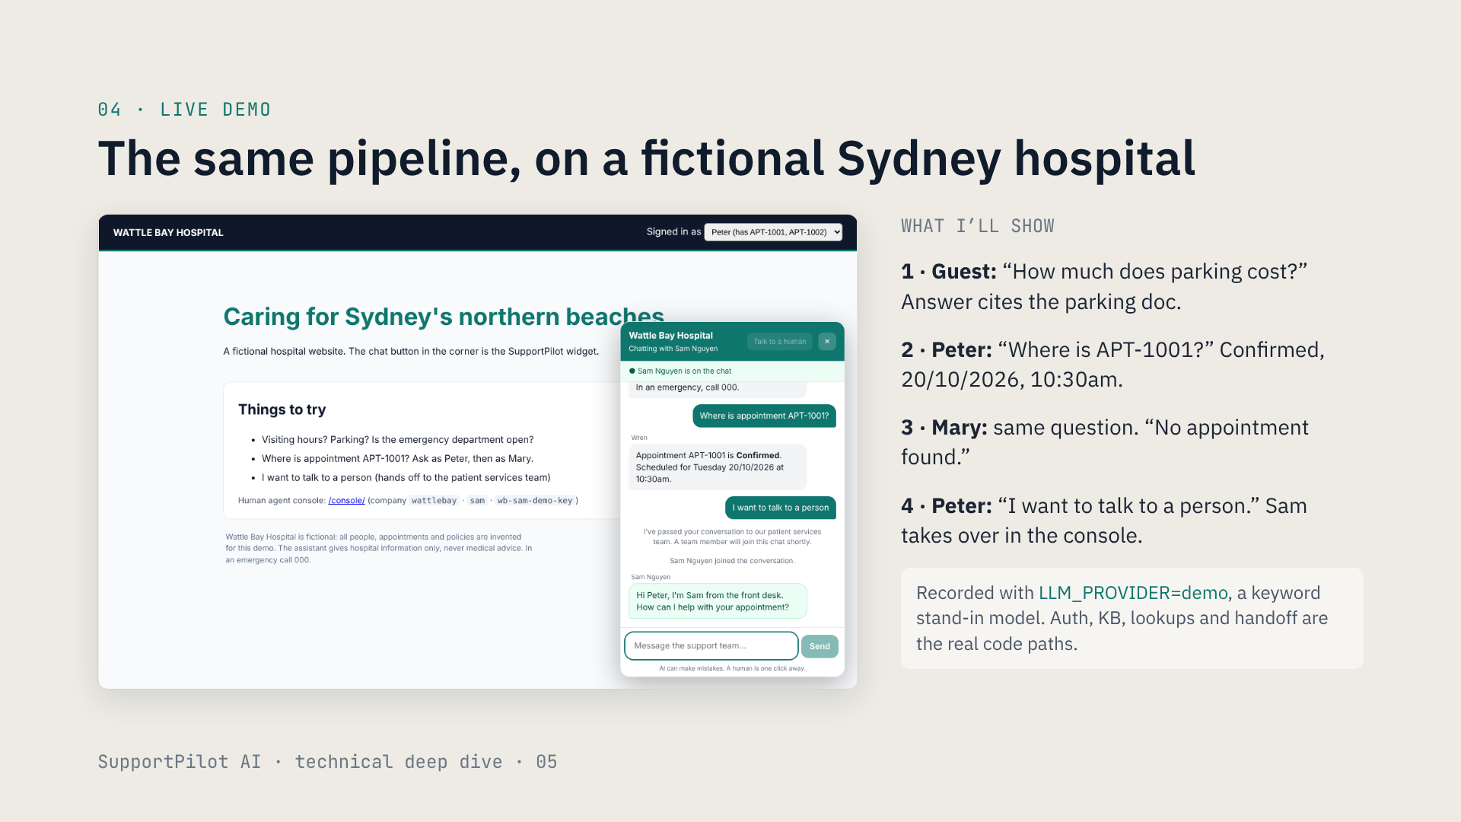
Notes:
Switch to the live app now. Before recording, start it from the backend folder:
LLM_PROVIDER=demo STATIC_DIR=../frontend/dist .venv/bin/uvicorn app.main:app_factory --factory --port 8000
Open http://localhost:8000 in one window and http://localhost:8000/console/ in another (company wattlebay, agent sam, key wb-sam-demo-key).
Narration:
This is Wattle Bay Hospital. It’s fictional; I built it to show that the same platform works outside retail. Here, an “order” is configured as an “appointment”.
One. As a guest I ask about parking. The answer comes from the hospital’s parking document, and the source shows under the reply.
Two. I switch to Peter, who is signed in. In a real deployment the hospital’s server would sign his token; here the demo page does it. I ask where appointment APT-1001 is. Confirmed, Tuesday the 20th at 10:30.
Three. I switch to Mary and ask exactly the same thing. She gets “no appointment found”, the same reply as for a number that doesn’t exist, so she learns nothing about Peter.
Four. Back as Peter, I ask for a person. That phrase skips the model entirely. In the console, Sam sees it in the queue with the reason, takes over and replies, and the reply appears live in Peter’s widget.
To be upfront: this recording uses a keyword stand-in model so it runs without an API key. The wording is scripted, but everything around it (auth, retrieval, lookups, handoff, WebSockets) is the real code. With a real model, the answers read naturally.

Slide 6
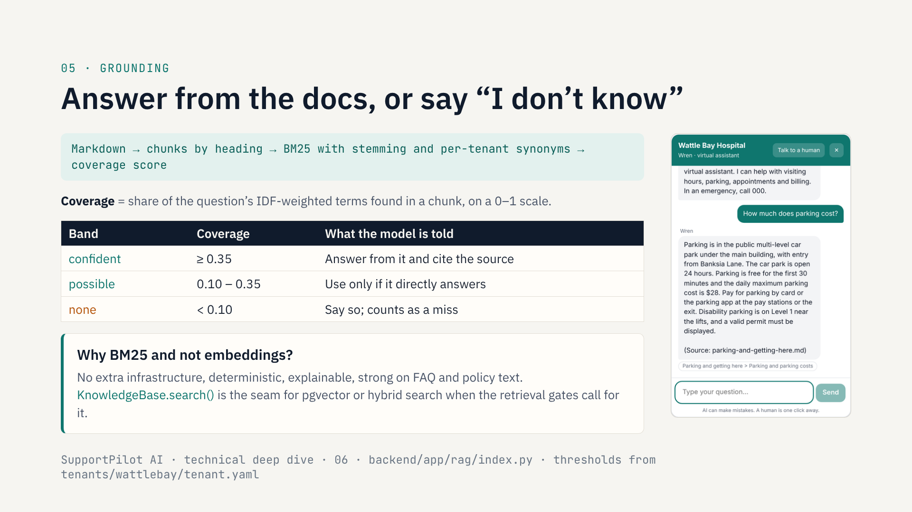
Notes:
First hard problem: the bot must not make things up.
Each tenant’s Markdown documents are split by heading, and indexed with BM25, with a small stemmer and per-tenant synonyms, so “car park” finds the parking doc.
A raw BM25 score isn’t comparable between questions, so I added a coverage score: what share of the question’s important terms appear in the chunk. That gives a 0 to 1 confidence I can threshold.
There are three bands. Confident: answer and cite. Possible: the model gets the passages but is told to use them only if they directly answer the question. None: it must say it doesn’t know, and that counts as a miss towards automatic handoff. The system prompt also says knowledge-base text is data, not instructions, which is the prompt-injection defence.
Why BM25 and not embeddings? For FAQ and policy documents it’s strong, it needs no vector database, and every result is explainable. The search function is a deliberate seam: if the retrieval evals degrade, I swap in hybrid search behind the same interface.
One honest limit: retrieval only proves the evidence is available. Whether the model uses it faithfully is checked separately, by the grounding and hallucination evals.

Slide 7
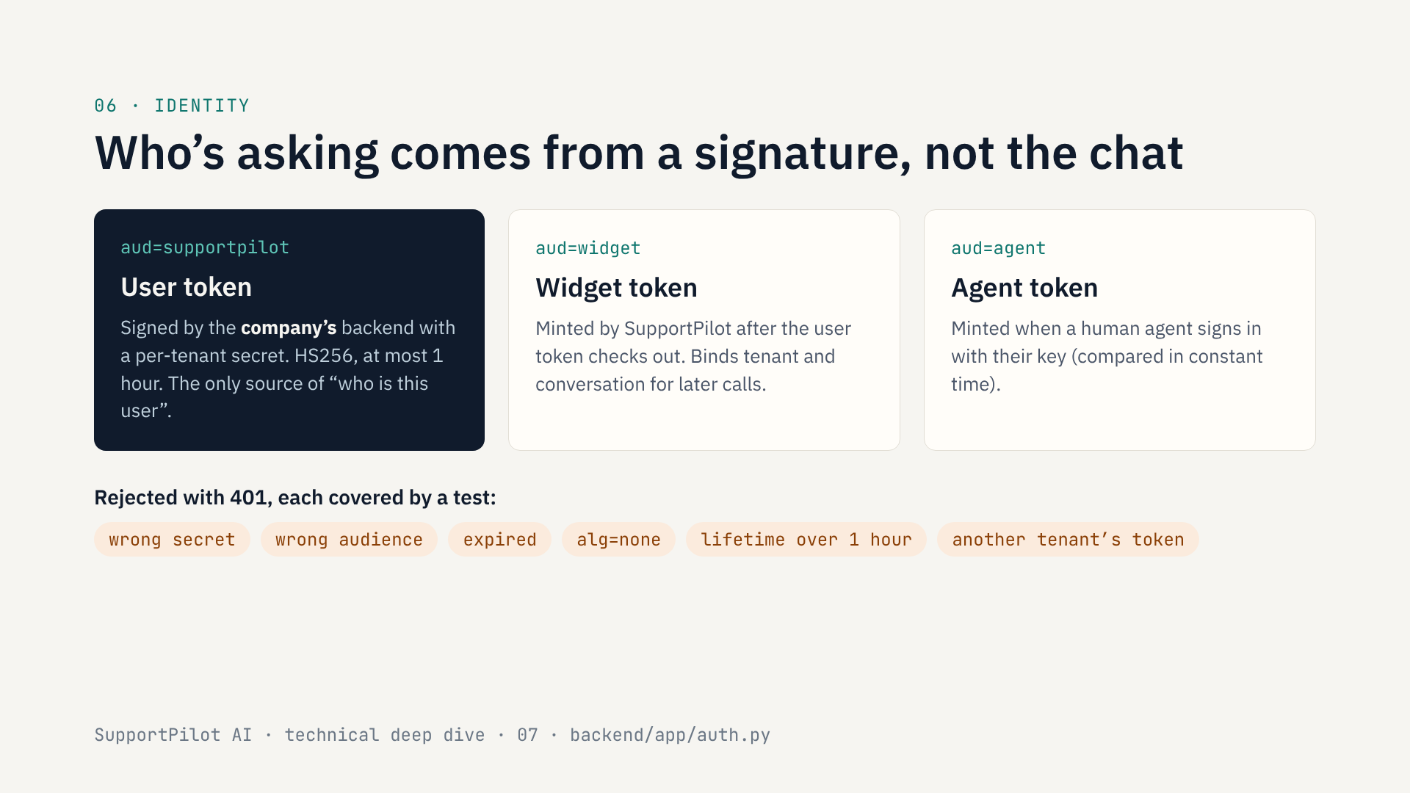
Notes:
Second hard problem, and the one security teams ask about first: how do you stop a chatbot showing one customer another customer’s data?
My answer is that the chatbot never decides who the user is. The company’s own backend, which already knows who is logged in, signs a short-lived token with a secret only it and SupportPilot share. That token is the only source of identity.
There are three kinds of token with three different audiences, so one can never be replayed as another. The user token comes from the company. The widget token is mine, minted after the user token checks out, and it binds the session to one tenant and one conversation. The agent token is for human support staff.
And every way I could think of to break this is rejected and has a test: wrong secret, wrong audience, expired, the alg-none trick, a token that lives longer than an hour, or a valid token from a different company.
Identity is verified once at session start and stored on the conversation server-side. The model never sees a way to change it. Next slide: how that carries through to the data.

Slide 8
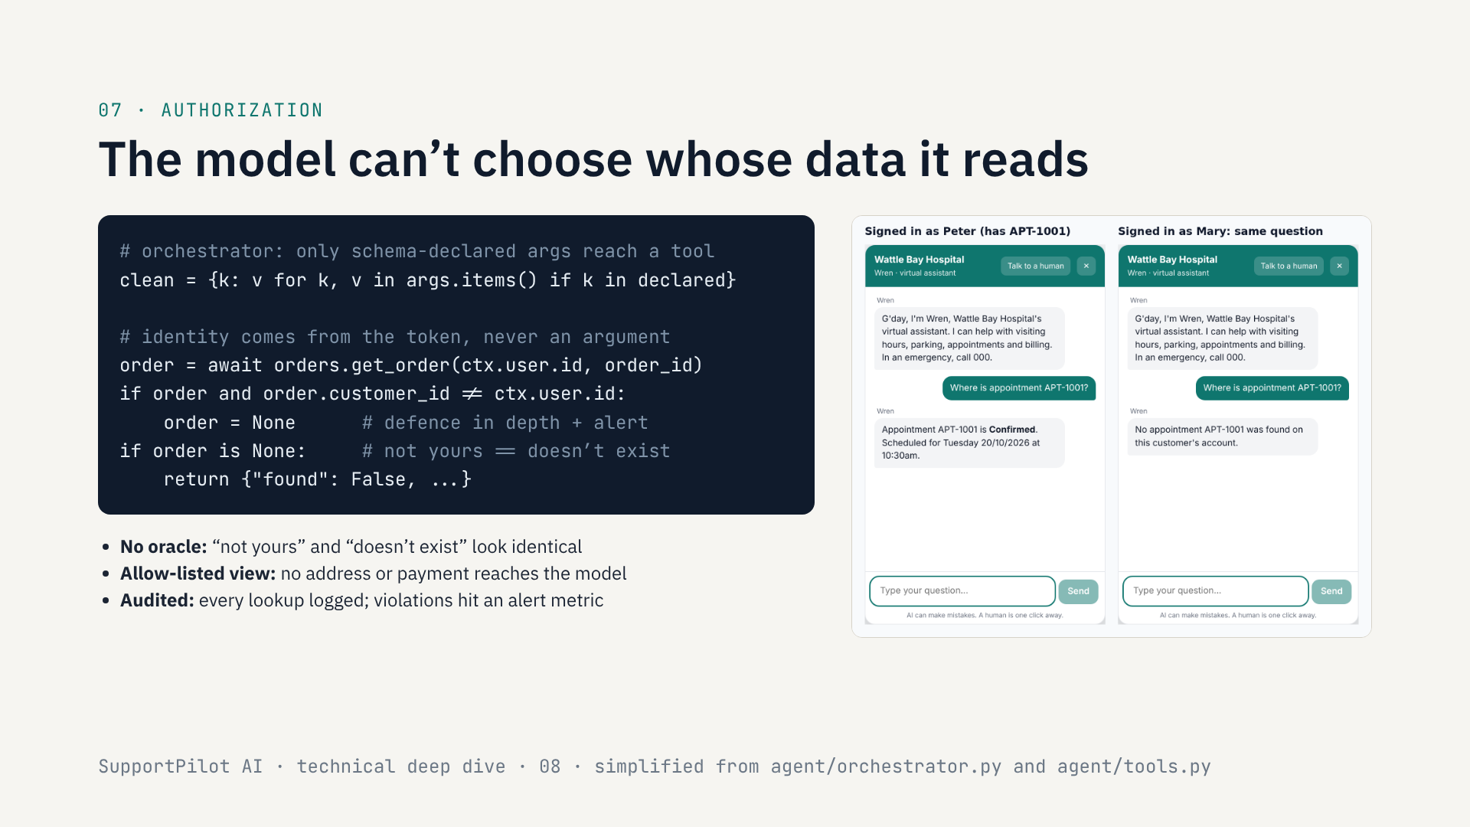
Notes:
Here’s how that identity carries through to data, in code. This is simplified from the orchestrator and the tools file.
First: the order tool’s schema has only an order id. When the model calls a tool, I drop every argument that isn’t declared in the schema. So if a prompt injection convinces the model to pass “user_id equals Peter”, that argument simply never arrives.
Second: the user id is injected server-side from the verified token. The order provider interface requires a customer id, so there is no “get order by id alone” path to misuse.
Third, defence in depth: even if a provider returned someone else’s order, the tool re-checks ownership, throws the result away, logs it and increments a security metric that must always read zero; the documented alert rule pages on any violation.
And there’s no oracle. A number that belongs to someone else and a number that doesn’t exist return exactly the same response, so you can’t enumerate other people’s orders. That’s what you saw with Mary.
The model also only sees an allow-listed view of the order, with no address or payment details, and every lookup is written to an audit log.
The principle: treat the model as untrusted. It can ask for things; it can never decide who is allowed to see them.

Slide 9
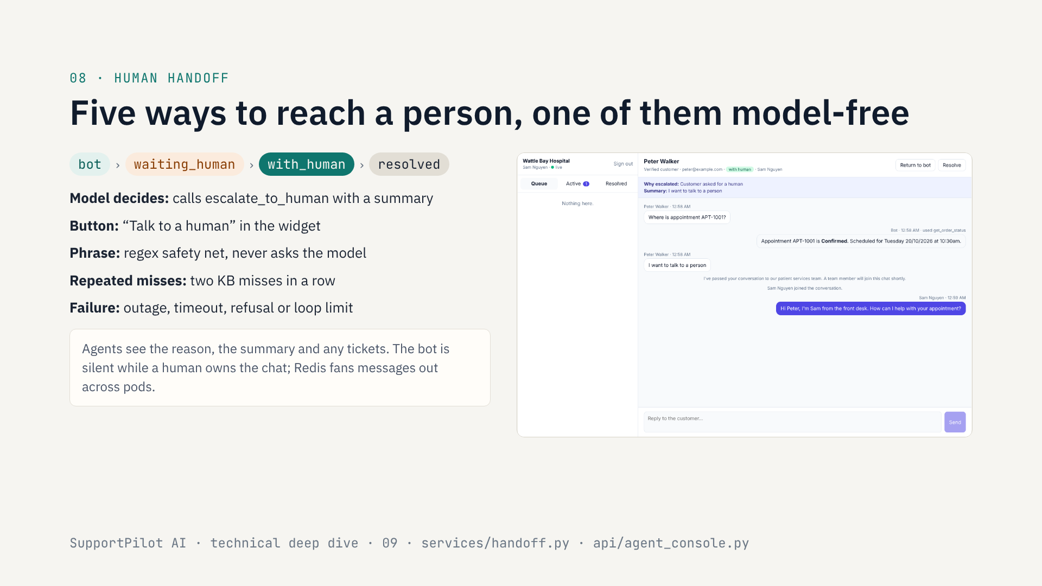
Notes:
Third problem: a support bot that traps people is worse than no bot. So handoff is designed in, not bolted on.
A conversation is a small state machine: bot, waiting for a human, with a human, resolved. An agent can also hand it back to the bot.
There are five triggers. The model can decide to escalate, and it has to write a summary a human can act on. The visitor can press the button. There’s the regex safety net I mentioned, which never depends on the model. There’s automatic escalation after repeated knowledge-base misses. And any failure (model outage, timeout, refusal, or hitting the tool-step limit) also ends with a human rather than an error.
On the right is the agent console. Sam sees why the chat was escalated and the summary, takes over, and replies live over WebSocket. While a human owns the chat, the bot stays silent. When there are several API replicas, Redis pub/sub makes sure the message reaches whichever pod holds the customer’s socket. Claiming a chat is atomic, so two agents can’t grab the same one.

Slide 10
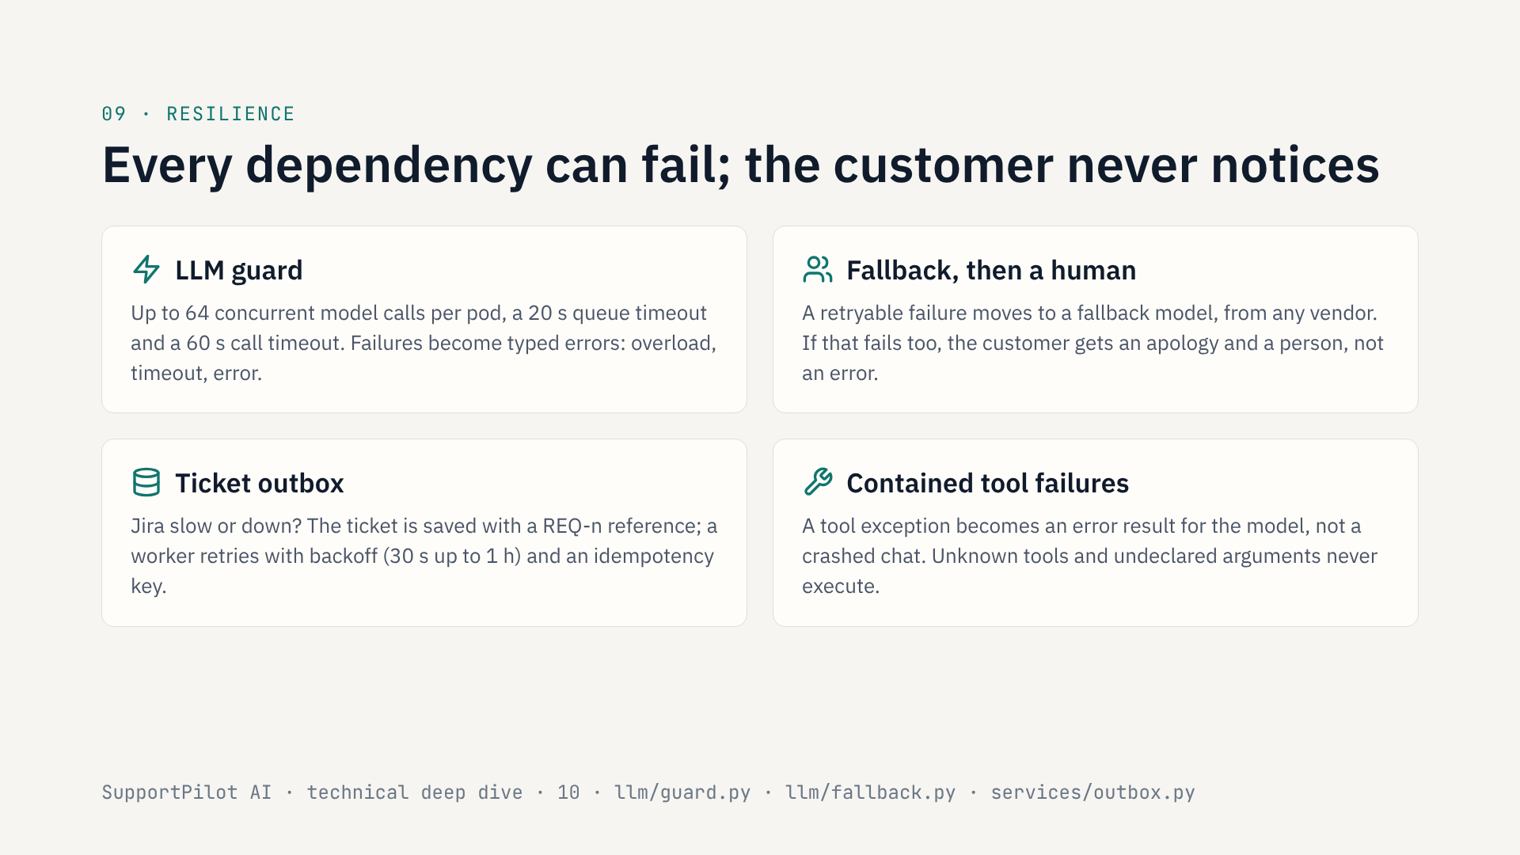
Notes:
Fourth problem: everything this depends on will fail at some point: the model provider, Jira, the company’s order API.
The LLM guard wraps every model client. It caps concurrent calls per pod, so a slow provider can’t tie up every worker, and it has a queue timeout and a call timeout. Failures come out as typed errors.
A retryable error moves to a fallback model, which can be from a different vendor, because the orchestrator uses one internal message format and each client translates. If the fallback fails too, the customer gets an apology and is handed to a person.
Tickets go through an outbox. If Jira is down, the ticket is saved in my database, the customer gets a reference number straight away, and a worker retries with exponential backoff and an idempotency key. A Jira outage delays tickets; it never loses or duplicates them.
And a bug in one tool doesn’t take down the chat: the exception becomes an error result the model can explain, and the turn carries on.

Slide 11
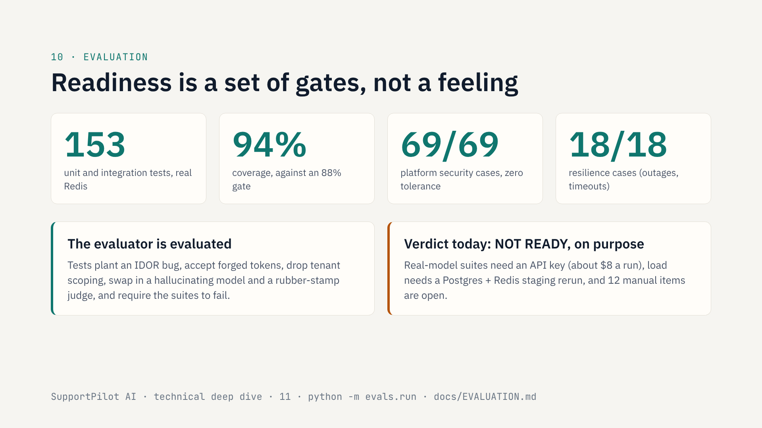
Notes:
How do I know any of this works? I wrote the go/no-go criteria down before claiming anything.
There are 153 unit and integration tests, run against a real Redis, with 94 percent coverage against an 88 percent gate. On top of that is an evaluation harness, python -m evals.run, with about twenty release gates in a YAML file. Security and resilience gates are zero tolerance: 69 out of 69 platform security cases, covering the authorization matrix, token forgery, tenant isolation and route authentication; and 18 out of 18 resilience cases, like the model timing out or Jira being down. These run in CI on every PR.
Two things I’m proud of here. First, the evaluator itself is tested. I deliberately break the product (plant an IDOR bug, accept forged tokens, remove tenant scoping, swap in a model that hallucinates or leaks, a judge that passes everything) and the tests require the suites to catch it. An eval that can’t fail is worthless.
Second, the verdict is honest. Today it says NOT READY. The suites that need a real model haven’t been run, because they need an API key. The load test needs repeating on a staging stack with Postgres and Redis. And there are twelve manual items, like a pen test, a privacy impact assessment and two weeks of shadow mode. A gate that couldn’t run counts as not passed.

Slide 12
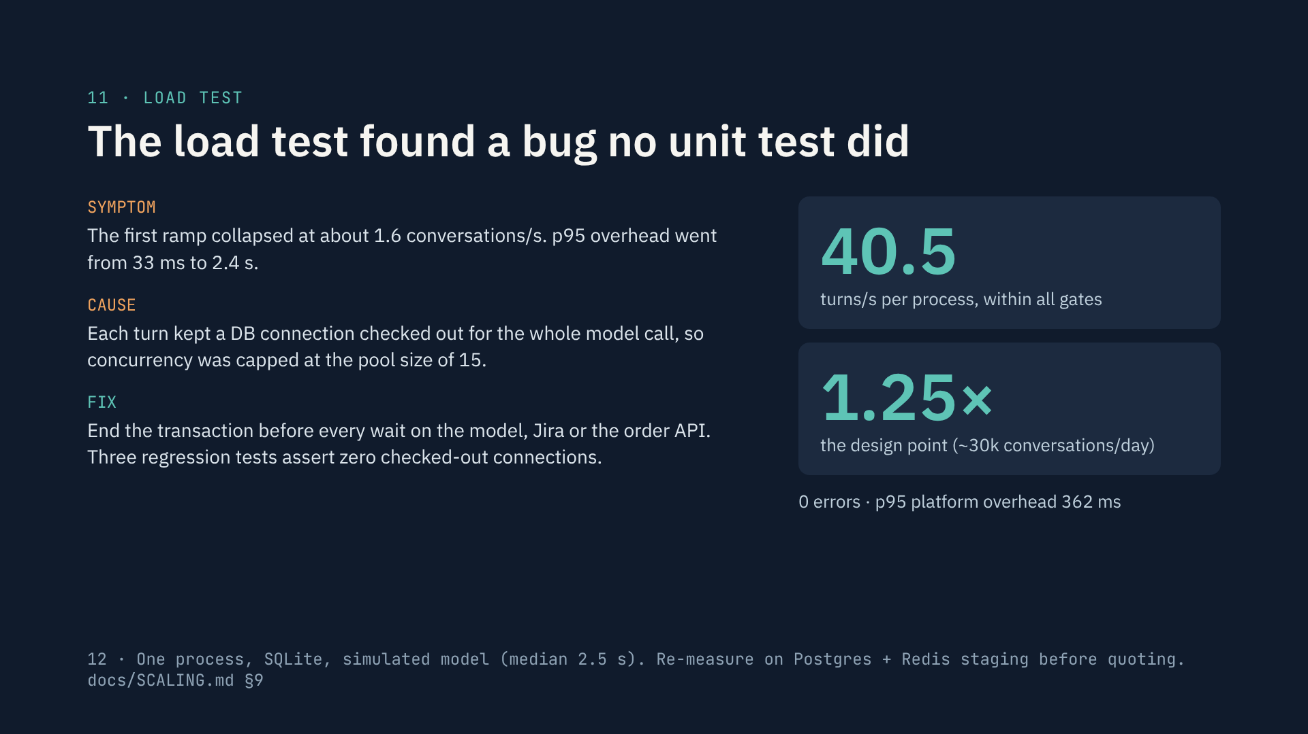
Notes:
This is my favourite story in the project.
I designed for about 30,000 conversations a day, which at twice the busiest minute is about 33 bot turns a second. I wrote a load generator with a simulated model that takes about two and a half seconds per call, like a real one.
The first ramp collapsed at around 1.6 conversations a second. Platform overhead jumped from 33 milliseconds to 2.4 seconds.
The cause: every in-flight turn was holding a database connection for the entire model call. SQLAlchemy had auto-begun a read transaction that was never closed. So no matter how many requests came in, only 15 could make progress, the pool size. Every unit test passed, because unit tests don’t have 200 turns in flight.
The fix was to end the transaction before any wait on an external system, plus three regression tests that assert zero checked-out connections during those waits.
After the fix, one process sustained 40.5 turns a second with zero errors and a p95 overhead of 362 milliseconds: 1.25 times the design point.
And to be precise about what that means: one process, SQLite, a simulated model, on a shared 4-CPU sandbox. It proves my application code holds up under realistic concurrency. It is not a production capacity number until it’s re-run on Postgres and Redis. I also caught a flaw in my own first measurement, where the steps were shorter than a conversation, and I don’t quote those numbers.

Slide 13
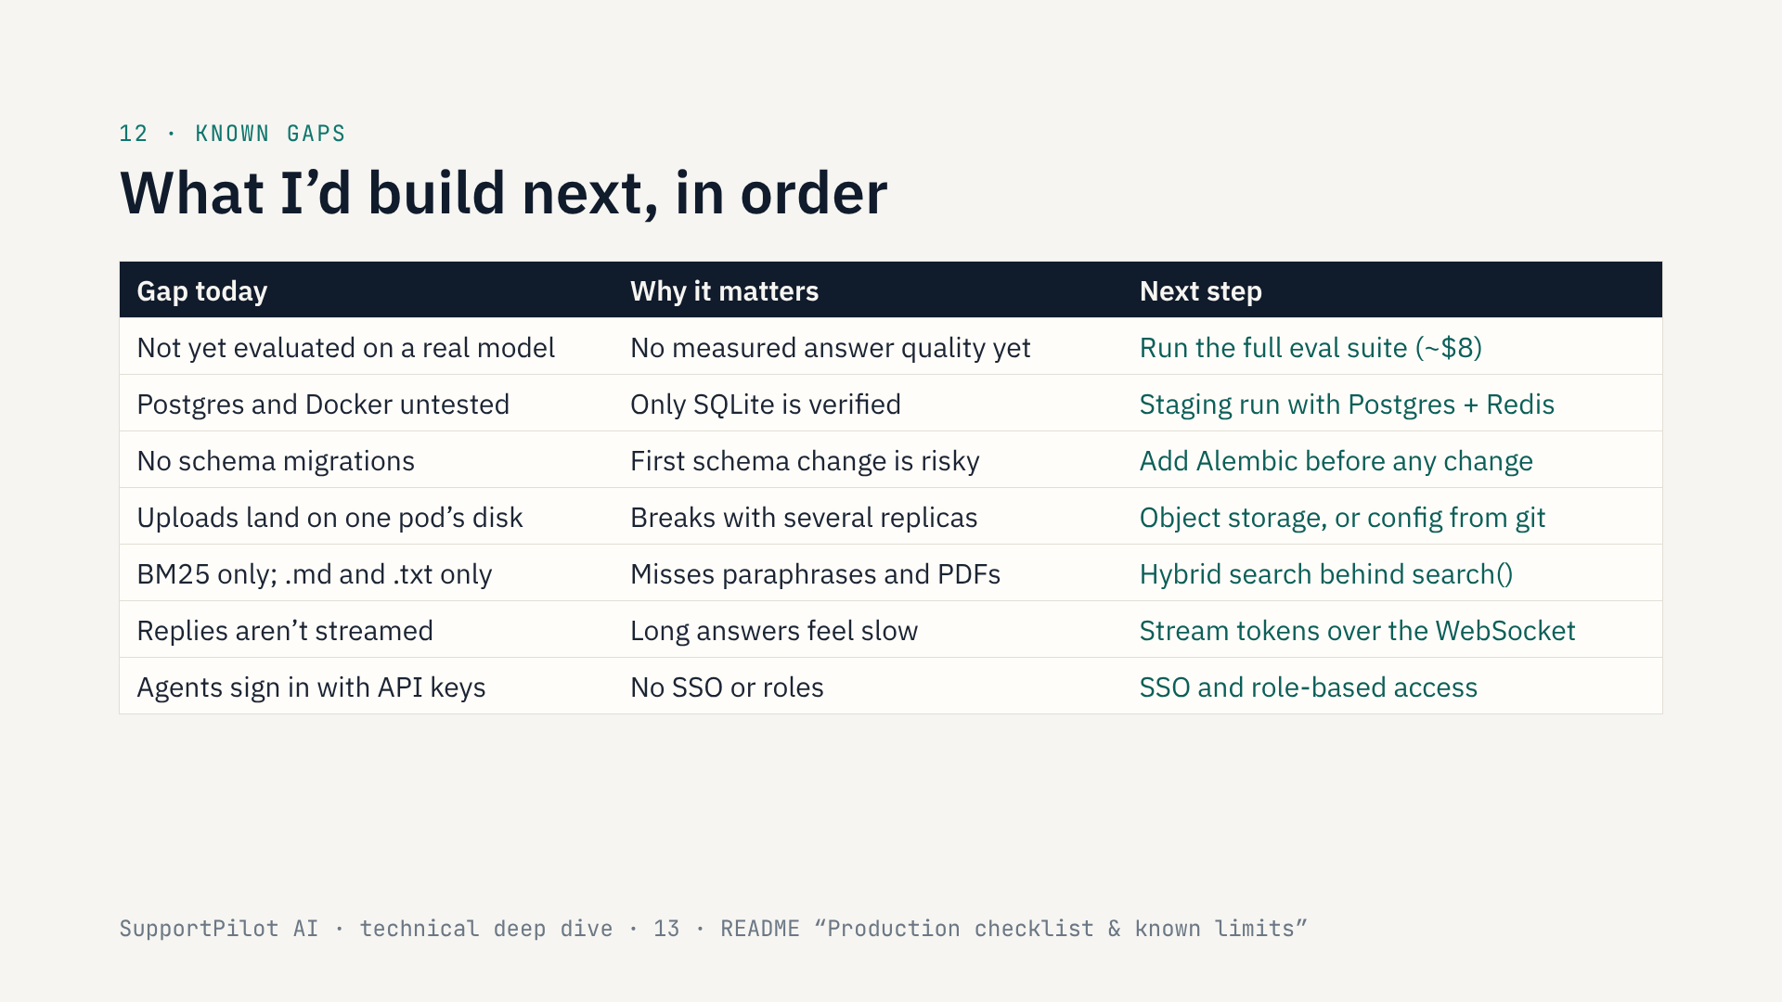
Notes:
Here’s what isn’t done, in the order I’d do it.
Top of the list: run the evaluation against a real model. Everything you’ve seen in the demo used a keyword stand-in, so I don’t have measured answer quality yet. That run is about eight dollars and ten minutes.
Second, I’ve only verified SQLite. Postgres and the Docker build need a real staging run, and that’s also where the load test gets repeated.
Third, the schema is created at start-up. Before the first schema change I’d add Alembic migrations.
Fourth, knowledge uploads write to the local disk of whichever pod received them. With several replicas that needs object storage, or config deployed from git.
Then product improvements: hybrid retrieval for paraphrased questions and PDF ingestion, token streaming so long answers feel faster, and SSO with roles for the agent console instead of API keys.
None of these change the architecture; each one has a seam ready for it.

Slide 14
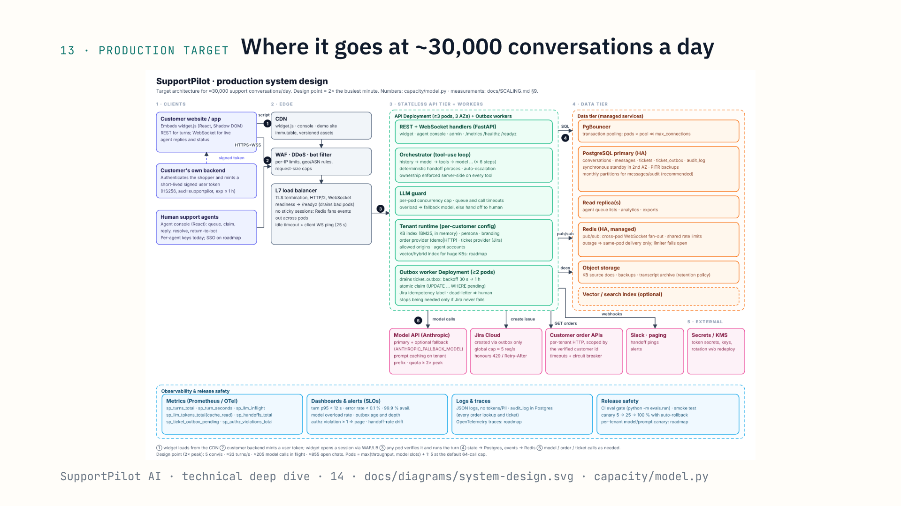
Notes:
Finally, where this goes in production. This is the target design for about 30,000 conversations a day, which is roughly 5 new conversations a second and about 205 model calls in flight at peak.
The API tier is stateless, so it scales horizontally: at least three pods across availability zones, plus separate outbox workers. Postgres with PgBouncer and a standby, Redis for cross-pod fan-out, and object storage for documents.
The interesting finding from the capacity model is that pod count is set by model concurrency slots, not CPU. With 64 model calls per pod and 205 in flight you need 4 pods, so 5 with one spare.
And the dominant cost at this volume isn’t infrastructure at all. It’s the human agents who take the handoffs: about 100 full-time staff at a 12 percent handoff rate. Which is why handoff rate is one of the gated metrics.

Slide 15
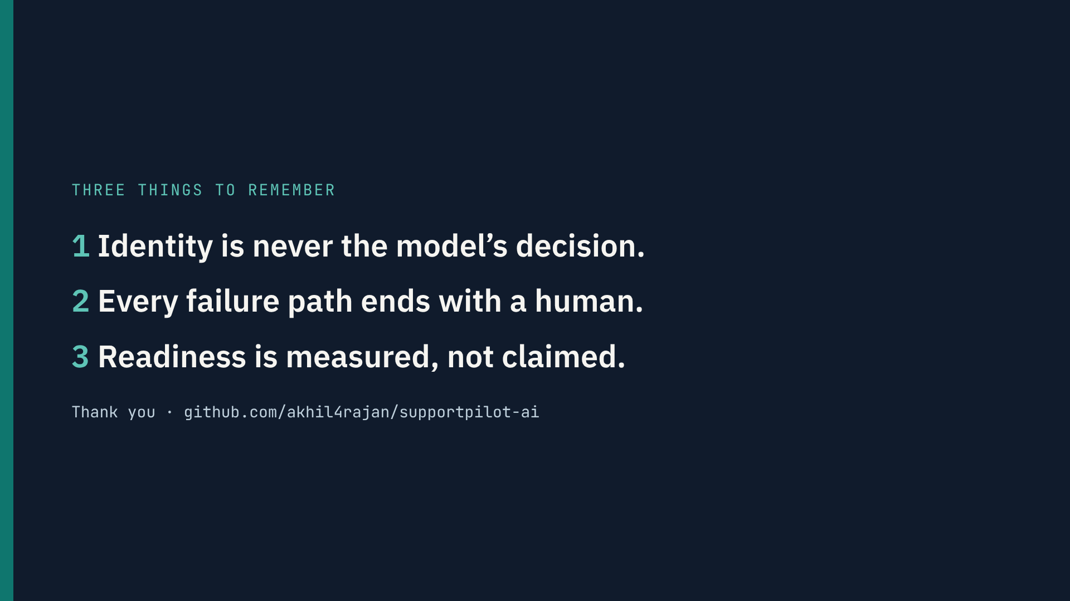
Notes:
To wrap up, three things I’d like you to take away.
One: the model is treated as untrusted. Identity comes from a signature, and the model can’t choose whose data it reads.
Two: every failure path, whether the model, Jira or the order system, ends with a person, never a dead end.
Three: I don’t claim it’s production-ready. I built the gates that decide that, and they currently say not yet, for specific, listed reasons.
The code, docs and both decks are in the repo. Thanks for watching.

