Slide 1

PriceWatch
- Akhil Singh Chauhan

Slide 2

Introduction
PriceWatch is a Web Application that allows users to track the price of their favorite amazon products.
It will notify the users when a product’s price drops via the email. PriceWatch will also show the lowest, highest and current prices of the amazon products.

Slide 3



MongoDB is NoSQL database. It uses JSON like data as opposed to the row/column model that allows it to integrate well with the other (JavaScript-based) components of the stack.
Next.js is a React framework for building server-rendered and statically generated applications. It simplifies React app development with features like automatic code splitting, hot module replacement, and server-side rendering.
Puppeteer is a Node library for controlling headless Chrome or Chromium. It facilitates automated web testing, scraping, and interaction by simulating user actions like clicks and form submissions.

Slide 4
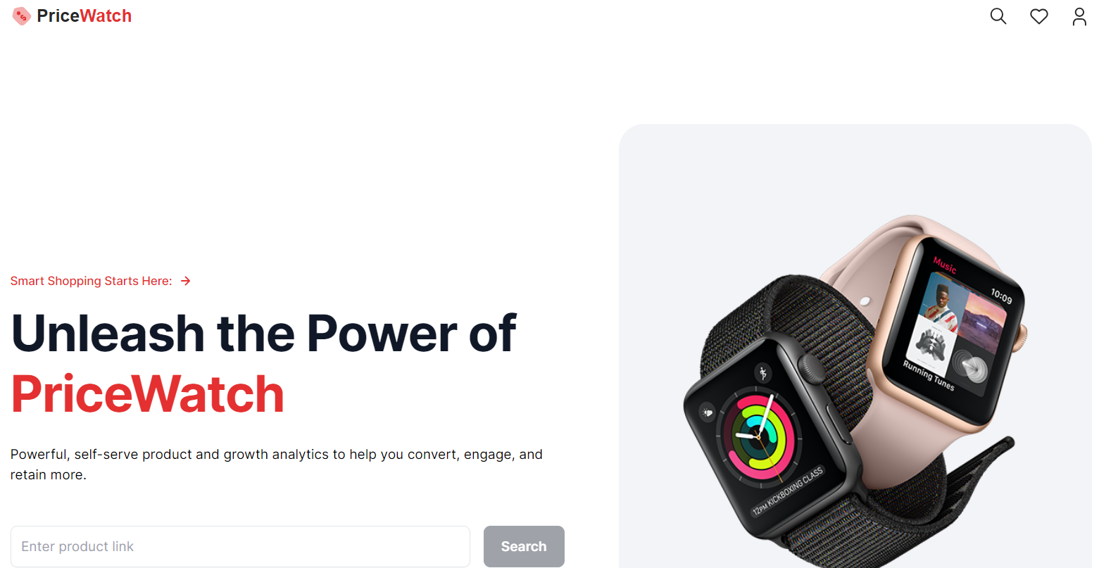
PriceWatch: Home Page

Slide 5
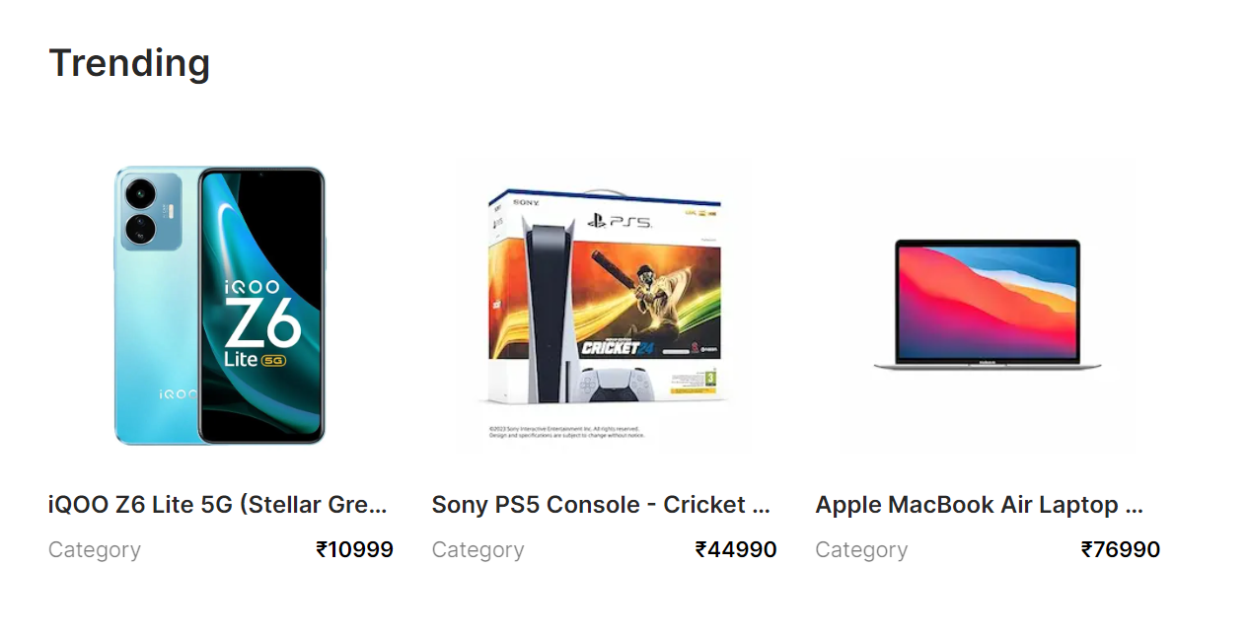
Tracked Products

Slide 6
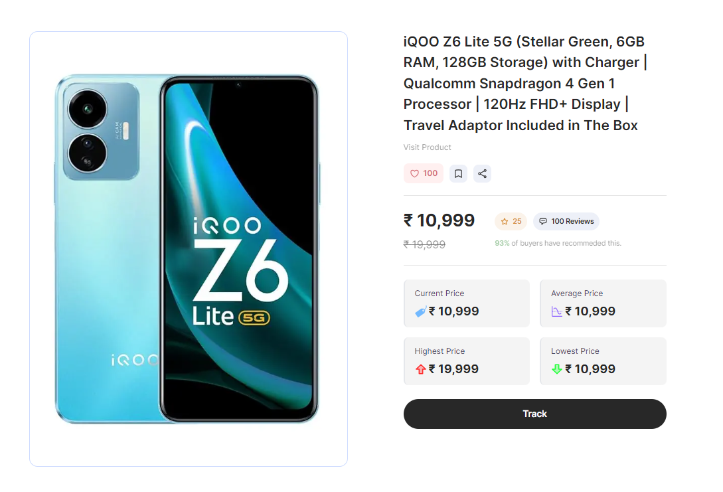
Product Details

Slide 7
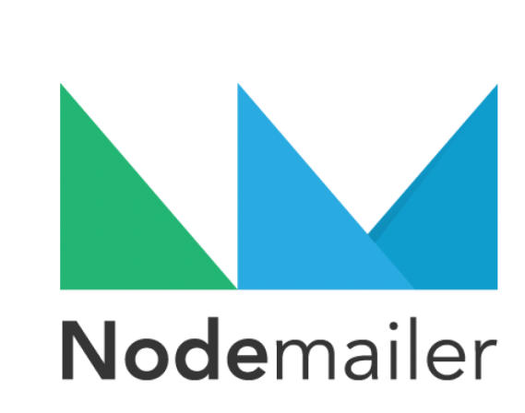


Modules

Slide 8
Project Schedule

