Slide 1

CODEBIN
- Akhil Singh Chauhan

Slide 2

Introduction
CodeBin is a site that gives users the ability to create and share plain text documents through public/private posts called 'pastes‘.
It is most commonly used to share source code, configuration data, log files and info dump amongst the software development community.

Slide 3
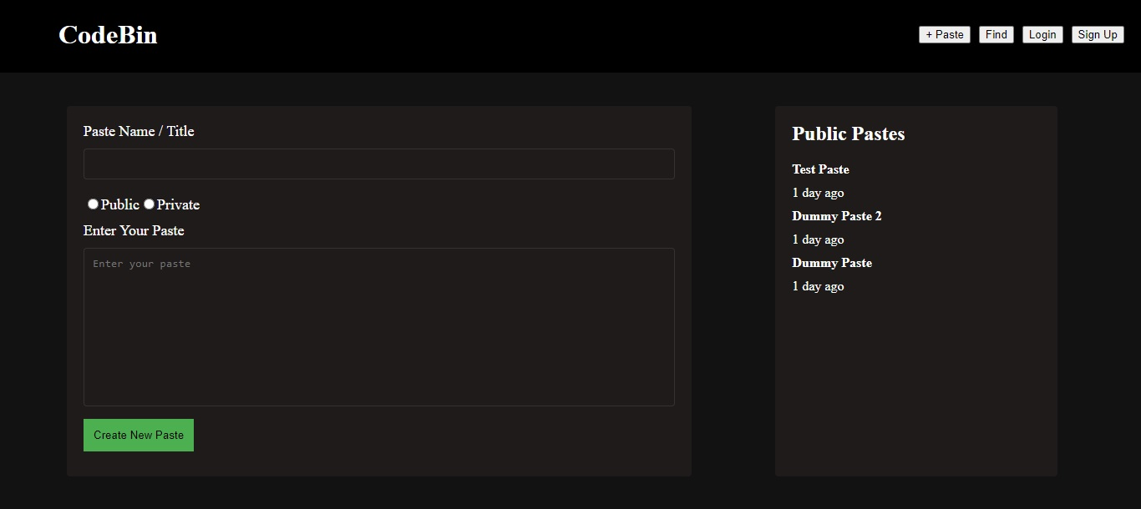
Demo

Slide 4

M: MongoDB is NoSQL database. It uses JSON like data as opposed to the row/column model that allows it to integrate well with the other (JavaScript-based) components of the stack.
E: Express.js (also referred to as Express) is a modular web application framework package for Node.js.
R: React is a free and open-source front-end JavaScript library for building user interfaces based on components.
N : Node.js is the application runtime that the MERN stack runs on.

Slide 5
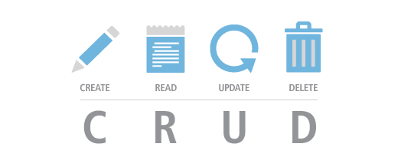


Modules

Slide 6
Project Schedule

