Slide 1

Sale-o-Meter
Housing Price Prediction Tool
Supervised Learning Course Project Presentation
Faculty: Dr. Jianlin (Jack) Cheng
Grad Students: Sai Akhil Chopparapu(14395374), Trinath Adusumilli(14395378), Sai Darahas Venigalla(14394460), Srija Panda(14397705)
Department of Electrical Engineering and Computer Science,
University of Missouri - Columbia

Slide 2
Agenda
Introduction
Problem Statement
Data Set Analysis
Solution Approach
Data Cleaning
Data Preparation
Model Building and Analysis
Algorithms & Implementation
Advanced Regression Concepts
Lasso and Ridge Regularization
Code Implementation in Python
Results
Test Set Results
Comparative Study
Key Features

Slide 3
Problem Statement
Housing price indices are important indicators for stakeholders in the real estate market including real estate agents, appraisers, assessors, mortgage lenders, brokers, property developers, investors and fund managers, and policy makers, as well as to actual and potential house owners.
Moreover, the development of a housing price prediction tool would greatly assist in the prediction of housing prices and the establishment of real estate policies.
Park, Byeonghwa, and Jae Kwon Bae. "Using machine learning algorithms for housing price prediction: The case of Fairfax County, Virginia housing data." Expert systems with applications 42.6 (2015): 2928-2934.
APA

Slide 4

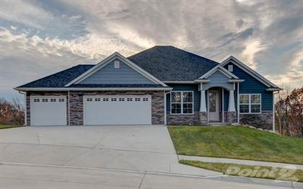
Do we need to pay the same Price?
A house in a Metropolitan City
A house in Rural Area

Slide 5
Data set Analysis
Dataset : https://www.kaggle.com/c/house-prices-advanced-regression-techniques/data
For this project, we used the real estate datasets from Kaggle, which is taken from the Ames Housing dataset, it's an incredible, modernized and expanded version of the often cited Boston Housing dataset.
We extracted approximately 1500 records from the above dataset.
Each extracted record included 81 attributes (variables).

Slide 6
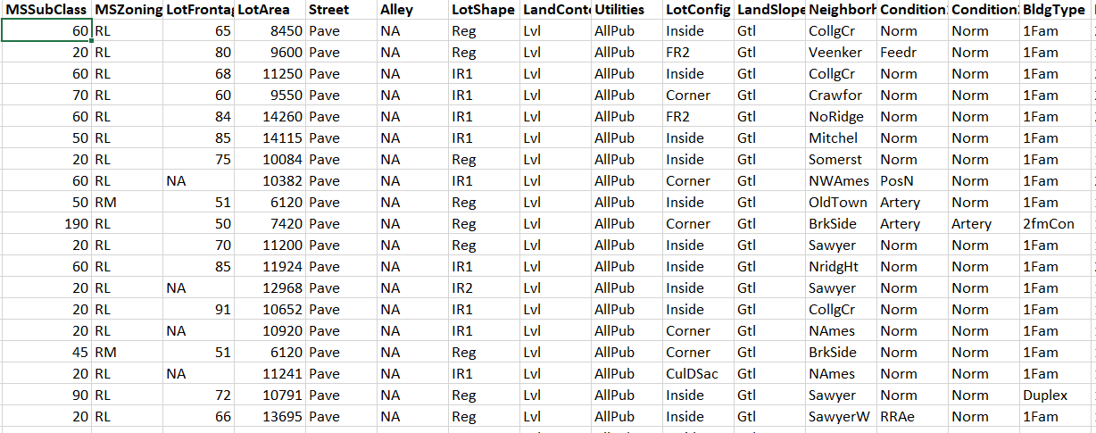
Data set Analysis (Contd.,)
The features of housing like Lot Area, Overall quality, Basement quality, Pool Area etc., are included in the 81 attributes (variables)
We have divided dataset into training(70%), and test set(30%).

Slide 7
Solution Approach
Our Solution Approach uses the concepts of Advanced Regression.
We use Linear regression with Regularisation to predict the Sale Price of a house.
We use Ridge and Lasso regularisations onto same data set to penalise the model and prevent it from over fitting.
Our Model also identifies the key performance indicators (most important features in the dataset) for the price prediction.

Slide 8
Solution Approach (Contd.,)
Data Cleaning and Preparation:
Our dataset have many features combining both categorical variables and continuous variables.
Many features have null values.
So, we handle these data consistencies by removing null values or imputing mean or mode into missing data values.
We convert categorical variables into dummy variables to make them feasible for model learning.
We scale the continuous variables so that the magnitude of the variable does not impact the importance of feature.

Slide 9
Solution Approach (Contd.,)
First, we build the model using linear regression using RFE (Recursive Feature Elimination).
Then, we implement regularisation techniques (both Ridge and Lasso) onto same data set with and without RFE.
We compare the results of Ridge and Lasso Regression techniques.

Slide 10
Reason for this Approach
We adapted this solution approach because of below advantages:
We don’t want our model to overfit and want to reduce the complexity.
We want our model to have decent trade-off between bias and variance.
We want our model to be robust to new unknown data and at the same time efficient in predicting the new data.
We want to predict the top key features from our dataset which are of high priority in prediction.

Slide 11
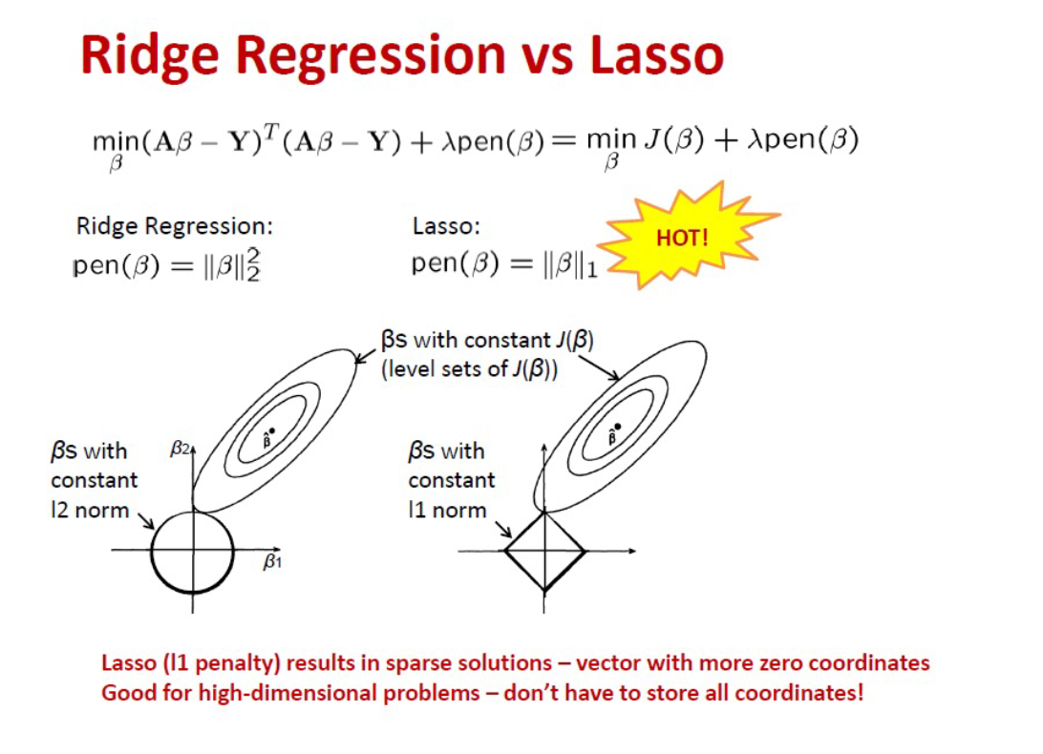
Advanced Regression Concepts

Slide 12
Regularization
Regularization is one of the ways to improve our model to work on unseen data by ignoring the less important features.
Regularization minimizes the validation loss and tries to improve the accuracy of the model on test data.
It avoids overfitting by adding a penalty to the model with high variance, thereby shrinking the beta coefficients.

Slide 13
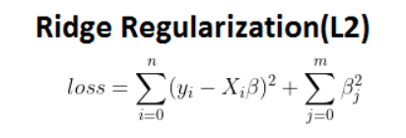
Lasso & Ridge Regularization
Ridge Regularization:
The penalty used in this regularisation techniques is the square of the beta coefficients.
This shrinks the coefficients to nearly zero values ( BUT NOT ZERO ).
It is computationally efficient as there is direct matrix form to obtain the solution.
This is mainly used when there is high correlation between the features.

Slide 14
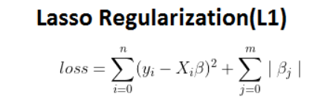
Lasso & Ridge Regularization
Lasso Regularization:
The penalty used in this regularisation techniques is the absolute value of beta coefficients.
This shrinks the coefficients to zero values ( ZERO ).
This regularisation thus gives sparse solutions.
It is computationally tough as it involves multiple iterations to obtain the solution.
This is mainly used when there is need for dimensionality reduction or feature selection.

Slide 15
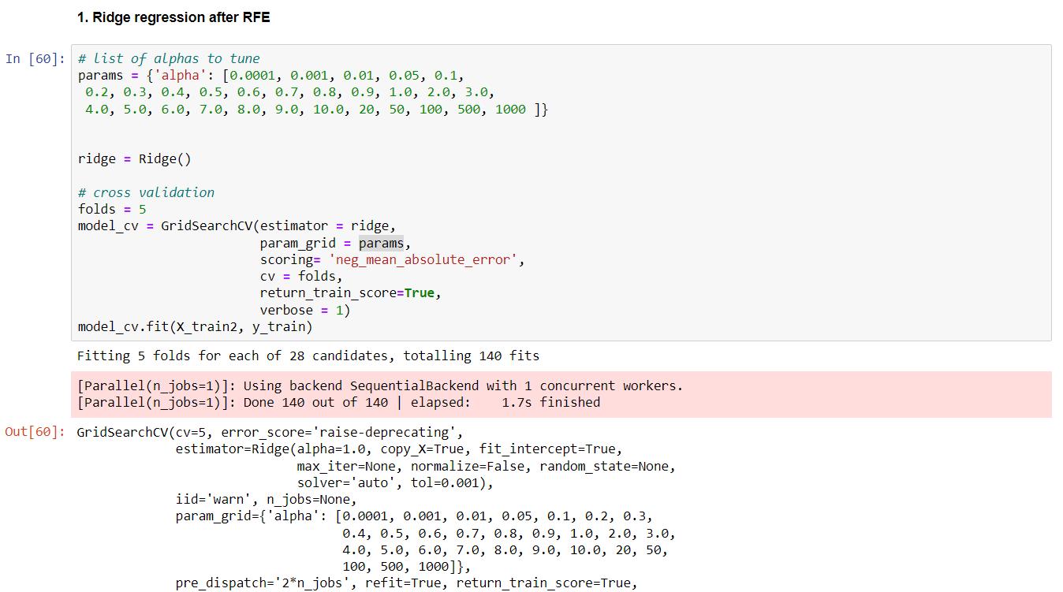
Implementation
Ridge after RFE:
After implementing RFE, we tune our model with Ridge regularisation using GridSearchCV to obtain the best value of λ (tuning parameter)

Slide 16
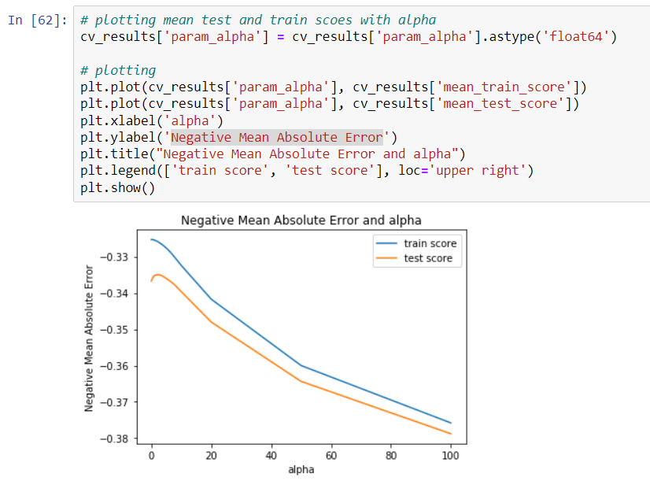
Implementation (Contd.,)
We plot the graph between lambda and mean train score, mean test score.
We choose the lambda value which gives least error.

Slide 17
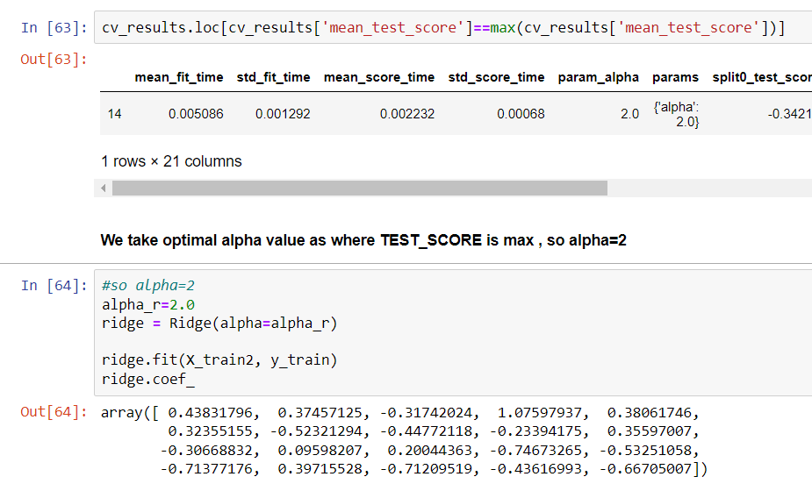
Implementation (Contd.,)
Here, we build the Ridge Model using optimal lambda value.

Slide 18
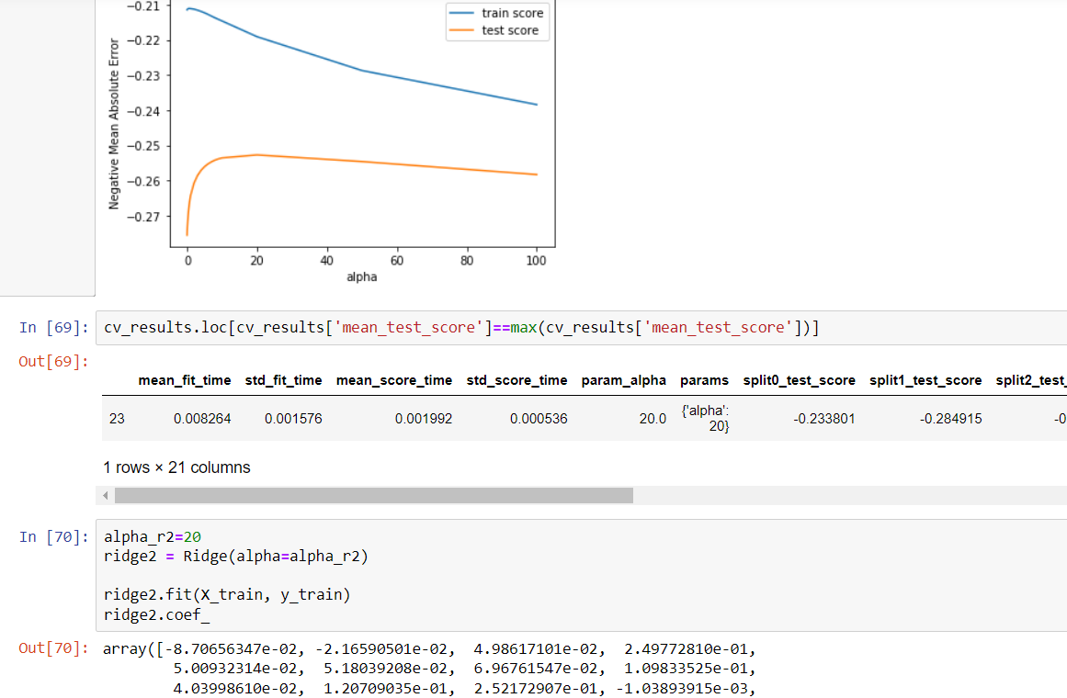
Implementation (Contd.,)
Ridge without RFE:
Similar to early method, we build ridge model with optimal lambda value.
Here, we do not perform RFE before the model build.

Slide 19
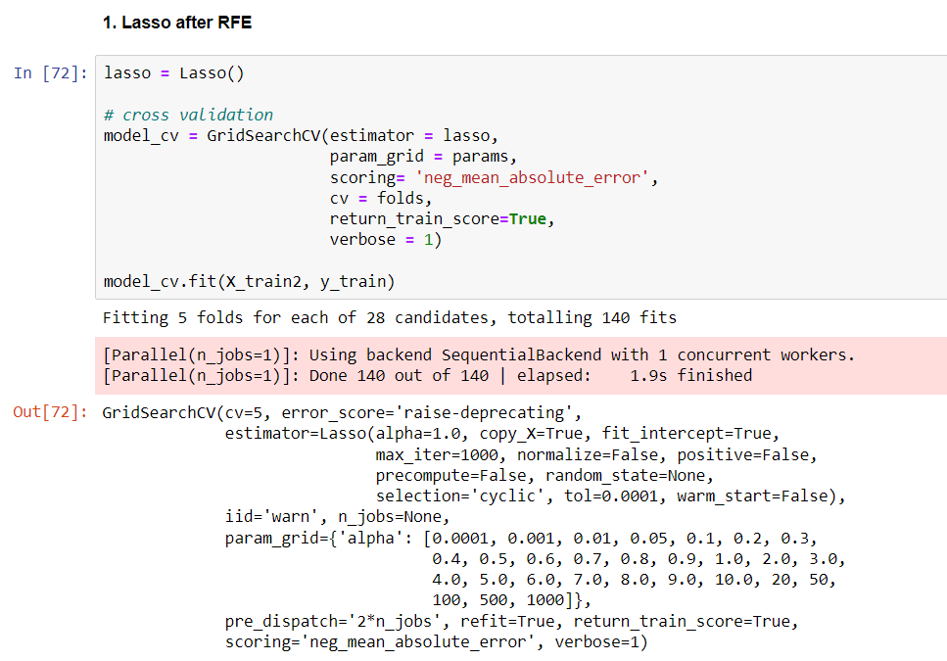
Implementation (Contd.,)
Lasso after RFE:
After implementing RFE, we tune our model with Lasso regularisation using GridSearchCV to obtain the best value of λ (tuning parameter)

Slide 20
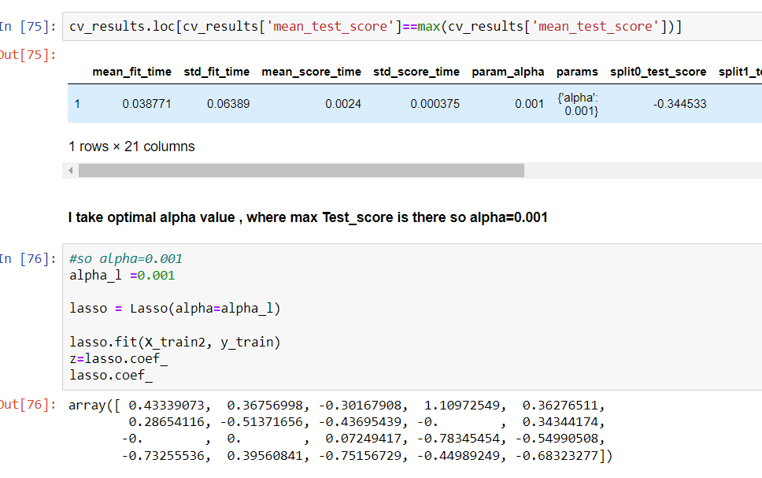
Implementation (Contd.,)
Here, we build the Lasso Model using optimal lambda value.
We could observe that many coefficients are reduced to 0 (which is main feature of Lasso penalty).

Slide 21
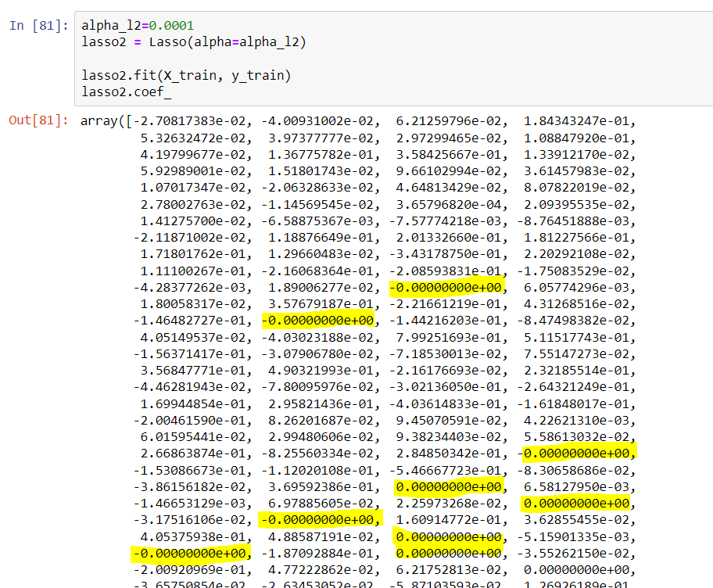
Implementation (Contd.,)
Lasso without RFE:
Similar to early method, we build lasso model with optimal lambda value.
Here, we do not perform RFE before the model build.
We could see many more coefficients are reduced to 0.

Slide 22
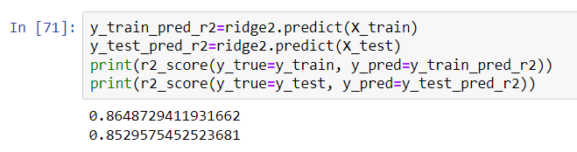
Results
For the model Ridge after RFE we calculated the train and test R2 score for train and test data.
By Using Ridge regression after RFE, we got 85.3% test score and 86.5% train score
**R2 score explains how well the variance in the observed data is explained.

Slide 23
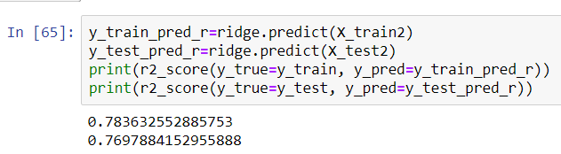
Results
For the model Ridge without RFE we calculated the train and test R2 score for train and test data.
By Using Ridge regression without RFE, we got 76.9% test score and 78.3% train score

Slide 24
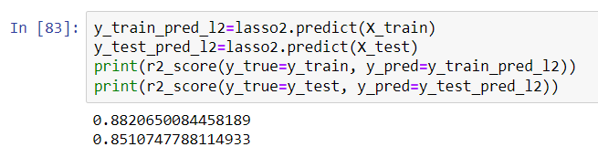
Results
For the model Lasso after RFE we calculated the train and test R2 score for train and test data.
By Using Lasso regression after RFE, we got 85.1% test score and 88.2% train score

Slide 25
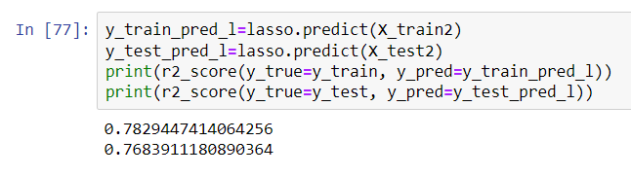
Results
For the model Lasso without RFE we calculated the train and test R2 score for train and test data.
By Using Lasso regression without RFE, we got 76.8% test score and 78.3% train score

Slide 26
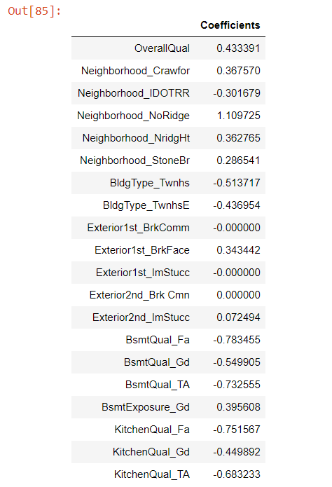
Key Features
We could see the key features responsible for predicting the price of house from our model.
The key features obtained from the model:
Overall Quality
Neighborhood
Exterior
Basement Quality
Kitchen Quality

Slide 27
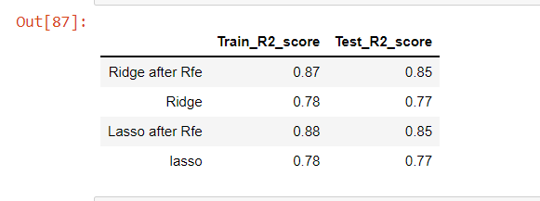
Comparing Results
Conclusion:
We could observe that R2 scores after RFE is better compared to without RFE as we took only top important features and built the model.
Without RFE, R2 scores are little lower as they consider other less important features too that may be redundant.

Slide 28
Thank you :)

