Slide 1
Homer
The Third eye for blind people
By MOZARTS

Slide 2
What is the project all about
The project is all about aiming on increasing the efficiency of blind author or person who wish to present their written thoughts to the world.
The project mainly run on the idea of text to speech . It makes convenient to the blind person to verify by listening what he or she has typed is exactly meant to be same as what they thought to express.

Slide 3
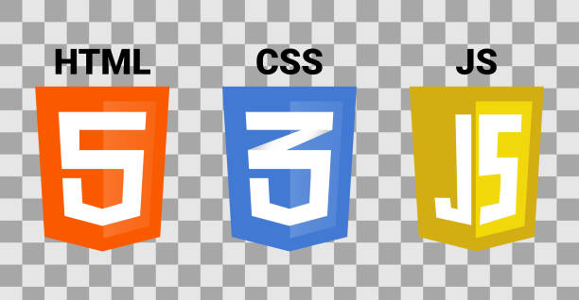
Software's used by us in making the project
The several languages we have used are
HTML
JAVASCRIPT
CSS

Slide 4
What all further advancement we are seeing forwards
We are seeing forward to add speech to text in the site .
Also see about joining cloud server to manage a data .

Slide 5
Benefits
It will help blind people to get job in data entry ,type writing ,contain writing.
It will to nurture the writing skills of blind person.
It will help the blind people to connect to the outside world .

Slide 6
Thanks

