Slide 1
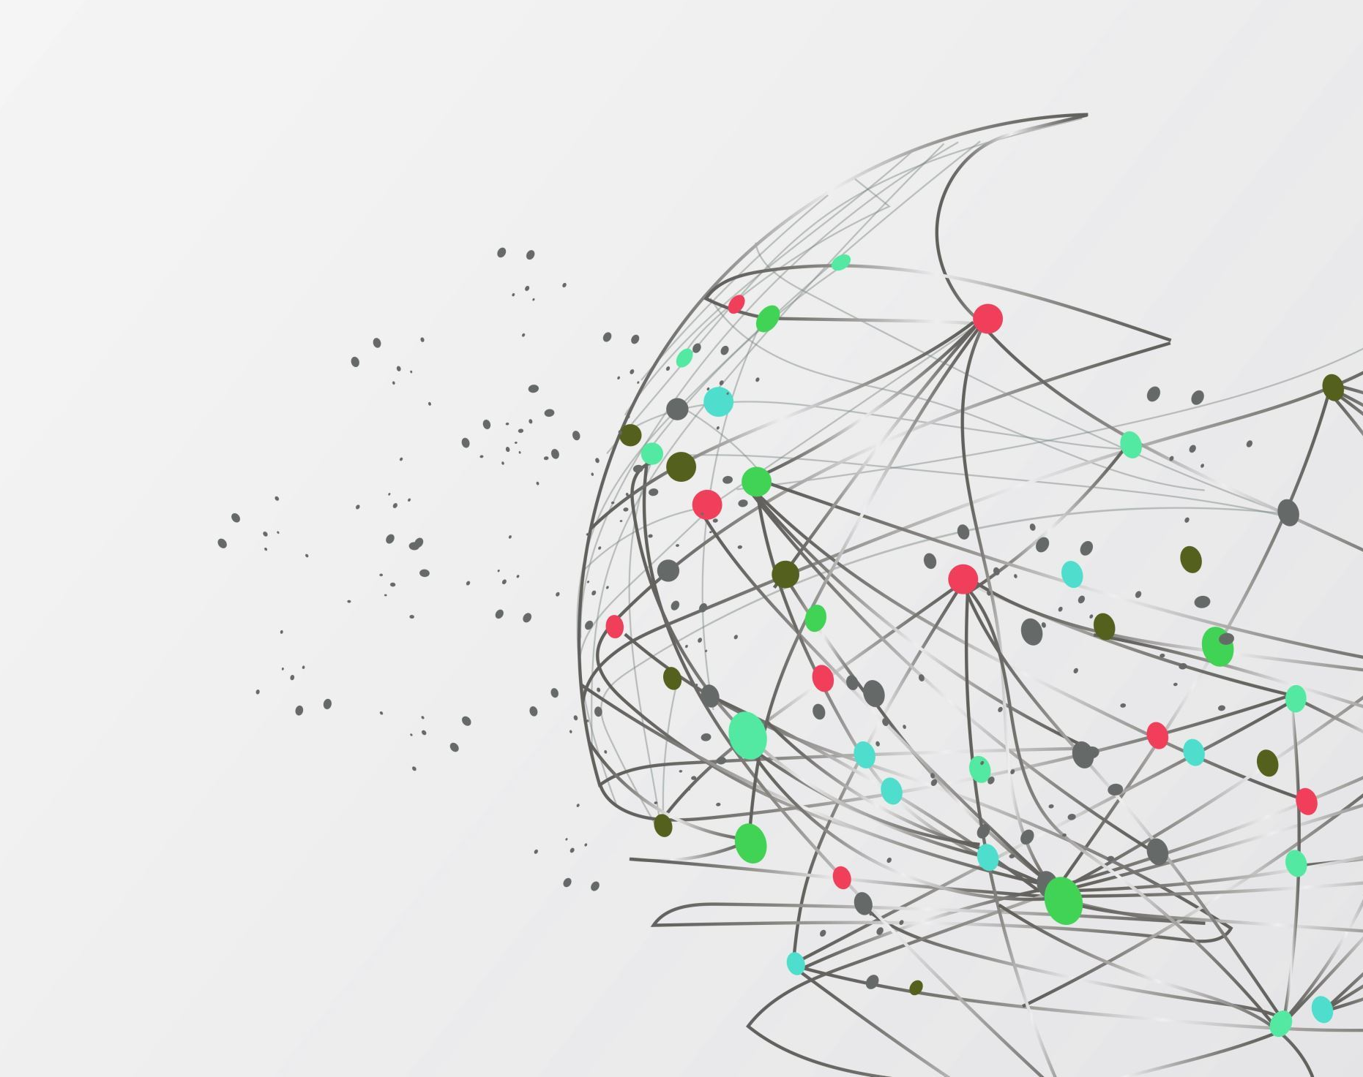
Legal Eagle Legal Text Analysis with NLP

Slide 2
01
Introduction
02
Data Collection
Agenda
03
Models and their Architecture
04
Future Scope and Limitations
05
Application Demonstration

Slide 3
01
Introduction.

Slide 4
Summarization: Condense complex legal texts into precise, easy-to-understand summaries.
Prediction: Predict the likelihood of a petition being accepted, leveraging AI-driven analysis.
Generation: Automate the drafting of contextually relevant legal documents.
Core
Features

Slide 5
Project Goals
Enhance productivity and accuracy in legal document processing.
Support in-depth legal research and informed decision-making.
Provide an essential tool for legal professionals, academics, and legal tech firms.

Slide 6
02
Data Collection

Slide 7
Data Features
Task | Source | Sample Size |  | Dataset columns
 |  | Train | Test
Text Summarization | Hugging Face Library | 7,030 | 100 | Text , Summary
Classification | GitHub | 33,299 | 1517 | Text, Label, Split
Text Generation | Hugging Face Library | 65083 |  | Text

Slide 8
03
Models and their Architecture

Slide 9
Introduction
Architecture and Working
LGPT-2, developed by OpenAI, is a transformer-based language model, leveraging unsupervised learning from diverse internet text.
GPT-2's architecture comprises multiple transformer layers, utilizing self-attention mechanisms that enable the model to generate contextually relevant text based on learned patterns from the data.
Our approach involves fine-tuning GPT-2 on the 'albertvillanova/legal_contracts' dataset, which consists of a large corpus of legal documents, to adapt it for legal text generation.
During fine-tuning, the model undergoes additional training where its parameters are adjusted to better align with legal text characteristics, enhancing its ability to comprehend and generate complex legal language.
This fine-tuning customizes the model's neural network weights, enabling it to internalize legal terminologies and document structures, a crucial aspect for generating authentic legal texts.
The adapted model efficiently processes input tokens, leverages learned positional encodings, and generates outputs that mirror the format and style of legal documents, ensuring both linguistic and contextual fidelity.

Slide 10
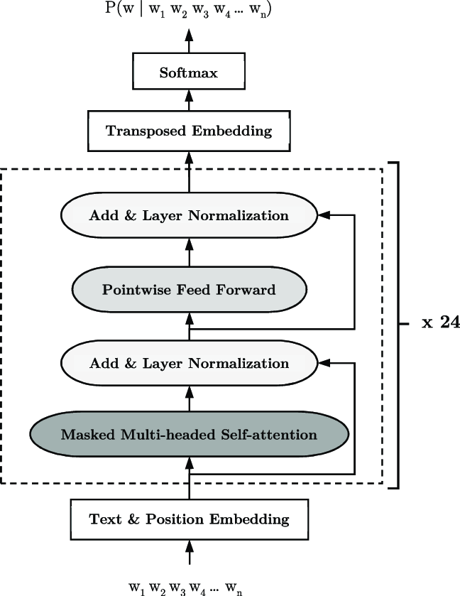
Model Architecture

Slide 11
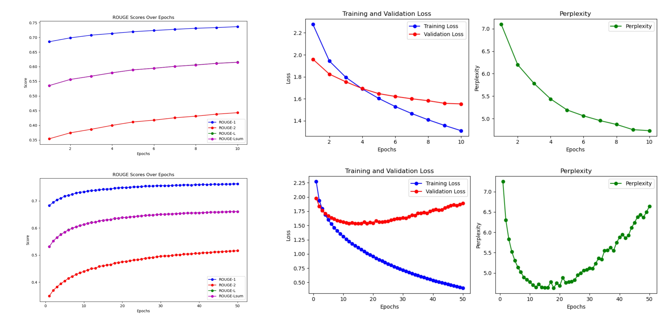
Results

Slide 12
Model Introduction
Prediction: Given a case proceeding document D, the task is to predict the decision y ∈ {0, 1}, where the label 1 corresponds to the acceptance of the appeal/petition of the appellant/petitioner.
The 'BertForSequenceClassification' model, is a transformer-based architecture designed for sequence classification tasks one of it.
This fine-tuning process aims to tailor the BERT pretrained model("law-ai/CustomInLawBERT") for the specific task of binary text classification in legal cases, allowing it to predict outcomes such as the petition is accepted/rejected.
This adaptation enhances the model's proficiency in comprehending legal text and making informed predictions in the context of legal case judgement.

Slide 13
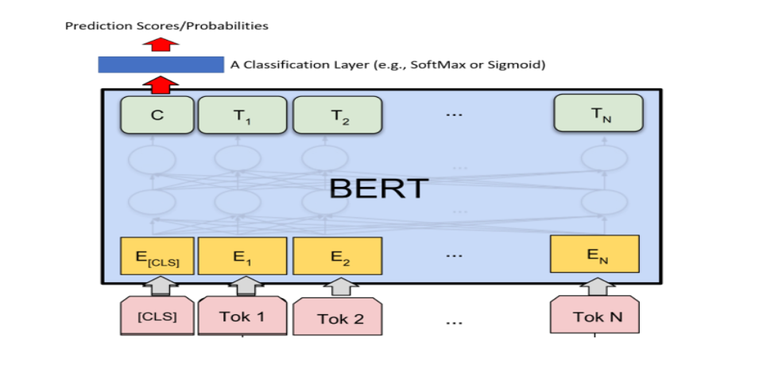
BERT Architecture and Workflow
Pre-trained BERT model("law-ai/CustomInLawBERT") as 12 transformer layers, each containing self-attention mechanisms and feedforward neural networks.
The final classification is performed by a linear layer, adapting the BERT representation to predict the output categories
output to a range between 0 and 1.
The purpose of this layer is to predict the probability of two output features. Predicting Judgment: "Accepted" or "Rejected"

Slide 14
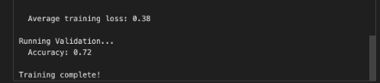
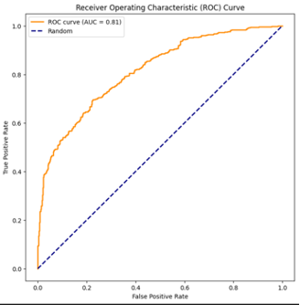
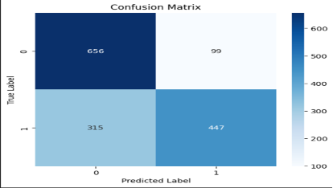
Result and Summary
Training Accuracy​
Prediction result on test set

Slide 15
Text Summarization Fine-Tuning
PEGASUS for legal document summarization:- This model (https://huggingface.co/nsi319/legal-pegasus) was used to perform abstractive summarization task on legal documents. The dataset used is government website (https://www.sec.gov/litigation/litreleases) which consists of more than 2700 litigation releases and complaints.
The maximum length of input sequence is 1024 tokens.
The dataset (https://huggingface.co/datasets/ninadn/indian-legal) used for fine-tuning the Pegasus model consists of text articles consisting of legal court proceedings in India along with their corresponding summaries.

Slide 16
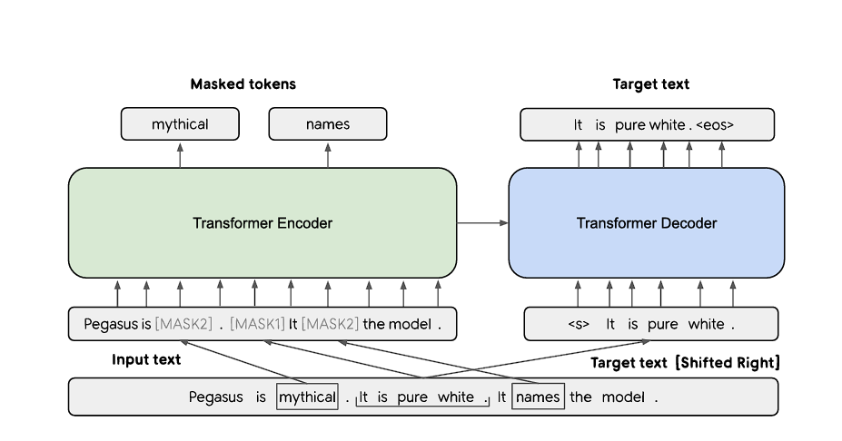
PEGASUS Architecture
The Pegasus transformer has encoder-decoder architecture trained on the CNN-Daily Mail dataset.
Like BERT and MLM models, 15% of input tokens are masked and need to be predicted by the encoder.
Additionally, GSG (Gap Sentences Generation) is also used where several sentences are selected from documents and concatenated into a pseudo summary. These pseudo-summaries are used as labels for training data.
The sentences are known as m-gap sentences and are either selected randomly, lead (first m sentences from the document) or principal (top m scored sentences according to importance).
Through GSG, PEGASUS learns to recognize which sentences logically follow each other and how they contribute to the overall meaning of the text. This heightened contextual understanding translates directly into the quality of the summaries it generates.
This unique training approach, combined with the power of Transformer-based architecture, makes PEGASUS a frontrunner in the field, setting new standards for abstractive text summarization.

Slide 17
Results
ROUGE-1 (Recall) | ROUGE-2 (Recall) | ROUGE-L (Recall) | ROUGE-1 (Precision) | ROUGE-2 (Precision) | ROUGE-L (Precision) | ROUGE-1 (F1-Score) | ROUGE-2 (F1-Score) | ROUGE-L (F1-Score)
16.57 | 6.49 | 14.94 | 52.99 | 26.46 | 48.18 | 24.48 | 10.01 | 22.16

Slide 18
04
Future Scope and Limitations

Slide 19
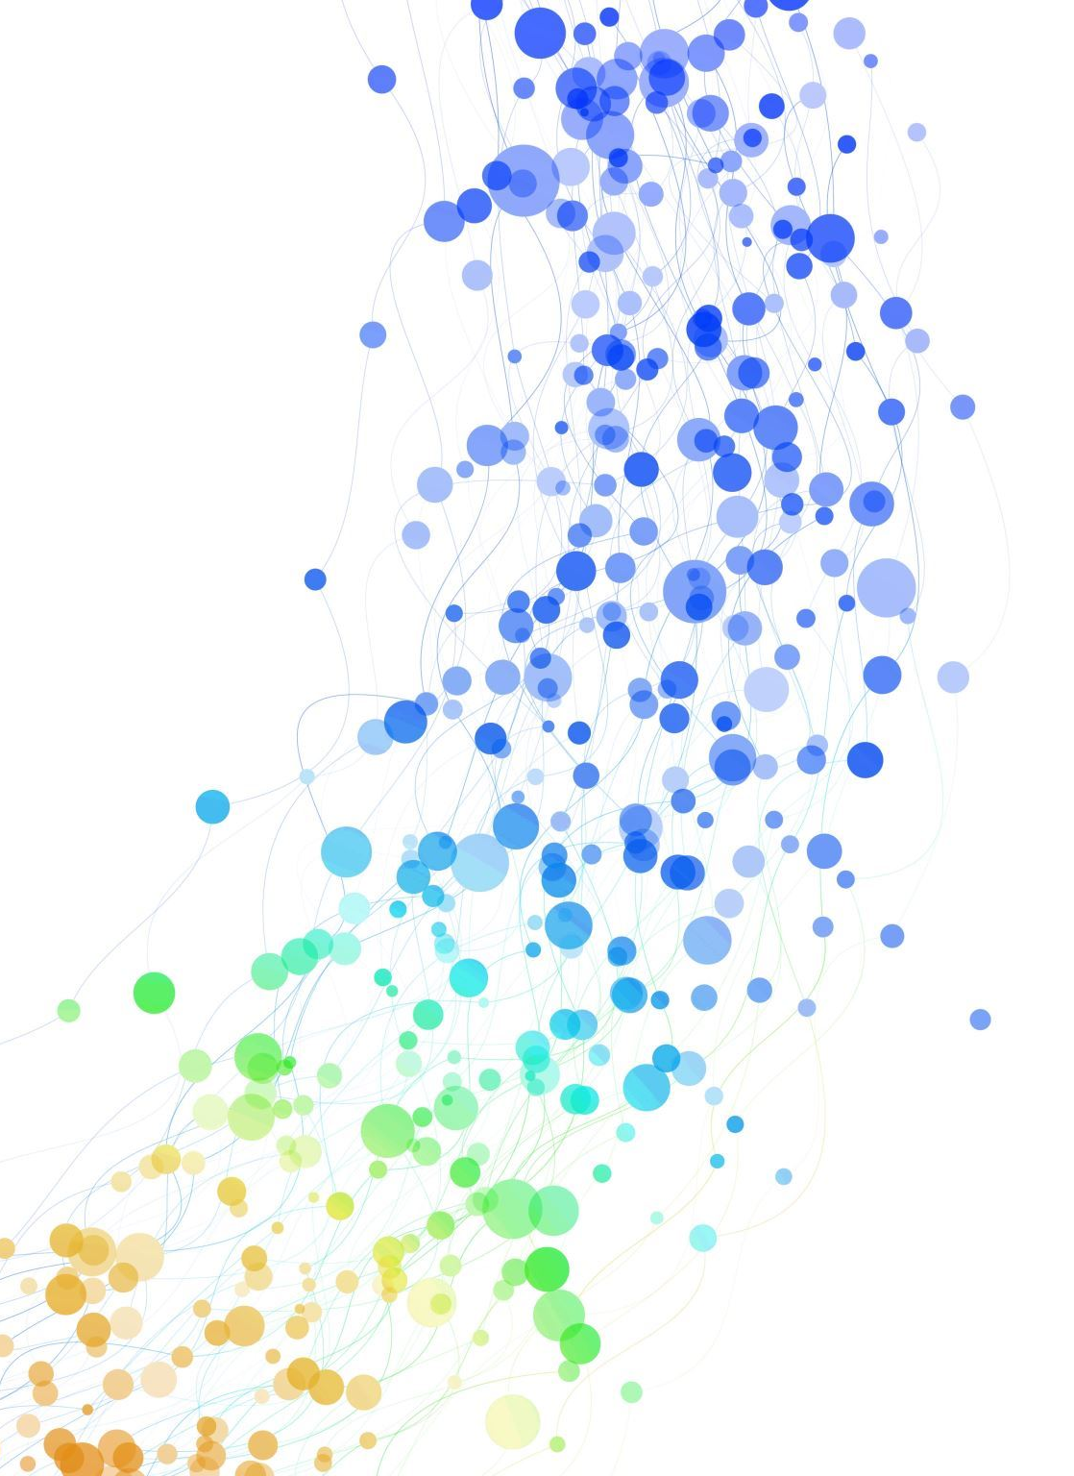
Future Scope​
Expansion to Multiple Languages: Beyond English to include other major languages in legal documents.​
Broader Legal Domains: Extending from specific areas like contract law to encompass wider legal fields.​
Advanced Predictive Models: Developing more nuanced and accurate prediction algorithms.​
Enhanced Data Accessibility: Working towards more open and accessible legal data while respecting privacy concerns.​

Slide 20
Limitations
Hardware Limitations: High computational requirements, advanced GPUs needed, scalability issues.
Dataset Constraints: Limited access to comprehensive legal datasets, data privacy concerns, variability in document formats, bias in historical texts.

Slide 21
05
App Demo

Slide 22
Click the link to view Legal Egale!

Slide 23
Thank you!

