Slide 1
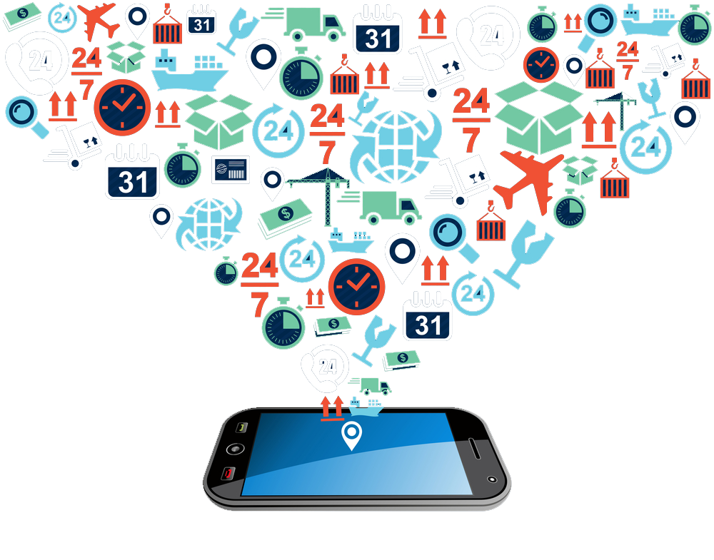
Team 13
Predicting Spam Mobile Applications
Team members :
Akhil Gupta
Arpit Kapoor
Harshit Gautam
Shreyansh Singhvi

Slide 2
Agenda
Apps
Objectives
Dataset Details
Exploratory Analysis
Models Implemented
Analysis and Findings
Lessons Learnt

Slide 3
Objective
Background
Objective
- Mobile Apps in the
market are increasing
exponentially
- Many spam apps are
floating in the market
- Classify app as spam or not
- Analyze given dataset and provide better recommendations to reduce spam app revenue in market
SPAM

Slide 4
Dataset Details
Data Source
Complexity
1) Unbalanced Dataset
2) Min. Correlation between predictors and rest of the variables
Size
Total Apps: 7640
Total Spam Apps: 551
Training: 5348
http://www.privmetrics.org/publications/www15/
Along with the description of project
Testing: 2292

Slide 5
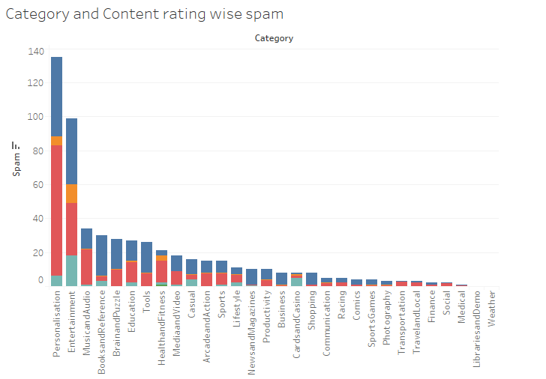
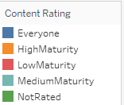
Exploratory Analysis
We visualized the original dataset to look for certain trends
We found out that for combination of category Personalization and Content rating Everyone and Low Maturity the Spam apps are highest

Slide 6
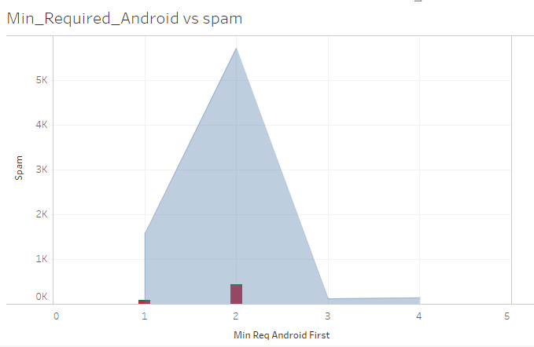
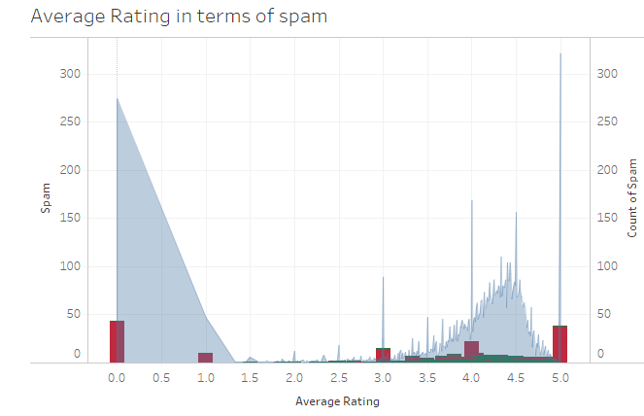
Exploratory Analysis
https://public.tableau.com/profile/publish/Tableau_new_0/Dashboard1#!/publish-confirm
We observed that for Min_Required_Android version 2 the no of spam app is highest
We observed that people have poorly rated the Spam apps.

Slide 7
Business trade - off
Spam
Credibility Loss
Non Spam
Monetary Loss

Slide 8

Models Implemented
Logistic Regression Bagging
Random Forest K – Nearest Neighbor
Classification Tree Association rule

Slide 9
Dataset Preparation - Sampling
Sampling
Original
Dataset
Under
Sampling
Over
Sampling

Slide 10
Logistic Regression
Regression Model | Confusion Matrix |  |  | Accuracy | Sensitivity
Model with sampled data | Actual | 0 | 1 | -- | --
 | 0 | 2136 | --
 | 1 | 156 | --
Model with under sampled data | Actual | 0 | 1 | 74.68 % | 62.82
 | 0 | 1508 | 628
 | 1 | 58 | 98
Model with over sampled data | Actual | 0 | 1 | 83.90 % | 37.82
 | 0 | 1864 | 272
 | 1 | 97 | 59

Slide 11
Ensemble Methods
Ensemble Model | Bagging |  |  |  | Random Forest
 | Confusion Matrix |  |  | Accuracy & Sensitivity | Confusion Matrix |  |  | Accuracy & Sensitivity
Model with sample data | Actual | 0 | 1 | 91.4 % & 2.54 | Actual | 0 | 1 | 92.4 % & 0
 | 0 | 2087 | 31 |  | 0 | 2118 | 0
 | 1 | 165 | 9 |  | 1 | 174 | 0
Model with under sampled data | Actual | 0 | 1 | 64.26 % & 73.71 | Actual | 0 | 1 | 67.58 % & 74.35
 | 0 | 1357 | 779 |  | 0 | 1433 | 703
 | 1 | 40 | 116 |  | 1 | 40 | 116
Model with over sampled data | Actual | 0 | 1 | 89.30 % & 16.02 | Actual | 0 | 1 | 83.46 % & 39.74
 | 0 | 2021 | 115 |  | 0 | 1851 | 285
 | 1 | 130 | 26 |  | 1 | 94 | 62

Slide 12
K – Nearest Neighbor
Model | Confusion Matrix |  |  | Accuracy | Sensitivity
Model with sampled data | Actual | 0 | 1 | 90.83 % | 6.74
 | 0 | 2071 | 58
 | 1 | 152 | 11
Model with under sampled data | Actual | 0 | 1 | 61.25 % | 43.72
 | 0 | 1289 | 840
 | 1 | 48 | 115
Model with over sampled data | Actual | 0 | 1 | 87.47 % | 19.63
 | 0 | 1973 | 156
 | 1 | 131 | 32

Slide 13
Classification tree
Trees | Confusion Matrix |  |  | No. of terminal Nodes | Accuracy | Sensitivity
ree with Under sampled data | Predict | 0 | 1 | 10 | 61.78 | 12.02
 | 0 | 1302 | 42
 | 1 | 834 | 114
Tree with Over sampled data | Predict | 0 | 1 | 4 | 68.28 % | 13.27
 | 0 | 1489 | 57
 | 1 | 647 | 99

Slide 14
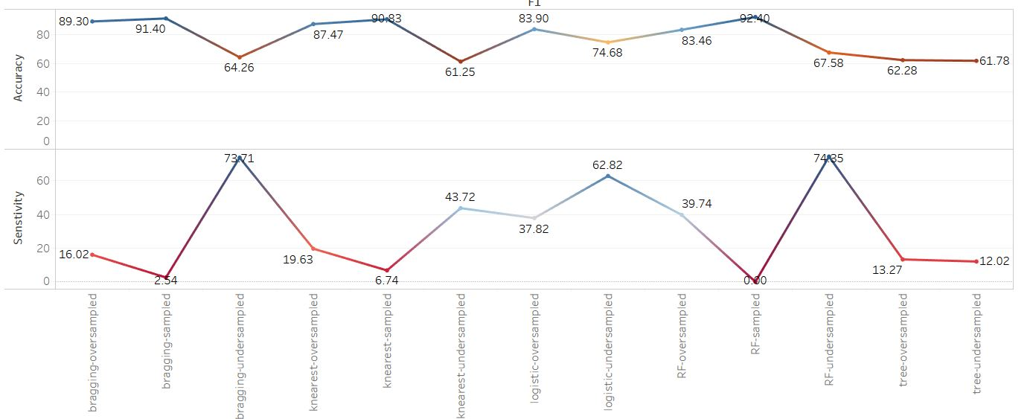
Models Accuracy and Sensitivity Comparison

Slide 15

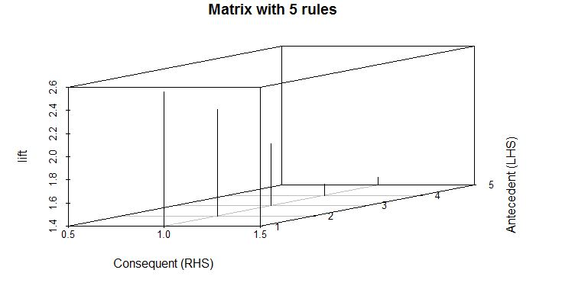
Association Rules
An App of Entertainment Category minimum required android version 2 has very high probability of being in spam category
An App from Personalization category and low maturity, has good probability of being an spam app.

Slide 16
Association Rule
2.8m
~180k
Android Apps
Entertainment
Apps
*2017 report
*Research
~80k
~35k
Spam Apps
Entertainment Spam App
*Research paper
*Association rule

Slide 17
Lessons Learnt
The performance measures are highly variant, hence model selection is difficult.
Sampling techniques can come handy when data is unbalanced
Tradeoff for drawing positive outcome for business purpose is an important consideration

Slide 18



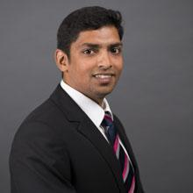
Thank You
Know more about our project at our GitHub Repository:
https://github.com/akhil9tiet/DataMiningProject

