Slide 1


Building a Movie Recommendations System
Welcome to our presentation on creating a movie recommendations system! In this project, we will explore the crucial steps of reading and cleaning the data, creating a matrix, and designing a user-friendly search box. Let's dive in!
AS
by Akhila Suru

Slide 2

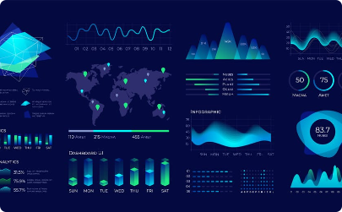
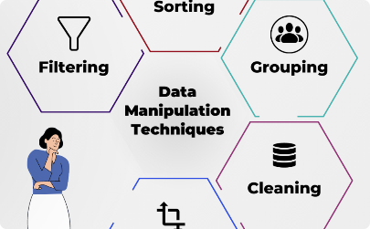
The Power of Data
Unearthing Insights
Visualizing Magic
Making Data Work
Through careful data analysis, we reveal hidden patterns and trends that drive personalized movie recommendations.
Data visualizations help us to understand the relationships between movies and connect users with the perfect film.
Using various techniques, we manipulate the data to prepare it for our groundbreaking movie recommendation system.

Slide 3

From Clean to Dream
1
Reading the Data
We gather movie data from multiple sources, including ratings, reviews, and genres, to provide accurate recommendations.
Cleaning the Data
2
We eliminate outliers, handle missing values, and ensure consistency in the dataset for improved recommendation accuracy.
3
Creating a Matrix
A matrix is built leveraging user preferences and movie attributes, forming the backbone of our recommendation algorithm.

Slide 4
The Art of Searching
Enhanced User Experience
Efficient and Smart
Promoting Discovery
Our search box boasts intuitive features, delivering an exceptional user experience with real-time suggestions and filter options.
Powered by advanced algorithms, our search box ensures fast and precise results, enabling users to quickly find their desired movies.
With its intelligent recommendations, our search box introduces users to films they might have overlooked, expanding their cinematic world.

Slide 5

Final Touches: Movie Recommendations
1
Personalized Suggestions
2
Analytics and Feedback
3
Adapting and Evolving
Our system tailors recommendations based on users' viewing history, preferences, and ratings, ensuring a perfect match every time.
We continuously monitor user feedback and analyze viewing patterns to improve our recommendations and enhance user satisfaction.
As new movies hit the big screen, our system adapts, enhancing its knowledge to offer up-to-date and relevant recommendations.

Slide 6
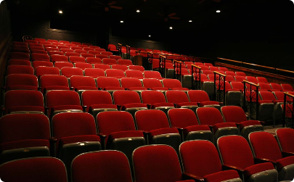

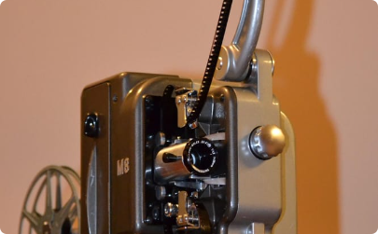
Unleash the Movie Lover in You!
The Ultimate Movie Experience
Discover Hidden Gems
Popcorn Ready?
Explore a world of undiscovered treasures and fall in love with the magic of cinema all over again.
Grab your popcorn, sit back, and let our movie recommendations transport you to another world.
Embrace the joy of cinema and make every movie night unforgettable with our cutting-edge recommendations.

Slide 7
THANK YOU

