Slide 1
Project Statement
Develop a Java project, generate a Docker image, upload it to Docker Hub, and configure a CI/CD pipeline using Jenkins.
Performing selenium automation testing with java on Ajio website.

Slide 2
Index/Requirements
Eclipse
Docker
Github
Jenkins
Selenium

Slide 3
Introduction
Spring Boot: Spring Boot is a framework built on top of the Spring framework that simplifies the development of Java applications.
Docker : Docker is a platform and tool that allows developers to package, distribute, and run applications in containers.
Git: Git is a distributed version control system used for tracking changes in source code during software development
Jenkins: Automates software development processes like building and deploying applications.

Slide 4
Procedure for spring boot project
Step 1:Open bowser search for spring initializer
Step 2: configure the require data
Step 3: add spring web dependency
Step4: download the zip file
Step 5:unzip the file
Step 6: open eclipse ->new->import->maven->existing maven project->next->select the unzip from the local system->finish
Step 7:create a docker file and write required data
Step 8:right click on java Application ->run as ->java application

Slide 5
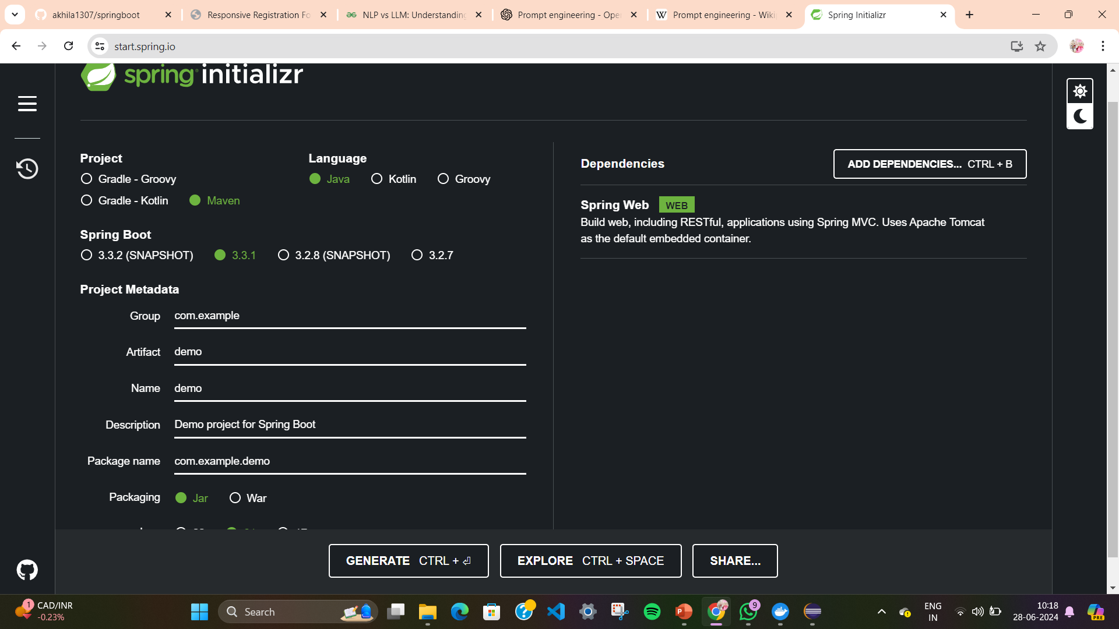
Spring Initilizer

Slide 6
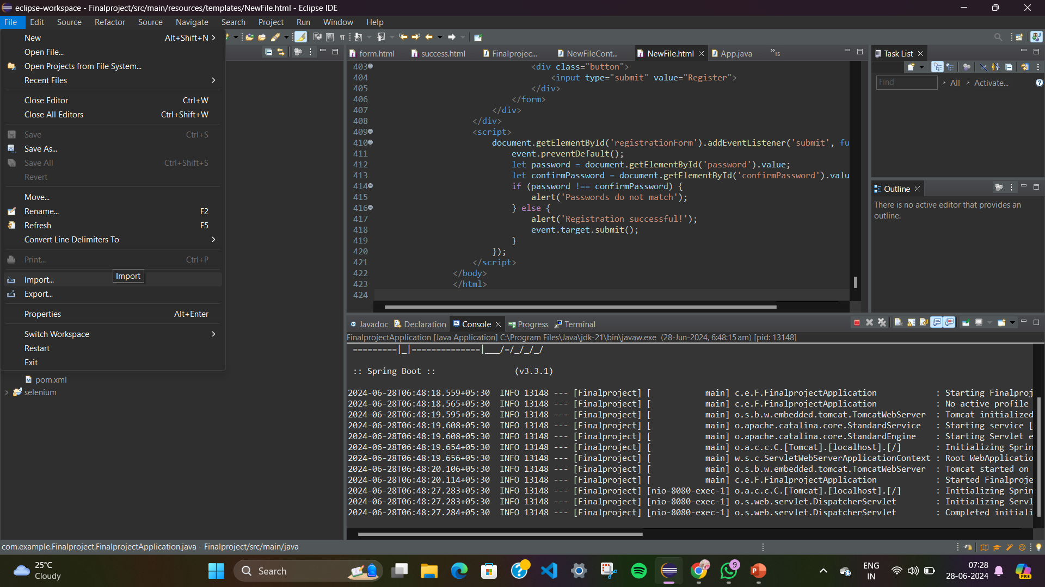
Maven project

Slide 7
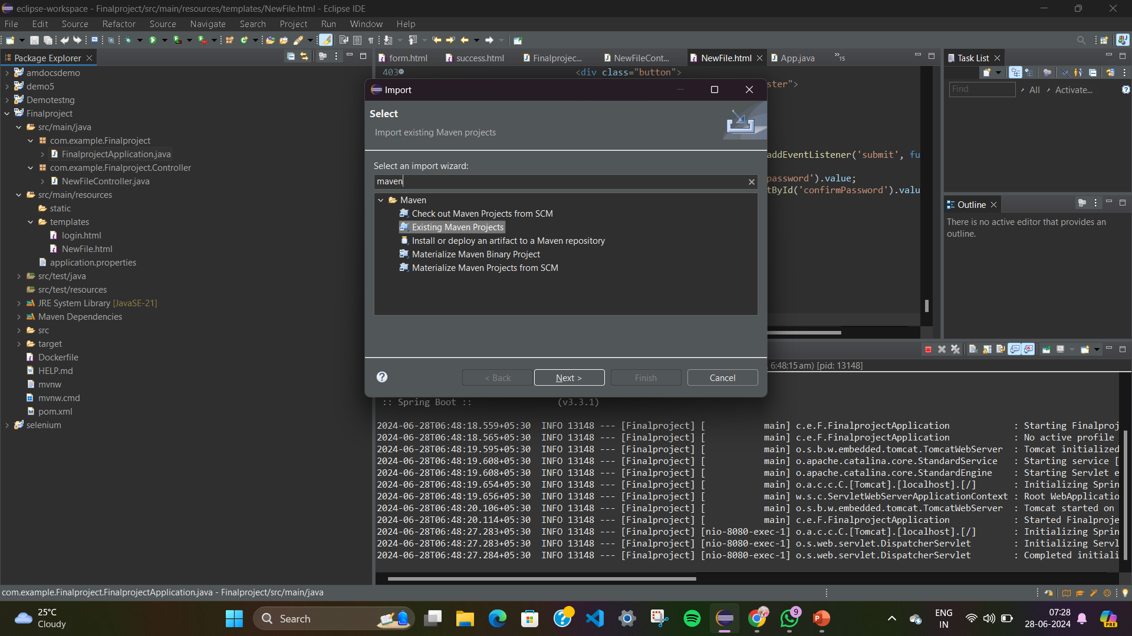

Slide 8
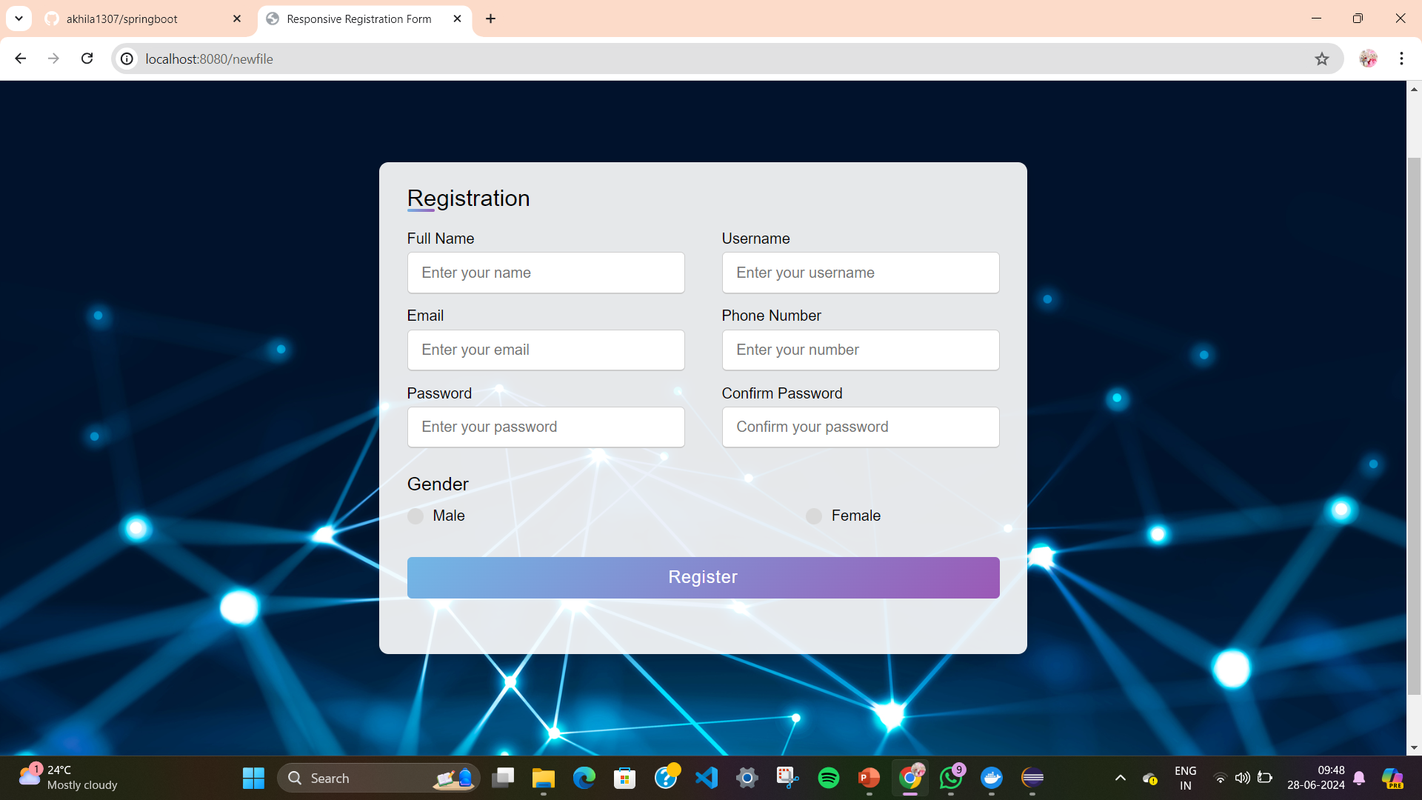
output

Slide 9
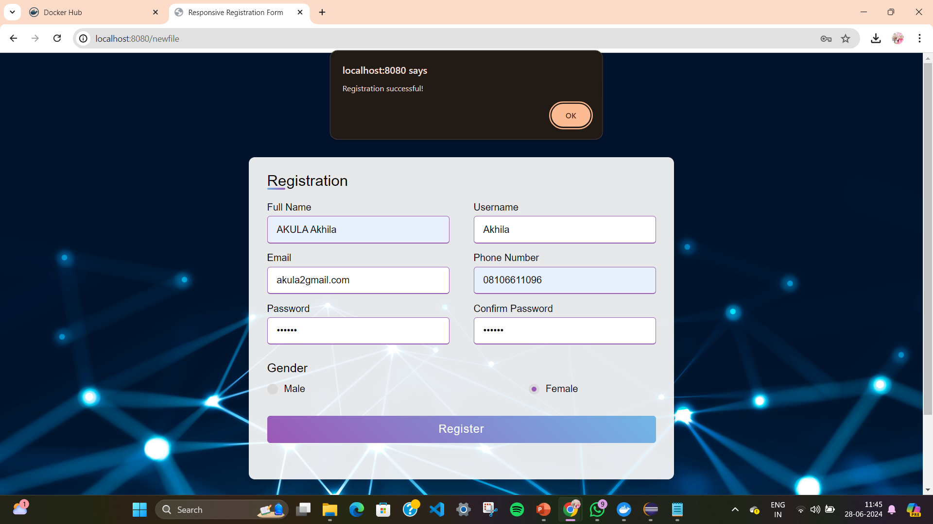
After click on register the following page is displayed

Slide 10
Creating docker image and pushing into docker
In eclipse local teminal build the docker image
docker build –t finalproject.jar .
Docker run –p 9090:8080 finalproject.jar
In local terminal run this commands
docker tag finalproject.jar:latest akhilaakula13/finaldemo_springboot:latest
Checking whether the image is created or not
Docker images
Pushing the docker image
docker push akhilaakula13/finaldemo_springboot:latest

Slide 11
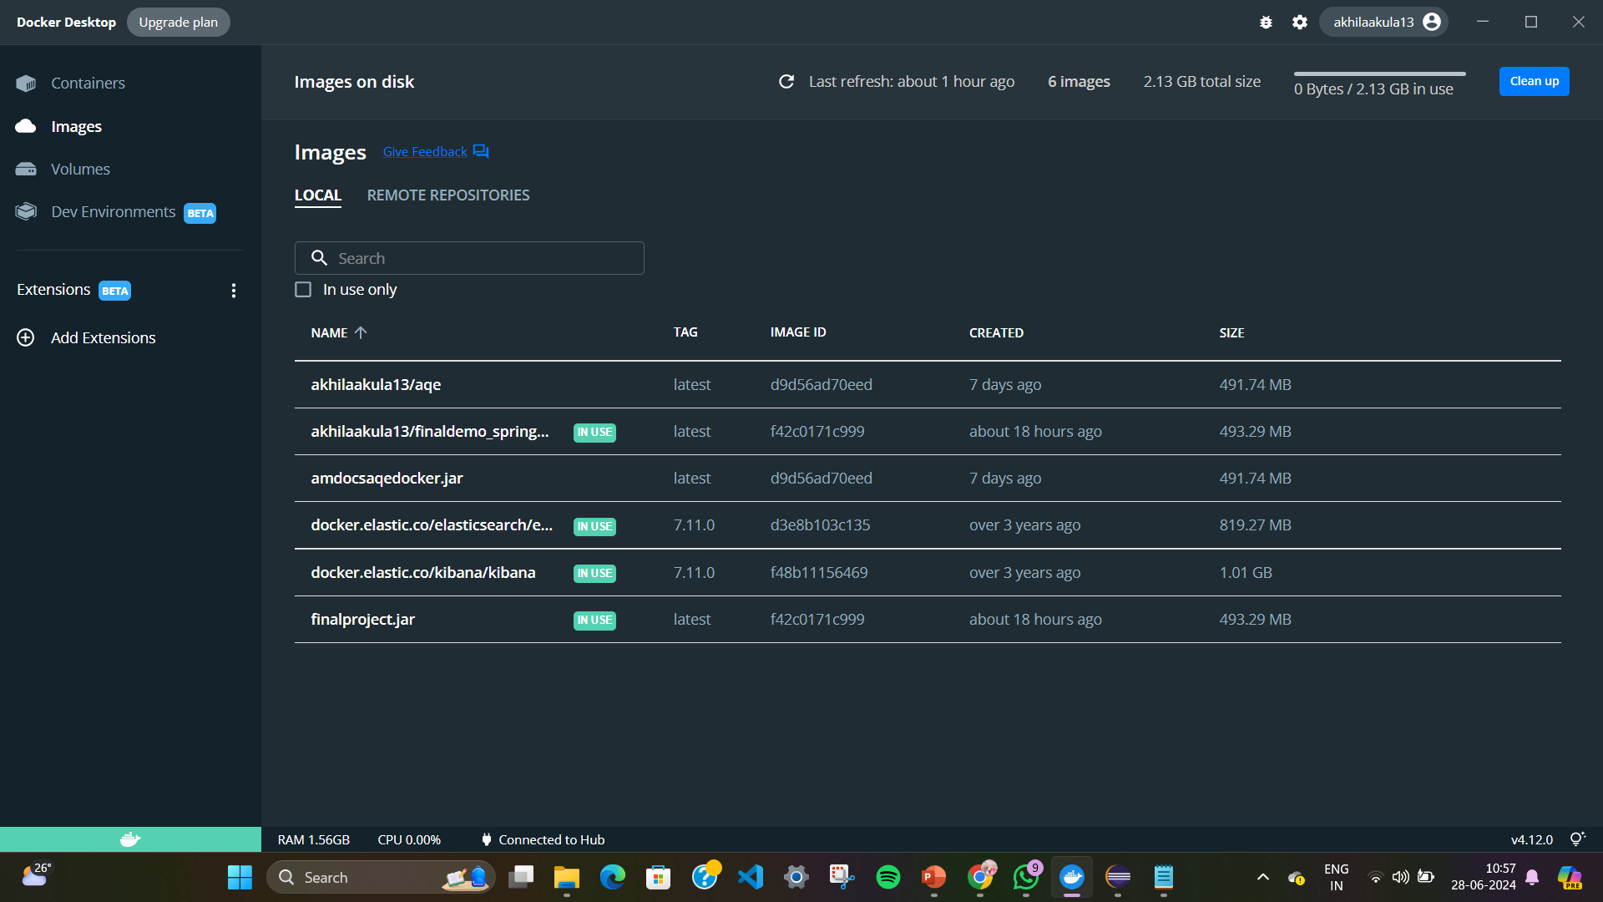
Docker Desktop images

Slide 12
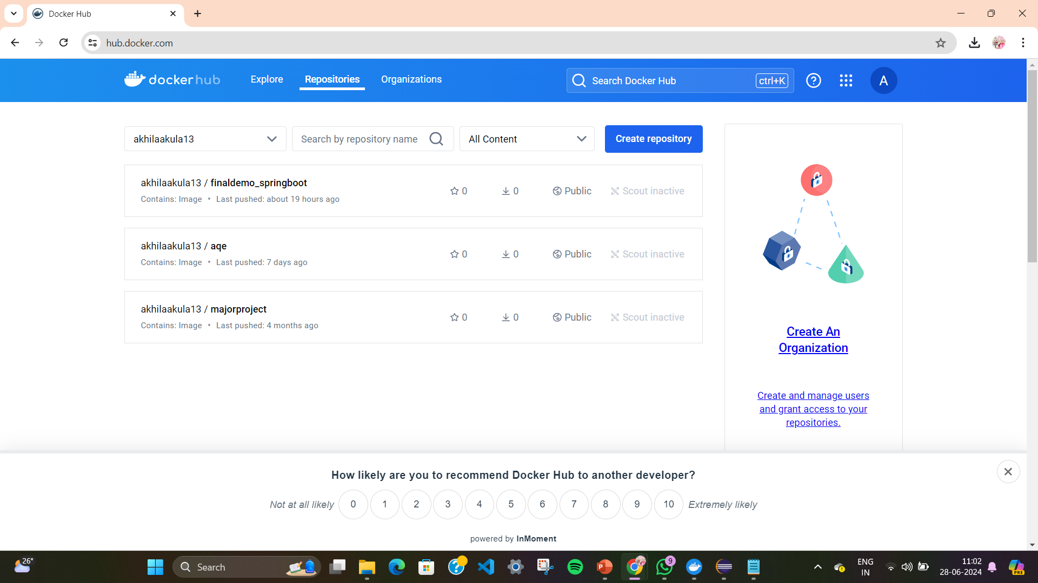
Docker hub image

Slide 13
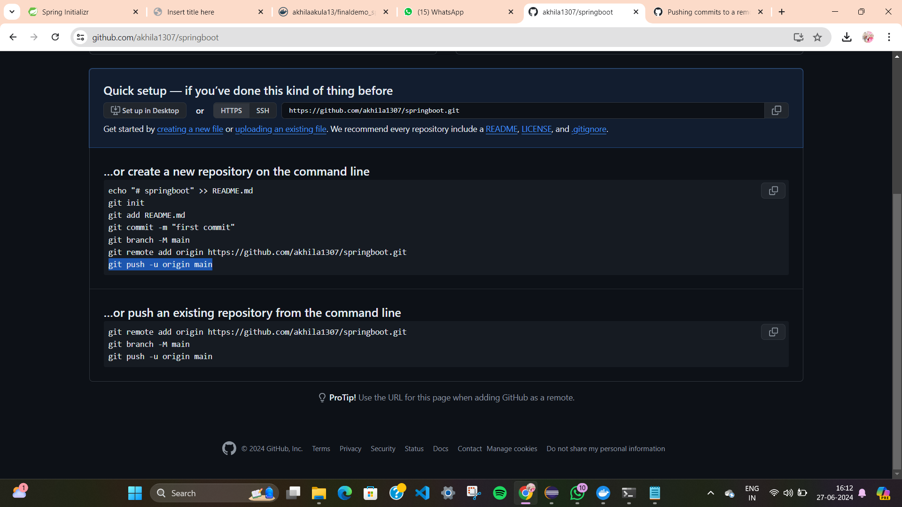
Commands to push code into github repository

Slide 14
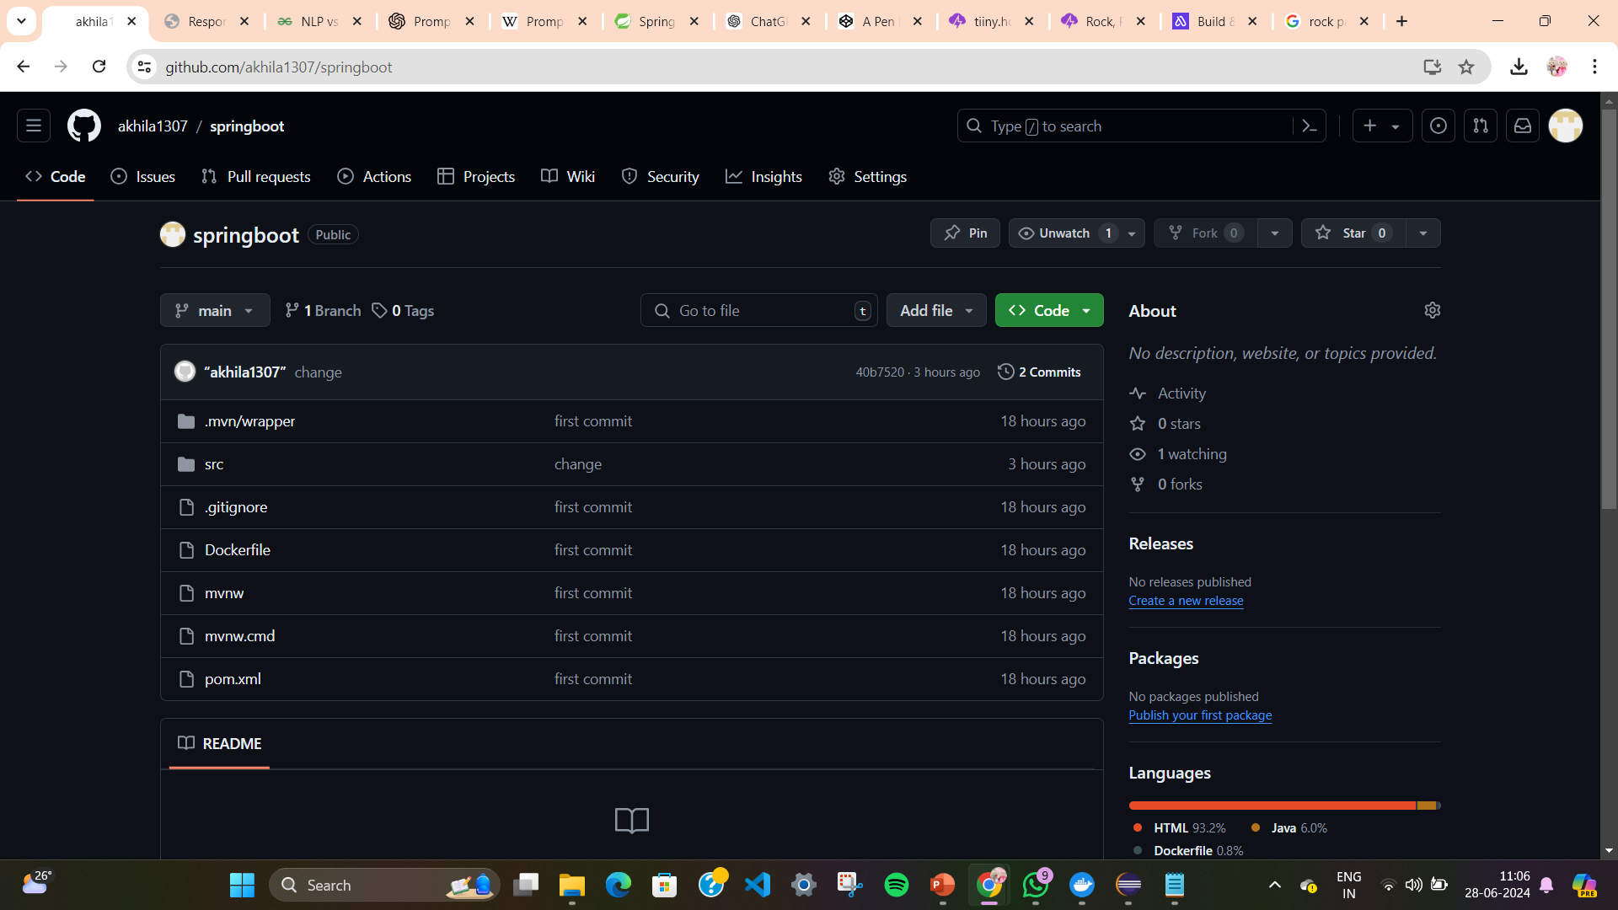
Git repository

Slide 15
Process to integrate jenkins
Step:1 open localhost:8080
Step 2: select new item->name to pipeline->select free style->ok
Step3:description->git->url->add git url->pool scm->schedule(* * * * * *)->Buildsteps->top-level-maven->save

Slide 16
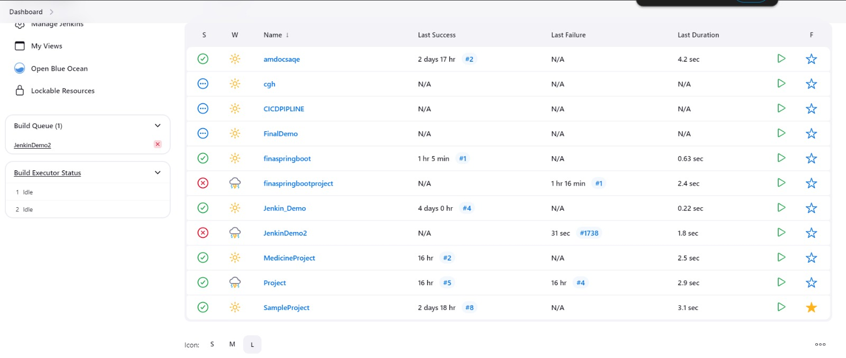
Jenkin page

Slide 17
Introduction to selenium
Selenium is a powerful tool for automating web browsers, enabling the testing and scraping of web applications. Here’s a brief overview of its key aspects:
Key Features
Browser Automation
Cross-Browser Compatibility
Programming Language Support
WebDriver

Slide 18
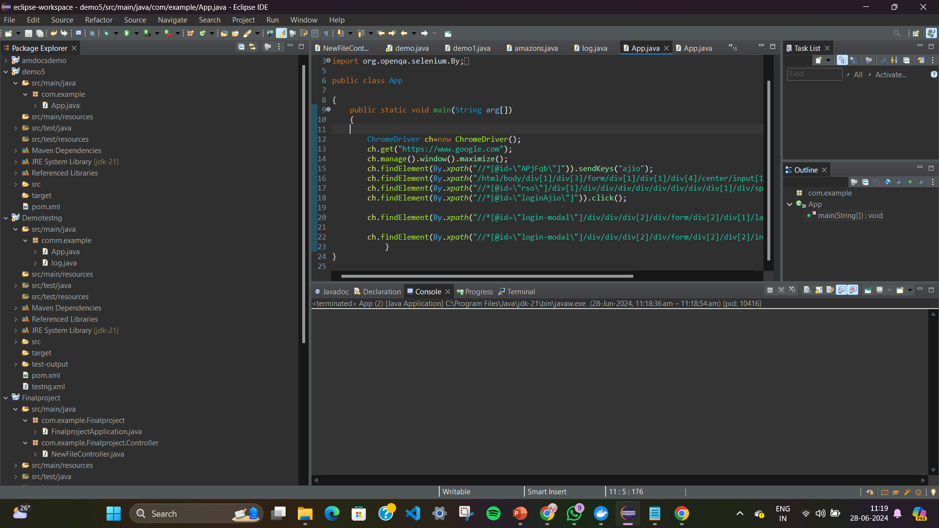
Selenium project code

Slide 19


