Slide 1


GRID CONNECTED PV PANEL WITH A dq CONTROLLED INVERTER
By
M.Vasavi Chowdary 19WH1A0212
S.Deepthi 19WH1A0235
A.Akhila 19WH1A0244
J.Bhagyalaxmi 20WH5A0205
Under the Guidance of
Ms.K.Amritha
Associate Professor
Batch 7
Department of Electrical and Electronics Engineering​
BVRIT HYDERABAD College of Engineering for Women
BVRIT HYDERABAD College of Engineering for Women
www.bvrithyderabad.edu.in

Slide 2
PROBLEM STATEMENT
Solar panels produce DC power. This DC should be converted to AC before injecting it to the grid.
Solar panel output depends upon the irradiance and temperature, which may change throughout the day.
Irrespective of the output of the solar panel, energy fed to the grid from the inverter should have constant voltage and frequency.
BVRIT HYDERABAD College of Engineering for Women
www.bvrithyderabad.edu.in

Slide 3
PROBLEM ANALYSIS
The output of a solar cell is very less. MPPT technique should be used to harness the maximum power from the panel. Also this DC power output should be increased by using a boost converter before feeding to the inverter.
To maintain constant voltage and frequency dq (Direct Quadrature) control method can be used.
BVRIT HYDERABAD College of Engineering for Women
www.bvrithyderabad.edu.in

Slide 4
OBJECTIVE
The controller design and MATLAB simulation of a 3 phase grid-connected inverter is being implemented in this project.
Inverter is used to convert DC to alternating current (AC), which the electrical grid uses. The energy fed to the grid from inverter is to be maintained at constant voltage and constant frequency. To improve the dynamic response of the grid connected inverter the dq control method is used.
BVRIT HYDERABAD College of Engineering for Women
www.bvrithyderabad.edu.in

Slide 5
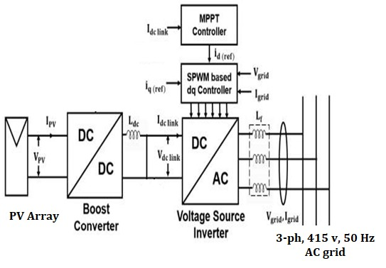
BLOCK DIAGRAM
BVRIT HYDERABAD College of Engineering for Women
www.bvrithyderabad.edu.in

Slide 6
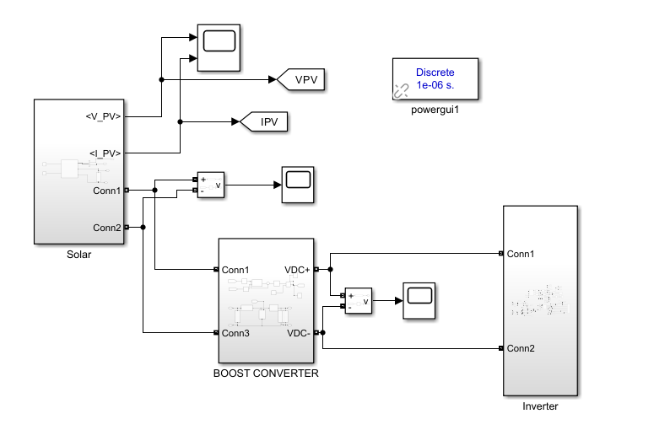
STATUS OF THE PROJECT
FINAL DESIGN
BVRIT HYDERABAD College of Engineering for Women
www.bvrithyderabad.edu.in

Slide 7
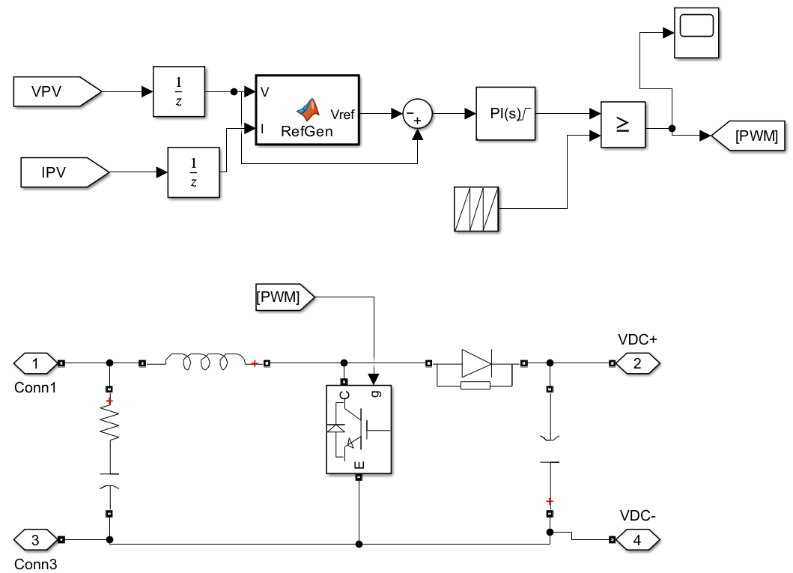
BOOST CONVERTER DESIGN
BVRIT HYDERABAD College of Engineering for Women
www.bvrithyderabad.edu.in

Slide 8
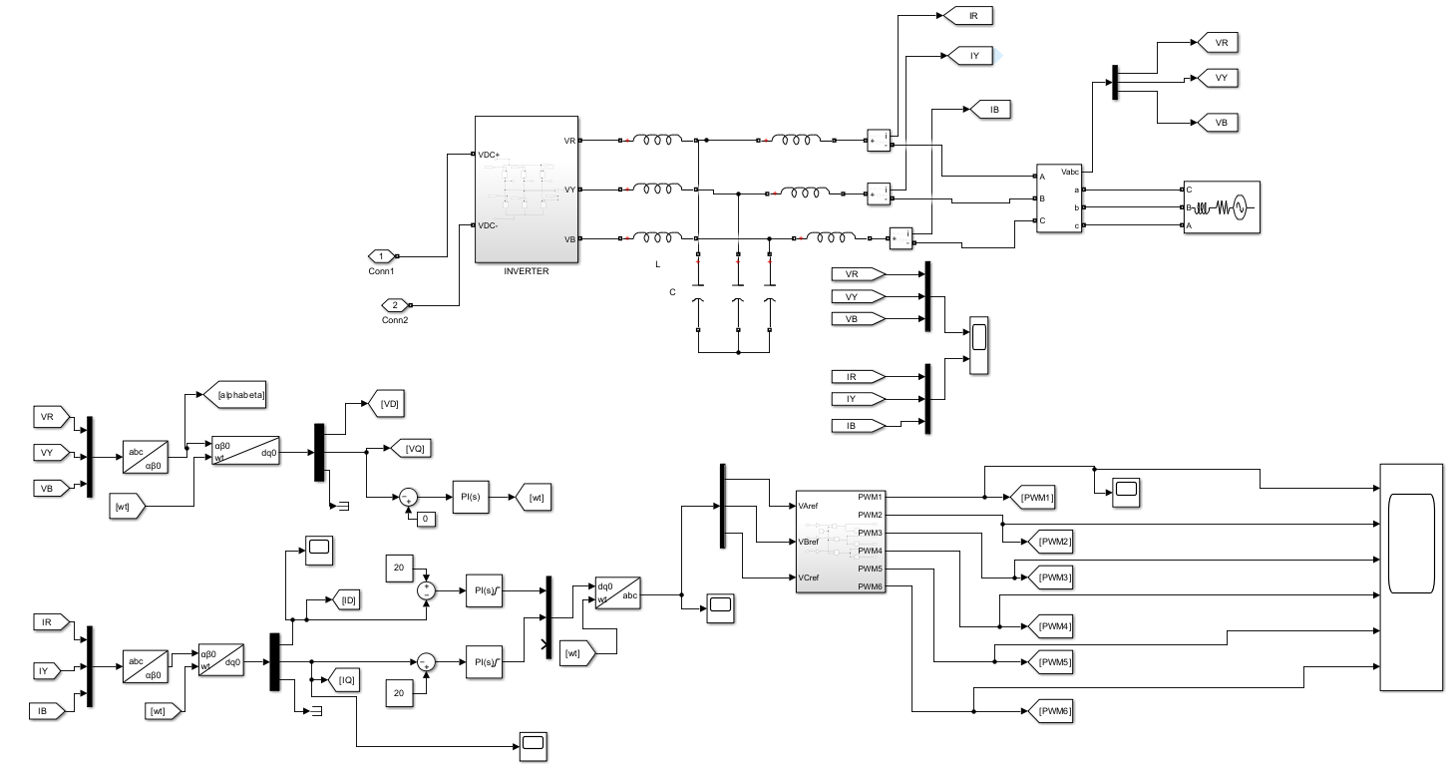
dq CONTROLLED INVERTER
BVRIT HYDERABAD College of Engineering for Women
www.bvrithyderabad.edu.in

Slide 9
LITERATURE SURVEY
The idea of “Direct-quadrature Control Method To Simulate A 3 Phase Grid Connected Inverter Using Matlab” is reference to the article entitled Choi, W., Morris, C., & Sarlioglu, B. (2016, February). Modelling three-phase grid-connected inverter system using complex vector in synchronous dq reference frame and analysis on the influence of tuning parameters of synchronous frame PI controller. In 2016 IEEE Power and Energy Conference at Illinois (PECI) (pp. 1-8). IEEE.
The information about MPPT Techniques for PV Systems is referred to the paper “Beriber, D., & Talha, A. (2013, May). MPPT techniques for PV systems. In 4th International conference on power engineering, energy and electrical drives (pp. 1437-1442). IEEE”.
BVRIT HYDERABAD College of Engineering for Women
www.bvrithyderabad.edu.in

Slide 10
The information of the design of closed loop Boost converter using PI Controller referred to the paper “Hasaneen, B. M., & Mohammed, A. A. E. (2008, March). Design and simulation of DC/DC boost converter. In 2008 12th International Middle-East Power System Conference (pp. 335-340). IEEE”.
The information about dq controlled inverter referred to the paper “Makovenko, E., Husev, O., Roncero-Clemente, C., Romero-Cadaval, E., & Vinnikov, D. (2017, October). Modified dq control approach for three-phase inverter. In 2017 IEEE 58th International Scientific Conference on Power and Electrical Engineering of Riga Technical University (RTUCON) (pp. 1-3). IEEE”.
BVRIT HYDERABAD College of Engineering for Women
www.bvrithyderabad.edu.in

Slide 11
EXISTING METHODS
There are many control methods are existed for inverter such as Stationary Reference Frame Control, Natural Frame Control, Evaluation of Control Structures and dq method.
We are using dq method because it is easy and accurate method among all these method.
BVRIT HYDERABAD College of Engineering for Women
www.bvrithyderabad.edu.in

Slide 12

TECHNOLOGIES USED
Software
BVRIT HYDERABAD College of Engineering for Women
www.bvrithyderabad.edu.in

Slide 13
METHODOLOGY
The output of the solar panel is less so, boost converter is used to boost up the voltage. Maximum Power Point Tracking (MPPT) is used to extract maximum available power by perturb and observe algorithm. Inverter is used to convert DC to alternating current (AC), which the electrical grid uses.
The energy fed to the grid from inverter is to be maintained at constant voltage and constant frequency. To improve the dynamic response of the grid connected inverter the dq control method is used. This transformation is achieved by use of the Clarke and Park transformation methods, which convert the abc to αβ and αβ to dq. This transformation produces DC components.
BVRIT HYDERABAD College of Engineering for Women
www.bvrithyderabad.edu.in

Slide 14
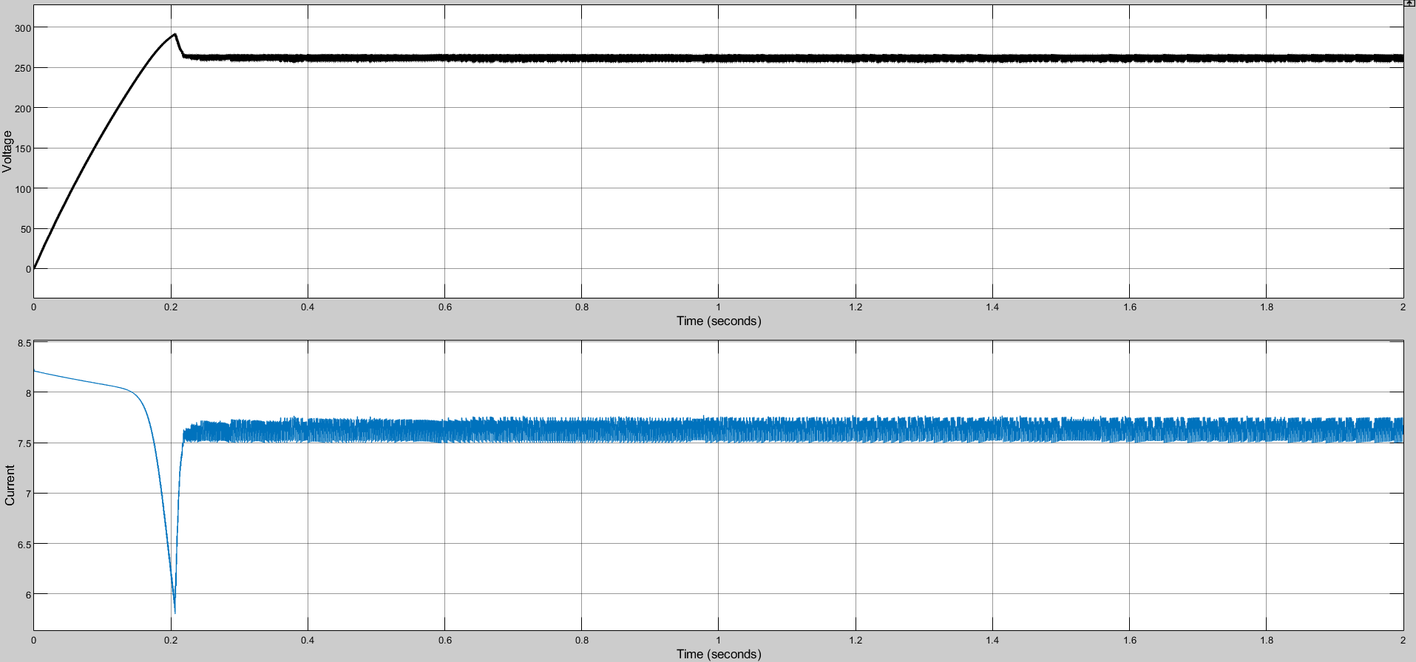
RESULTS
Solar Panel Output(Voltage vs Time) and (Current vs time)
BVRIT HYDERABAD College of Engineering for Women
www.bvrithyderabad.edu.in

Slide 15
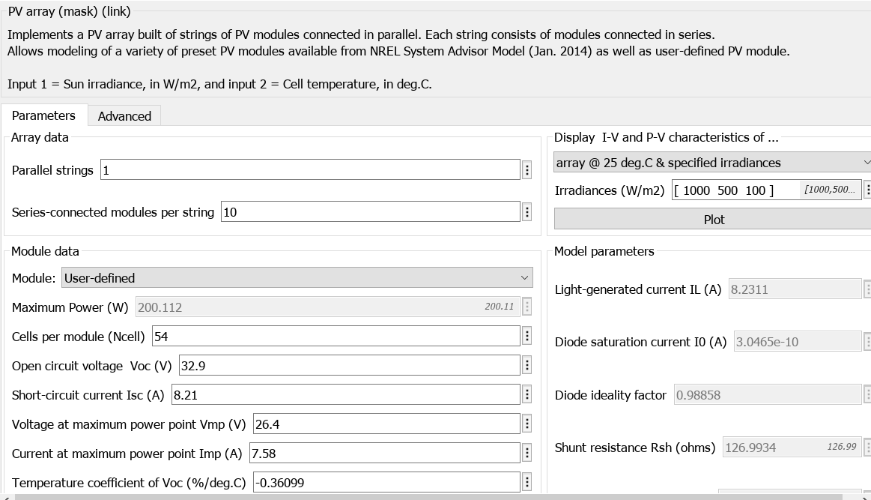
SOLAR PANEL PARAMETERS
BVRIT HYDERABAD College of Engineering for Women
www.bvrithyderabad.edu.in

Slide 16
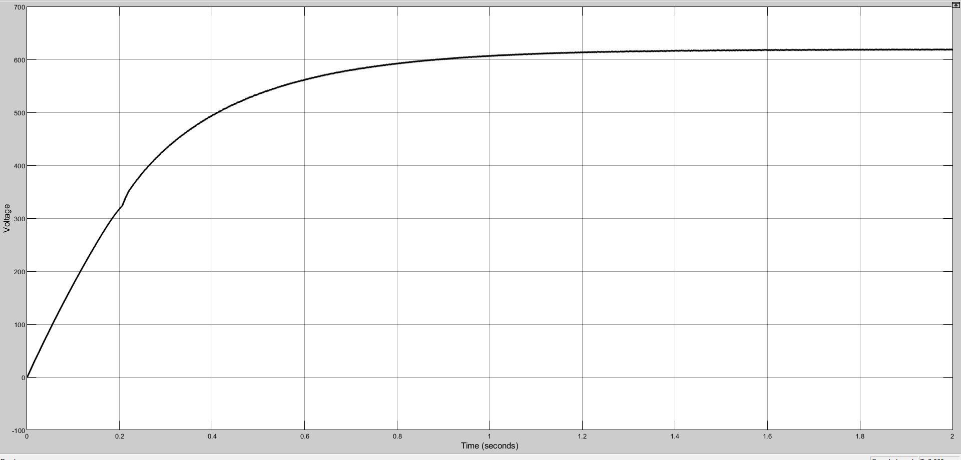
BOOST CONVERTER OUTPUT
BVRIT HYDERABAD College of Engineering for Women
www.bvrithyderabad.edu.in

Slide 17
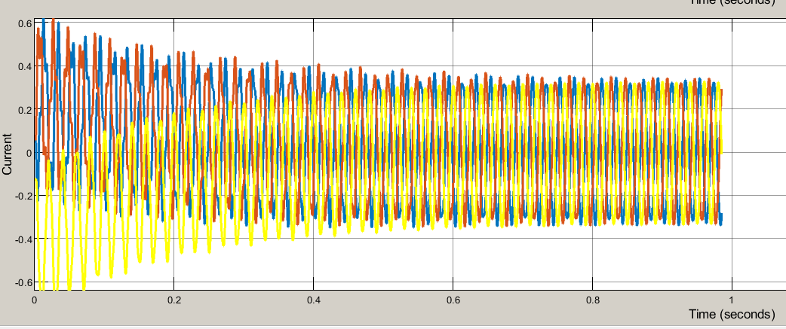
WITHOUT dq CONTROLLER
CURRENT OUTPUT
BVRIT HYDERABAD College of Engineering for Women
www.bvrithyderabad.edu.in

Slide 18
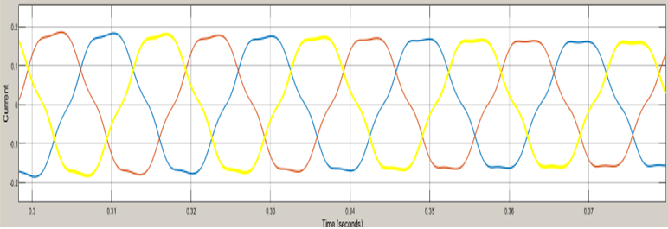
WITH dq CONTROLLER
CURRENT OUTPUT
BVRIT HYDERABAD College of Engineering for Women
www.bvrithyderabad.edu.in

Slide 19
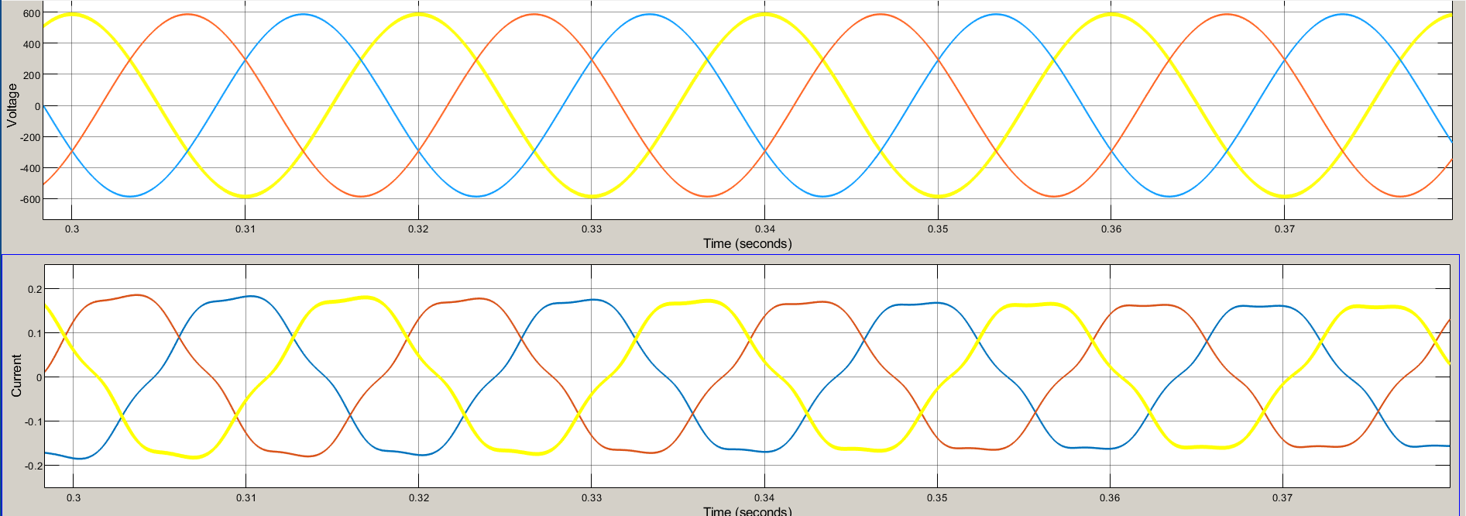
DIRECT QUADRATURE OUTPUT
BVRIT HYDERABAD College of Engineering for Women
www.bvrithyderabad.edu.in

Slide 20
CONCLUSION
The PV panel, a boost converter, an inverter and utility grid are physically modelled in this model.
dq controlled inverter is used to maintain constant voltage and frequency at the grid. The transformation is achieved by use of the Clarke and Park transformation methods, which convert the abc to αβ and αβ to dq. dq control strategy improves the dynamic response of the grid-connected inverter.
BVRIT HYDERABAD College of Engineering for Women
www.bvrithyderabad.edu.in

Slide 21
FUTURE SCOPE
Instead of dq method fuzzy logic control method can be used.
Fuzzy logic control (FLC) techniques usually decompose a complex system into several subsystems according to the human experts' knowledge about the system.
The major advantages of fuzzy logic control includes better error detection and correction, wider range of operating conditions and more readily customizable.
BVRIT HYDERABAD College of Engineering for Women
www.bvrithyderabad.edu.in

Slide 22
THANK YOU
BVRIT HYDERABAD College of Engineering for Women
www.bvrithyderabad.edu.in

