Slide 1

Digital Books Publishing Analytics
AKHILA PAGIDI
Batch-543

Slide 2
About me
Background:I did my Bachelor’s in Electronics and communication Engineering from Rajiv Gandhi University of Knowledge Technologies.
Why do you want to learn Datascience?:Taking information and turning it into a real answer or a decision that helps businesses is what I take interest in, and that paved the way for learning Datascience.
Profile URLs:
Linkedin:www.linkedin.com/in/pagidi-akhila-077505305
Github:https://github.com/akhilaPagidi

Slide 3
Agenda
Business Problem
Business Statement
Introduction
Data Overview
DataFrame
Key analysis questions and insights
Recommendations
Conclusion
Experience & challenges while working

Slide 4
Goodreads contains a large collection of books with information such as ratings, number of ratings, authors, pages, formats, genres, publication dates, list scores and votes. However, this information is spread across web pages, making direct comparison and analysis difficult. Readers need to identify books that offer strong ratings and popularity while comparing factors such as ratings, reviews, pages, format and genre. Authors and publishers can benefit from understanding how books perform in terms of reader ratings and popularity. At the same time, Goodreads can use such patterns to improve book discovery and recommendations. The core business problem, therefore, is to move from individual book listings to a structured understanding of book popularity, ratings, formats, genres and publication trends through web scraping and data analysis.
Business Problem

Slide 5
Business Statement
The project aims to collect and analyze Goodreads book data using web scraping and Python understand patterns in book ratings, popularity, formats, genres and publication trends. By analyzing factors such as average rating, rating count, list score, total votes, pages, publication year and genre, the project provides meaningful insights into how books perform and how different book characteristics are related to their popularity and reader ratings.

Slide 6
Introduction
The Goodreads Web Scraping and Analysis project focuses on collecting and analyzing book-related information from Goodreads. The project uses Python, Requests, BeautifulSoup and Selenium to scrape details such as book title, author, average rating, rating count, list score, total votes, pages, format, publication date and genres. The collected data is cleaned and organized using Pandas, followed by exploratory data analysis using Matplotlib and Seaborn. The analysis helps identify patterns in book popularity, ratings, formats, genres and publication trends and converts raw web data into meaningful business insights.

Slide 7
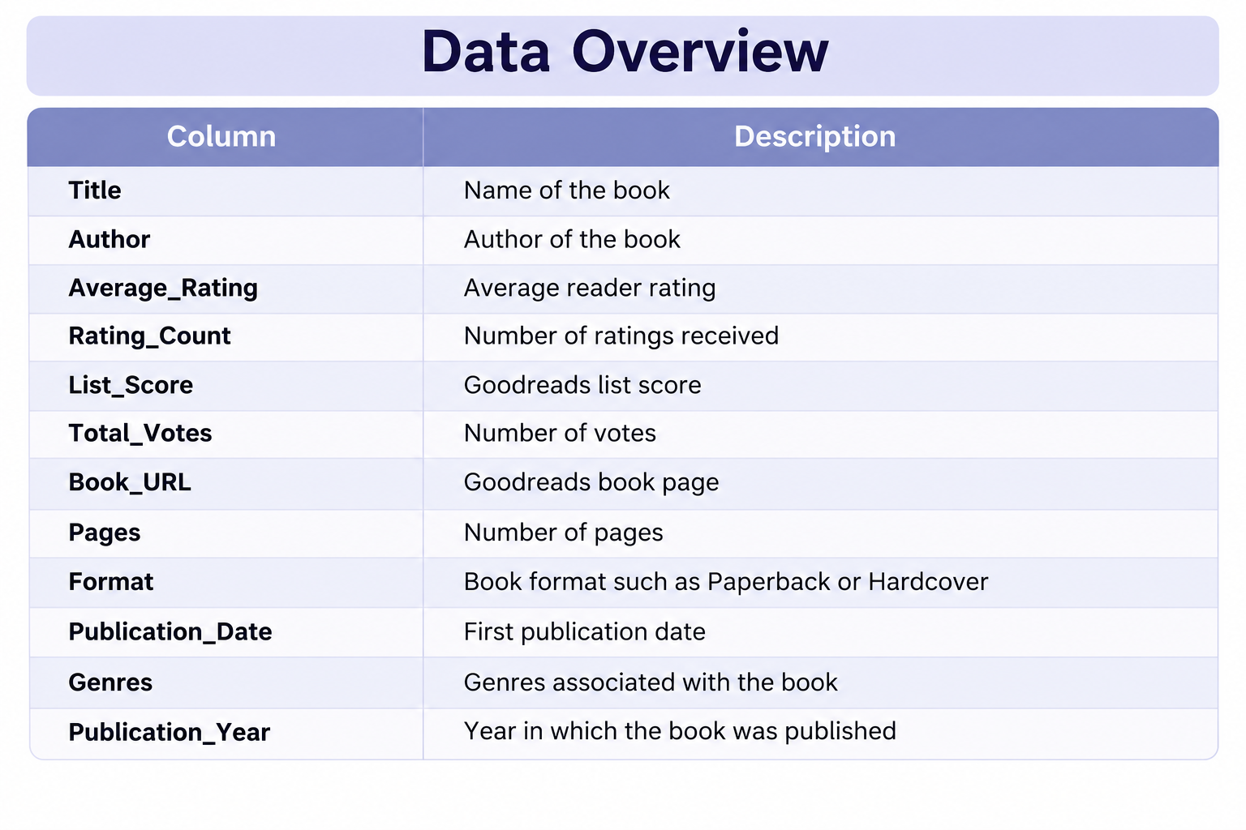
Data Overview

Slide 8
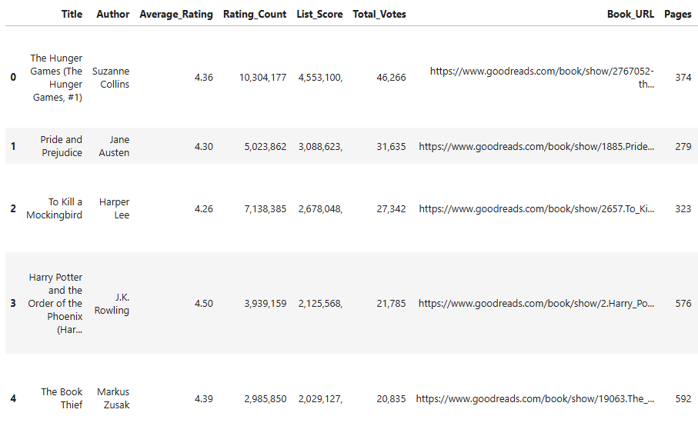
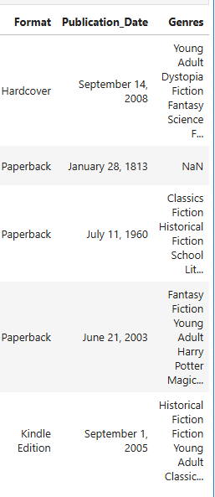
DataFrame

Slide 9
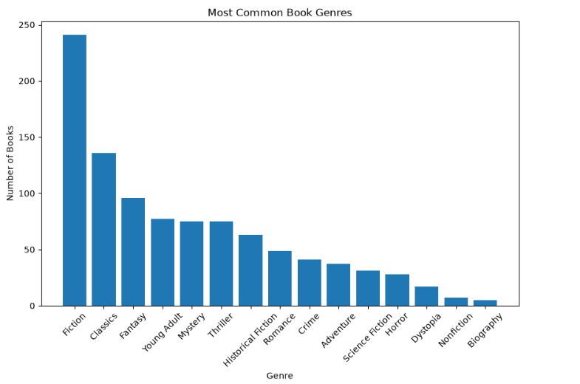
Univariate Analysis
1.what are most common book genres ?
Insights:
Fiction is the most common genre in the dataset, followed by other popular categories such as Fantasy and Classics. This shows that the selected Goodreads books are largely concentrated in popular literary and fictional genres.

Slide 10
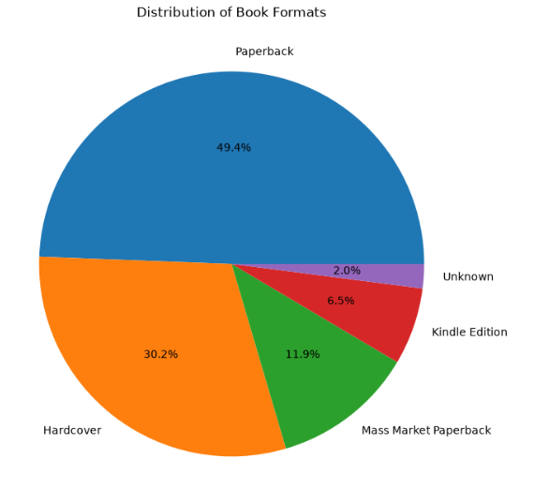
Univariate Analysis
1.How are the book formats distributed ?
Insights:
Paperback is the most common book format in the dataset, followed by Hardcover and Mass Market Paperback. Kindle Edition and ebook formats are less common, while Board book appears only rarely. This shows that physical book formats, especially Paperback, dominate the selected Goodreads books.

Slide 11
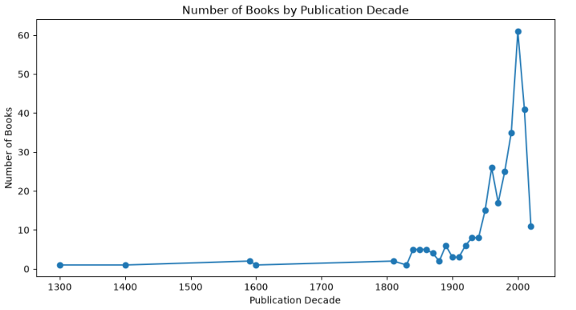
Bivariate Analysis
1.which decade records the highest number of book publications?
Insights:
The number of books varies across publication years, with some periods having a higher concentration of books than others. This shows that 2000 decade records highest books published.

Slide 12
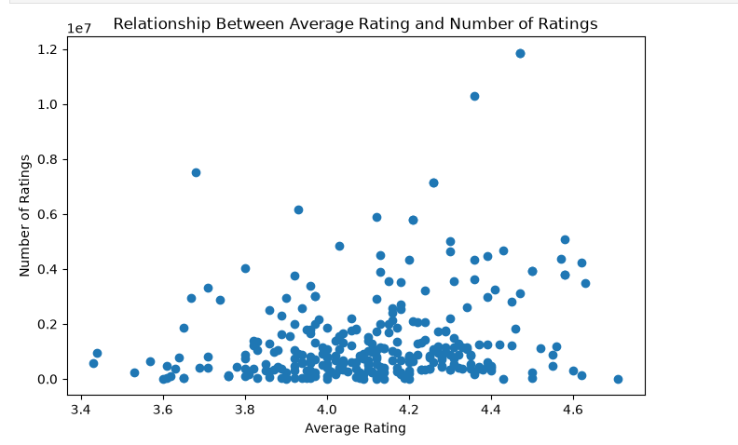
Bivariate Analysis
1.Is there any relationship between average rating and number of ratings?
Insights:
The scatter plot shows that a higher number of ratings does not necessarily mean a higher average rating. Some books have very large numbers of ratings but only moderate ratings, while some highly rated books have comparatively fewer ratings.

Slide 13
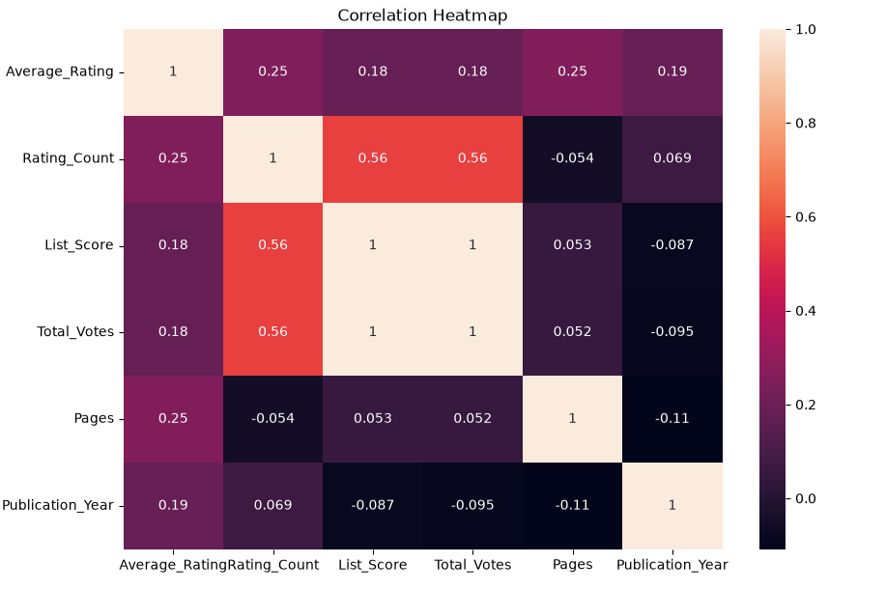
Multivariate Analysis
1.How are all the numerical columns related to each other?
Insights:
List Score and Total Votes have a perfect positive correlation (1.00), meaning they move together in this dataset.
Rating Count has a moderate positive correlation (0.56) with both List Score and Total Votes.
Pages and Publication Year have very weak relationships with most other variables.

Slide 14
Hypothesis Testing
Null Hypothesis (H₀): The Average book rating is 4.0
Alternative Hypothesis (H₁): The Average book rating is not 4.0
Test Used: Two-tailed Z-test
Significance Level: 5%
Decision Rule:
If p-value < 0.05, reject H₀.
If p-value ≥ 0.05, fail to reject H₀.
Conclusion:
P-value: 0.0
Reject H0

Slide 15
Recommendations
Develop an interactive dashboard to allow users to explore books based on rating, popularity, genre, format and publication year.
Expand the scraped dataset by collecting more Goodreads books and additional pages to improve the reliability of the analysis.
Analyze authors and genres in greater detail to identify popular authors, frequently occurring genres and highly rated categories.
Improve book discovery and recommendations by using rating, popularity, genre and other book characteristics to identify books that may be relevant to readers.

Slide 16
Conclusion
The Goodreads web scraping project successfully transformed book information available across web pages into a structured dataset for analysis.
The analysis also shows that book characteristics such as pages, format and publication year can be compared with ratings and popularity to identify meaningful patterns.
Univariate, bivariate and multivariate analysis helped examine individual distributions as well as relationships between multiple book attributes.
Overall, the project demonstrates how web scraping, data cleaning and exploratory data analysis can convert raw online book data into useful business insights.

Slide 17
Experience and Challenges
Selenium and BeautifulSoup were used together to access individual book pages and extract additional information such as pages, format, publication date and genres.
Another challenge was handling missing and inconsistent scraped values, which required data cleaning and appropriate treatment of missing values.
Working on this project provided practical experience in web scraping, data cleaning, Pandas and exploratory data analysis.
The project also improved my understanding of how to convert unstructured web data into a structured dataset and derive meaningful insights from it.

Slide 18
Q & A

Slide 19

THANK YOU

