Slide 1

ENERGY CONSUMPTION ANALYSIS
USING MYSQL
Presented By : Akhila Pagidi Batch No : 543

Slide 2
About me
Background:I did my Bachelor’s in Electronics and communication Engineering from Rajiv Gandhi University of Knowledge Technologies.
Why do you want to learn Datascience?:Taking information and turning it into a real answer or a decision that helps businesses is what I take interest in, and that paved the way for learning Datascience.
Profile URLs:
Linkedin:www.linkedin.com/in/pagidi-akhila-077505305
Github:https://github.com/akhilaPagidi

Slide 3
Agenda :
✓ Business Problem
✓ Business Statement
✓ Introduction
✓ Data Description
✓ ER diagram
✓ Cardinalities
✓ Key Analysis Questions and insights
✓ Conclusion
✓ Recommendations
✓ Experiences and challenges while working

Slide 4
Business Problem:
Energy, economic, population, and emission data is stored across multiple tables, countries, years, and energy types, making it difficult to understand the overall patterns directly from the raw data. The challenge is to combine and analyze this data efficiently to compare countries, identify trends, and understand the relationship between energy consumption, production, GDP, population, and emissions.

Slide 5
Business Statement:
The project aims to develop a SQL-based analysis of energy consumption and related factors across countries and time. By analyzing production, consumption, GDP, population, and emissions, the project provides some useful insights into country-level and global level energy patterns and supports data-driven understanding of the relationships between these tables.

Slide 6
Introduction:
The Energy Consumption Analysis project focuses on analysing energy production, energy consumption, GDP, population, and emissions across different countries and years. The project uses multiple related tables to organize the data and SQL queries to analyse different aspects of energy and environmental trends. It helps transform raw data into meaningful information through comparisons and trends.
.

Slide 7
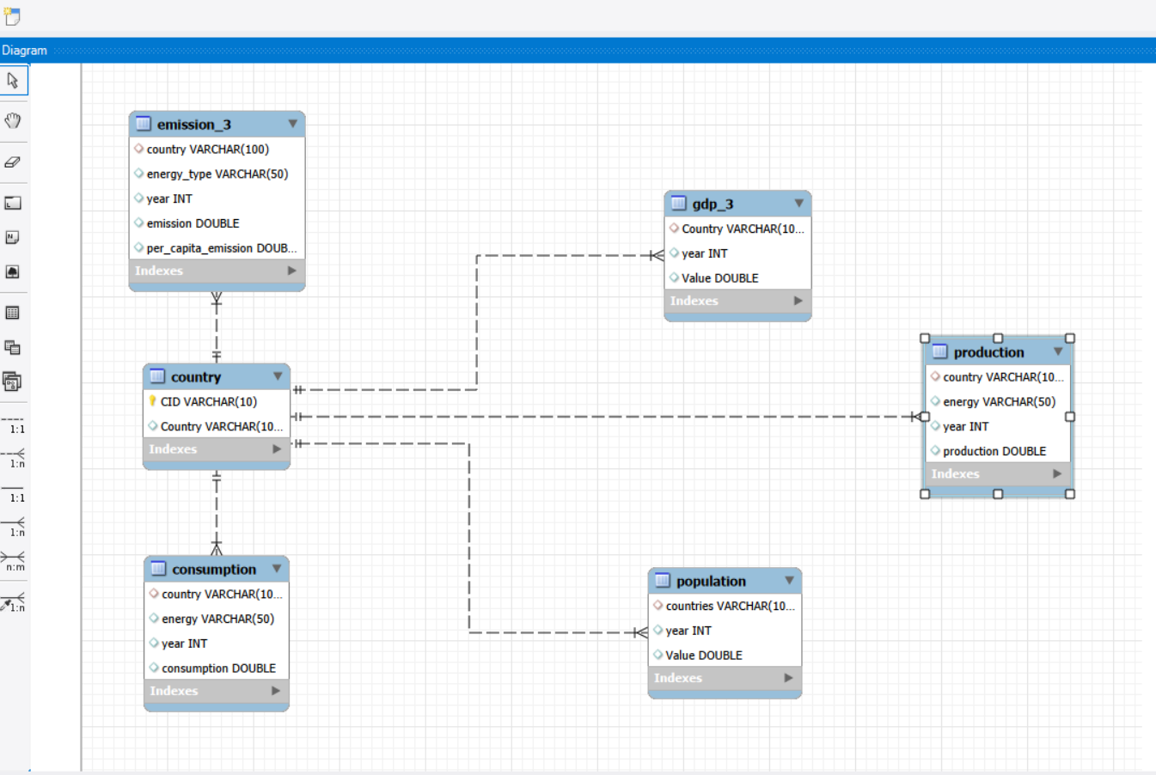
Data Description:
Entity Relationship (ER Diagram) :

Slide 8
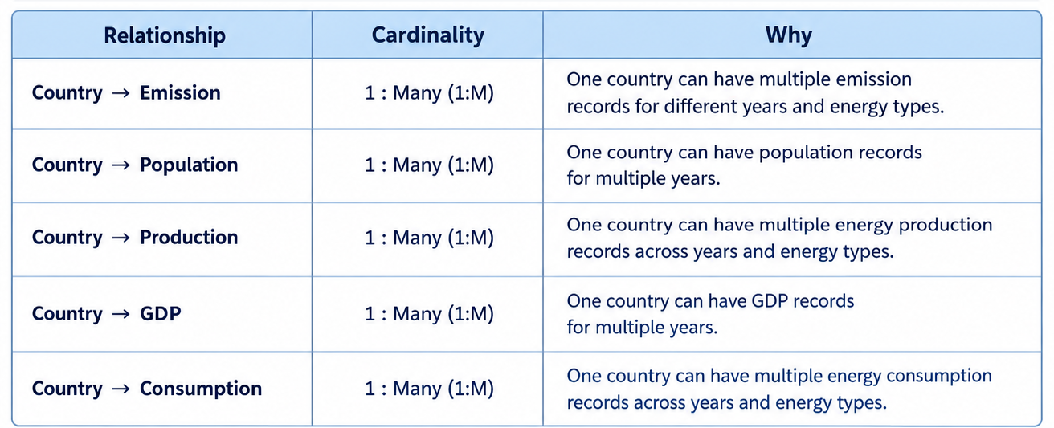
Cardinalities :

Slide 9
Database Schema :
The Energy Consumption Analysis consists of 6 tables that store information related to countries, emissions, population, energy production, GDP, and energy consumption. Each table contains specific data and is connected to other tables through Primary Keys (PKs) and Foreign Keys (FKs).
Country
The Country table stores country details such as country ID and country name. CID is the Primary Key (PK), while Country is a unique field used to connect the country information with other tables.
Emission
The Emission table stores information about emissions for different countries, energy types, and years. It contains emission and per-capita emission values and is connected to the Country table through the country field.

Slide 10
Production
The Production table stores energy production data for different countries, energy types, and years. country is connected to the Country table through a Foreign Key (FK).
GDP
The GDP table stores GDP values for different countries and years. It is connected to the Country table through the country field, allowing GDP data to be analyzed along with other country-level information.
Consumption
The Consumption table stores energy consumption data for different countries, energy types, and years. It is connected to the Country table through the country field and allows energy consumption to be compared with production, GDP, population, and emissions.
Population
The Population table stores population data for different countries and years. It contains the population value for each country and year and is connected to the Country table through the countries field.

Slide 11
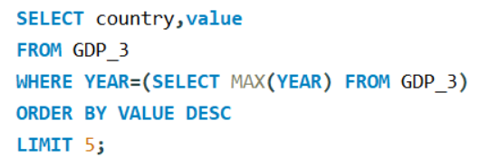
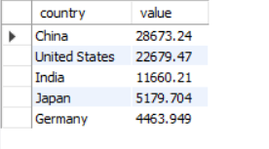
Key Analysis Questions :
1. What are the top 5 countries by GDP in the most recent year?
Query
Output
Insights
Five countries with the highest GDP in the latest available year. It gives an overview of the largest economies represented in the dataset.

Slide 12
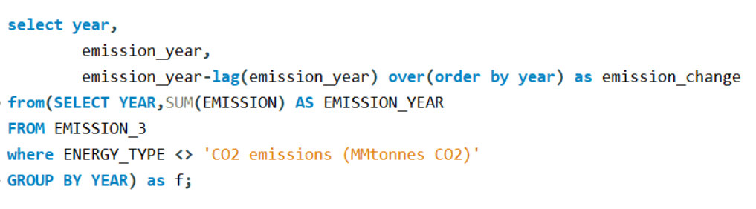
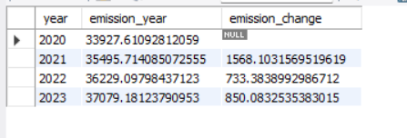
2.How have global emissions changed year over year?
Query
Output
Insights
This measures how total global emissions change from one year to the next using LAG(). A positive change means emissions increased, while a negative change means they decreased.

Slide 13
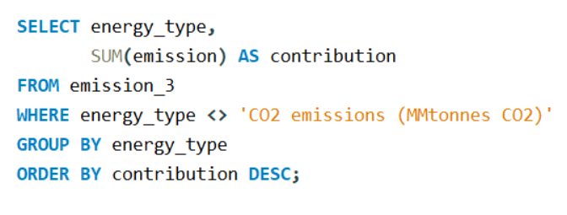
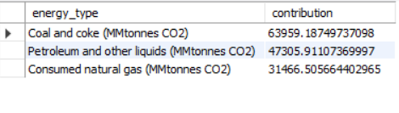
3. Which energy types contribute most to emissions across all countries?
Query
Output
Insights
This measures what energy types contributed to the most of the emissions

Slide 14
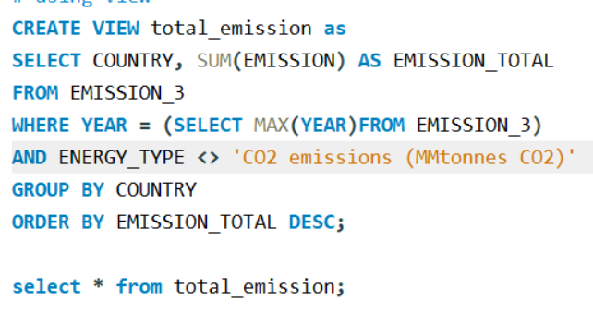
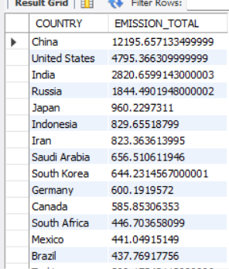
4.What is the total emission per country for the most recent year available?
Query
Output
Insights
This analysis identifies the total emissions generated by each country in the latest available year. It helps compare countries based on their overall emission levels, excluding the already calculated total CO₂ row to avoid double-counting

Slide 15
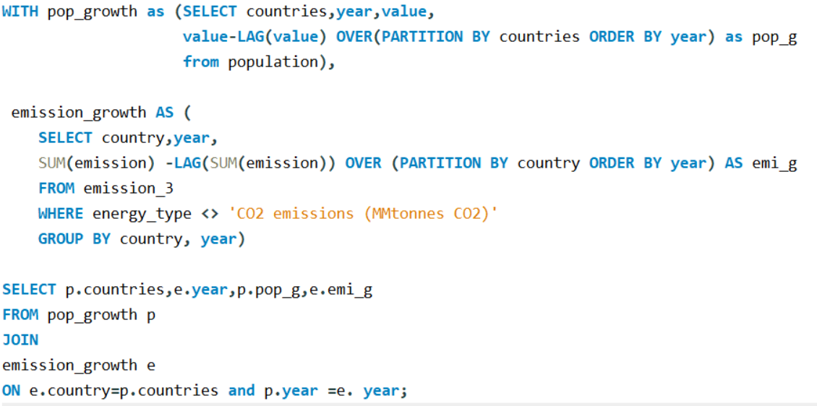
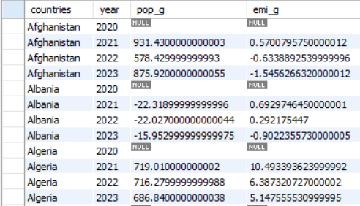
5. How has population growth affected total emissions in each country?
Query
Output
Insights
It does not prove that population growth
causes emissions growth.

Slide 16
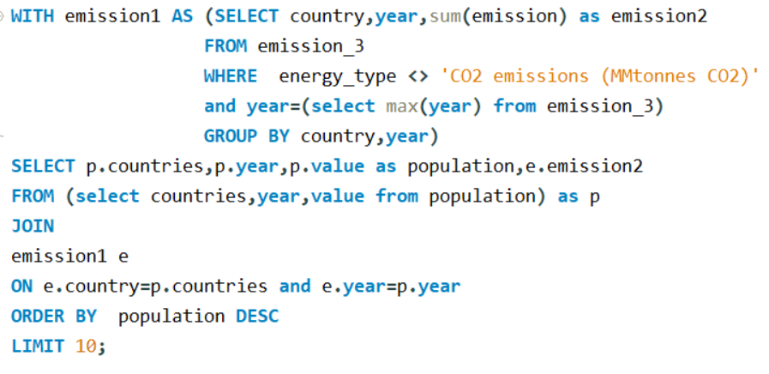
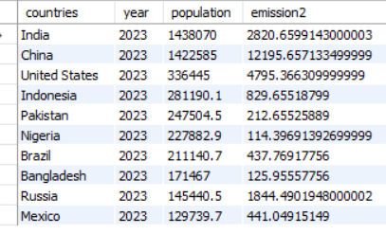
6. What are the top 10 countries by population and how do their emissions compare?
Query
Output
Insights
It does not prove that population growth
causes emissions growth.

Slide 17
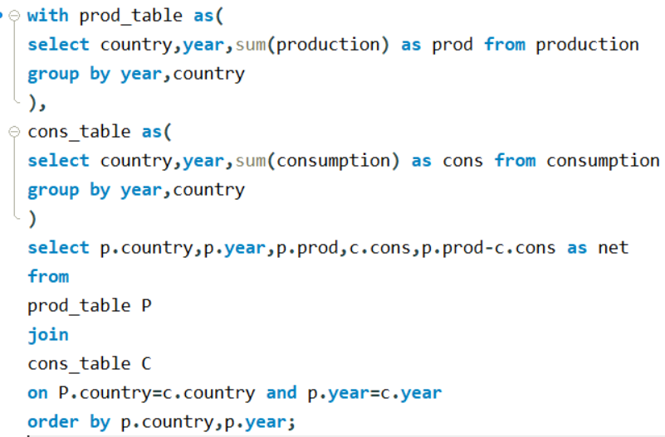
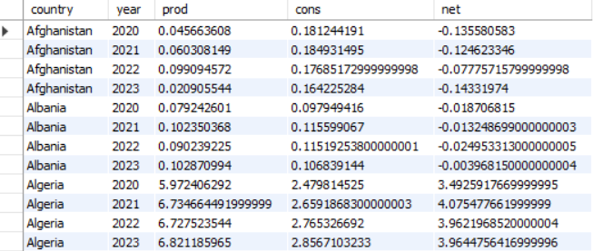
7. Compare energy production and consumption by country and year.
Query
Output
Insights
It helps to identify whether a country produces
more energy than it consumes or vice versa.
→negative--consumption is more
→ positive--production is more

Slide 18
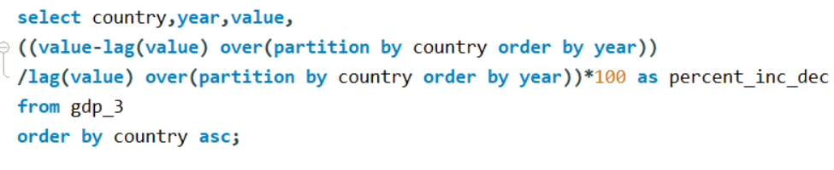
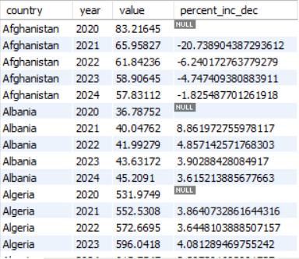
8. What is the trend in GDP for each country over the given years?
Query
Output
Insights
It helps identify periods of economic growth or decline for individual countries.so,for some countries gdp increased meanwhile others it is decreased.

Slide 19
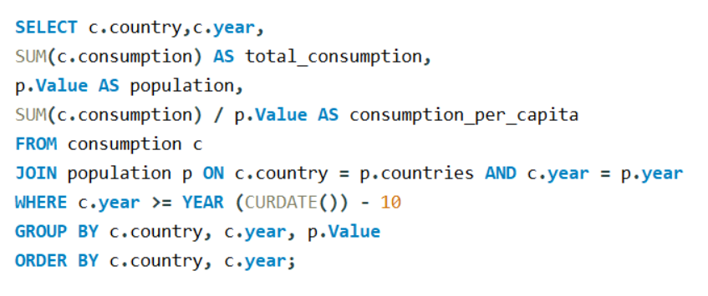
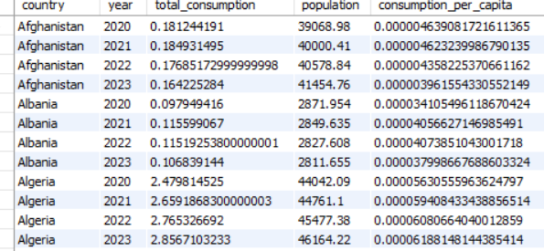
9.What is the energy consumption per capita for each country over the last decade?
Query
Output
Insights
It provides a fairer comparison between countries with different population sizes for the last decade.

Slide 20
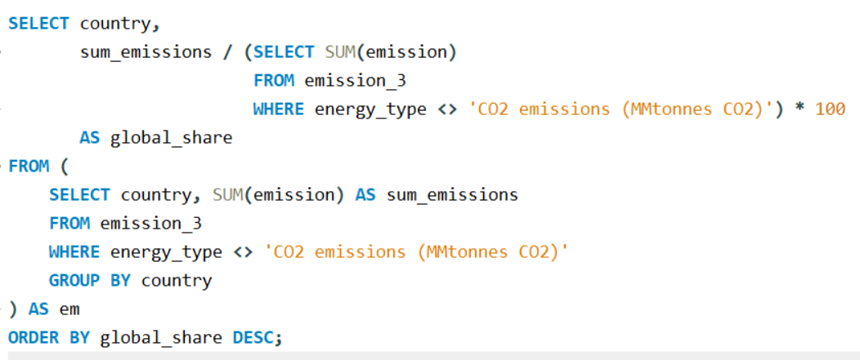
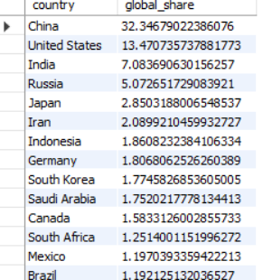
10. What is the global share (%) of emissions by country?
Query
Output
Insights
China has highest share of emissions,followed by United States and India.
It shows how much each country contributes to the overall emissions represented in the dataset.

Slide 21
Conclusion:
The analysis provides a clear view of energy and emission patterns across countries.
Energy production and consumption vary significantly between countries.
GDP and population provide useful context when comparing energy and emissions.
Per-capita measures help make fairer comparisons between countries.
Year-wise analysis helps identify changes and trends over time.
SQL helped transform multiple datasets into useful analytical insights.

Slide 22
Recommendations:
Add an interactive dashboard to explore countries, years, energy types etc.
Add filters to compare countries based on GDP, population, production, consumption, and emissions.
Add automatic yearly updates so the analysis always uses the latest available data.
Add country-wise and year-wise visual comparisons for easier analysis.
Add alerts for significant changes in energy consumption or emissions.

Slide 23
Experience and challenges:
One of the main challenges was joining multiple tables correctly using country and year and avoid double counting emission values of Co2.
Another challenge is interpreting the results correctly .
Working on this project provided practical experience in handling and analysing multiple related datasets using SQL.
The project also improved my understanding of how to connect different tables and extract meaningful insights from raw data.

Slide 24


Slide 25

THANK YOU

