Slide 1

SENTIMENT ANALYSIS on Food Reviews
AKHILA VaLLABHANENI

Slide 2
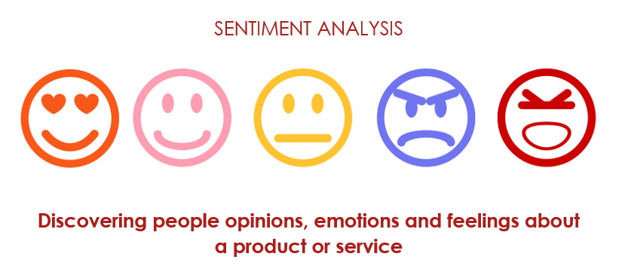
WHAT IS SENTIMENT ANALYSIS?

Slide 3
Why do we need sentiment analysis ?
Quickly understand consumer attitude.
Know what people think.
Predictions
Market Trends
Improve Business

Slide 4
Sentiment analysis on FOOD REVIEWS ?
Improve business(Restaurant, fast food).
Satisfy customer needs.
How?
Classify positive and negative reviews.
Analyse the negative reviews on food item.
Improve the food !
Happy customers ☺ = Good business 👍

Slide 5
STEPS involved
Data Collection
Data Preparation
Sentiment Generation
Analyse/Organise
Results

Slide 6

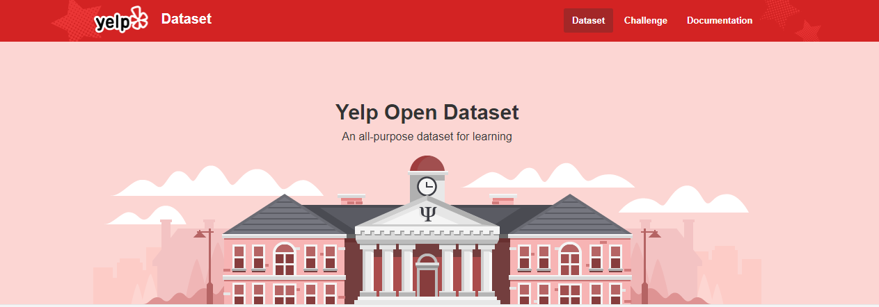
Data collection
https://www.yelp.com/dataset

Slide 7
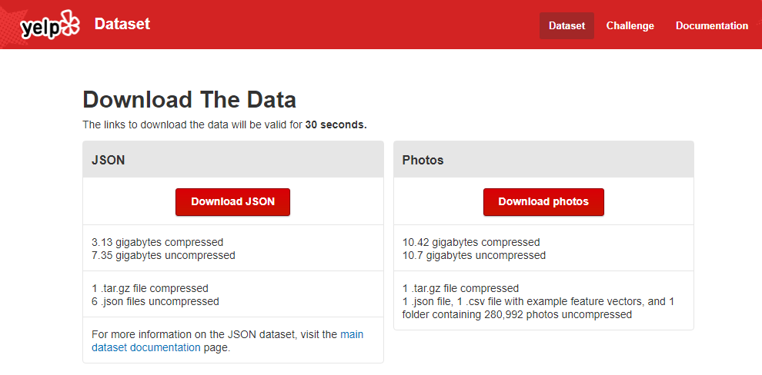
Data collection
~4 GB of Data

Slide 8
Data collection
Sample data: review.json
root:{} 9 items
review_id:x7mDIiDB3jEiPGPHOmDzyw
user_id:msQe1u7Z_XuqjGoqhB0J5g
business_id:iCQpiavjjPzJ5_3gPD5Ebg
stars:2
date:2011-02-25
text:The pizza was okay. Not the best I've had. I prefer Biaggio's on Flamingo / Fort Apache. The chef there can make a MUCH better NY style pizza. The pizzeria @ Cosmo was over priced for the quality and lack of personality in the food. Biaggio's is a much better pick if youre going for italian - family owned, home made recipes, people that actually CARE if you like their food. You dont get that at a pizzeria in a casino. I dont care what you say...
useful:0
funny:0
cool:0

Slide 9
Data collection
Sample data: business_id.json
root:{} 15 items
business_id:Apn5Q_b6Nz61Tq4XzPdf9A
name:Minhas Micro Brewery
neighborhood:
address:1314 44 Avenue NE
city:Calgary
state:AB
postal_code:T2E 6L6
latitude:51.0918130155
longitude:-114.031674872
stars:4
review_count:24
is_open:1
attributes:{} 13 items
categories:Tours, Breweries, Pizza, Restaurants, Food, Hotels & Travel
hours:{} 6 items

Slide 10

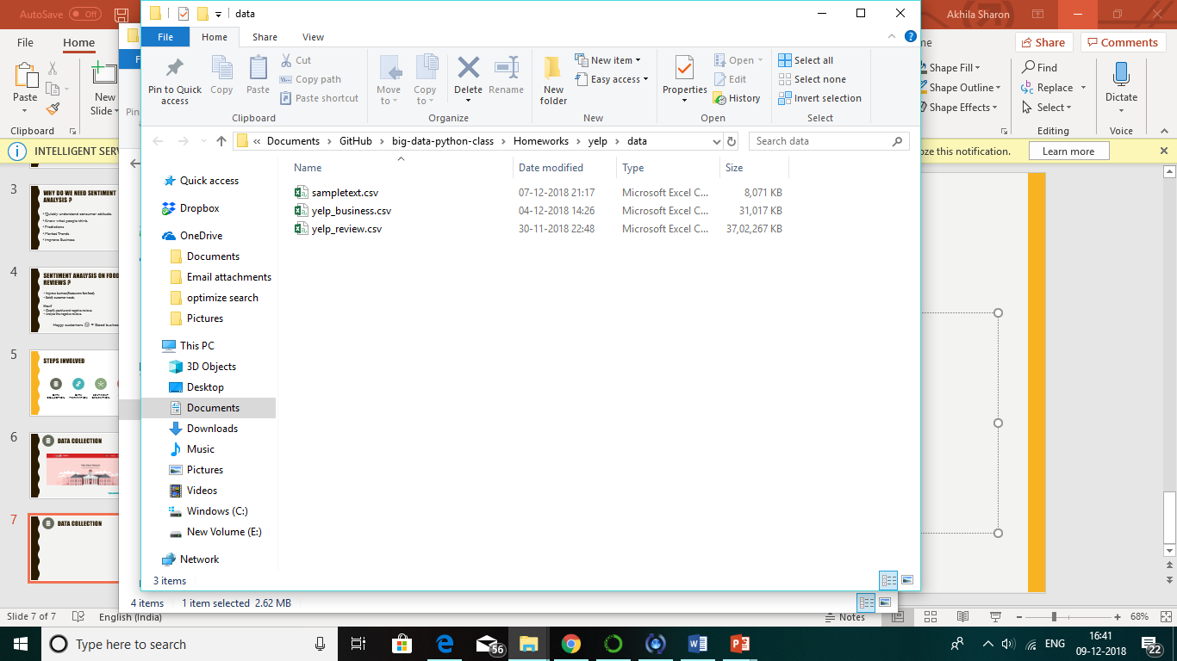
Data PREPARATION
Convert JSON to CSV
Load the first 20,000 rows into a new file.
Drop columns which are not required (Both new_review and business)
Map the reviews to the restaurant.(combining both the files) new_data = pd.merge(reviews,business, how='left', on=['business_id'])
Save the new file.

Slide 11

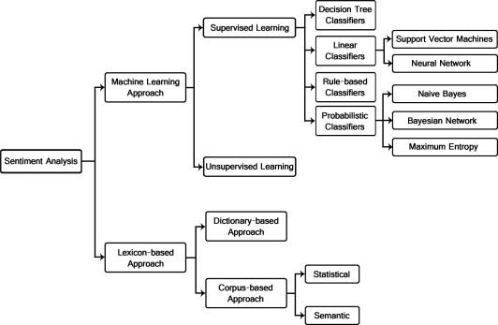
Sentiment generation

Slide 12
Sentiment generation
ML- BASED
Create a model by training the classifier with a set of example.
Gather dataset, extract features and train your algorithm based on examples.
Lexicon – BASED
These techniques use dictionaries of words.
Each word is annotated with its emotional polarity and sentiment strength.
This dictionary is then matched with the document to calculate its overall polarity score of the document.

Slide 13
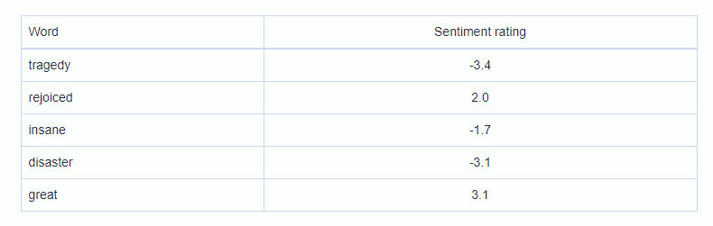
VADER - Sentiment Analysis
Valence Aware Dictionary for Sentiment Reasoning
It is a model used for text sentiment analysis that is sensitive to both polarity (positive/negative) and intensity (strength) of emotion.

Slide 14
VADER - Sentiment Analysis
For example,
“The food is good and the atmosphere is nice”

Slide 15


VADER - Sentiment Analysis
For example,
“The food is good and the atmosphere is nice”
has two words in the lexicon (good and nice) with scores of 0.9 and 0.8 respectively.
Sentiment = ~ 0.85

Slide 16
VADER - Sentiment Analysis
Quantifies the Emotion of a Word
Maps lexical features to emotion intensities called sentiment scores
Amazon Mechanical Turk!
Also Quantifies the Emotion of a Sentence
The sentiment score of a sentence is calculated by summing up the sentiment scores of each VADER-dictionary-listed word in the sentence.

Slide 17
Five Simple Heuristics
1.Punctuation
I like it.
I like it !!!
VADER adds a certain empirically-obtained quantity for every exclamation point (0.292) and question mark (0.18). If the score is negative, VADER subtracts.

Slide 18
Five Simple Heuristics
2. Capitalization
AMAZING performance
amazing performance
VADER takes this into account by incrementing or decrementing the sentiment score of the word by 0.733, depending on whether the word is positive or negative, respectively.

Slide 19
Five Simple Heuristics
3. Degree Modifiers
soooo cute.
sort of cute.
VADER maintains a booster dictionary which contains a set of boosters and dampeners.
Modifier beside the base word adds or subtracts 0.293 to the sentiment score of the sentence, depending on whether the base word is positive or not.

Slide 20
Five Simple Heuristics
4. Shift in polarity due to “but”
I love rain,
but I don’t want it to rain today.
VADER implements a “but” checker.
All sentiment-bearing words before the “but” have their valence reduced to 50% of their values, while those after the “but” increase to 150% of their values.

Slide 21
Five Simple Heuristics
5. Negator words
I like candy.
I do not like candy.
VADER examines the tri-gram before a sentiment-laden lexical feature to catch polarity negation.
VADER maintains a list of negator words.
Negation is captured by multiplying the sentiment score of the sentiment-laden lexical feature by an empirically-determined value -0.74.

Slide 22
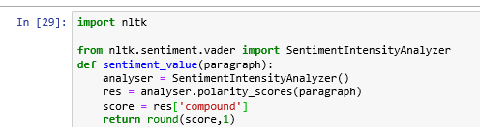
VADER - Sentiment Analysis
We need to load the SentimentIntensityAnalyser object in from the VADER package.
Write a reusable function.

Slide 23
VADER - Sentiment Analysis
Sentiment Scores | Sentiment Value
1.0 – 0.5 | Very Positive
0.5 – 0 | Positive
0 | Neutral
0 – -0.5 | Negative
-0.5 – -1.0 | Very Negative

Slide 24
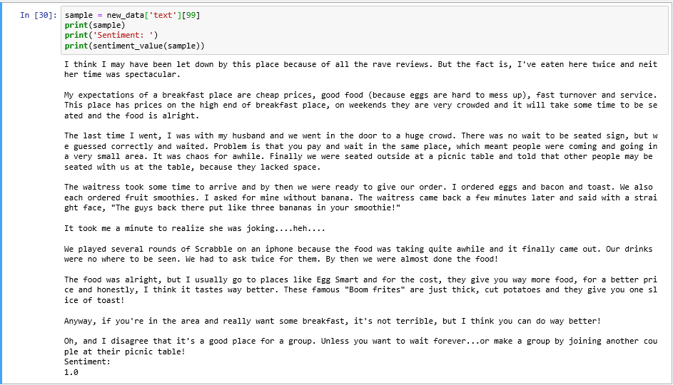
VADER - Sentiment Analysis

Slide 25

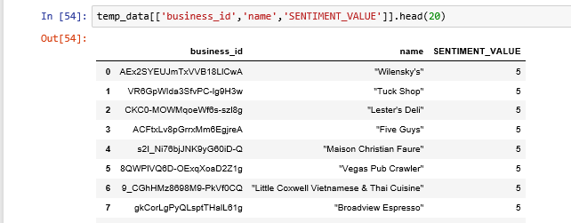
Result
Passed the entire file into VADER

Slide 26
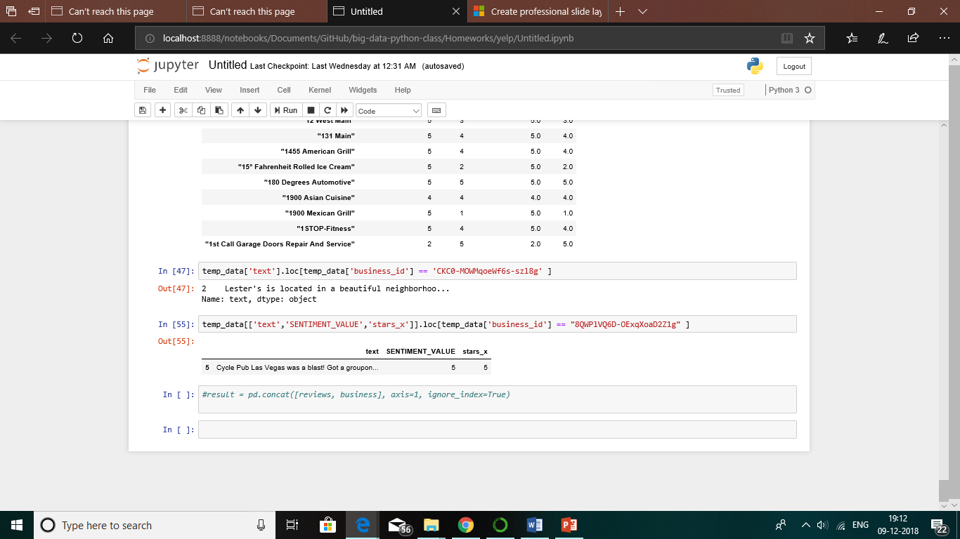
Result
Added two new columns with “SENTIMENT_VALUE” and “SENTIMENT”
Saved as a new file.
Perform queries on the new file to get specific restaurant review.
8QWPlVQ6D-OExqXoaD2Z1g is the business_id of "Vegas Pub Crawler"

Slide 27
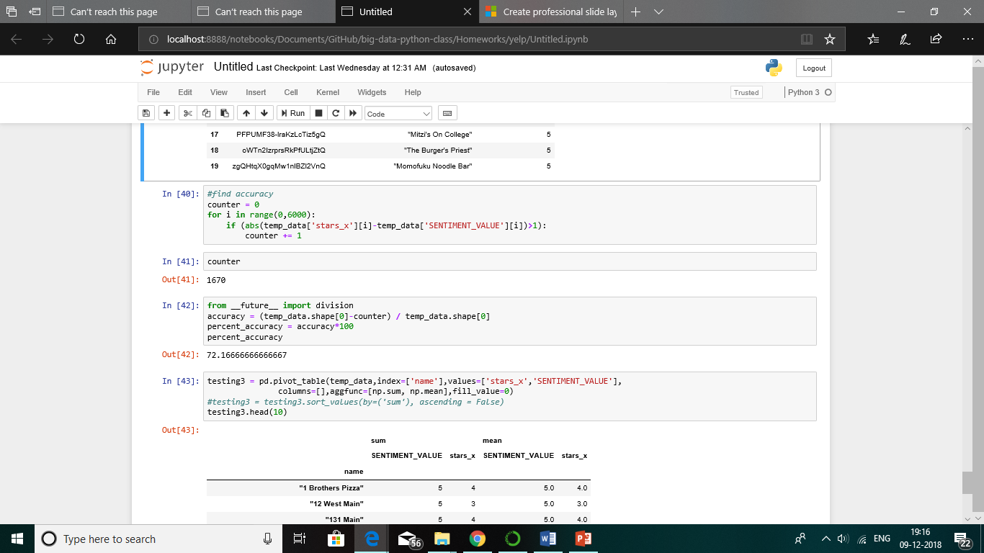
Result
Performed an accuracy test
~73% match
~27% of the ratings given by users did not match the sentiment value we generated.

Slide 28

IN-PROGRESS/FUTURE enhancements
What if the results are huge?
Name Entity recognition?
Skim the reviews and classify the food items.
“I want a Chicken pizza”
Food/menu item

Slide 29
IN-PROGRESS/FUTURE enhancements
spaCy , is a free open-source library for Natural Language Processing in Python.
A named entity is a "real-world object" that's assigned a name –
for example, a person, a country, a product or a book title.
spaCy can recognise various types of named entities in a document.
spaCy uses incremental parsing with Bloom embeddings & residual convolutional neural network (CNN)

Slide 30
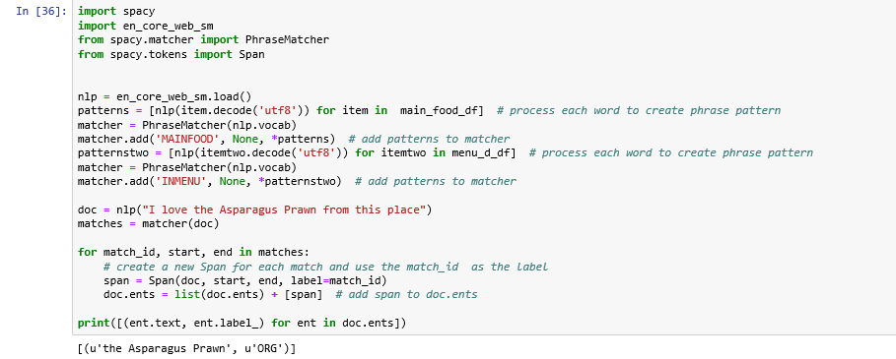
IN-PROGRESS/FUTURE enhancements
List the entities ( food items) , put them in a counter

Slide 31
IN-PROGRESS/FUTURE enhancements
Lester's Deli
Item | count | sentiment
Moma med | 30 | V negative
Avocado salad | 10 | Negative
Chicken Sukiyaki | 29 | Neutral
Tortellini Geiogio | 4 | V negative

Slide 32
Thank you
-AKHILA VaLLABHANENI

