Slide 1
APRIORI ALGORITHM
By,
AKHILA VALLABHANENI

Slide 2
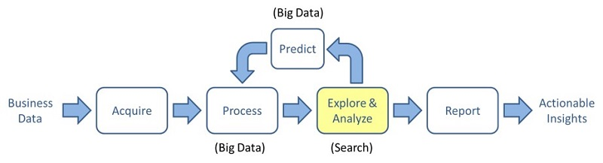

Slide 3
Introduction
Apriori algorithm is given by R. Agrawal and R. Srikant in 1994.
Apriori Algorithm is an influential algorithm for mining frequent itemsets for boolean association rules.
Name of algorithm is Apriori is because it uses prior knowledge of frequent itemset properties.
Apriori employs an iterative approach known as level-wise search, where k-itemsets are used to explore (k+1) itemsets.
Apriori is designed to operate on database containing transactions.
Example – Collections of items bought by customers
Notes:
Find interesting relationships between variables in dataset.

Slide 4
KEY CONCEPTS
All subsets of a frequent itemset must be frequent.
Ex: {socks, shoes} is frequent → {socks}and {shoes} are frequent
If a itemset is infrequent all its supersets will be infrequent.
Ex: {apples} not frequent → {apple, x x} are not be frequent
Two Main Steps :
Self – Join
Pruning
Ck – Candidate Itemset is a potentially frequent itemset.
Fk - Frequent Itemset is an itemset whose support is greater than some user-specified minimum support.

Slide 5
THE ALGORITHM
Apriori uses breadth-first search and a Hash tree structure to count candidate item sets efficiently.
Step 0. Start with itemsets containing just a single item.
Step 1. Determine the support for itemsets. Keep the itemsets that meet your minimum support threshold, and remove itemsets that do not.
Step 2. Using the itemsets you have kept from Step 1, generate all the possible itemset configurations.
Step 3. Repeat Steps 1 & 2 until there are no more new itemsets.

Slide 6
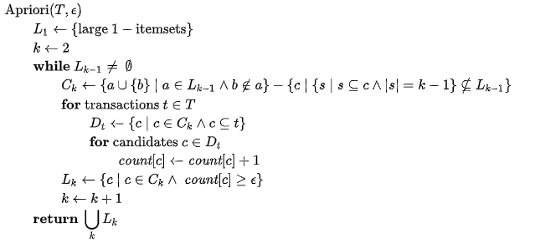
PSEUDOCODE

Slide 8

ASSOCIATION RULES
Association rules analysis is a technique to uncover how items are associated to each other.
Support is an indication of how frequently the itemset appears in the dataset.
Confidence is an indication of how often the rule has been found to be true.
Confidence(A->B)= Support_count(A∪B) / Support_count(A)
Lift the ratio of the observed support to that expected if X and Y were independent.

Slide 9
EXAMPLE
Transact | Transaction ID | Items
1 | 100 | Cheese, Butter, Milk
2 | 200 | Bread, Butter, Salt
3 | 300 | Cheese, Bread, Butter, Salt
4 | 400 | Bread, Salt
Item
Cheese
Bread
Butter
Milk
Salt
Min Support : 2
Scan
C1
Item | Count
Cheese | 2
Bread | 3
Butter | 3
Milk | 1
Salt | 3

Slide 10
EXAMPLE
Transact | Transaction ID | Items
1 | 100 | Cheese, Butter, Milk
2 | 200 | Bread, Butter, Salt
3 | 300 | Cheese, Bread, Butter, Salt
4 | 400 | Bread, Salt
Item
Cheese
Bread
Butter
Milk
Salt
Min Support : 2
C1
Item | Count
Cheese | 2
Bread | 3
Butter | 3
Milk | 1
Salt | 3

Slide 11
EXAMPLE
Transact | Transaction ID | Items
1 | 100 | Cheese, Butter, Milk
2 | 200 | Bread, Butter, Salt
3 | 300 | Cheese, Bread, Butter, Salt
4 | 400 | Bread, Salt
Item
Cheese
Bread
Butter
Milk
Salt
Min Support : 2
C1
F1
Item | Count
Cheese | 2
Bread | 3
Butter | 3
Milk | 1
Salt | 3
Item | Count
Cheese | 2
Bread | 3
Butter | 3
Salt | 3
Join
Notes:
Keep repeating the join, scan, prune

Slide 12
Item
Cheese, Bread
Cheese, Butter
Cheese, Salt
Bread, Butter
Bread, Salt
Butter, Salt
Scan

Slide 13
C2
Item | Count
Cheese, Bread | 1
Cheese, Butter | 2
Cheese, Salt | 1
Bread, Butter | 2
Bread, Salt | 3
Butter, Salt | 2

Slide 14
C2
Item | Count
Cheese, Bread | 1
Cheese, Butter | 2
Cheese, Salt | 1
Bread, Butter | 2
Bread, Salt | 3
Butter, Salt | 2
F2
Item | Count
Cheese, Butter | 2
Bread, Butter | 2
Bread, Salt | 3
Butter, Salt | 2
Join

Slide 15
Item
Cheese, Butter, Bread
Cheese, Butter, Salt
Bread, Butter, Salt
Bread, Cheese, Salt
Scan
Notes:
Scan for frequency

Slide 16
C3
Item | Count
Cheese, Butter, Bread | 1
Cheese, Butter, Salt | 1
Bread, Butter, Salt | 2
Bread, Cheese, Salt | 1

Slide 17
C3
Item | Count
Cheese, Butter, Bread | 1
Cheese, Butter, Salt | 1
Bread, Butter, Salt | 2
Bread, Cheese, Salt | 1

Slide 18
C3
Item | Count
Cheese, Butter, Bread | 1
Cheese, Butter, Salt | 1
Bread, Butter, Salt | 2
Bread, Cheese, Salt | 1
F3
Item | Count
Bread, Butter, Salt | 2
Notes:
Now you have item set which are most frequent

Slide 19
Association Rules :
Transact | Transaction ID | Items
1 | 100 | Cheese, Butter, Milk
2 | 200 | Bread, Butter, Salt
3 | 300 | Cheese, Bread, Butter, Salt
4 | 400 | Bread, Salt
Support:
Supp {Bread} = 3 / 4 = 0.75 = 75%
Supp {Cheese} = 2 / 4 = 0.5 = 50%
Confidence:
{Bread, Butter} →{Salt} = supp {Bread, Butter, Salt} / supp {Bread, Butter} = 2/2 = 1 = 100%
{Bread, Salt} →{Butter} = supp {Bread, Butter, Salt} / supp {Bread, Salt} = 2/3 = 0.6 = 60%
{Salt, Butter} →{Bread} = supp {Bread, Butter, Salt} / supp {Salt, Butter} = 2/2 = 1 = 100%

Slide 20
Item | Count
Bread, Butter, Salt | 2
Bread, Butter and Salt can be placed on the same shelf, so that buyers of one item would be prompted to buy the other.
Promotional discounts could be applied to just one out of the three items.
Advertisements on Bread could be targeted at buyers who purchase Butter.
Bread and Butter could be combined into a new product.

Slide 21
ADVANTAGES
Easy to understand.
Easy to implement.
Uses large itemset property.
Easy to parallelized.

Slide 22
Limitations
The algorithms scans the database too many time which reduces its overall performance.
Due to these many scans, the algorithm assumes that the database is permanent in the memory.
Time and space complexity of this algorithm is very high.

Slide 23
Improvements in apriori algorithm
Using buckets : The itemsets can be hashed into different buckets and the buckets which do not match the minimum support count should not be considered as candidate set.
Transaction reduction : A transaction that does not have k-frequent itemsets will never have k+1-frequent itemsets. So, we can ignore such transactions from future scans.
Sampling : Rather than finding frequent itemsets from the entire database, a subset of transactions from the database is picked to find frequent itemsets. The minimum support count is reduced so that the algorithm does not miss the frequent itemset.

Slide 24
Improvements in apriori algorithm
Partitioning : In this method, only two database scans are required.
In the first scan, local frequent itemsets are found which form the global candidate set.
In the second scan, this global candidate set is scanned to find the actual frequent itemset.
Dynamic counting : In this method, the database is divided into the blocks and a count is maintained. If the count crosses the minimum support count, the block is added to the set of frequent itemsets.

Slide 25
APPLICATIONS ON DIFFERENT DOMAINS
Healthcare
To find the frequency of diseases affecting patients over a period of time.
To find renal functional impairment.
To Identify clinical parameters akin to occurrence of brain tumor.
Sales / Retail
To guide sales decisions and improve turn over rate.
Eco-system conservation
To find the association of weather conditions with forest fire.

Slide 26
APPLICATIONS ON DIFFERENT DOMAINS
Security
Frequent sequence excavation to obtain the crime signature patterns in Network Security.
Web Mining
To get the frequent links from one organizations web log data.
Gaming
Extract knowledge from a gamer dataset to create strong rules that can guide the game design process

Slide 27
Mining medical data to identify frequent diseases using Apriori algorithm
Done by two researchers from Alagappa University, Karaikudi, India.
Proposes a association rule based apriori data mining technique that finds the frequency of diseases affecting patients.
The study is made on patients from various geographical locations and at various time periods.
Totally 1216 patient records affected by 29 different diseases during the year 2012 were analysed.
WEKA data mining tool is employed to identify the frequency of the diseases .
The outcome of this research will help the practitioners in making medicinal decisions for frequently occurring diseases.

Slide 28
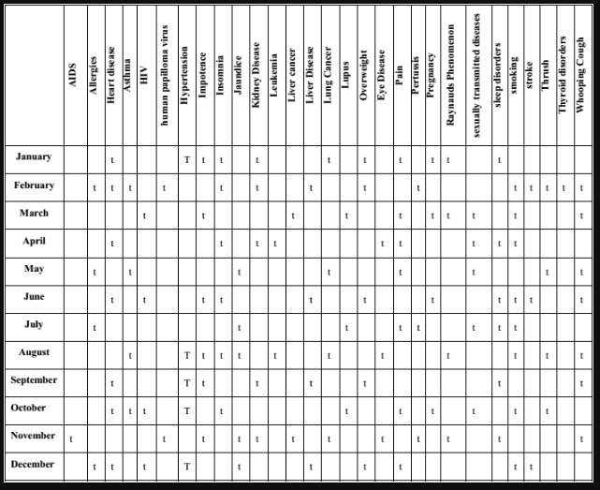
This table shows the occurrence of various diseases over 12 months in a year.
Notes:
This table shows the occurrence of various diseases over 12 months in a year.
Represented by t

Slide 29
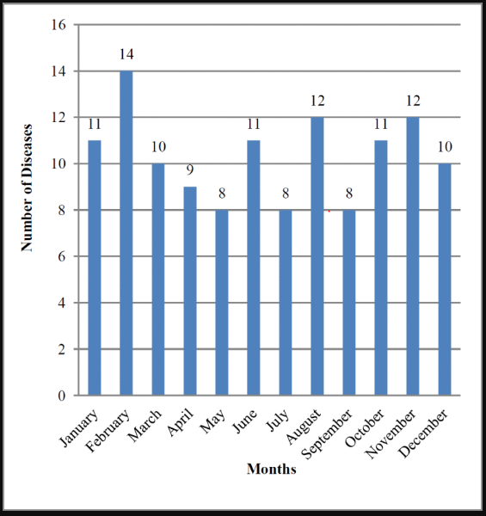
The bar graph depicts the month-wise number of diseases affecting the patients.

Slide 30
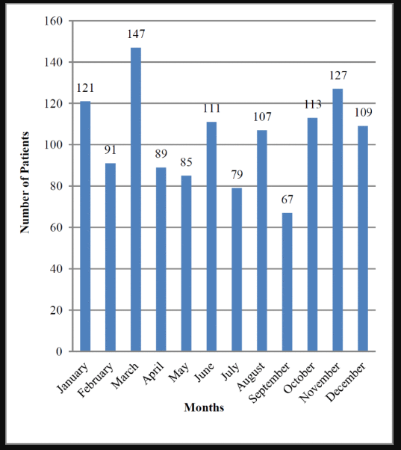
The bar graph shows the month-wise number of patients affected by various diseases

Slide 31
RESULT
It reveals the fact that some patients are suffering from the same disease in a particular month.
The analysis revealed the fact that 4 different diseases affected the patients frequently at various geographical locations during the year 2012.
Notes:
What measures can be taken to prevent them?
What kind of medication should be readily available?

Slide 32
Conclusion
First Candidate Generation Algorithm
Outdated, but is the basis of many other algorithms.
Apriori-BSO Algorithm
Classification Based on Association – CBA algorithm
APPSO algorithm
Set operation for Frequent Item using Transaction – SFIT algorithm
Notes:
Slight variation, same concept

