Slide 1

“ANALYZING ROAD CRASHES AND FATALITIES IN TEXAS FOR BETTER ROAD SAFETY”
GROUP – 1
AKHILA AKULA – 11697123
JITHENDAR REDDY GORRE – 11697698
SRIMAN MOTURI – 11680022
SHRAVANI SANGAM – 11724285
PRATHYUSHA ERRA – 11717316
04/21/2025
- PROF. SAMEH SHAMRUOKH

Slide 2

BUSINESS UNDERSTANDING & PREPARATION:
OBJECTIVES:
Predict crash severity, roadway clearance times, and injury outcomes using environmental, temporal, and vehicle-related data to improve traffic safety, emergency response, and injury prevention strategies.
BUSINESS GOALS:
Develop machine learning models for crash severity classification and clearance time prediction
Improve prioritization of emergency services using predictive insights
Reduce overall crash-related delays through early intervention
SUCCESS CRITERIA:
Achieve at least 80% accuracy and a high ROC-AUC for severity classification.
Achieve R² > 0.6 for clearance duration prediction.
Identify key real-time predictors to inform dispatch and control centers.

Slide 3
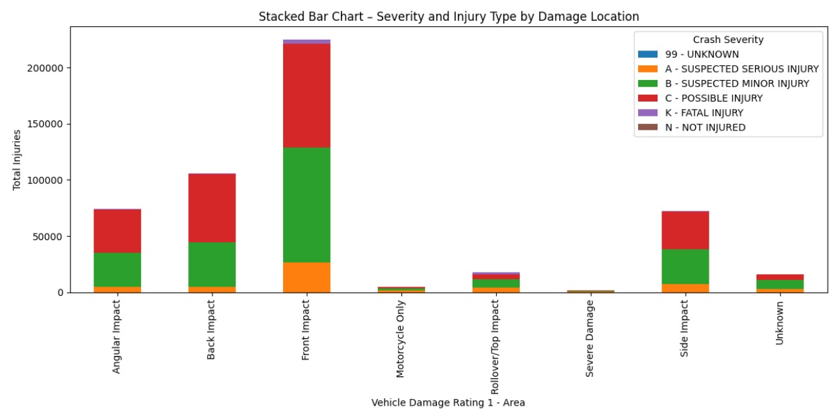
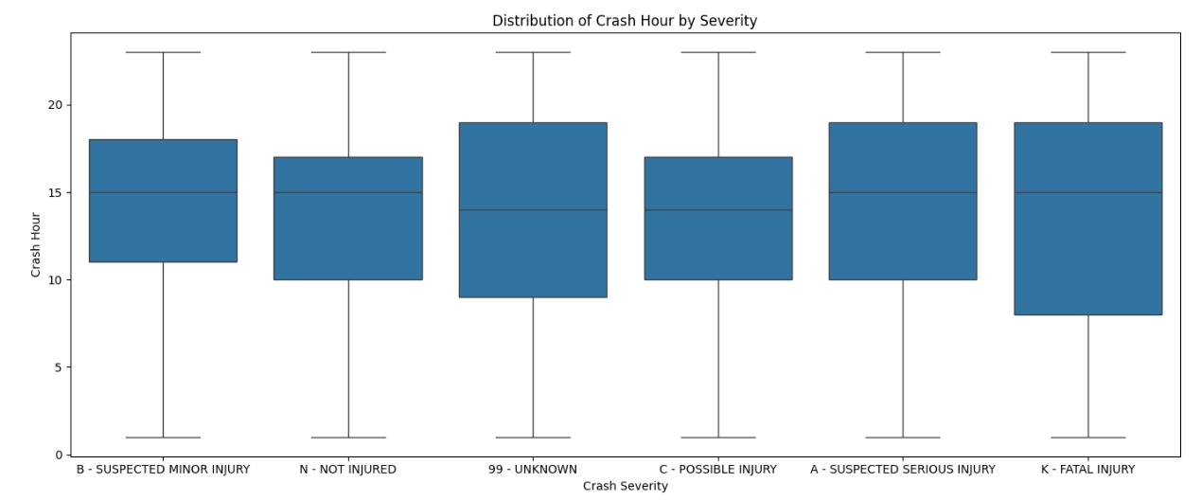
DATA UNDERSTANDING:
DATA SOURCES:
C.R.I.S (Crash Records Information System) or (TxDOT CRIS)
We have 4 key data sets: Vehicle Data, Driver Data, We & Crash Data. It has 2.4M crash records.
DATA CHALLENGES:
Handling missing data - We don't have missing data, but have NA, No Data.
Handling Outliers - We do have a few Outliers, but after careful consideration, we felt they are not considered Outliers
EXPLORATION INSIGHTS:
Most crashes occur under clear weather and during afternoon rush hours.
Vehicle damage severity and airbag deployment have a strong relationship with injury severity.
Hit-and-run crashes have significantly longer clearance durations.

Slide 4

MODELING AND EVALUATION:
MODELING TECHNIQUES:
Classification Models: Logistic Regression, Decision Tree Classifier, Random Forest Classifier, XGBoost Classifier
Regression Models: Linear Regression, Random Forest Regressor, XGBoost Regressor
PERFORMANCE METRICS:
Crash Severity Prediction (Classification Models)
XGBoost achieved 84.18% accuracy for crash severity prediction.
Macro-average ROC-AUC: 0.80, Precision: ~65%, Recall: ~40%.
ROC-AUC: 0.78 (Minor), 0.75 (Moderate), 0.87 (Severe injuries).
Clearance Duration Prediction (Regression Models)
Random Forest Regressor achieved the best R² Score of 0.28.
EVALUATION INSIGHTS:
Airbag deployment and motorcycle crashes are strong predictors of injury severity.
Rollover and motorcycle impacts significantly increase crash severity.
Hit-and-run crashes and night-time accidents prolong roadway clearance times.
Rural and non-trafficway roads are linked to higher crash severity.

Slide 5
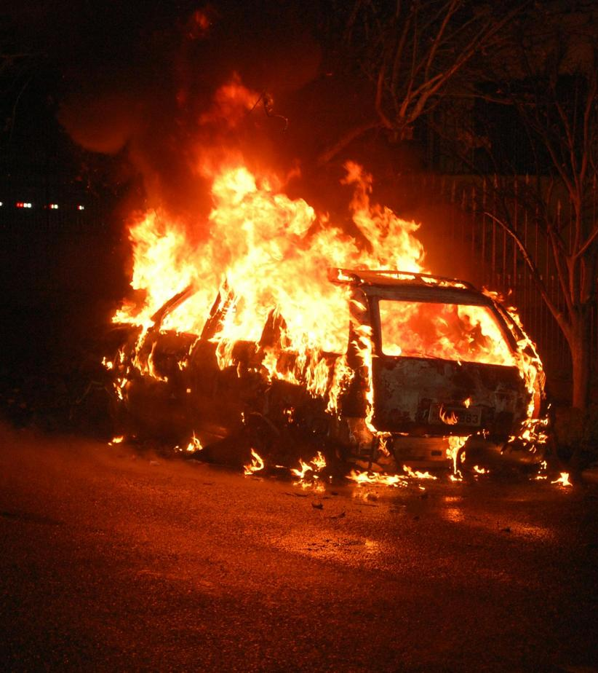
RECOMMENDATIONS:
ACTIONS BASED ON FINDINGS:
Prioritize emergency dispatch for crashes predicted as severe based on model outputs (especially involving rollovers or motorcycles).
Increase patrol and response readiness during night-time and high-risk road types (rural, non-trafficway).
Launch targeted public safety campaigns focusing on hit-and-run and night driving risks.
Monitor vehicle types and roadway categories that have historically led to delayed clearance times.
OPERATIONAL INTEGRATION:
Integrate severity prediction models into traffic incident management systems for real-time severity flagging.
Support data-driven resource allocation for peak traffic periods and high-risk zones.
Periodically retrain models to incorporate new crash records and maintain predictive performance

Slide 6
Real-World Use Case:
Real-Time Severity Tagging System:
Embed the severity classification model into 911 call centers, telematics, or traffic dashboards to automatically tag crash records by predicted severity.
Benefits:
Instant alerting for high-severity incidents
Estimated clearance time for detour planning
Enables EMS prioritization and trauma center alerting
Basis for connected vehicle and smart city integration

Slide 7

SUMMARY:
Built classification models (XGBoost, Random Forest, Logistic Regression, Decision Tree) to predict crash severity.
Built regression models (Random Forest Regressor, XGBoost Regressor) to estimate roadway clearance durations.
Achieved 84.18% accuracy and ROC-AUC 0.80 for crash severity prediction.
Identified key factors influencing severity: airbag deployment, motorcycle crashes, rural roads, and rollovers.
IMPACT:
Enables real-time identification of high-severity crashes, improving emergency response prioritization.
Supports better allocation of tow trucks, ambulances, and police units based on predicted clearance durations.
CONCLUSION AND NEXT STEPS:
FUTURE WORK:
Integrate real-time weather, traffic flow, and CCTV feeds for dynamic crash prediction
Expand classification labels to fine-grained severity levelsExtend to include post-clearance impact estimation (e.g., congestion recovery time)

Slide 8

ANY QUESTIONS
?
THANK YOU

