Slide 1

Malicious URL Detection using Machine Learning in Python
Malicious URL Detection using Machine Learning in Python
BY AKHILA C U
BY AKHILA C U

Slide 2

Introduction to the project
This project aims to develop a machine learning model for detecting malicious URLs using Python. By leveraging advanced techniques, we seek to enhance cybersecurity and protect users from online threats. Through this presentation, we will delve into the details of our innovative approach and the potential impact on web security.

Slide 3
Overview of Malicious URLs and the need for detection
Risks of Malicious URLs
Methods of Concealment
Malicious URLs can lead to data breaches, identity theft, and financial loss.
Cybercriminals use URL shorteners and obfuscation techniques to hide their malicious links.
Impact on Organizations
Emerging Threat Landscape
Malicious URLs can disrupt business operations and damage brand reputation.
New evasion tactics and sophisticated phishing schemes pose constant challenges for detection.

Slide 4

About Dataset
For training and testing machine learning algorithms, we have used a huge dataset of 651,191 URLs, out of which 428103 benign or safe URLs, 96457 defacement URLs, 94111 phishing URLs, and 32520 malware URLs. Figure 2 depicts their distribution in terms of percentage. As we know one of the most crucial tasks is to curate the dataset for a machine learning project. We have curated this dataset from five different sources.
For collecting benign, phishing, malware and defacement URLs I have used URL dataset (ISCX-URL-2016) For increasing phishing and malware URLs, we have used Malware domain black list dataset. I have increased benign URLs using faizan git repo At last, I have increased more number of phishing URLs using Phishtank dataset and PhishStorm dataset As we have told you that dataset is collected from different sources. So firstly, we have collected the URLs from different sources into separate data frame and finally merge them to retain only URLs and their class type.

Slide 5


Data Collection and Preprocessing
Data Sources: Utilized open-source repositories, web crawlers, and API access for diverse URL samples.
Data Cleaning: Removed duplicate URLs, resolved redirections, and handled missing or invalid data.
Feature Engineering: Extracted domain information, URL length, for text data.

Slide 6
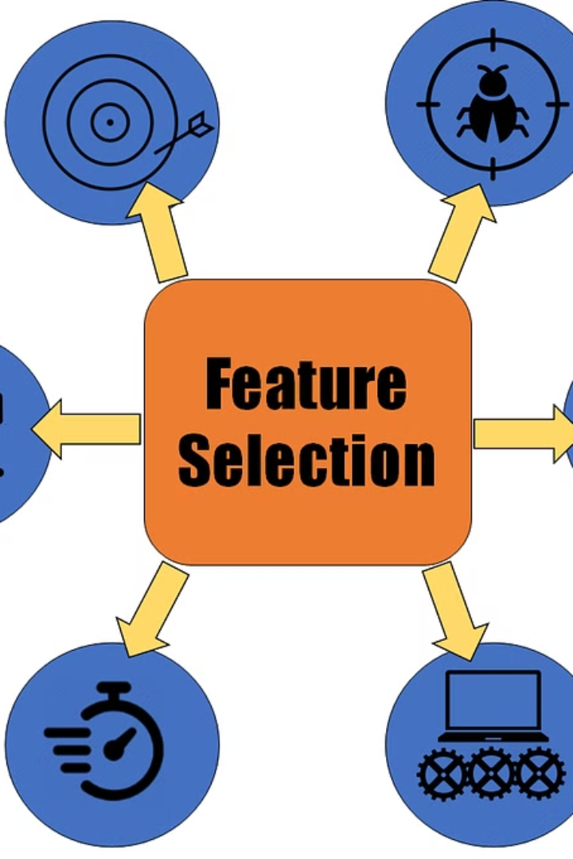
Feature Extraction and Selection
During this phase, relevant features are extracted from the dataset to represent malicious URL characteristics.
The process involves identifying key attributes and eliminating irrelevant or redundant ones to improve model performance.
The features used in this project are having_ip_address, abnormal_url, google_index, Count. Count-www, count@, Count_dir, Count_embed_domain, Suspicious words in URL, Short_url, Count_https, Count_http, Count%,, Count?,, Count, Count=, url_length, hostname_length, First directory lengthLength of top-level domains,, Count_digits, Count_letters.

Slide 7
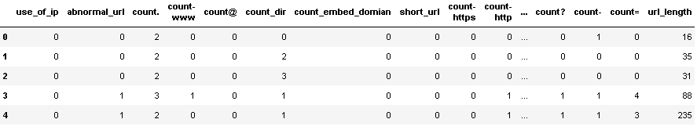
Feature Extraction and Selection
So, now after creating the above 22 features, the dataset looks like the below..
Now, in the next step, we drop the irrelevant columns i.e., URL,google_index, and tld.

Slide 8
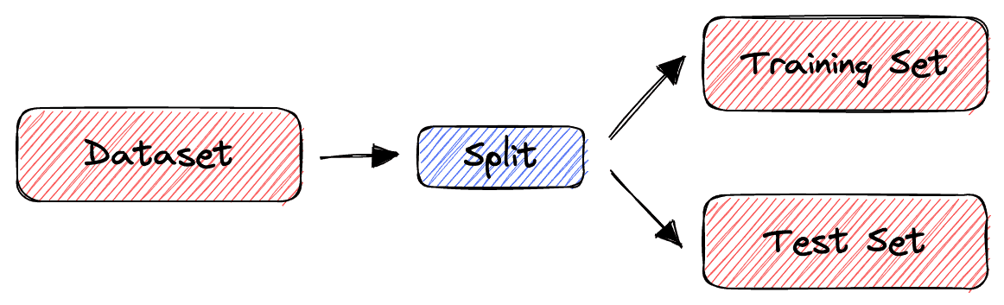
Training & Test Split
The next step is to split the dataset into train and test sets. We have split the dataset into 80:20 ratio i.e., 80% of the data was used to train the machine learning models, and the rest 20% was used to test the model.
As we know we have an imbalanced dataset. The reason for this is around 66% of the data has benign URLs, 5% malware, 14% phishing, and 15% defacement URLs. So after randomly splitting the dataset into train and test, it may happen that the distribution of different categories got disturbed which will highly affect the performance of the machine learning model.

Slide 9




Machine learning models used for classification
Light GBM
XG Boost
Random Forest
Ensemble Learning
Light GBM Is a gradient boosting framework that uses tree based learning algorithms
It is a gradient boosting framework that uses tree based learning algorithms
It s a popular ensemble learning algorithm used for both classification and regression tasks in machine learning
Combines multiple models to improve accuracy and robustness.

Slide 10
Model evaluation & comparison
Random Forest Classifier
precision recall f1-score support
benign 0.99 1.00 1.00 4422
defacement 0.96 0.99 0.98 1112
phishing 0.92 0.73 0.82 147
malware 0.94 0.89 0.91 351
accuracy 0.98 6032
macro avg 0.96 0.90 0.93 6032
weighted avg 0.98 0.98 0.98 6032
accuracy: 0.985
Light GBM Classifier
precision recall f1-score support
benign 0.99 1.00 1.00 4422
defacement 0.97 0.99 0.98 1112
phishing 0.93 0.76 0.83 147
malware 0.95 0.92 0.93 351
accuracy 0.99 6032
macro avg 0.96 0.92 0.94 6032
weighted avg 0.99 0.99 0.99 6032
accuracy: 0.987
XG boost Classifier
precision recall f1-score support
benign 1.00 1.00 1.00 4422
defacement 0.98 0.99 0.98 1112
phishing 0.92 0.78 0.84 147
malware 0.94 0.92 0.93 351
macro avg 0.96 0.92 0.94 6032
weighted avg 0.99 0.99 0.99 6032
accuracy: 0.987
accuracy 0.99 6032

Slide 11
Evaluation Metrics for Model Performance
Support
Precision
Measures the number of actual occurrences of each class in the dataset
Measures the accuracy of the positive predictions and the ability of the model to find all the positive instances, respectively.
F1 Score
Recall
Represents the balance between precision and recall, providing a single score that summarizes both.
It measures the proportion of actual positive cases that were correctly identified by a model.

Slide 13



Future work and improvements
Enhanced Feature Selection
1
Explore advanced techniques for identifying key features.
Model Tuning
2
Optimize hyperparameters for improved performance.
Real-time Detection
3
Develop website for URL classification & detection.
For future work, focus on advanced feature selection methods to enhance model performance and explore real-time URL detection algorithms. Additionally, optimize model tuning for improved accuracy and efficiency in malicious URL identification.

Slide 14

Findings
In this project, we have demonstrated a machine learning approach to detect Malicious URLs. We have created 22 lexical features from raw URLs and trained three machine learning models XG Boost, Light GBM, and Random forest.
Further, we have compared the performance of the 3 machine learning models and found that XG Boost and Light GBM outperformed others by attaining the highest accuracy of 98.7%.
By plotting the feature importance , we found that hostname_length, count_dir, count-www, fd_length, and abnormal_url are the top 5 features for detecting the malicious URLs.

Slide 15

Conclusion
As we conclude, Detection Malicious URL detection using machine learning algorithms is an effective approach to safeguarding users from online threats.

Slide 16

THANK YOU

