Slide 1

𝗜𝗡𝗗𝗜𝗥𝗔 𝗚𝗔𝗡𝗗𝗛𝗜 𝗪𝗜𝗗𝗢𝗪 𝗣𝗘𝗡𝗦𝗜𝗢𝗡 𝗦𝗖𝗛𝗘𝗠𝗘 🌿💙
𝐅𝐘 𝟐𝟎𝟐𝟑-𝟐𝟒
-- Lagishetty Akhila

Slide 2
Details:
The Indira Gandhi Widow Pension Scheme (2023-2024) ensures structured tracking of welfare benefits across regions and demographics. LGD codes uniquely identify states and districts, while scheme codes categorize programs. This enhances transparency and accountability, ensuring funds reach the right beneficiaries.
Aadhaar and mobile numbers aid in DBT validation, preventing fraud. Demographic analysis (SC, ST, OBC, General) ensures fair distribution.Time-based tracking (financial year, month, last update) allows trend analysis and irregularity detection.
Covering multiple districts in Jammu & Kashmir the dataset provides a comprehensive and structured approachto welfare monitoring.

Slide 3
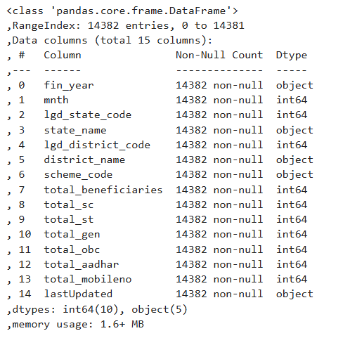
About dataset:
df.info()
Data frame info:
This dataset contains 14,382 records with 15 columns, including financial year with 10 numerical columns categorical fields, making it useful for demographic and financial analysis.

Slide 4
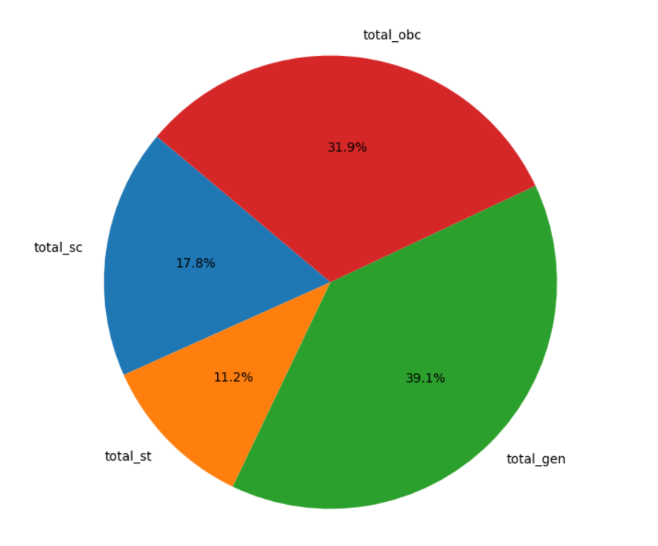
Total Benificiary across diff categories
This pie chart represents the distribution of beneficiaries across different social categories: General (total_gen - 39.1%), OBC (total_obc - 31.9%), SC (total_sc - 17.8%), and ST (total_st - 11.2%). The General category has the highest proportion, followed by OBC, SC, and ST, indicating how benefits are allocated among different groups.

Slide 5
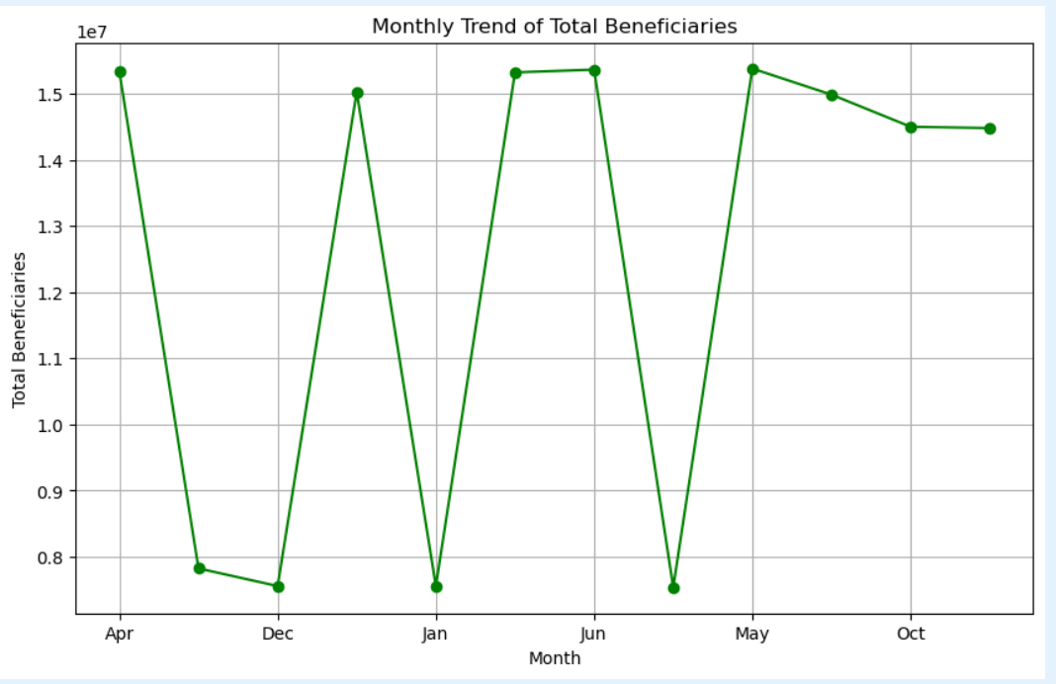
Monthly trend of total beneficiaries:
This line chart illustrates the monthly trend of total beneficiaries over a year. The y-axis represents the number of beneficiaries, while the x-axis denotes the months. The graph shows sharp fluctuations, indicating months with sudden increases and decreases in beneficiaries, possibly due to policy changes, seasonal factors, or data collection variations.

Slide 6
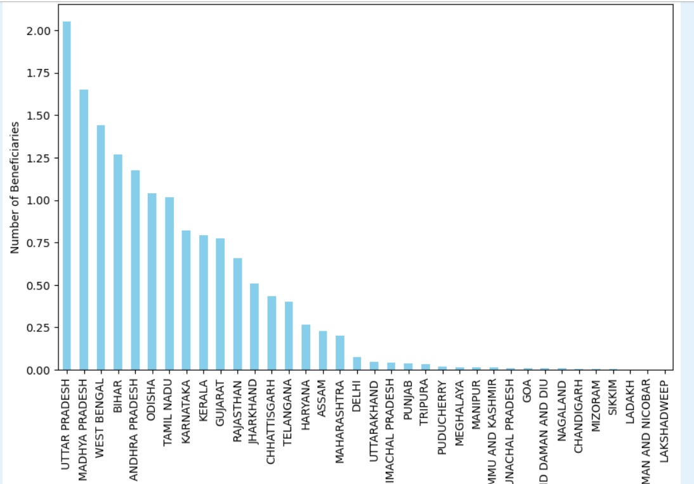
Total Beneficiaries by State:
This line chart illustrates the monthly trend of total beneficiaries over a year. The y-axis represents the number of beneficiaries, while the x-axis denotes the months. The graph shows sharp fluctuations, indicating months with sudden increases and decreases in beneficiaries, possibly due to policy changes, seasonal factors, or data collection variations. 📈

Slide 7
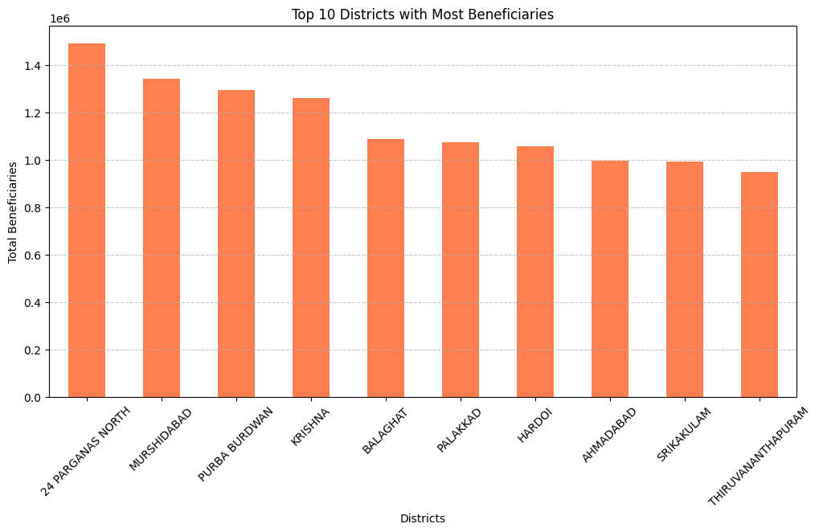
Total 10 districts with most beneficiaries:
This bar chart displays the top 10 districts with the highest number of beneficiaries. 24 Parganas North has the largest number of beneficiaries, followed by Murshidabad, Purba Burdwan, and Krishna. The y-axis represents the total beneficiaries, while the x-axis lists the district names. The distribution indicates regional variations in beneficiary allocation.

Slide 8
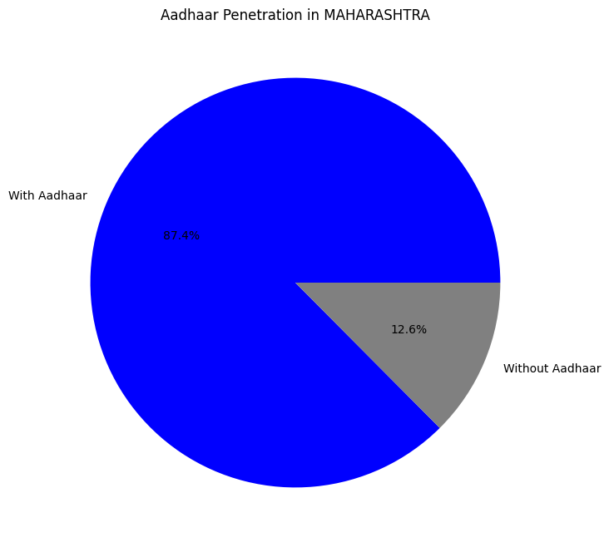
Aadhar penetration in states ex:Maharastra
This pie chart represents Aadhaar penetration in Maharashtra. The majority (87.4%) of the population has an Aadhaar card (represented in blue), while 12.6% do not (represented in gray). This indicates a high Aadhaar adoption rate in the state.

Slide 9
Conclusion:
Maharashtra has a high Aadhaar penetration (87.4%), ensuring efficient beneficiary distribution. Top districts like 24 Parganas North and Murshidabad receive the most benefits. Uttar Pradesh and Madhya Pradesh lead in total beneficiaries, while smaller states have minimal counts. Monthly trends show fluctuations, likely due to policy changes or seasonal factors.

