Slide 1
Tata Data Visualization -Empowering Business with Effective Insights -Tableau
By
Akhil Anilkumar

Slide 2
Problem Statement
Review their data and provide valuable insights to the CEO and CMO to help them strategically plan for the upcoming year
Analyze the data and identify the major factors that contribute to the company's revenue
The management team can focus on and invest in areas that are performing well
It will help the business grow and succeed in the long term

Slide 3
Dataset Information
Data is taken from Kaggle (Telecom churn Dataset)
No. of features: 9
No. of records: 541909
Target Column: Revenue
No. categorical columns : 4
InvoiceNo:Unique Invoice ID assigned to every distinct item
StockCode:Unique identifier assigned to each product
Description:Describe the product name
Quantity: Quantity of each product
InvoiceDate: Date of Invoice
UnitPrice:Price of each product
CustomerID:Unique identifier assigned to each customer
Country:Country name

Slide 4
Data Preparation
To ensure the data is clean and accurate before starting the analysis, we utilized Excel to perform several data cleaning steps:
Removed Rows in the Quantity column showing negative numbers or below 1
Removed Rows in the UnitPrice column that are below $0
Removed Rows with blanks
Added Revenue Column from multipling UnitPrice with Quantity

Slide 5
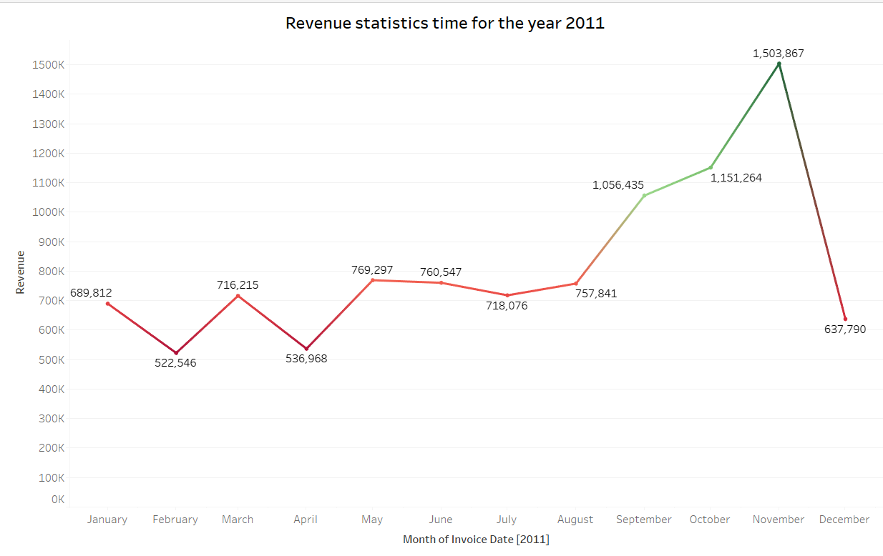
Q1: The CEO of the retail store is interested to view the time series of the revenue data for the entire year. The CEO is interested in viewing the seasonal trends and wants to dig deeper into why these trends occur. This analysis will be helpful for the CEO to forecast for the next year.

Slide 6
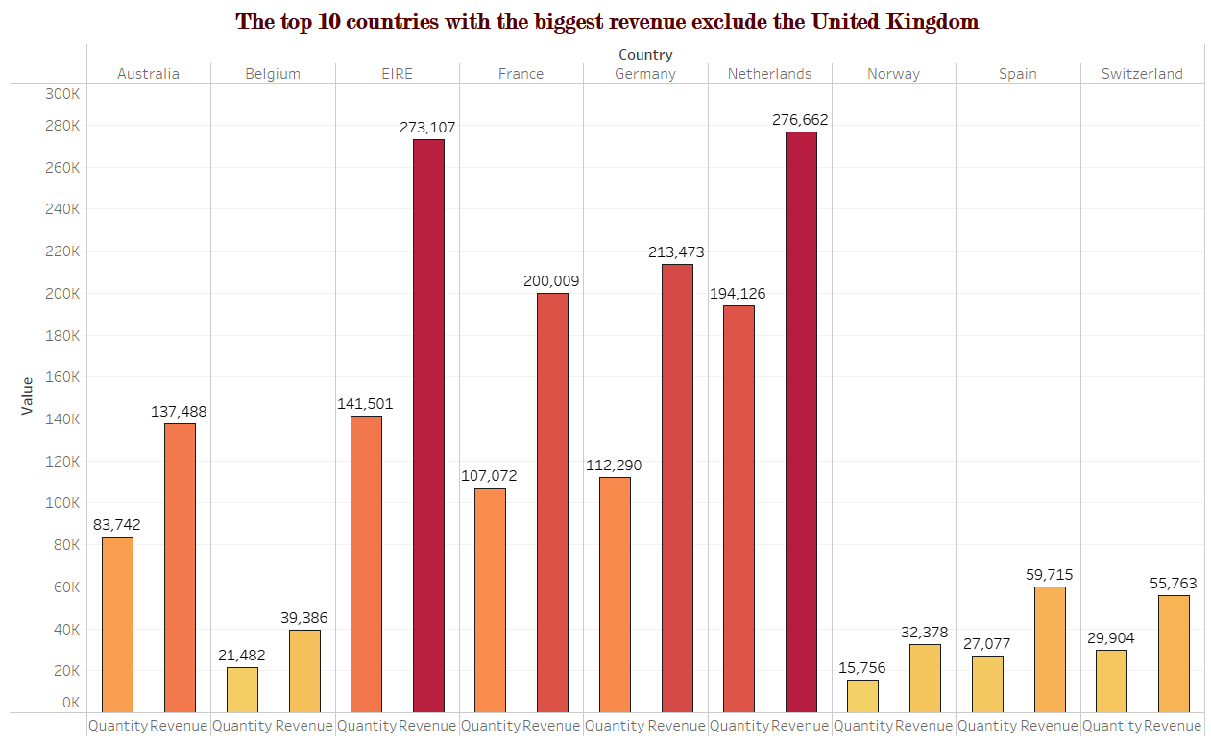
Q2 : The CMO is interested in viewing the top 10 countries which are generating the highest revenue. Additionally, as a subcomponent, they would also like to see which products are contributing to the total revenue being generated by each country.

Slide 7
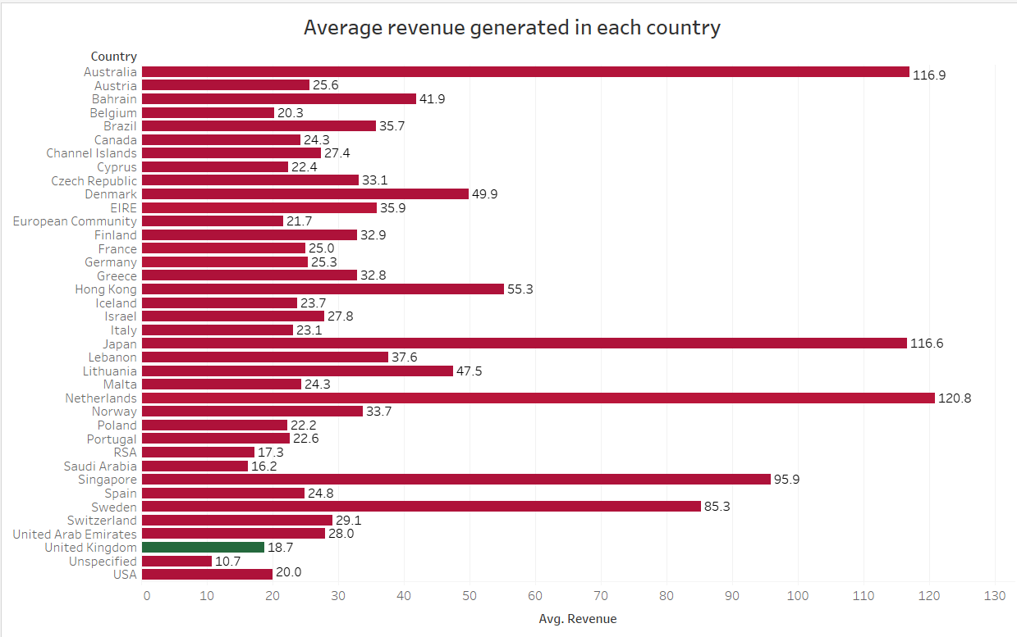
Q3 : The CEO of the online retail store wants to see how much average revenue is generated by each country. They are interested in viewing the following metrics on the visual:

Slide 8
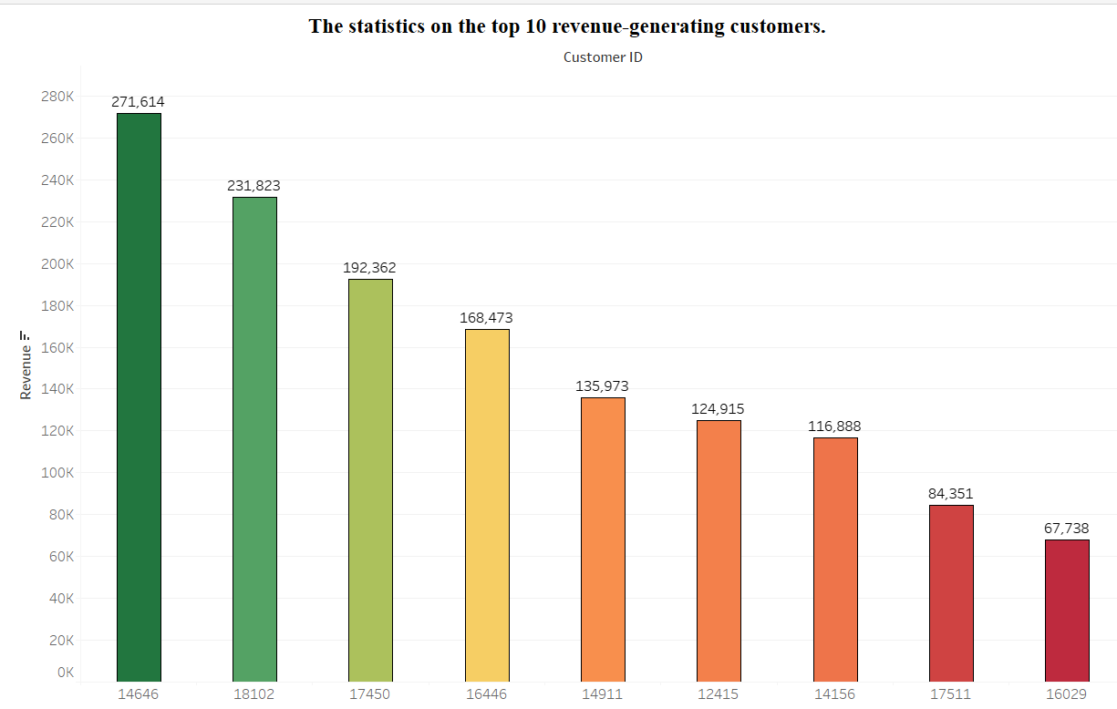
Q4 : The CMO of the online retail store wants to view the information on the top 10 customers by revenue. They are interested in a visual that shows the greatest revenue-generating customer at the start and gradually declines to the lower revenue-generating customers. The CMO wants to target the higher revenue-generating customers and ensure that they remain satisfied with their products.

Slide 9
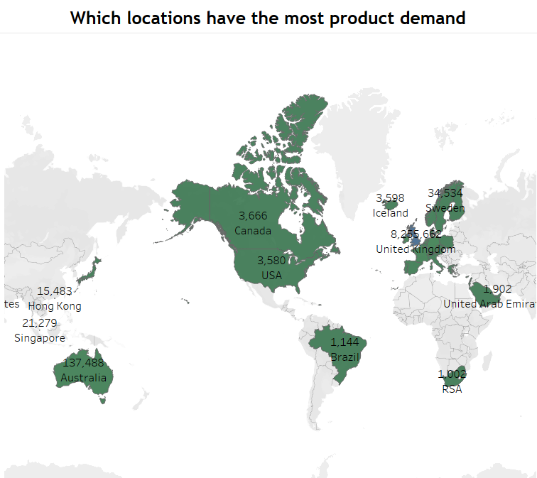
Q5 : The CEO is looking to gain insights on the demand for their products. They want to look at all countries and see which regions have the greatest demand for their products. Once the CEO gets an idea of the regions that have high demand, they will initiate an expansion strategy which will allow the company to target these areas and generate more business from these regions.

Slide 10
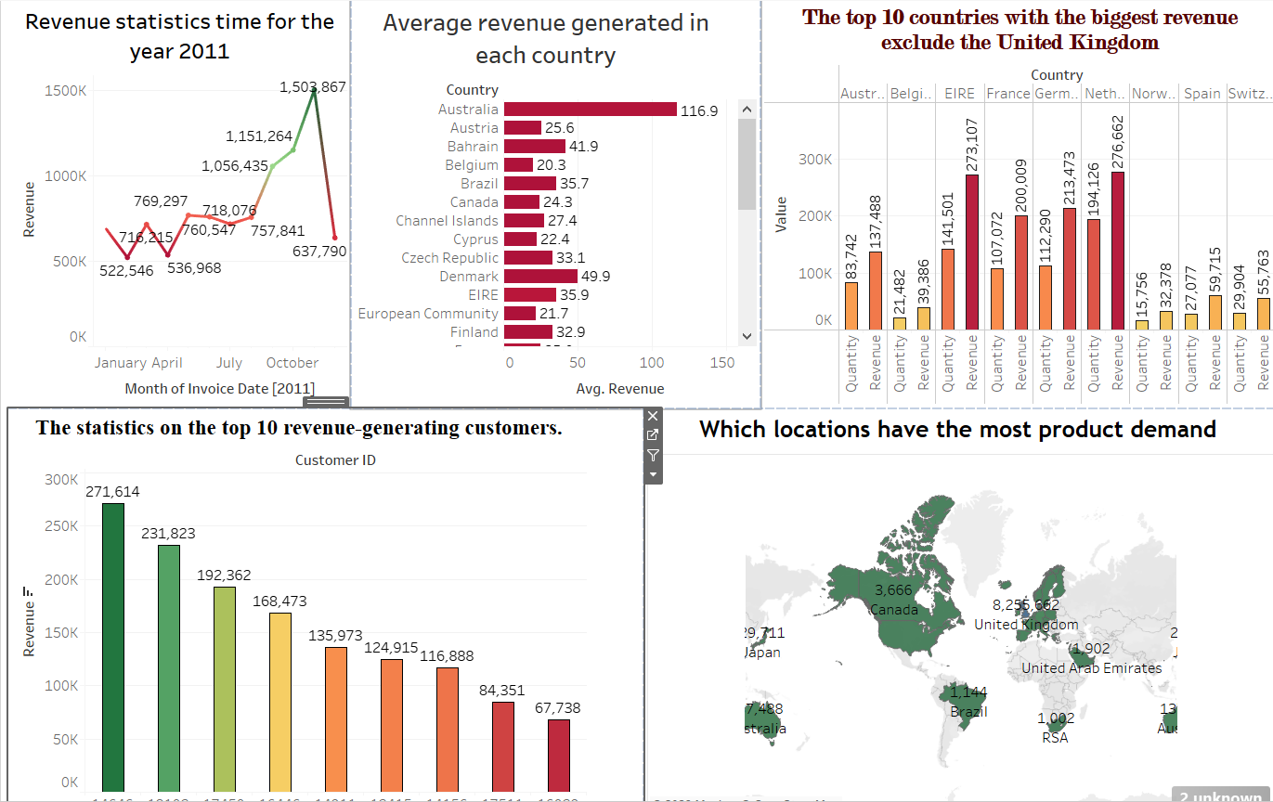
To view the entire data on a single view without the need to scroll or hover over the data points to identify the demand.

Slide 11
THANK YOU

