Slide 1


Early Detection of Metabolic Syndrome Through Patient Risk Profiling
Problem Statement : Metabolic Syndrome is often underdiagnosed due to the need to evaluate multiple clinical risk factors together. This project aims to build a data-driven, interpretable model to identify high-risk patients early and support preventive care.
Source: Collected from Data World – https://data.world/informatics-edu/metabolic-syndrome-prediction
Records: 2,401 patient entries
Variables: 15 clinical and demographic features, including:
Age, Gender, Marital Status, Race, Income
Waist Circumference, BMI, Blood Glucose, HDL, Triglycerides
Albuminuria, Uric Acid, Urinary Albumin-to-Creatinine Ratio
Target Variable: Metabolic Syndrome (Yes/No)
Utilized R throughout the project to perform the complete data analysis pipeline, including data import, cleaning, exploratory analysis, visualization, and predictive modeling.
R Packages : tidyverse, ggplot2, dplyr, rpart, caret

Slide 2
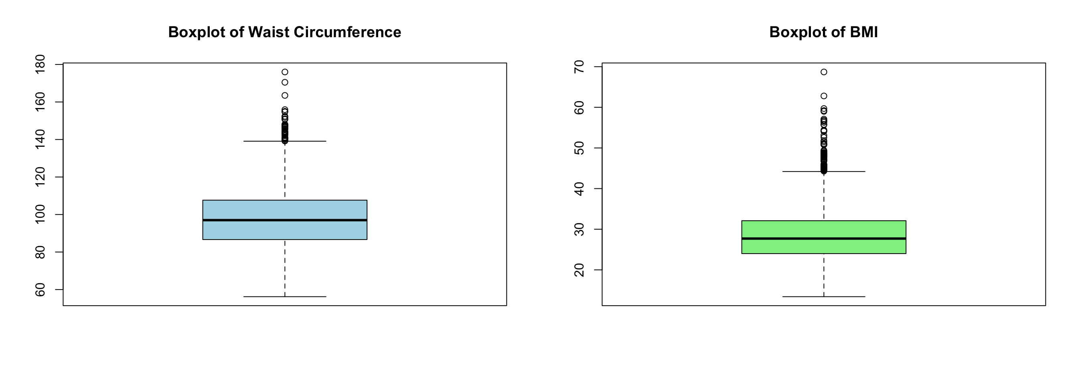
Building a Robust Dataset for Reliable Risk Analysis
Duplicates - Checked using duplicated()
Result: No duplicates found
Missing Values – Checked using colSums(is.na(data) | data == "")
Found in:
Marital – 208.
Income – 117
Waist Circumference – 85
BMI – 26
Imputation Strategy
Outliers in BMI and Waist Circumference were removed using the Interquartile Range (IQR) method.
Column | Method | Reason
Income | Median | Skewed distribution
Waist Circumference | Mean | Normal distribution
BMI | Mean | Normal distribution
Marital | Removed | Categorical + blanks

Slide 3
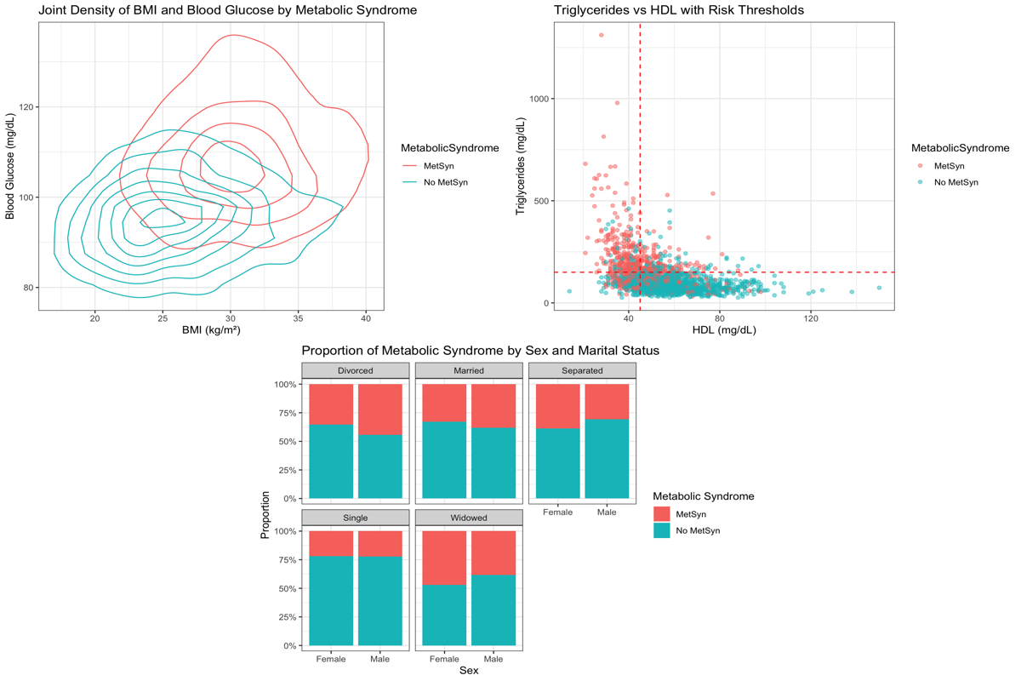
Analyzing Risk Factors of Metabolic Syndrome
Joint Density of BMI and Blood Glucose :
Metabolic Syndrome group clusters at BMI 30–35 and Glucose 100–120 mg/dL.
Non-Metabolic Syndrome group peaks at BMI 22–28 and Glucose 80–100 mg/dL.
Triglycerides vs HDL with Clinical Risk Thresholds :
Metabolic Syndrome cases cluster in the high-risk zone (low HDL & high triglycerides).
Non-Metabolic Syndrome group is dense in the healthy zone (HDL > 45, Trig < 150).
Metabolic Syndrome by Gender & Marital Status :
Widowed females and divorced males have highest Metabolic Syndrome rates.
Single males/females show lowest Metabolic Syndrome proportions.

Slide 4
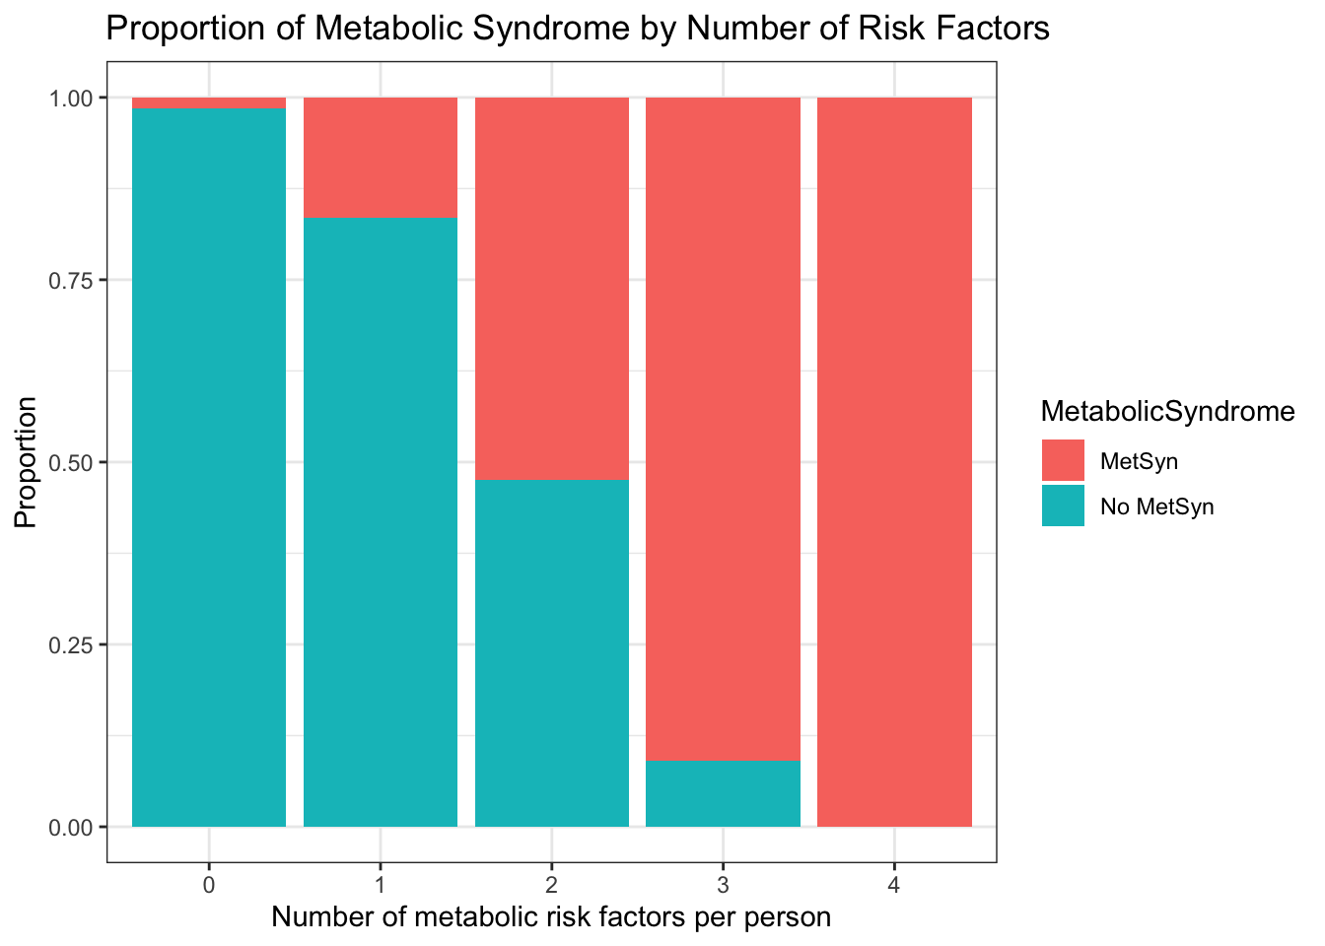
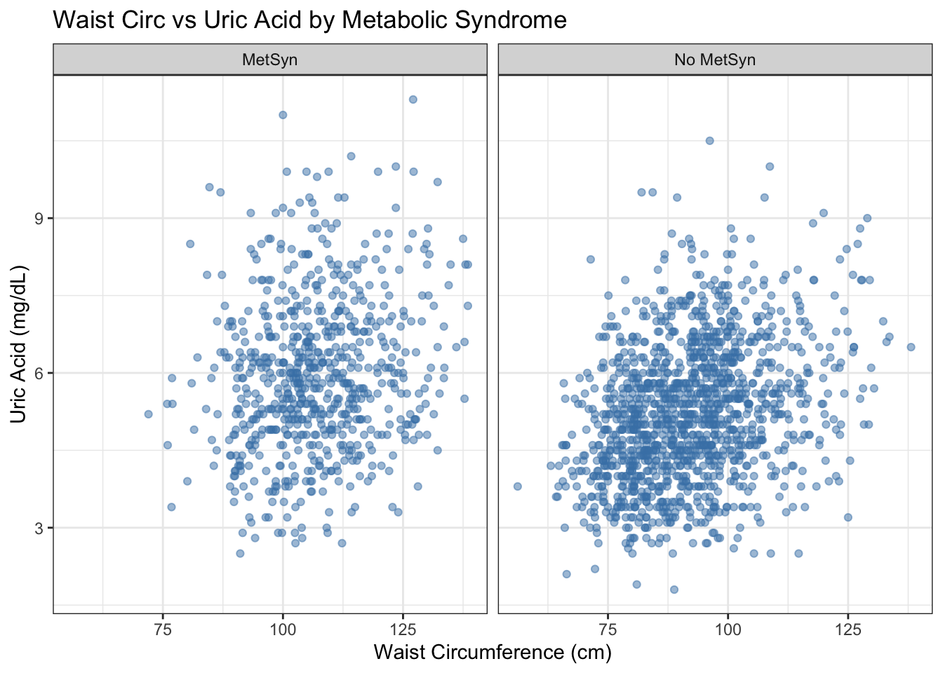
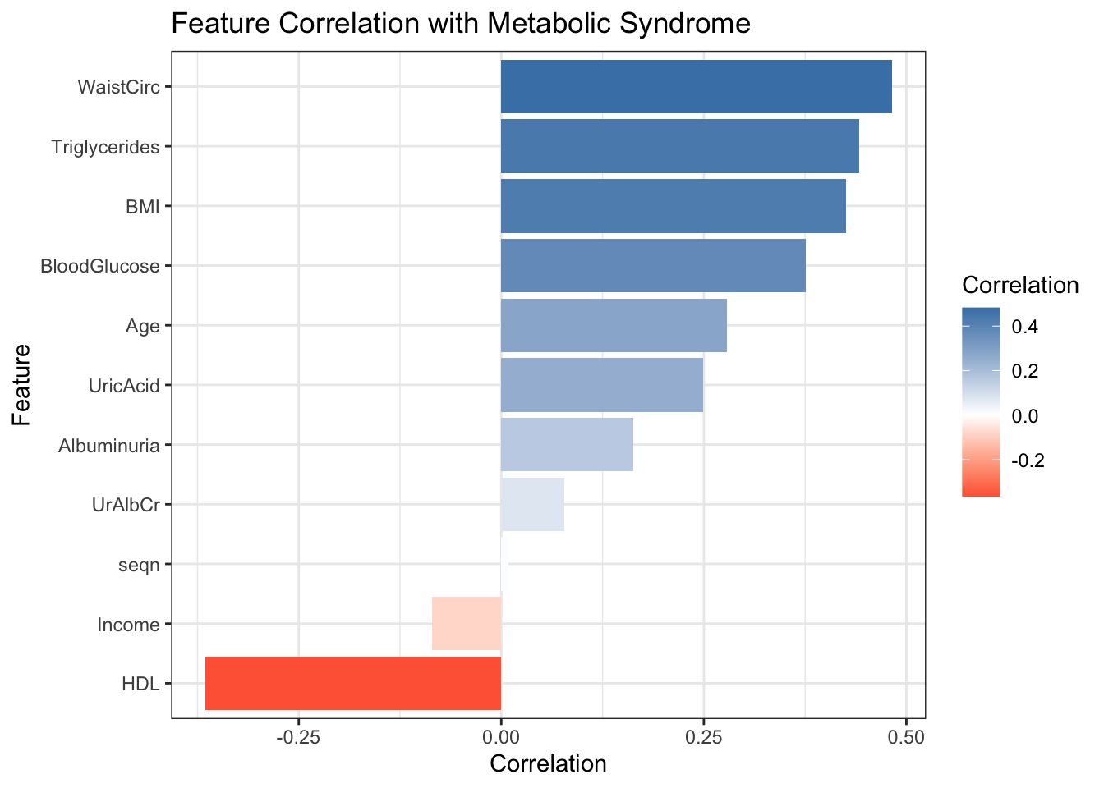
Proportion of Metabolic Syndrome by Number of Risk Factors
Individuals with 0–1 metabolic risk factors are predominantly free of Metabolic Syndrome.
At 3–4 risk factors, nearly all individuals fall into the Metabolic Syndrome group, showing a clear threshold effect.
Waist Circumference vs Uric Acid by Metabolic Syndrome
Most Metabolic Syndrome patients often have waists over 100 cm and have uric acid levels clustered toward the upper normal range, around 5–7 mg/dL.
This highlights a combination of abdominal obesity and a bit of raised uric acid.
Most people without Metabolic Syndrome have waist sizes around 80–110 cm and keep their uric acid under 7 mg/dL, both below clinical risk cutoffs, showing a stable, healthy profile.
Feature Correlation with Metabolic Syndrome
Waist circumference and triglycerides show the strongest positive correlations with Metabolic Syndrome.
HDL is negatively correlated, as previously seen in the HDL vs Triglycerides scatter plot.

Slide 5
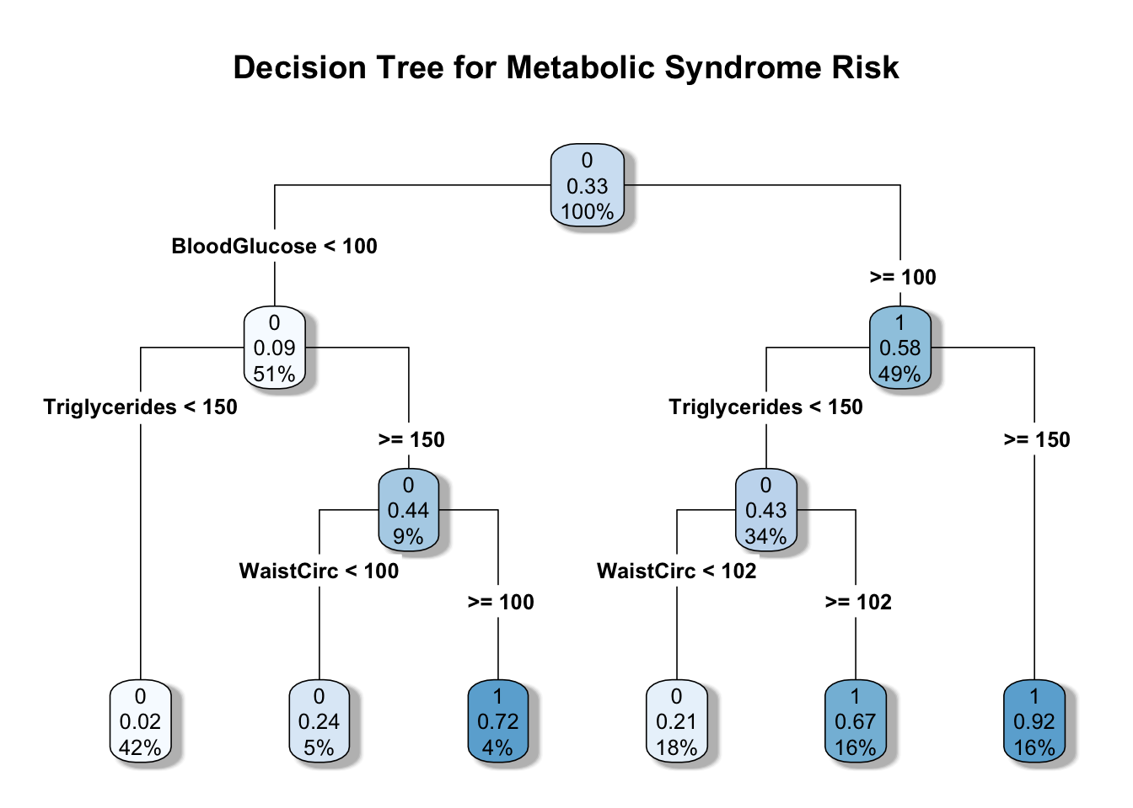
Predictive Modeling & Key Insights
Triglycerides and waist circumference define risk: In patients with high glucose (≥100 mg/dL), elevated triglycerides alone predicts Metabolic Syndrome with 92% probability, whereas in those with normal glucose (<100 mg/dL), the combination of high triglycerides (≥150 mg/dL) and waist circumference ≥100 cm gives a 72% Metabolic Syndrome probability.
Blood Glucose is the top divider: The first split at 100 mg/dL separates nearly half of patients into high-risk vs. low-risk branches, highlighting glucose control as the primary discriminator.
Strong overall performance: The decision tree achieves 86.0% accuracy on the test data, balancing predictive power with clinical interpretability.

Slide 6
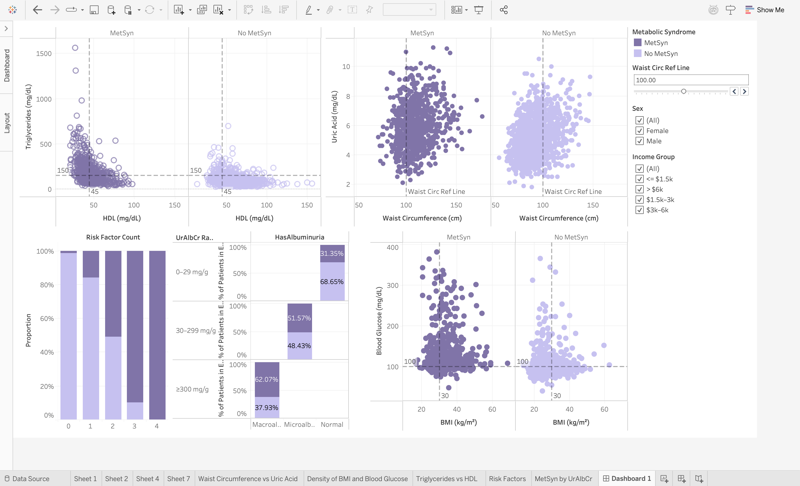


Conclusion
Developed interactive Tableau dashboard that allow dynamic filtering by demographics such as age, sex, marital status, Income Groups to explore Metabolic Syndrome risk patterns.
Enabled interactive deep dives into clinical metrics, glucose, triglycerides, and waist circumference and other, so users can pinpoint and explore high-risk patient clusters.

