Slide 1
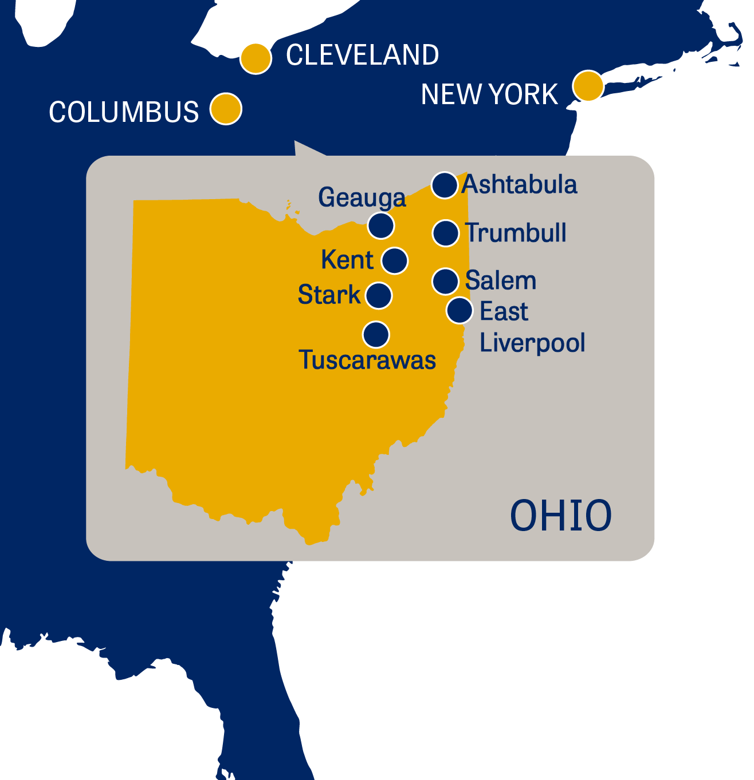
Regional Campus Dashboard

Slide 2
To allow campuses leadership team for taking managerial decisions
To depict the performances of Individual campus
To visualize the KPI’s
Objective

Slide 3
Overview
The Overall Admissions across all the campuses is constant for past two years.
Substantial Increase in Stark campus.
Slightly decrease for Ashtabula campus
Remained constant for Kent campus .

Slide 4
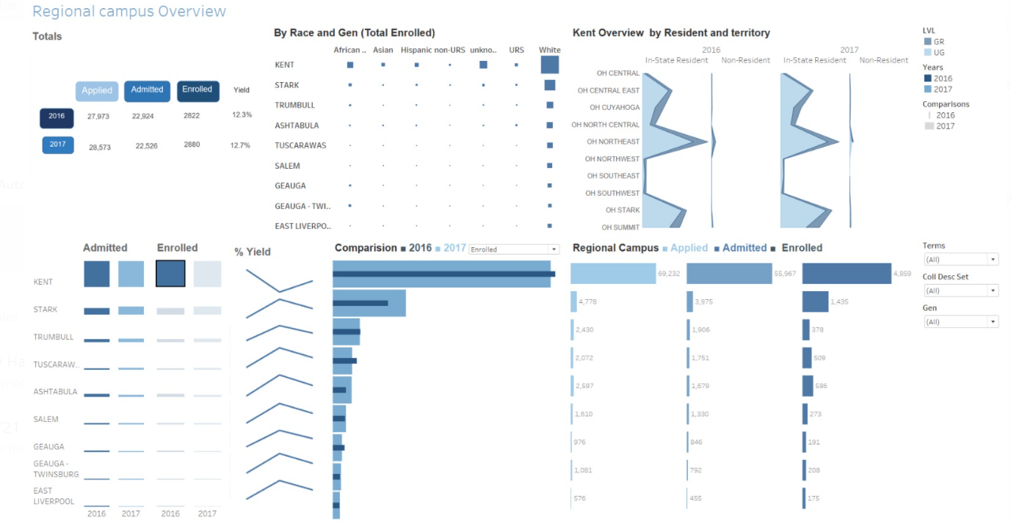

Slide 5

Thank you

