Slide 1
DBMS PROJECT – DA
RideGraph
Team:
Praveen Sakthi S – 25BCE1605
Akhil Gokul – 25BCE5009
Prakash V – 25BCE1769

Slide 2
Problem, motivation and objectives
What RideGraph does and who it serves
Problem: ride-hailing apps must match riders with available drivers nearby and keep a consistent record of every ride, payment, rating and cancellation.
Motivation: questions like "which drivers are free in this pickup zone?" need 3–4 SQL JOINs; in a graph they are one short traversal.
Objectives: ER model → relational schema in 3NF → Neo4j property graph; a working React–Flask–Neo4j app with 7 end-to-end features; validation and tests.
Users: riders (book, pay, rate), drivers (accept, complete, earnings) and an admin (statistics).
11
Graph node types
3
Application tiers
12
Relationship types
2

Slide 3
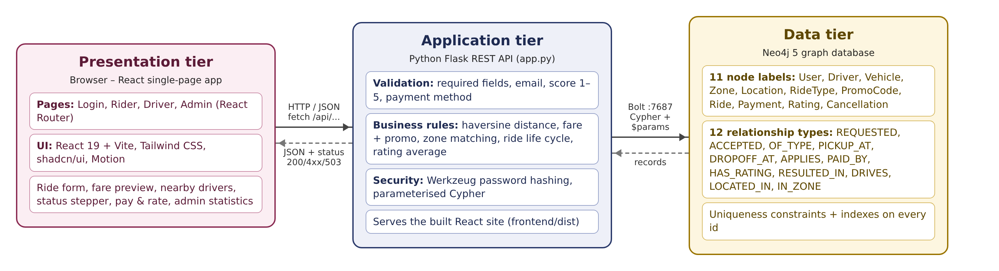
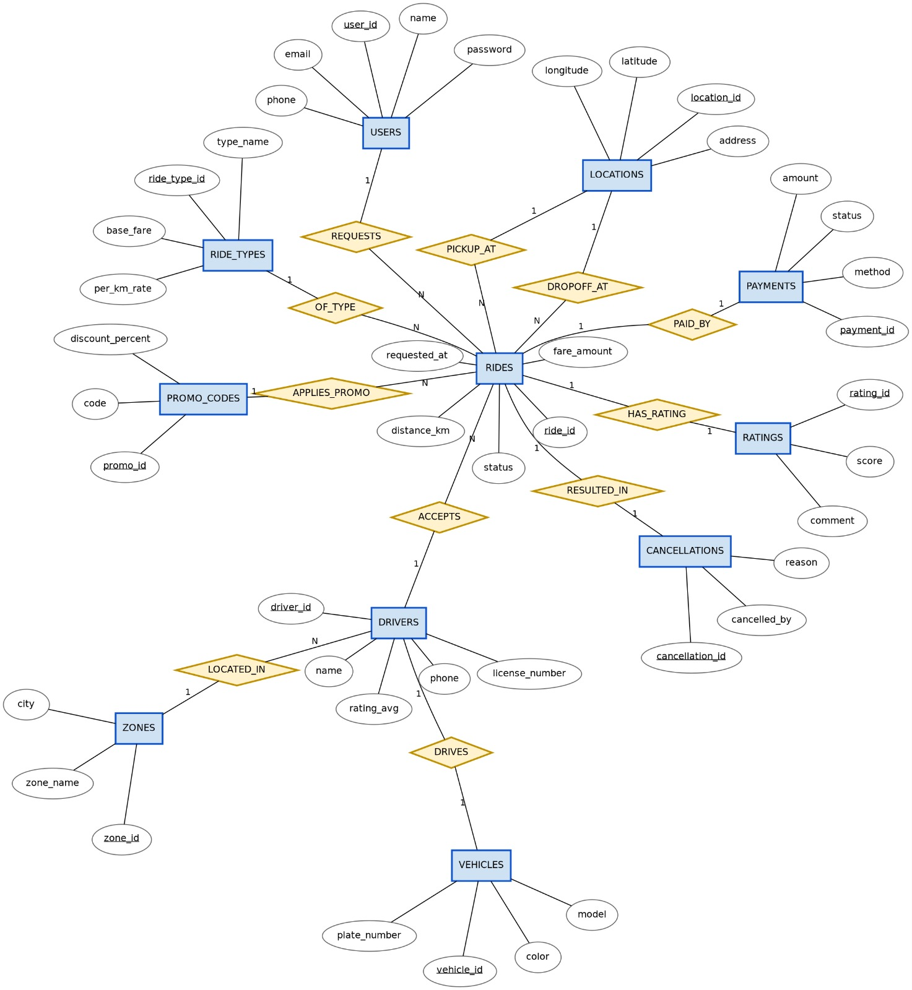
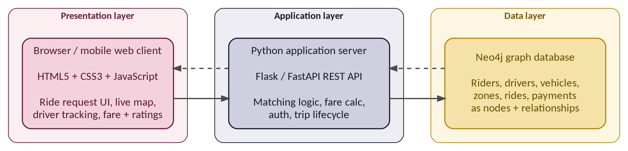
System architecture and ER diagram
React client → Flask REST API → Neo4j graph database; 13-entity ER model
Presentation: React 19 + Vite, React Router, Tailwind CSS (Login, Rider, Driver, Admin pages)
Application: Python Flask REST API – validation, fare & zone rules, password hashing
Data: Neo4j 5 via the official Python driver over Bolt; all Cypher is parameterised
ER → graph: each entity becomes a node label (11), each relationship / foreign key a relationship type (12)
3

Slide 4
Relational schema, keys and normalization
Derived from the ER diagram, normalized to 3NF, then mapped to Neo4j
Relation | Primary key | Unique / foreign keys
USERS | user_id | email (UNIQUE)
DRIVERS | driver_id | phone, license_number (UNIQUE); zone_id → ZONES
VEHICLES | vehicle_id | plate_number (UNIQUE); driver_id → DRIVERS
LOCATIONS | location_id | zone_id → ZONES
RIDES | ride_id | user_id, driver_id, ride_type_id, pickup/dropoff_location_id, promo_id
PAYMENTS / RATINGS / CANCELLATIONS | *_id | ride_id → RIDES (UNIQUE, 1 : 1)
ZONES, RIDE_TYPES, PROMO_CODES | *_id | type_name, code (UNIQUE)
Normalization
UNF: ride receipt with a repeating group of rides per user
1NF: flatten → key (user_id, ride_id)
2NF: remove partial deps → USERS + RIDES (key ride_id)
3NF: remove transitive deps via driver, type, location, zone, promo → 11 relations (also BCNF)
Kept on purpose: fare_amount (price snapshot), distance_km, rating_avg
In Neo4j: a uniqueness constraint on every *_id and on email, phone, licence, plate, promo code; foreign keys become relationships such as (:User)-[:REQUESTED]->(:Ride).
4

Slide 5
Implementation and key Cypher operations
Seven end-to-end features, each React screen → Flask endpoint → Cypher
Book a ride (INSERT) – fare = base + per-km × distance − promo; Ride + 4 relationships
// Accept a ride safely
MATCH (d:Driver {driver_id:$did,
status:'available'})
-[:LOCATED_IN]->(z:Zone)
MATCH (r:Ride {ride_id:$rid,
status:'requested'})
-[:PICKUP_AT]->(:Location)
-[:IN_ZONE]->(z)
SET r.status='accepted',
d.status='busy'
CREATE (d)-[:ACCEPTED]->(r)
Zone matching (JOIN) – available drivers in the pickup zone, best rated first
Accept / complete / pay (UPDATE) – conditional match blocks double booking
Rate, cancel, admin stats – avg rating, OPTIONAL MATCH, GROUP BY
Also used: EXISTS / COUNT / CALL subqueries, a reusable RIDE_DETAIL "view", one transaction per API call, DETACH DELETE. Stack: Python Flask, React + Vite, Neo4j 5.
5

Slide 6
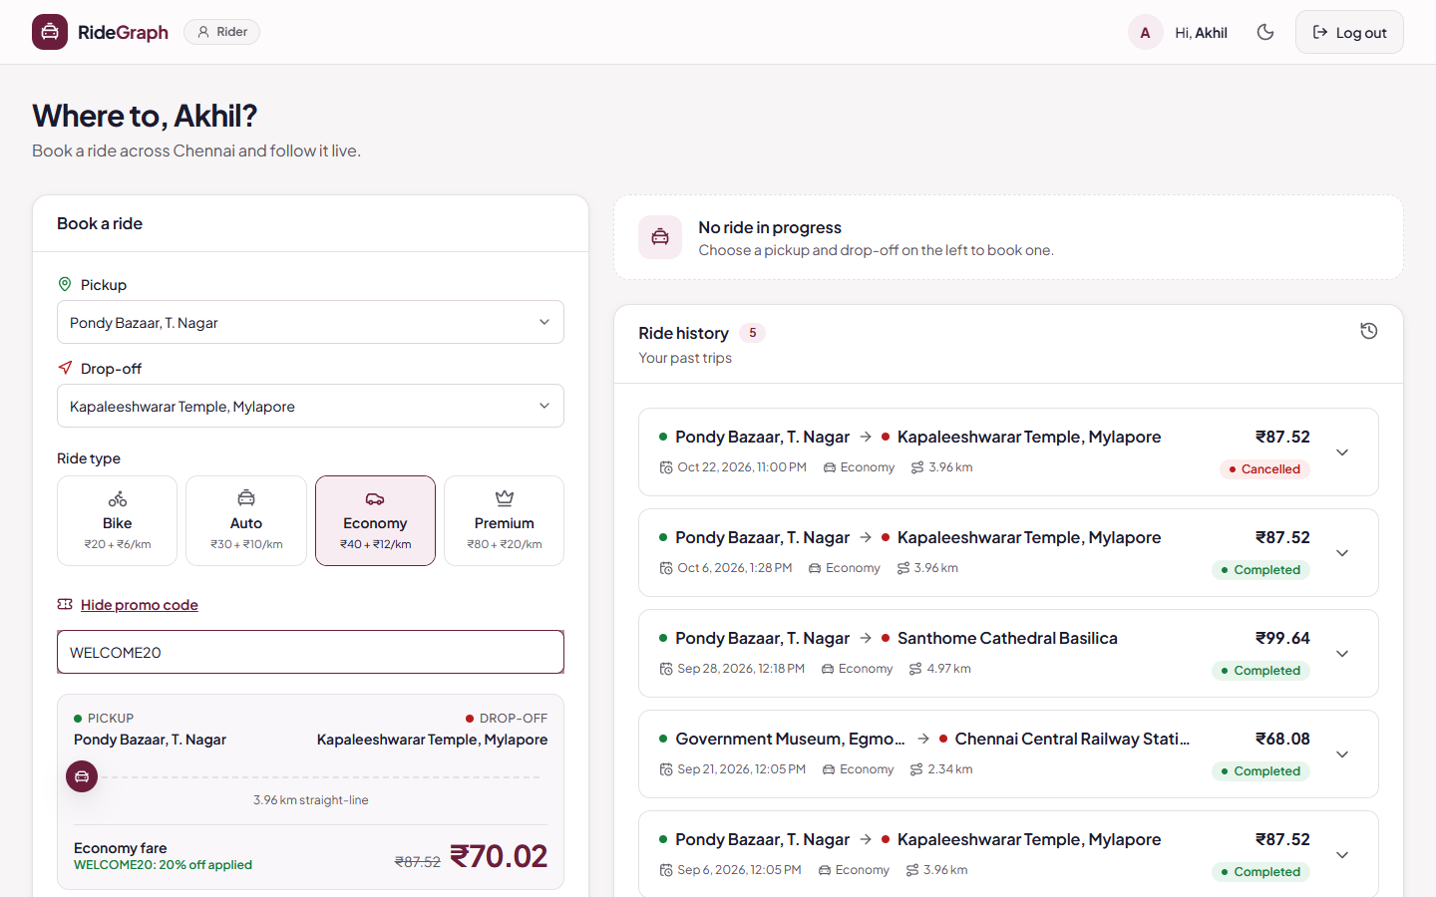
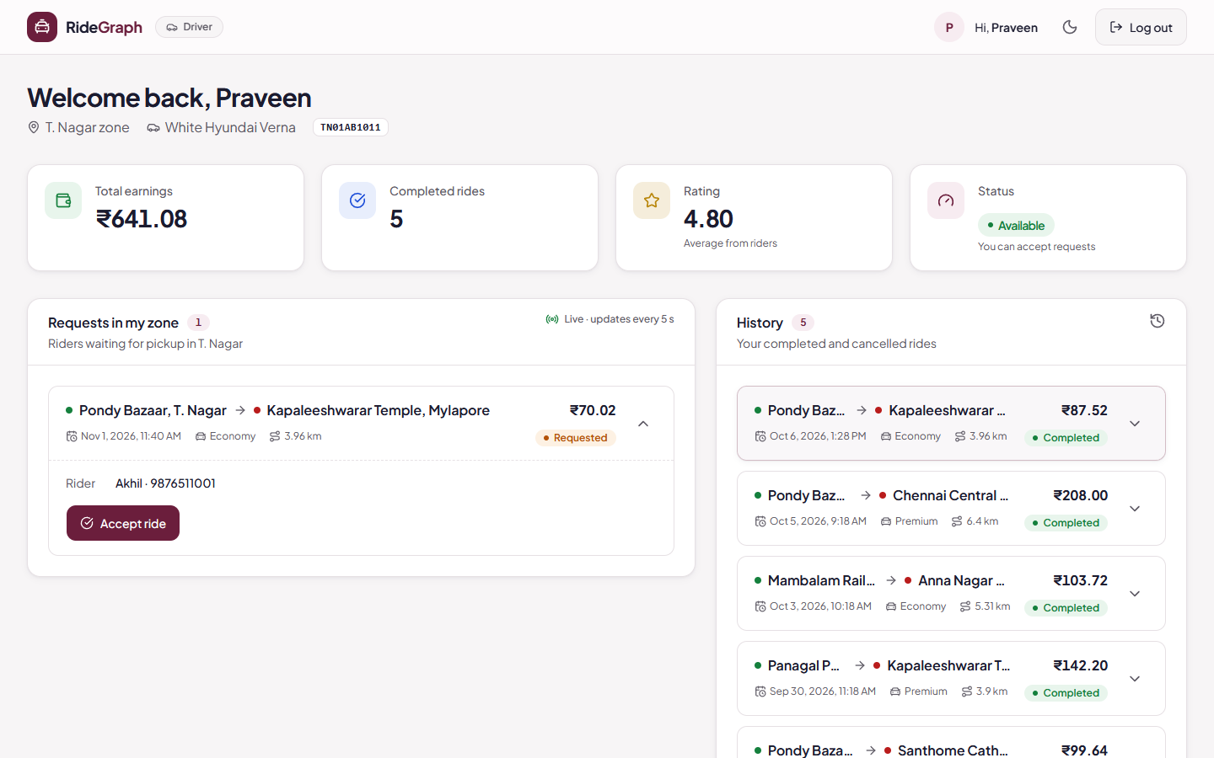
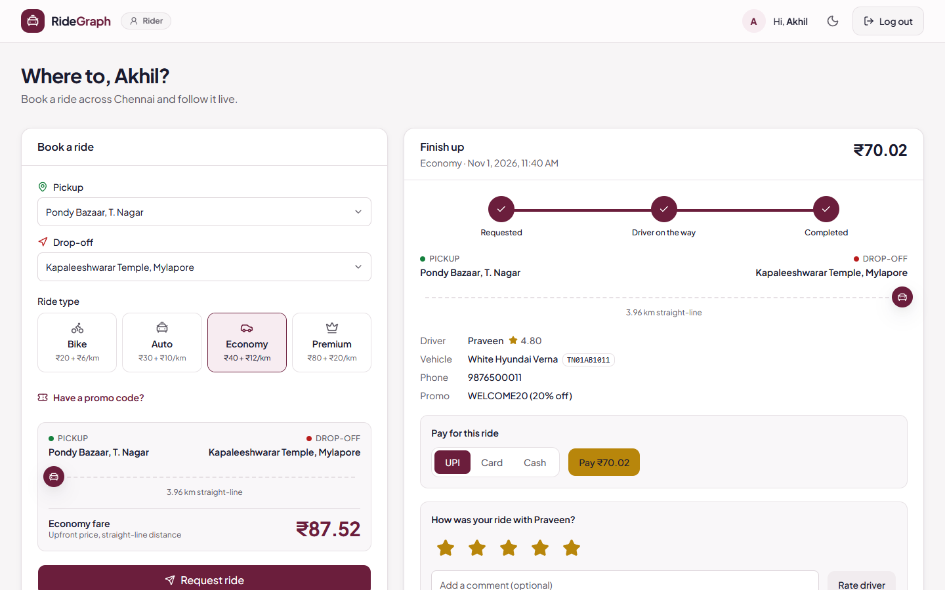
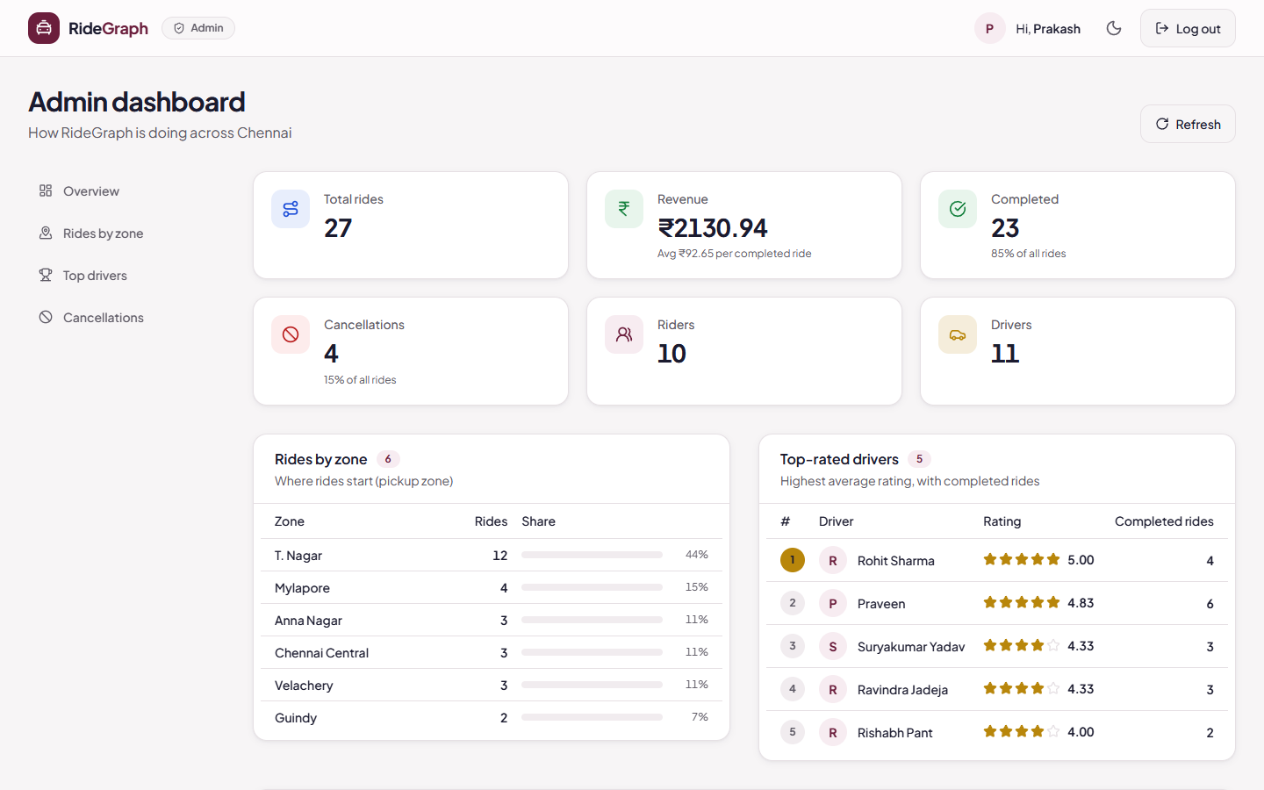
The working application
Screens captured from the running app on the seeded Chennai data
Rider: fare estimate with WELCOME20 (₹87.52 → ₹70.02)
Driver: open request in own zone (T. Nagar)
Rider: ride completed – pay and rate
Admin: rides, revenue, zones, top drivers
6

Slide 7
Testing, results and future work
Automated end-to-end tests plus database script checks
73 / 73
156
24
API checks passed
(tests/test_api.py)
Cypher statements run
without errors
seeded rides – 21 completed,
₹1,973.40 revenue
What the tests prove
Full ride life cycle: register → request → accept → complete → pay → rate
Errors handled: duplicate email (409), missing fields (400), wrong login (401), other-zone accept (403), double accept / pay / rate (409), Neo4j down (503)
Duplicate primary key rejected by a Neo4j uniqueness constraint
Limitations → future work
No JWT tokens → role-based authentication
Straight-line distance, zone = location → live GPS with Neo4j point() and a map
Simulated payments → UPI / card gateway
One-way ratings → two-way ratings, scheduling, carpooling
7

Slide 8


