Slide 1
A DATA-DRIVEN STUDY OF 12 IPL SEASONS
IPL Mini-Project
Analysing how toss, scoring trends and venue patterns
decide outcomes across IPL 2008 – 2019
Pandas · NumPy · Matplotlib · Seaborn
756
179,078
12
MATCHES
DELIVERIES
SEASONS
Mini Project | Dataset: IPL Complete (Kaggle)
Prepared by: Akhil Bedi | Course: B.Tech CSE — Data Science |

Slide 2
OVERVIEW
Project Objectives
What this analysis sets out to answer
Understand the Data
Engineer the Signals
Explore 756 matches and 179K deliveries across 12 IPL seasons to map scoring, dismissals and team form into one analysable picture.
Clean missing fields, derive over-phase, boundary flags and season integers so every later question can be answered with one groupby.
Test the Toss Theory
Translate Into Strategy
Statistically check whether choosing to field first really converts into more wins, or whether it is only folklore from commentators.
Convert the strongest pattern into ONE concrete recommendation a coach or analyst could actually use on match day.
2 / 19

Slide 3
DATASET
Dataset Overview
Two CSVs from Kaggle — match-level metadata joined with ball-by-ball data
MATCHES PLAYED
SOURCE & STRUCTURE
756
• matches.csv — one row per match: teams, toss, venue, winner, MoM.
• deliveries.csv — one row per ball: batsman, bowler, runs, wicket info.
• Merged on match id → 179,078 enriched rows for ball-level questions.
• Spans 2008–2019: pre-COVID, pre-Impact-Player era — a clean baseline.
12 IPL seasons, 2008–2019
BALLS BOWLED
179,078
Every legal & extra delivery captured
JOINED COLUMNS
WHY THIS DATASET WORKS WELL
39
It pairs match outcomes with ball-by-ball detail — letting us move past 'who won' into measurable cause-and-effect questions like toss impact, scoring inflation and home advantage.
After merging matches + deliveries on match id
3 / 19

Slide 4
PART A / STEP 2
Data Cleaning — Handling Missing Values
Every blank was a decision, not a delete
city (matches.csv)
Only 7 rows missing. Imputed from venue via a one-to-one map; remaining fallback set to 'Unknown' so no match is silently dropped.
player_of_match
Blank for abandoned / tied games. Filled with 'No Award' so those matches still contribute to toss and venue analysis.
dismissal_kind (deliveries.csv)
NaN simply means the batter wasn't dismissed on that ball. Re-labelled as 'not out' so groupby on dismissal types behaves correctly.
umpire3
637 missing — third umpire is often unrecorded. Left as NaN: not used downstream, and dropping rows would distort match counts.
4 / 19

Slide 5
PART A / STEP 3
Feature Engineering
New columns that turn raw rows into answerable questions
total_runs_calc
batsman_runs + extra_runs — true runs conceded per ball.
is_boundary
Flag for 4s and 6s, enabling boundary-rate analysis.
over_phase
Powerplay (1–6) | Middle (7–15) | Death (16–20).
year, month
Parsed from match date — powers all seasonal trends.
season (int)
Strings like '2007/08' normalised to 2007 for sorting.
These five derivations unlock every downstream question — scoring trend, boundary share, death-over volatility — without further joins.
5 / 19

Slide 6
PART A / STEP 4
Aggregations & Summary Statistics
What a few well-chosen groupby calls reveal
TOP 5 BATSMEN · TOTAL RUNS
BEST ECONOMY · ≥ 500 LEGAL BALLS
• V Kohli — 5,434 runs
• SK Raina — 5,415 runs
• RG Sharma — 4,914 runs
• DA Warner — 4,741 runs
• S Dhawan — 4,632 runs
• A Kumble — econ 6.58
• M Muralitharan — econ 6.70
• Rashid Khan — econ 6.73
• SP Narine — econ 6.75
• DL Vettori — econ 6.78
TOP TEAM BY WIN % · PER SEASON
2008
2009
2010
2011
2012
2013
Rajasthan Royals
Delhi Daredevils
Mumbai Indians
Chennai Super Kings
Kolkata Knight Riders
Mumbai Indians
81.2%
66.7%
68.8%
68.8%
70.6%
68.4%
2014
2015
2016
2017
2018
2019
Kings XI Punjab
Mumbai Indians
Sunrisers Hyderabad
Mumbai Indians
Chennai Super Kings
Mumbai Indians
70.6%
62.5%
64.7%
70.6%
68.8%
68.8%
6 / 19

Slide 7
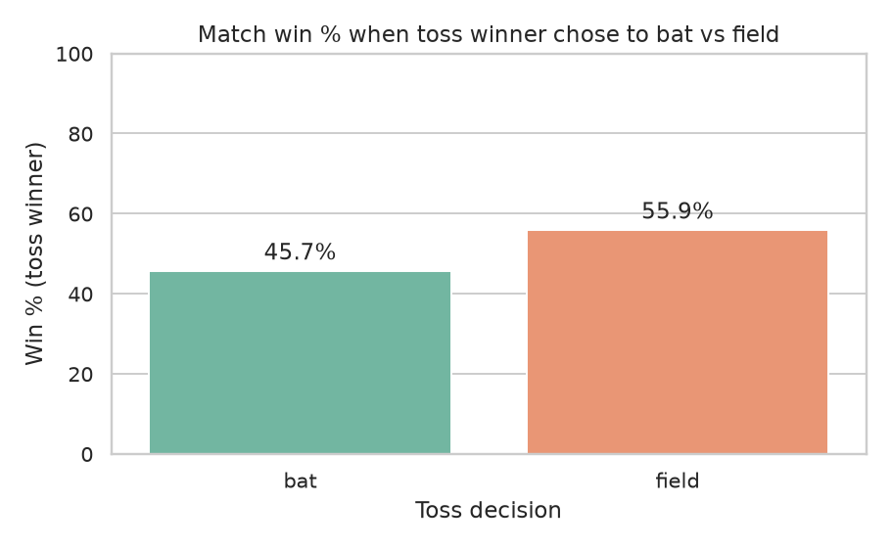
PART B / INSIGHT 1
Does Winning the Toss Actually Help?
Comparing field-first vs bat-first outcomes across 756 matches
STRONGEST EDGE FOUND
FIELD-FIRST WIN RATE
55.9%
vs. 45.7% when teams choose to bat first — a ~10-point swing.
WHY IT HOLDS
Chasing converts the target into a clear ball-by-ball plan, dew on evening pitches makes the ball skid on, and the second-innings surface usually plays slightly better than the first. The pattern is consistent across nearly every season after 2013.
7 / 19

Slide 8
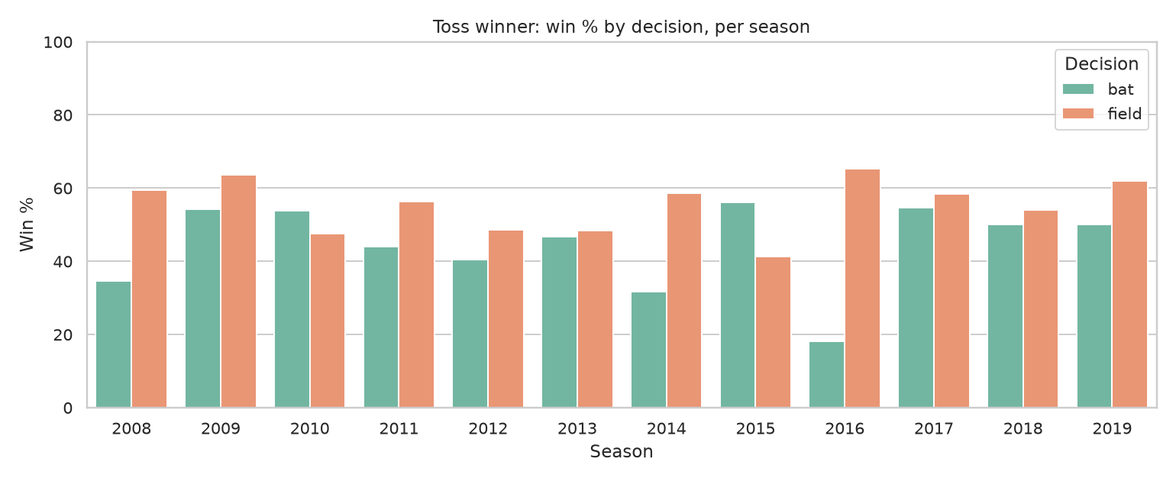
PART B / INSIGHT 1
Toss Decisions Over Time
How captains' field-first preference grew season after season
Before 2013 captains split roughly 50/50. After 2013, field-first becomes the default — confirming the trend is behavioural learning, not random variance.
8 / 19

Slide 9
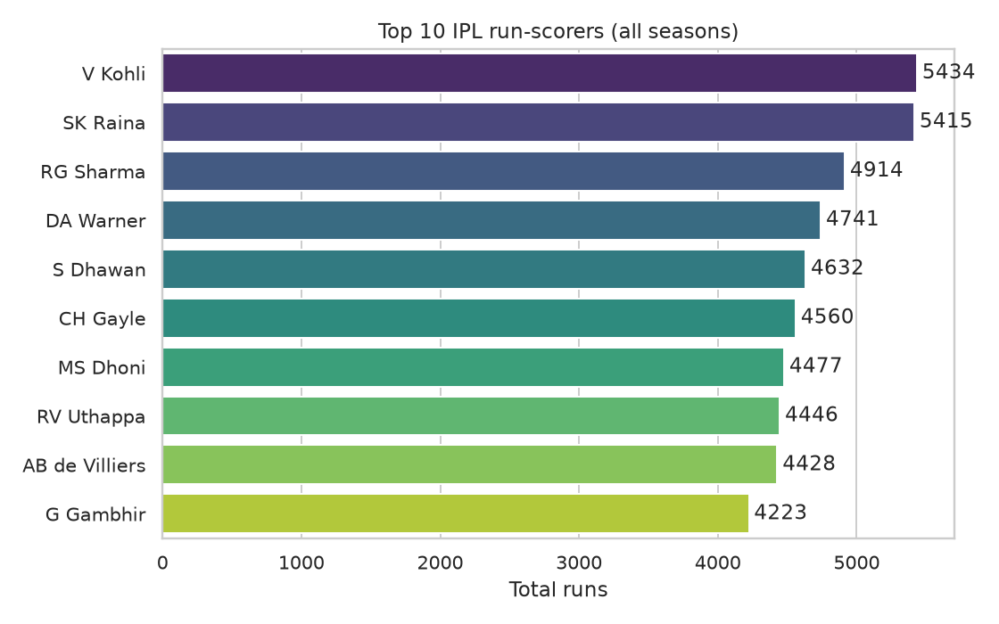
PART B / INSIGHT 2
Top Run-Scorers of the IPL
Who consistently put runs on the board across 12 seasons
THE ELITE BAND
V KOHLI — TOTAL RUNS
5,434
Leads the chart; top 10 sit between 4.2K and 5.4K — a tight group.
WHAT IT MEANS FOR STRATEGY
Almost every top-10 batter is a top-order specialist who exploits the powerplay. Teams should protect in-form openers in the order, and bowlers must plan dismissals for them inside the first six overs before they settle.
9 / 19

Slide 10
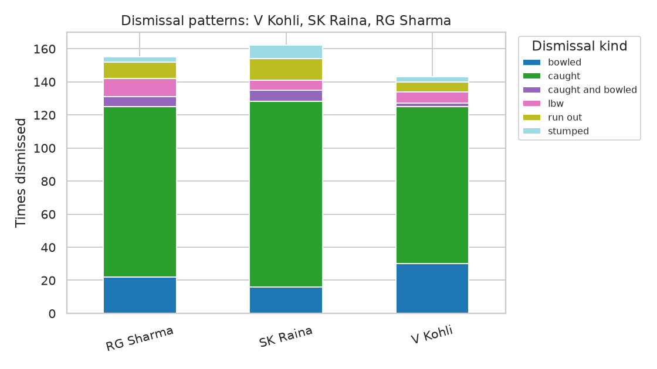
PART B / INSIGHT 2
Dismissal Patterns — Top 3 Scorers
How elite batters get out, and what bowlers can learn from it
ONE DISMISSAL DOMINATES
'Caught' is overwhelmingly the most common dismissal for Kohli, Raina and Sharma — usually on aerial shots in the middle overs.
BOWLER PLAYBOOK
• Set deep boundary riders 30/45 to bait the slog.
• Attack stumps early — 'bowled' is the #2 mode.
• Yorker / full-length in death to deny the swing.
• Avoid short into the slot for set right-handers.
10 / 19

Slide 11
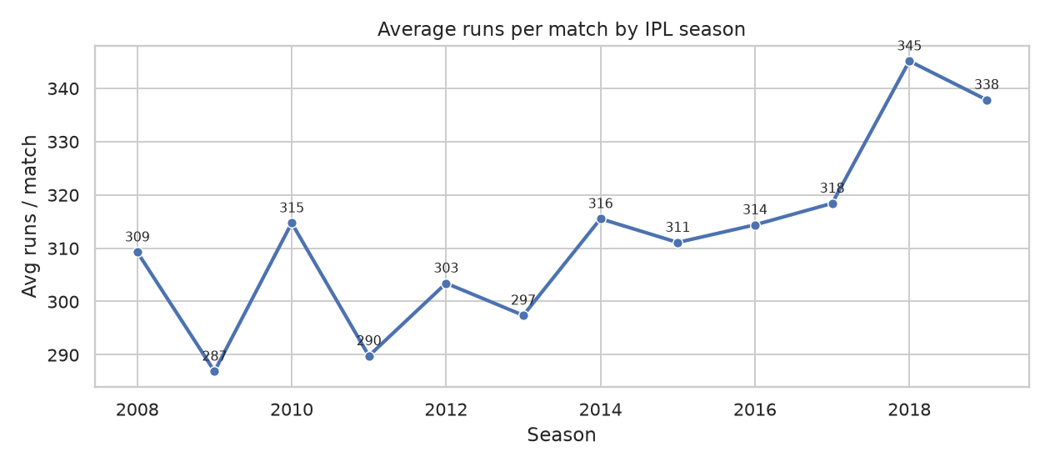
PART B / INSIGHT 3
Has Scoring Increased Over the Years?
Average runs per match, season by season
THE LEAGUE IS GETTING HOTTER
AVERAGE UPLIFT
+3.6 runs / season
Linear regression on per-season mean confirms a steady rise.
THE STORY IN NUMBERS
2008 opened at ~309 runs / match. By 2018 the league peaked near 345, settling around 338 in 2019. The IPL is measurably more high-scoring today — flatter pitches, deeper batting line-ups and shorter boundaries all compound year after year.
11 / 19

Slide 12
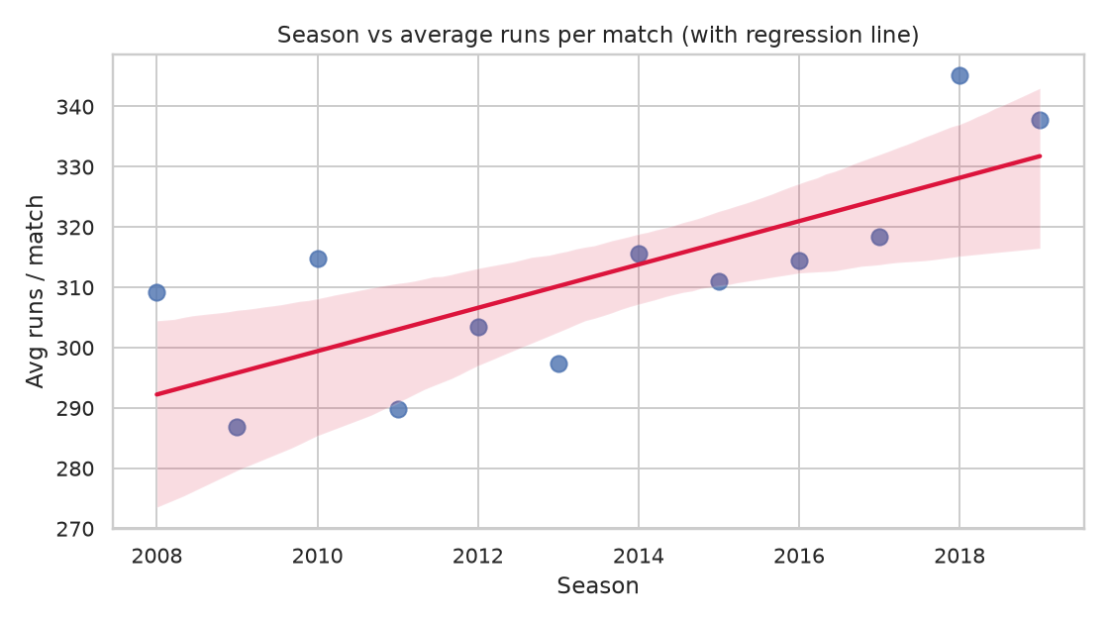
PART B / INSIGHT 3
Trend Confirmed — Linear Regression Fit
A simple regression removes the year-to-year noise
The fitted slope of +3.6 runs per season is small per year but compounds into ~40 extra runs per match across the decade — a meaningful shift for both batting plans and bowling expectations.
12 / 19

Slide 13
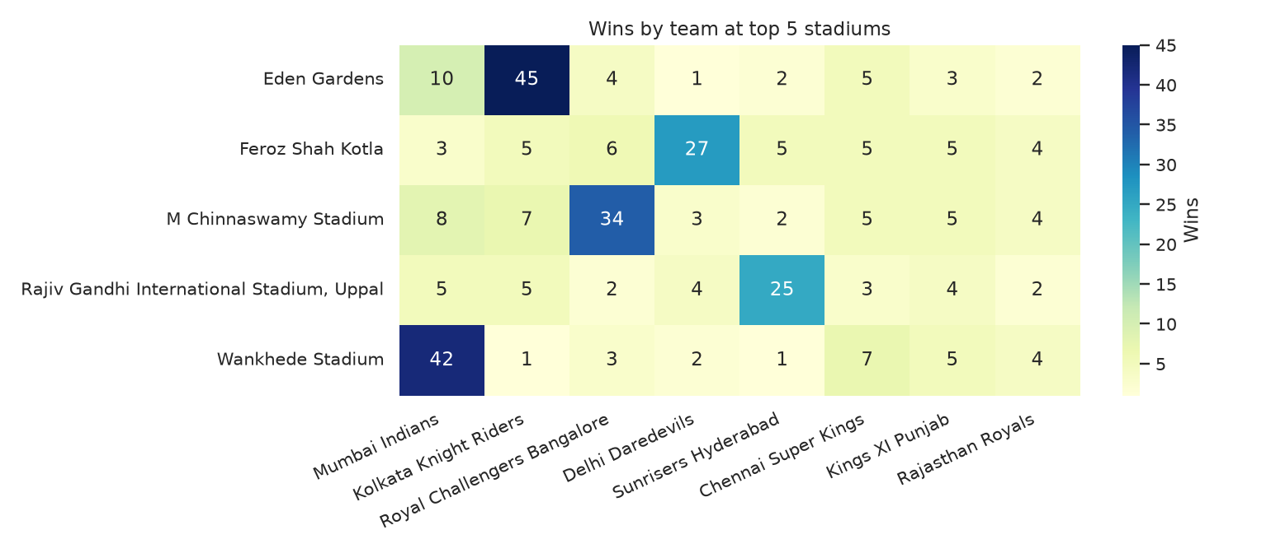
PART B / INSIGHT 4
Venue Analysis — The Home Advantage
Win-rate of home teams across the most-used IPL venues
WHERE HOME MATTERS MOST
• Chinnaswamy → strongest RCB tilt.
• Wankhede → reliable MI fortress.
• Chepauk → CSK's spin stronghold.
TAKEAWAY
Home venues aren't decorative — they shift win probability by 5–15 points. Factor each franchise's home conditions into auction picks (e.g. spinners for Chepauk, finishers for Wankhede).
13 / 19

Slide 14
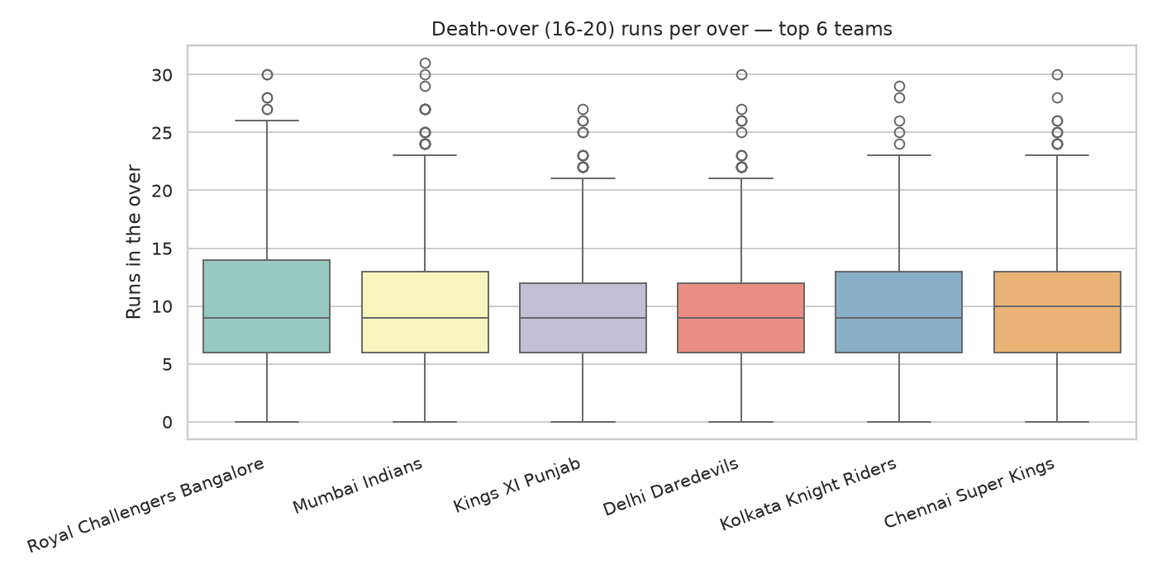
PART B / INSIGHT 5
Death-Over Performance (Overs 16–20)
Who keeps their head when the ball flies at the death
MOST CONSISTENT
CSK
Median 10 runs/over · std 5.14 — the calmest death-over unit in the league.
MOST EXPLOSIVE
RCB
Mean 10.33 runs/over · std 5.57 — bigger ceiling, bigger swings.
14 / 19

Slide 15
PART C / SYNTHESIS
Executive Summary
The single sentence that ties twelve seasons together
THE HEADLINE
Winning the toss and choosing to FIELD first delivers a ~10-point win-percentage edge — the single most actionable pattern in 12 seasons of IPL data.
WHY WE'RE CONFIDENT
• Field-first wins 55.9% of matches versus 45.7% for bat-first across 756 games.
• The effect is reinforced by a measurable +3.6 runs / season scoring uplift.
• The pattern holds in nearly every season after 2013 and across most venues.
15 / 19

Slide 16
PART C / RECAP
Key Insights at a Glance
Six findings — each tested, each ready to act on
Field-first wins ~56% of matches vs ~46% for bat-first — the strongest edge in the data.
IPL scoring is rising steadily at roughly +3.6 runs per season since 2008.
01
02
Top 5 run-scorers — Kohli, Raina, Sharma, Warner, Dhawan — are all top-order specialists.
Elite batters are dismissed mostly 'caught' — bowlers should plan for the aerial slog.
03
04
Home advantage is strongest at Chinnaswamy (RCB), Wankhede (MI) and Chepauk (CSK).
CSK is the most consistent death-over team; RCB is the most explosive but volatile.
05
06
16 / 19

Slide 17
PART C / RECOMMENDATION
One Recommendation for Team Strategy
Translating the strongest pattern into a match-day rule
THE COACHING RULE
"On winning the toss at a high-scoring or dew-prone venue — Chinnaswamy, Wankhede or Uppal — elect to FIELD first."
WHY IT WORKS — AND WHEN TO BREAK IT
• A known target lets the chase pace itself; the bowling plan becomes ball-specific.
• Evening dew makes the ball harder to grip — second-innings spin becomes less hostile.
• Reverse the rule for spin-friendly, slow tracks (e.g. Chepauk) where chasing is harder.
17 / 19

Slide 18
PART C / REFLECTION
Self-Reflection & Limitations
What this analysis can — and cannot — say
Window ends in 2019
No pitch / weather data
COVID seasons and the Impact-Player rule reshaped IPL after 2020 — our conclusions describe the pre-2020 league only.
We see WHO won and HOW MUCH was scored, but not the conditions. Dew and pitch wear are inferred, not measured.
No ball-tracking
No player metadata
Line, length and pace aren't in the dataset, so dismissal advice is directional rather than ball-by-ball prescriptive.
Salary, age and role aren't available — we can't link auction spend to on-field returns.
Next step: extend via Cricsheet to 2024, add ball-tracking, and build an over-by-over logistic win-probability model.
18 / 19

Slide 19
Thank You

