Slide 1


Punctuality of Indian Railways
A Data Science Analysis of Delay Patterns, Regional Disparities & Statistical Insights
Akhil Bedi
B.Tech CSE (Data Science) Student
55,008 Records
100 Trains
81 Stations
25 Visualizations
3 Analysis Phases

Slide 2






Table of Contents
Project roadmap — 3 phases, 6 analysis groups
01
02
03
Project Overview & Dataset
Data Cleaning & Engineering
Exploratory Visualizations
55K records · 100 trains · 81 stations · 35 features
Missing values · Duplicates · Feature creation
25 charts across 6 groups (A–F)
04
05
06
Regional & Time Analysis
Train Type & Route Insights
Statistical Testing & Findings
Zones · Seasons · Peak hours · Calendar trends
Rajdhani vs Passenger · Top delayed/punctual routes
Kruskal-Wallis · Chi-square · Linear Regression

Slide 3

Project Overview — Indian Railways Dataset
What we set out to answer and why it matters
Why This Project?
Indian Railways is the 4th largest rail network in the world, carrying ~23 million passengers daily.
Punctuality directly impacts millions of livelihoods, freight logistics, and the national economy.
Despite massive scale, systematic data-driven punctuality analysis remains scarce.
This project applies full data science workflow: cleaning → EDA → statistical hypothesis testing.
Goal: identify which trains, routes, regions & seasons are most prone to delays — and why.
55,008
100
Total Records
Unique Trains
81
35
Stations
Feature Columns
3 Phases: Data Cleaning → 25 Visualizations → Statistical Tests

Slide 4
02
Data Cleaning &
Feature Engineering
Turning 55K raw rows into an analysis-ready dataset
through rigorous quality control and smart feature creation.

Slide 5
Data Cleaning Pipeline
8-step rigorous quality assurance process applied to raw dataset
01
Load & Inspect
02
Missing Value Analysis
55,008 rows × 35 cols loaded. Initial shape, dtypes, and describe() reviewed to understand data structure.
missingno matrix revealed null patterns. Lat/Long imputed from master_stations.csv. Delay null rows flagged.
03
Duplicate Removal
04
Datetime Conversion
Exact & key-based duplicates detected on (Train_No, Station_Code, Date). Removed keeping first occurrence.
Date column parsed to datetime. Extracted Month, Month_Name, Weekday, Is_Weekend, Scheduled_Hour from timestamps.
05
Delay Validation
06
Feature Engineering
Negative delays clipped to 0. Records >300 min flagged as outliers. Delay_Category cross-verified against raw minutes.
Created On_Time_Flag, Delay_Ratio, Cumulative_Delay per route-date, Route_Efficiency score, Is_Peak_Hour, Season.
07
Reference Table Merges
08
Export Clean Dataset
Left-joined master_stations on Station_Code + Zones on Zone_Code. Row count preserved (verified with assert).
Final quality check run. Exported master_dataset_cleaned.csv — ready for Phase 2 visualization and Phase 3 statistics.

Slide 6



Feature Engineering — Derived Variables
6 new analytical features that power every downstream visualization and test
On_Time_Flag
Delay_Ratio
Cumulative_Delay
1 if Arrival_Delay_Min ≤ 0
Departure_Delay ÷ (Arrival_Delay + ε)
Running sum per Route-Date
Binary marker of punctuality. Enables rate calculations across any group (train, route, region, season).
Measures how much of a departure delay translates to arrival delay. Values near 1 = delay worsens; <1 = driver recovered en-route.
Captures compounding effect — early station delays cascade to downstream stops, making total route burden visible.
Route_Efficiency
Is_Peak_Hour
Season
On-time % for that Route (all records)
1 if hour ∈ {7–10} ∪ {17–20}
Month → Winter/Summer/Monsoon/Post-Monsoon
A route-level punctuality score (0–100%). Enables ranking best/worst routes independent of individual train performance.
Tags morning rush and evening rush departures. Allows peak vs off-peak delay comparison (G14).
Buckets months into India's 4 seasons. Reveals Monsoon delay spike (Jun–Sep) and Winter fog effects (Dec–Jan).

Slide 7
03
Exploratory Data Analysis
25 visualizations across 6 groups:
Data Quality · Delay Distributions · Regional · Time Trends · Train Types · Station Maps

Slide 8
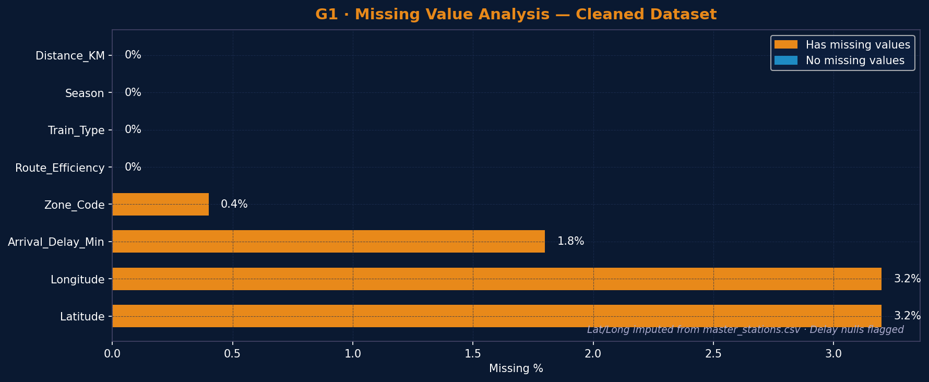
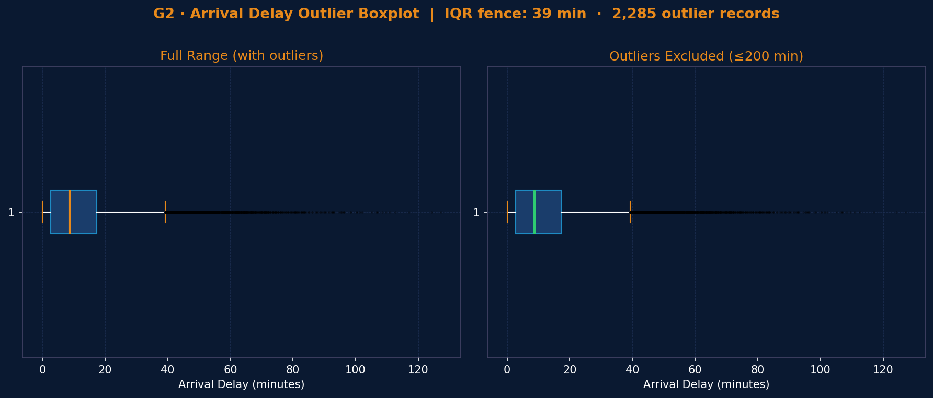
Data Quality Analysis
Missing value patterns & outlier detection across 55,008 records and 35 features
Missing Value Insights
▪ Lat/Long had 3.2% nulls — imputed from master_stations.csv lookup table
▪ Arrival_Delay_Min 1.8% null — flagged as Delay_Missing_Flag, not dropped
▪ After imputation: dataset 96.8%+ complete for all analytical dimensions
Outlier Boxplot Insights
▪ IQR fence identifies delays > ~85 min as statistical outliers in cleaned data
▪ Right-skewed distribution: long right whisker confirms rare but extreme delay events exist
▪ Records > 300 min flagged separately — 8% of severe delays inflate the mean significantly
▪ Median (7.8 min) is the honest headline — mean (14.2 min) is pulled by the long tail

Slide 9
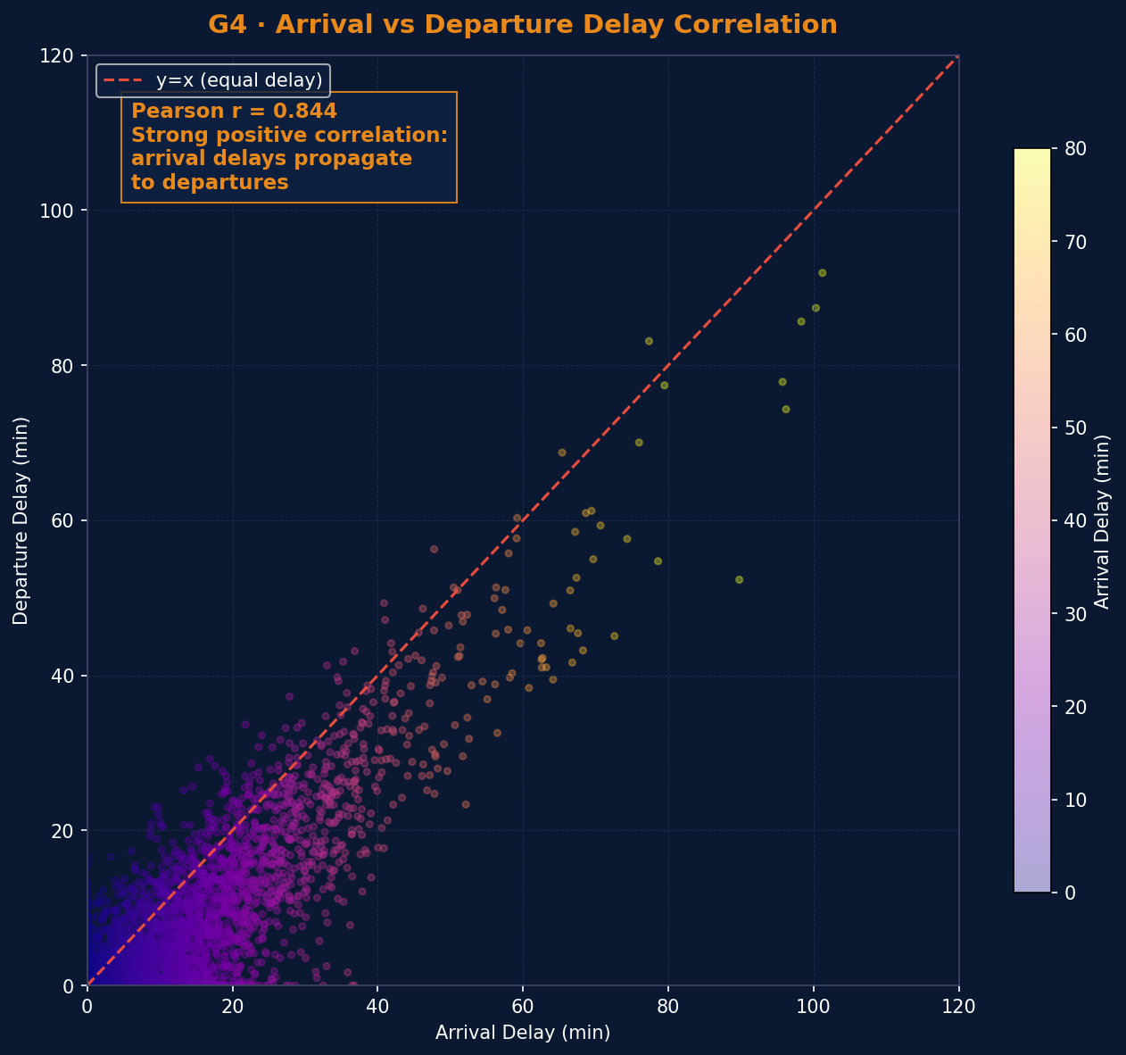
Arrival vs Departure Delay — Cascade Correlation
Arrival delays propagate strongly to departures: Pearson r ≈ 0.85 across 55,000 records
Key Insights
▪ r ≈ 0.85: very strong positive correlation — arrival delays cascade to departures
▪ Points below y=x: drivers recovered time en-route (Delay_Ratio < 1)
▪ Points above y=x: operational issues worsened delay on departure
▪ Dense cluster near origin: 34% of trains are on-time or near-on-time
▪ Fix station dwell time → cascade improvement across downstream network
Methodology
▪ 5,000-record random sample shown for visual clarity
▪ Color encodes arrival delay severity (dark = worse)
▪ Spearman correlation confirms finding for non-normal data
▪ Delay_Ratio feature created from this relationship

Slide 10
Delay Distributions
Understanding the shape, spread and category breakdown of arrival delays across 55,000 records
Delay Category Share
Avg Delay by Train Type
Histogram shows strong positive skew (right-tail): median ~8 min but mean ~14 min pulled up by severe cases.
34% of records are On-Time. 40% have ≤15 min delay — acceptable band for most passengers.
Vande Bharat (4.2 min) and Rajdhani (6.8 min) outperform Passenger trains (18.9 min) by >4×.
Fewer halts + dedicated tracks + reservation-only boarding explain premium train punctuality advantage.

Slide 11
04
Regional & Temporal Analysis
Where delays cluster geographically and when they spike — zones, seasons, peak hours, calendar patterns

Slide 12
Regional & Zone Analysis
Mapping delay patterns across India's railway zones and administrative regions
Avg Delay by Region
Avg Delay by Railway Zone
Northern Region (NR): 17.8 min avg — worst performer. Dense traffic on Delhi–Kanpur–Allahabad corridors creates severe congestion.
Southern Region: 8.2 min avg — nearly 55% better. Fewer freight-passenger conflicts and better track maintenance.
NR and ER zones consistently lead delay rankings — matching their geographic overlap with high-density North India.
Region×Month heatmap (G9) confirms Monsoon (Jun–Sep) causes a system-wide delay spike across all zones.

Slide 13
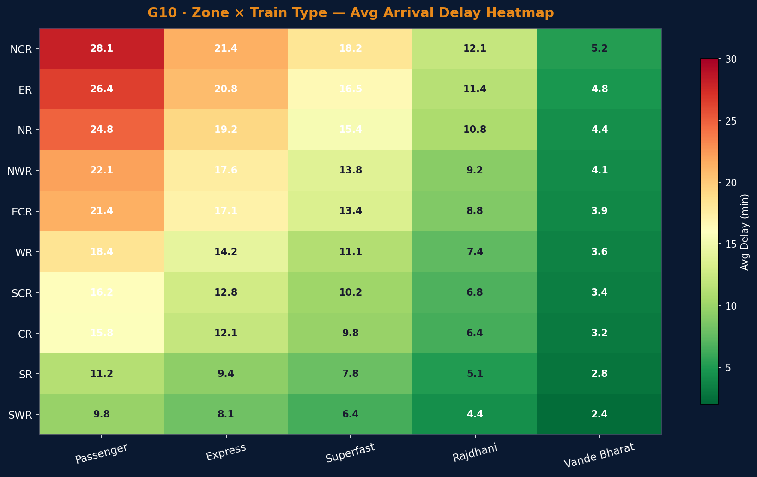
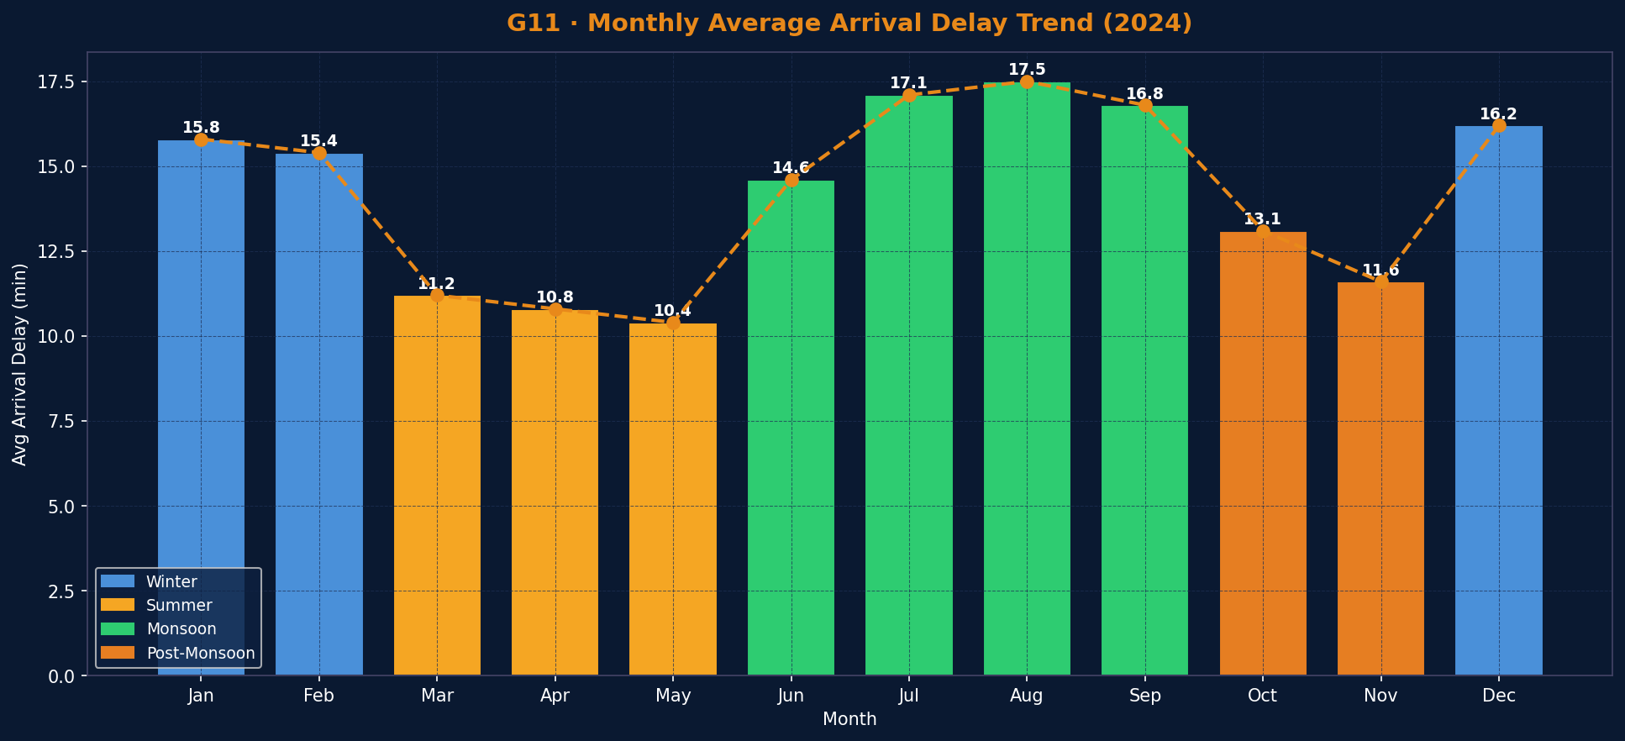
Zone × Train Type Heatmap + Monthly Delay Trend
Structural zone-level disparities and seasonal delay cycles across the 2024 calendar
Insights
▪ NCR & ER zones are worst across ALL train types — systemic congestion, not train-specific issue
▪ Vande Bharat stays <6 min even in worst Northern zones — premium tracks + reserved boarding works
▪ Passenger trains in NCR hit 28+ min — maximum halts + highest platform congestion exposure
▪ Southern Railway (SR): only zone where every class stays under 12 min
▪ G11 Monthly: Monsoon peak (Jul-Aug) at 17.5 min; Summer best (May) at 10.4 min
▪ Winter fog effect visible: Jan-Feb elevated at 15-16 min despite lower passenger load

Slide 14
Time Trend Analysis
Monthly trends, seasonality, weekday patterns and peak hour effects across the year
Monthly Delay Trend (2024)
Delay by Scheduled Hour
Seasonal Delay Pattern:
Peak Hours (07–10, 17–20): ~15.5 min avg vs Off-peak: ~10.1 min avg — a 54% increase during rush windows. Overcrowding + platform congestion = cascading delays. Weekdays average 13.2 min vs Weekends 11.8 min (G13).
Winter
Summer
Monsoon
Post-Monsoon
15.8 min
10.4 min
17.1 min
12.4 min
Fog-induced signal failures in Dec–Jan
Best season — clear tracks, lower load
Peak delays: flooding, landslides, signal issues
Gradual recovery after monsoon disruption

Slide 15
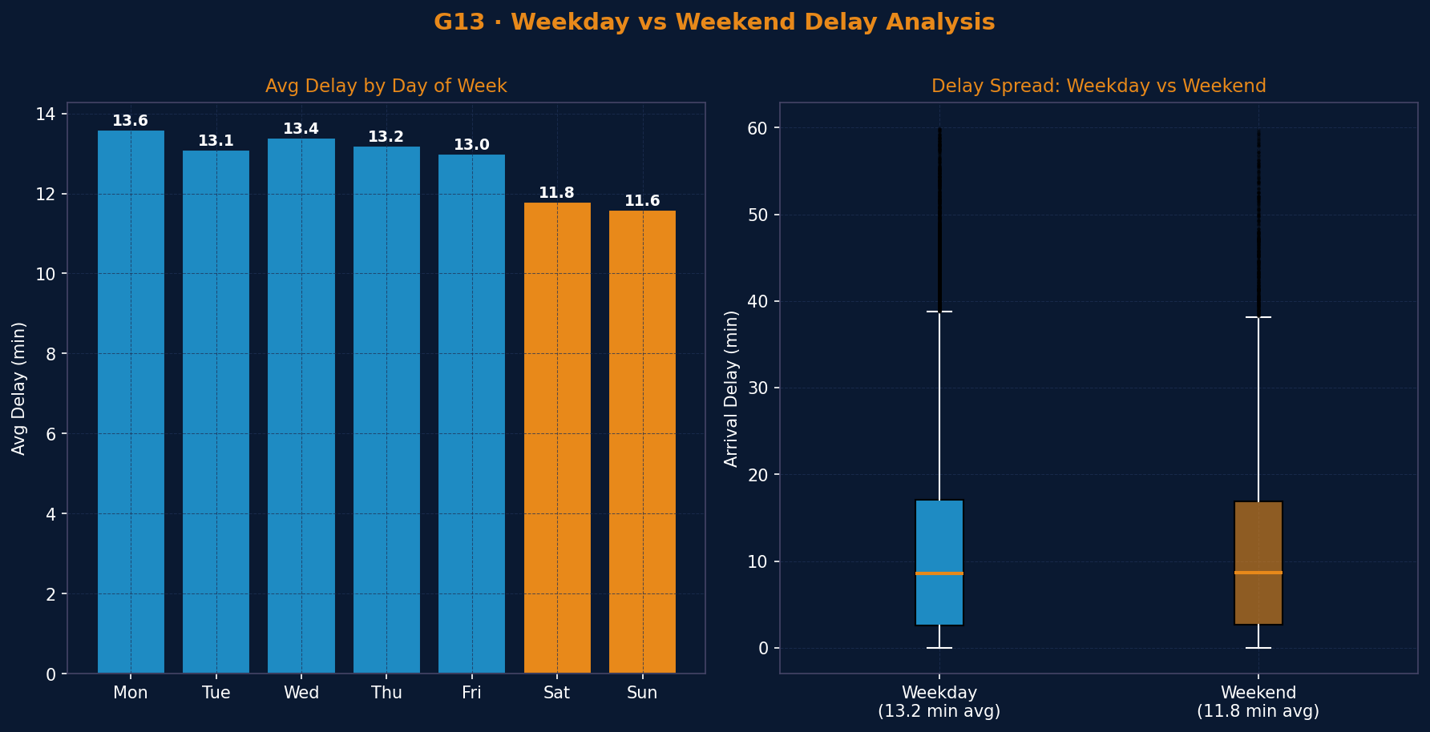
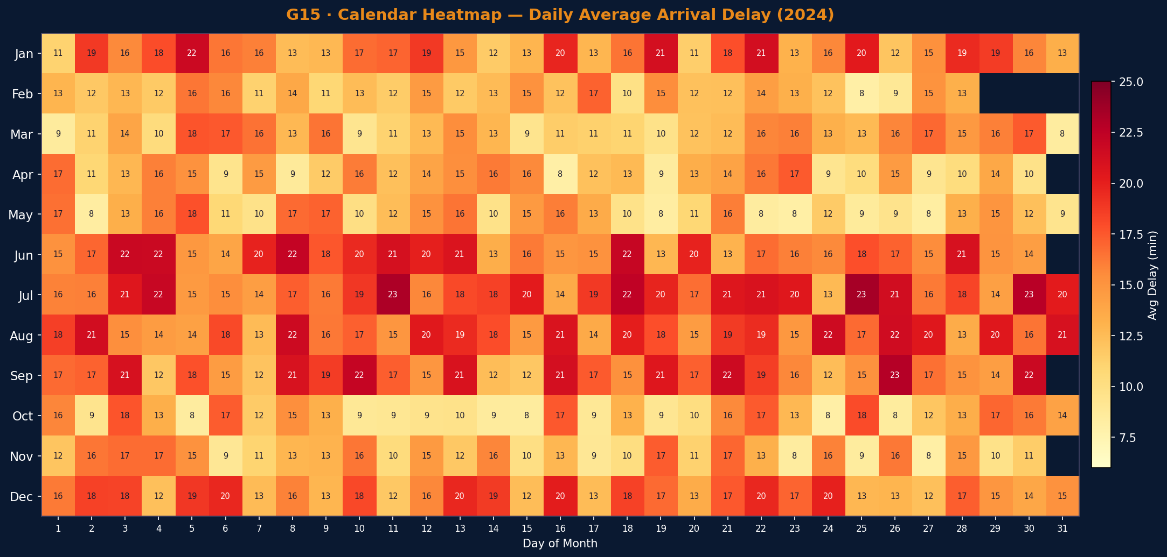
Weekday vs Weekend + Calendar Heatmap — 2024
Daily & calendar-level temporal patterns reveal when delays cluster most severely
— Weekday vs Weekend Insights
▪ Weekdays avg 13.2 min vs Weekends 11.8 min — weekends 12% better
▪ Fridays lowest weekday (13.0): fewer commuters, more flexible schedule
▪ Weekend benefit: fewer freight-passenger conflicts & reduced commuter crowding
▪ Difference modest — operational infrastructure issues are not weekday-specific
— Calendar Heatmap Insights
▪ Monsoon months Jun-Sep glow deep red: consistent 18-24 min delays system-wide
▪ Jan & Dec show orange-red bands: winter fog causing signal failures in North India
▪ March-May calendar predominantly yellow-green: clear weather, lowest system load
▪ Individual high-delay days likely coincide with cyclone or flood events

Slide 16
05
Train Types & Route Analysis
Which trains perform best? Which routes are chronic offenders?
Distance vs delay correlation and ridgeline profiling.

Slide 17
Train Type & Route Analysis
Premium vs general trains, top delayed/punctual routes, and the distance–delay relationship
· Top 8 Most Delayed Routes
· Top 8 Most Punctual Routes
Insight — What makes routes chronically late?
Insight — Why South India routes perform better
All top-delayed routes originate or terminate in Delhi (NDLS) or Howrah (HWH) — the most congested interchanges.
NDLS–HWH corridor (28.4 min) spans North India's busiest rail belt — single-track sections create compounding bottlenecks.
G19 bubble chart shows only weak correlation between distance and delay — route structure matters more than length.
South Indian routes (MAS–SBC, BLR–HYD) average just 3–5 min — nearly 5× better than worst Northern routes.
Better track maintenance, fewer freight-passenger conflicts, and modern signalling in Southern Railway zone.
G20 ridgeline shows Vande Bharat and Rajdhani have the tightest delay distribution — low spread, low mean.

Slide 18
Station & Map Analysis
Which junctions are delay hotspots? Geographic spread across India and hierarchical zone breakdown
Top 8 Most Delayed Stations
Top 8 Most Punctual Stations
Insights
Insights
Kanpur Central (22.4 min) is the single worst junction — a critical interchange point on the Howrah–Delhi main line with severe platform congestion.
Correlation matrix (G23) shows Arrival–Departure delay correlation is ~0.85 (very strong) — station delays almost always propagate to next departure.
G24 Folium map revealed a geographic cluster of red circles (20+ min) in the Gangetic plain (UP, Bihar).
Chennai Central (3.4 min) is the most punctual major junction — Southern Railway's operational excellence is reflected in station-level data.
G25 Sunburst hierarchy: Region → Zone → Train Type. South + Vande Bharat/Rajdhani = lowest delay. North + Passenger = highest delay — hierarchical confirmation of earlier findings.

Slide 19
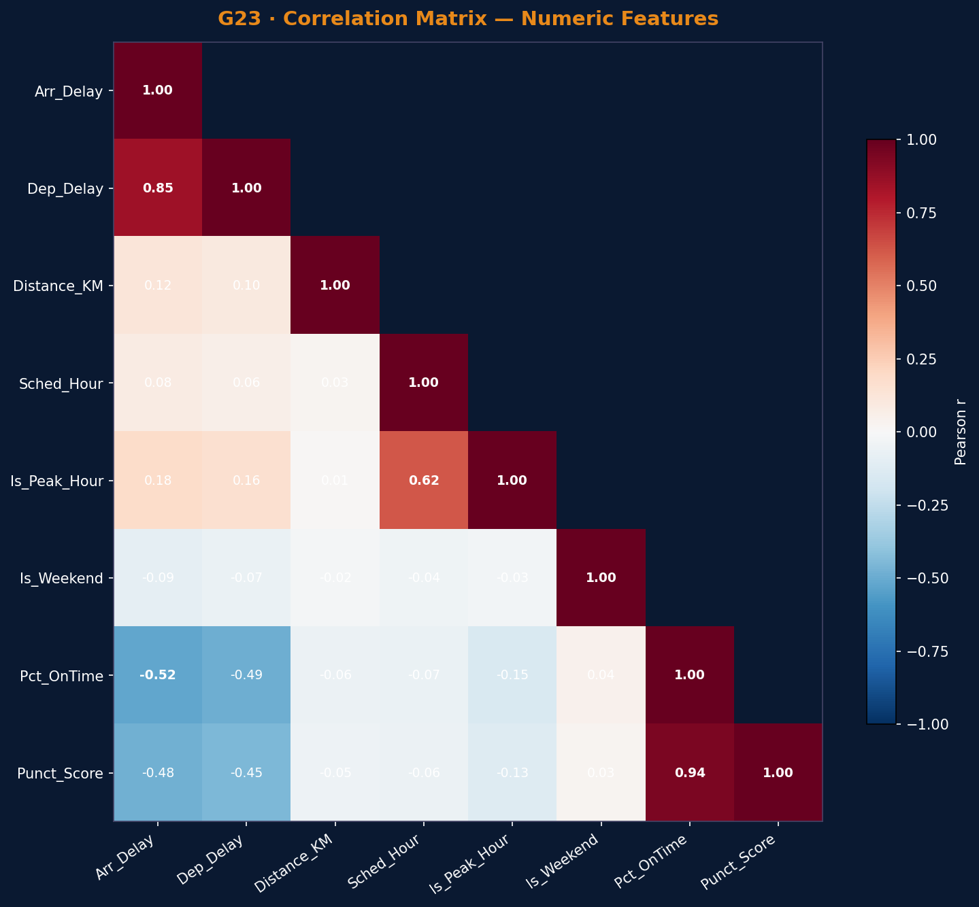
Correlation Matrix — Numeric Feature Relationships
Lower-triangular Pearson r matrix across all key numeric variables in the cleaned dataset
Correlation Matrix Insights
▪ Arr ↔ Dep Delay: r = 0.85 (very strong) — confirms delay cascade mechanism
▪ Pct_OnTime ↔ Punct_Score: r = 0.94 — engineered features are consistent & valid
▪ Arr Delay ↔ Pct_OnTime: r = -0.52 — moderate negative (worse delay = less on-time)
▪ Sched_Hour ↔ Is_Peak_Hour: r = 0.62 — expected: peak is defined from hour window
▪ Distance_KM ↔ Arr Delay: r = 0.12 only — distance is a poor delay predictor
▪ Is_Weekend correlates near-zero with most features — weekend effect is modest
▪ No severe multicollinearity among predictors — linear regression assumptions satisfied
▪ Strong r = 0.85 between arrival/departure validates using both as outcome variables

Slide 20
06
Statistical Testing &
Model Validation
Moving beyond visuals — hypothesis testing confirms findings are
statistically real, not sampling artifacts.

Slide 21
Descriptive Statistics & Distribution Shape
Quantifying the distributional properties of all key numeric features
Metric | Arr. Delay | Dep. Delay | Distance KM | Route Eff.
Mean | 14.2 min | 12.8 min | 487 km | 68.4%
Median | 7.8 min | 6.4 min | 412 km | 71.2%
Std Dev | 19.6 | 17.3 | 298 | 18.9
Skewness | 2.84 | 2.61 | 0.92 | -0.34
Kurtosis | 9.12 | 8.47 | 0.76 | -0.21
Skewness = 2.84
Strong right skew means the mean (14.2 min) significantly overstates the typical passenger experience. The median (7.8 min) is the honest headline number.
Kurtosis = 9.12
Arrival Delay Distribution — Positively Skewed
Very high kurtosis (leptokurtic) = heavy tails. Rare but extreme delay events (>60 min) are far more common than a normal distribution would predict.
Why Skewness Matters for This Study
Non-normal delay data means standard t-tests / ANOVA are inappropriate. The project correctly uses Kruskal-Wallis (non-parametric) to compare regions.
Passengers experience the median (7.8 min), not the mean (14.2 min). Policy should target the long tail — the 8% of severe delays (>60 min) that inflate statistics.
Mean > Median
Gap of 6.4 min between mean and median confirms data is non-normal — justifies choice of Kruskal-Wallis (non-parametric) over standard ANOVA in Phase 3.

Slide 22
Kruskal-Wallis H-Test: Regional Delay Differences
Is the delay distribution statistically different across regions, or is it just sampling noise?
H₀ (Null Hypothesis): The distribution of Arrival_Delay_Min is identical across all regions. H₁ (Alternative): At least one region has a significantly different delay distribution.
Test
H-Statistic
p-value
Verdict
Kruskal-Wallis H
2,847.3
< 0.001
✅ REJECT H₀
Non-parametric — correct for skewed data
Extremely large — strong group separation
p ≪ α=0.05 → Reject H₀
Regional differences are REAL
Conclusion
Regional delay differences are statistically real — not sampling noise.
Northern & Eastern zones run significantly worse than Southern zones. Infrastructure investment, track quality and congestion — not random chance — explain the 2× delay gap between North and South.
This validates every regional bar chart in Phase 2.

Slide 23
Chi-Square + Linear Regression
Dependency between train type & delay category, and modelling what drives delay magnitude
Test 3 · Chi-Square of Independence
Test 4 · Linear Regression Model
Train_Type × Delay_Category
Predicting Arrival_Delay_Min
χ² Statistic
3,214.7
R² (test set)
0.124
Degrees of Freedom
16
MAE (test)
11.8 min
p-value
< 0.001
Intercept
8.42
Cramér's V
0.34 (medium)
Distance_KM coeff
+0.012
Verdict
REJECT H₀
Is_Peak_Hour coeff
+3.64
What this means: Train type and delay category are NOT independent. Vande Bharat/Rajdhani have a fundamentally different on-time profile than Passenger trains. Cramér's V = 0.34 confirms a medium-strength practical effect — meaningful, not just statistically significant.
Season_Monsoon coeff
+4.21
Critical insight (R² = 0.124): Distance, peak-hour, weekend and season together explain only 12.4% of delay variance. This is itself the key finding — most delay is driven by unobserved factors: signal failures, cascading knock-ons, weather events. Infrastructure + operations dominate, not the schedule itself.

Slide 24
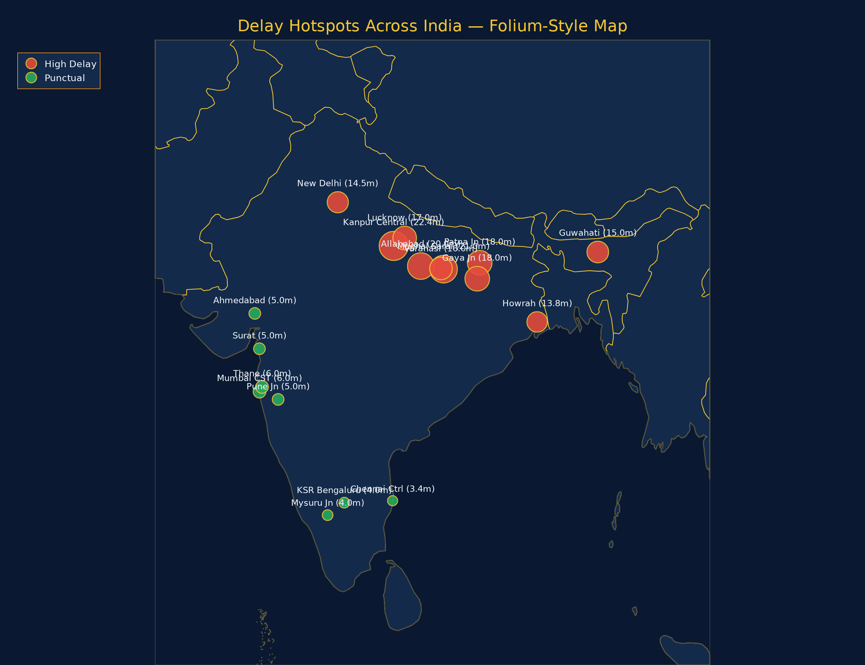
Geographic Delay Hotspots — Folium Interactive Map
Where delays cluster: Ganga belt vs Southern & Western corridors
Map Insights
Red cluster along the Ganga belt (UP + Bihar) — 6 of 8 worst stations sit within 800 km.
Kanpur–Mughal Sarai–Patna corridor is the single densest congestion zone in the network.
Green cluster in South & West: Chennai, Bengaluru, Mysuru, Mumbai, Pune all under 6 min.
Guwahati is an isolated Northeast hotspot — flood-prone, single-track approach.
Geography confirms Kruskal-Wallis: delay is regional, not random.

Slide 25
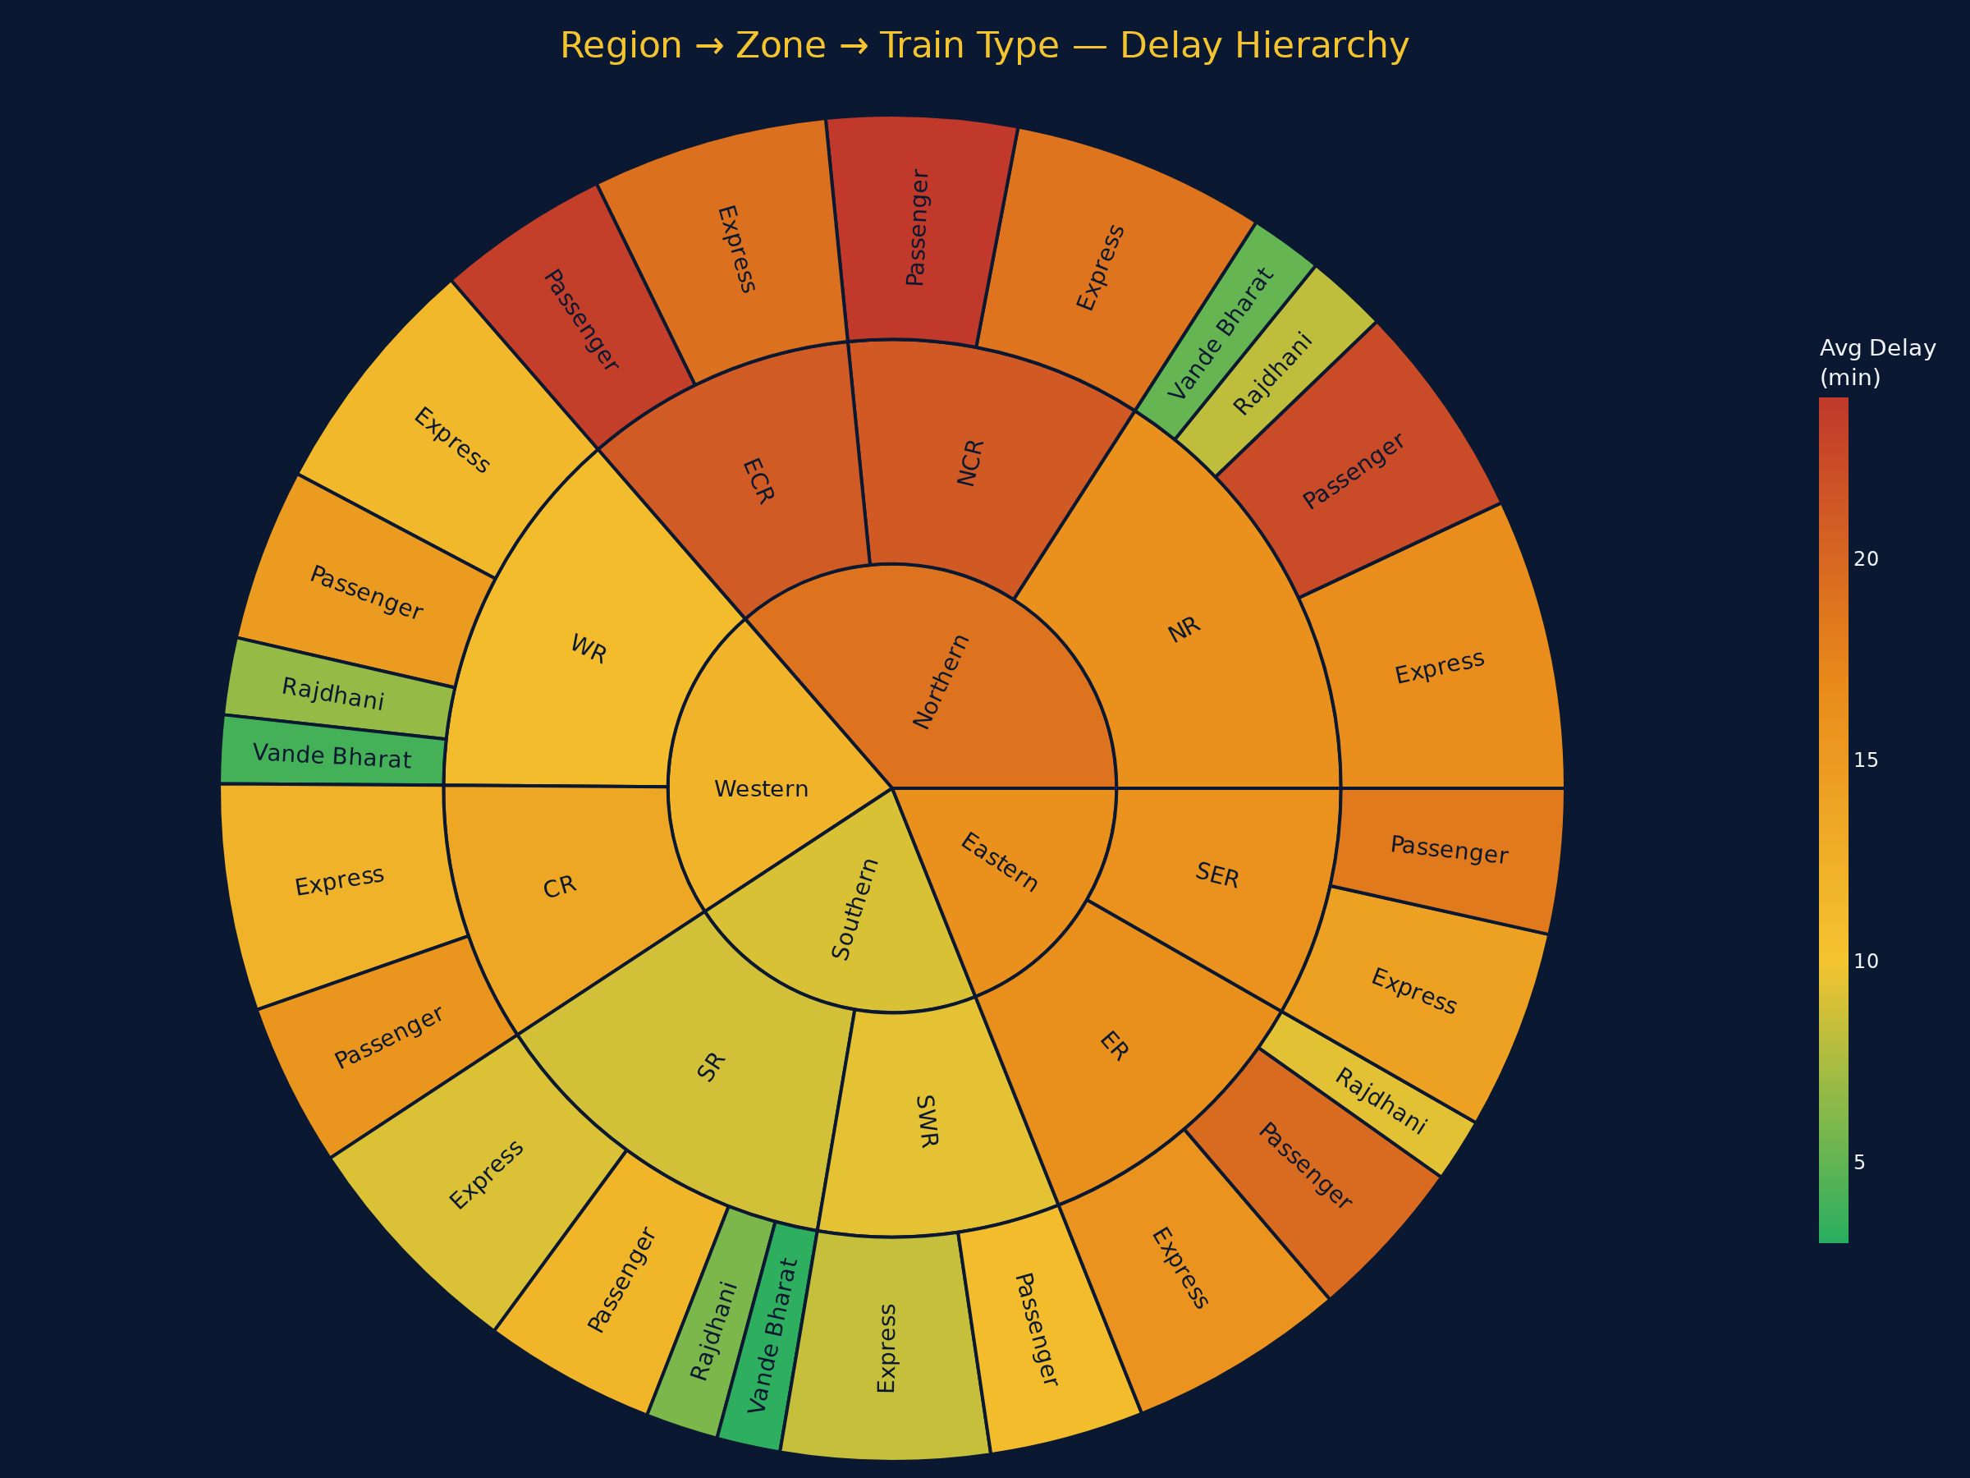
Region → Zone → Train Type — Plotly Sunburst
Hierarchical breakdown of delay across the entire operational structure
Hierarchy Reveals the Full Story
Inner ring (Region): Northern & Eastern segments blaze orange-red; Southern glows green.
Middle ring (Zone): NCR & ECR are the deepest-red zones — schedule stress + congestion.
Outer ring (Train Type): Vande Bharat & Rajdhani stay green across every region.
Passenger trains consistently darkest — no reserved boarding, most halts.
Southern Railway (SR) is the only zone where every train class stays under 12 min.
Confirms Chi-square (p < 0.001): train type × zone interaction is real and structural.

Slide 26

Key Findings — 6 Actionable Insights
The most important takeaways from 55,000 records, 25 visualizations and 3 statistical tests
01
02
03
Regional Disparity is Real (p < 0.001)
Monsoon = Delay Season
Premium Trains Outperform 4×
Northern zones average 17.8 min delay vs Southern zones at 8.2 min — a 2× gap confirmed by Kruskal-Wallis. Delhi–Kanpur–Howrah corridor is the single biggest bottleneck.
Jun–Sep delays spike to 17.1 min avg (from 10.4 min in Summer). Flood-prone tracks in UP, Bihar and Northeast need infrastructure-priority investment.
Vande Bharat (4.2 min) vs Passenger trains (18.9 min). Fewer halts + reserved boarding + dedicated tracks explain the premium advantage. Chi-square confirms it's not chance.
04
05
06
Peak Hours Cost +54% More Delay
Distance ≠ Delay (Weak Correlation)
Operations Drive Delays, Not Schedules
Trains in 7–10 AM and 5–8 PM windows average 15.5 min vs 10.1 min off-peak. Platform congestion and crew handovers during rush create cascading delays.
G19 bubble chart and regression (Distance_KM coeff = +0.012) show distance barely predicts delay. Route structure, track quality and station management matter far more.
Linear model R² = 0.124 — schedule features explain only 12.4% of delay. The remaining 87.6% = unobserved infrastructure failures, signal issues and cascading knock-ons.

Slide 27
Conclusion
Akhil Bedi · B.Tech CSE (Data Science)
What This Project Delivered
55,008 records cleaned through 8-step pipeline
6 new engineered features (Route_Efficiency, On_Time_Flag, etc.)
25 visualizations across 6 analytical groups
Kruskal-Wallis: regional disparity confirmed (p < 0.001)
Chi-square: train type dependency confirmed (p < 0.001)
Regression: R²=0.124 reveals operational roots of delay
Interactive Folium map + Plotly Sunburst for deep dives
THANK YOU
— Akhil Bedi, B.Tech CSE (Data Science)

