Slide 1
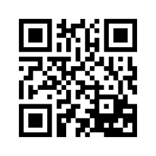
Word of the day - | Adequate
Meaning | Satisfactory or acceptable in quality or quantity.
Example | The project to build a new sports center has fallen through for lack of adequate funds.
 | This paper should be adequate for your purpose.
Synonym | sufficient, enough, ample, requisite, apposite, appropriate, suitable
Pronunciation: Please scan the QR code

