Slide 1

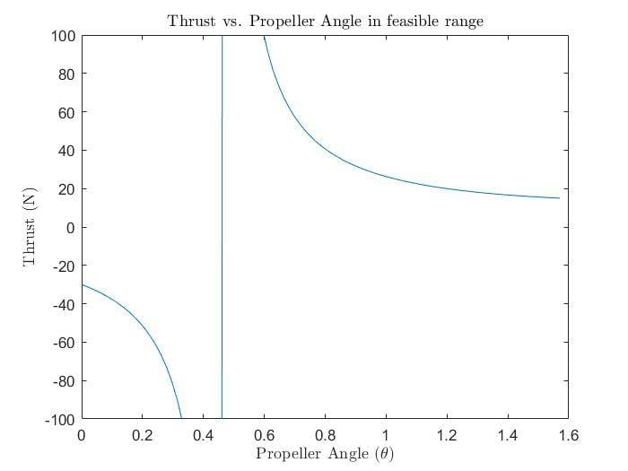
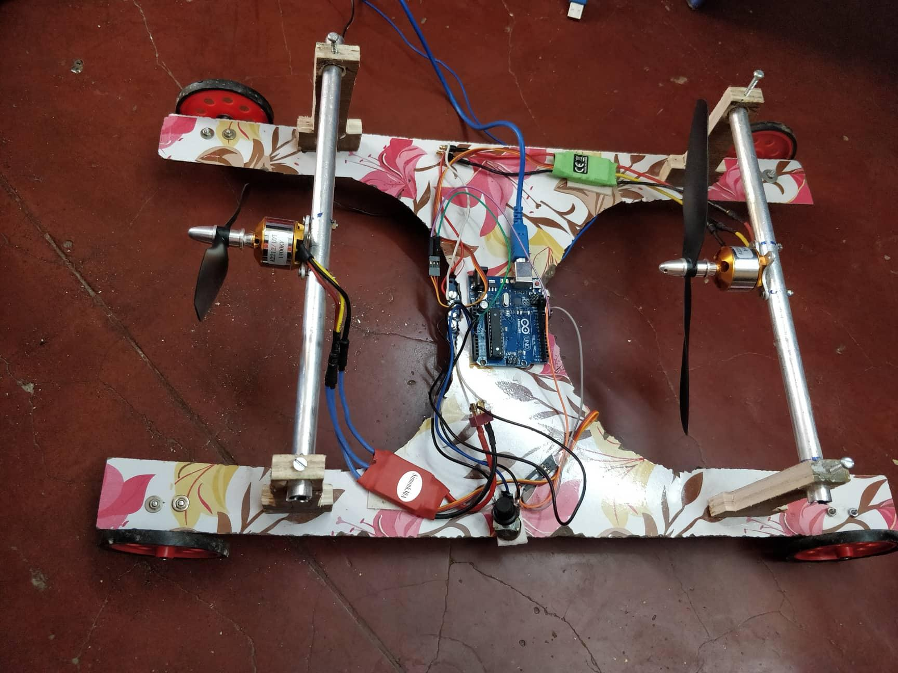
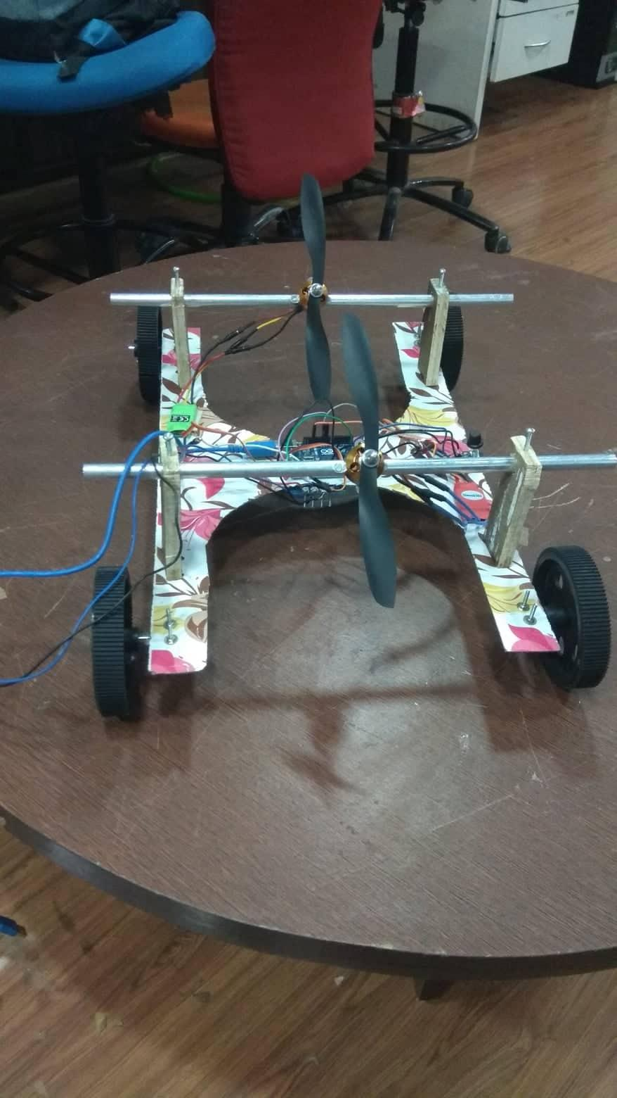
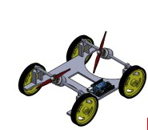
Inclined Wall Climbing Bot
ME 423 S1 Machine Design (Autumn 2018)
~Guided by Prof. Parag Tandaiya
ABSTRACT
Motivation
Mechanical Subsystem
Electrical Subsystem
Force Analysis
This wall-climbing robot is capable of climbing walls up-to inclinations of 60 degrees. The robot has two tilted propellers that provide thrust onto the wall, four wheels that are acted upon by frictional force and the body of the robot that encounters the drag force. The use of propellers over motors to provide thrust onto the inclined wall ensures that the robot is able to traverse without getting toppled. The choice of an H-shaped chassis ensures that propellers do not impinge the surface while reducing the cornucopia of deadweight material.
There are a lot areas where there is a need for robots which can scale vertical walls. Some of the applications include cleaning glass panes of tall buildings or climbing structures carrying a payload. Currently, these jobs include human labour and the development of this robot will surely help reduce the dangers associated with them. Our robot is inspired by the bot named “Vertigo”, developed by the students at ETH Zurich in collaboration with Disney Research. This is a wheeled vehicle which can move on the ground as well as on rough vertical surfaces and can promise robust motion on extensive terrain shapes and environmental conditions. The primary sources for the motion of the robot are the propellers attached at the top of the vehicle which can provide sufficient thrust for directional movements as well as normal forces to utilize friction forces from rough terrains. Thus, this bot can turn out to be a useful tool to travel through urban and indoor environments. The possibility of having the propellers rotate in two directions enables the bot to even explore sharply changing terrains.
The mechanical subsystem consists of the following components:
Wooden plywood base
Four plastic wheels
Two plastic propellers
Two steel rods
Four wooden stands
Two wooden sticks
Nuts and Bolts
The electrical subsystem consists of the following components:
Two Brushless DC Motors
One Arduino UNO
One Potentiometer
Two Electronic Speed Controller (ESC)
Jumper Cable
One Li-Po 2200mAh rechargeable battery
One Power Distribution Board
CAD Model
Group Members
Akhilesh Somani
Rohit Kumar Meena
Savyaraj Deshmukh
Tarun Meena
Tejas Adsul
Acknowledgment
We thank Professor Parag Tandaiya and Teaching Assistant Ms. Gouripriya S. for their valuable feedbacks and motivation. We would also like to thank Department of Mechanical Engineering, IIT Bombay for providing financial support for the project

