Slide 1
Git (Global information trackers) & Git Hub

Slide 2
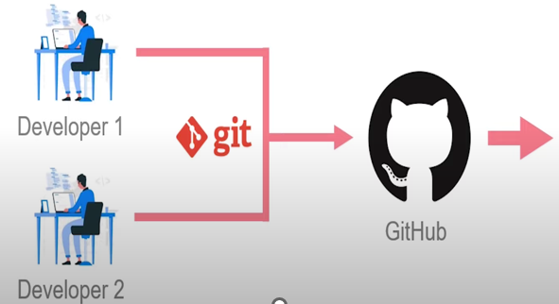
WHAT IS GIT?
Version Control System(VCS) for tracking changes in computer files.
Distributed version control
Coordinates work between multiple developers
Who made what changes and when
Revert back at any time
Local & remote repository

Slide 3
CONCEPTS OF GIT
Keeps track of code history.
Take “Snapshots” of your files.
You decide when to take a snapshot by making a “commit”
You can visit any snapshot at any time
You can stage files before commit

Slide 4
What is version control?
These days when software is developed, It is not developed with the mind set that there will only be one piece of code that will be deployed and
that’s it . These days smaller snippets of code are deployed in regular successions with regular feedback. This leads to many different version of the code.
And that creates a need to organise the code and all its different version of it. This is where version Control comes in. It is a practice of managing and storing different version of a source code.
This is specially the case with larger companies that have multiple projects and multiple team working within it.

Slide 5
Why do we need a VCS?
Just as we discussed, the purpose of version control system is as the name suggests, it controls the different version of the code.
The idea of a VCS meshes very well with the DevOps ideology. It allows for quick delivery of code and automatic job triggering.
This allows for easy automation of the whole software development pipeline.

Slide 6
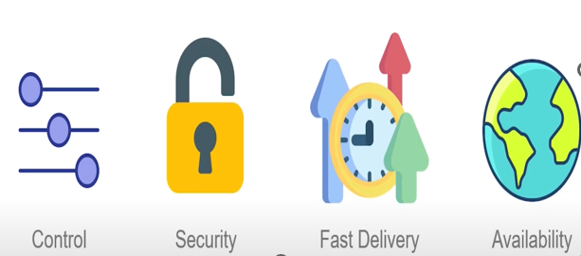
Benefit of VCS

Slide 7
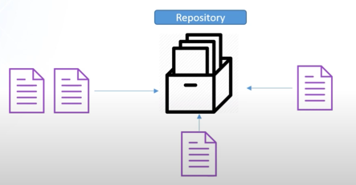
What is a Repository?
JA directory or storage space where your projects can live. It can be local to folder on your computer,
Or it can be a storage space on GitHub or another online host. You can keep code files, txt files, image files ,
You name it, inside a repository.
There are two types of repositories :
Central Repository
Local Repository
JA directory or storage space where your projects can live. It can be local to folder on your computer,
Or it can be a storage space on GitHub or another online host. You can keep code files, txt files, image files ,
You name it, inside a repository.
There are two types of repositories :
Central Repository
Local Repository

Slide 8
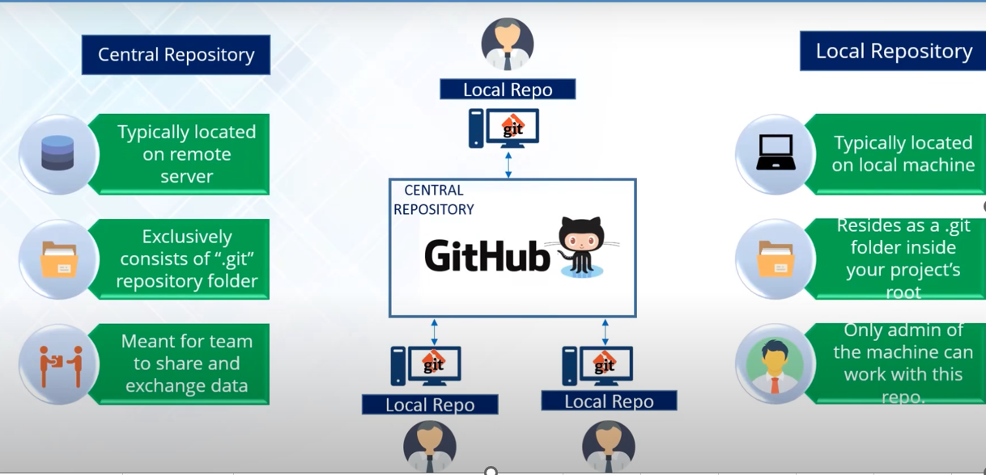
Central & Local Repository

Slide 9


Installing & Configuring Git

Slide 10
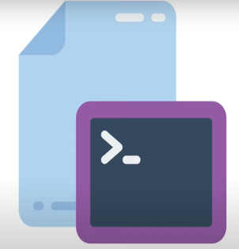
Git Basic Commands
$ git init //Initialize Local Git Repository
$ git add<file name> // Add Files to Index
$ git Status // Check status of Working Tree
$ git commit –m ‘dfdfd’ // Commit changes in index
$ git push //Push to Remote Repository
$ git pull //Pull Lates From Repository
$ git clone // Clone Repository into A New
Directory

Slide 11
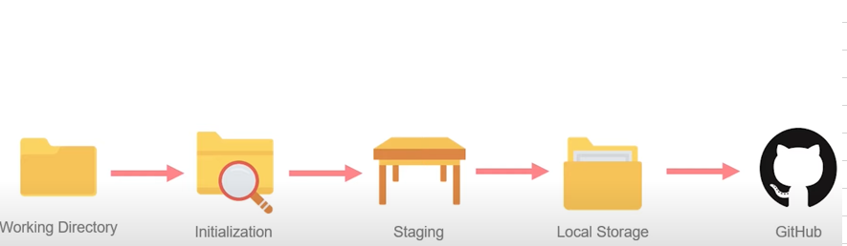
The life cycle of the code with Git

Slide 12
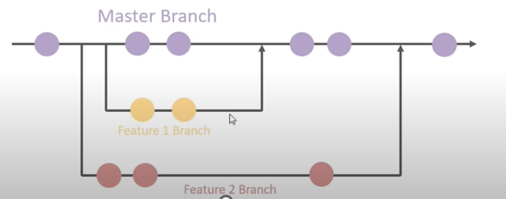
Branches
Branches allow easy management of the different parts of a software, for e.g.
Let’s say your team is working on delivering a website. This website will have different feature right? Each of these feature will be counted as branch that will merged into the master branch .
The master branch will be the one that goes into production.

Slide 13
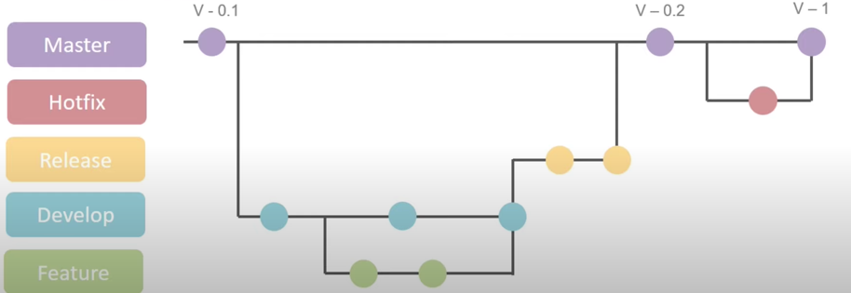
Git Workflow
Git is a powerful tool, leveraging it effectively in software development is important.
This is where the approach of the git workflow comes in. git needs to be designed.

Slide 14


