Slide 1
Comprehensive End-to-End Testing with Cypress
By Akhil Janapatla

Slide 2
Introduction
Objective:
To create end-to-end testing suite for the “Demo X-Cart” e-commerce platform that ensures functionality across critical user scenarios. Integrate the CI/CD pipelines for automation testing and deployment.
Technologies Used:
Cypress: Automated testing framework for UI and end-to-end testing
JavaScript: Main scripting language for writing test cases
Node.js: Back-end runtime environment for executing JavaScript code
Git: Version control for managing code changes
GitHub Actions(CI/CD pipeline): Continuous Integration/Continuous Deployment pipeline with GitHub Actions to automate testing and deployment

Slide 3
Key Features and Scenarios Tested
Basic Tests: Verify core functionality such as page load and essential content visibility.
Functional Tests: Simulate complete user journeys, including logging in, searching for products, adding items to the cart, and completing the checkout process.
Edge Case Tests: Evaluate how the system responds to unexpected inputs or scenarios, ensuring robust error handling.
UI and Visual Tests: Ensure that key visual components are correctly displayed and consistent across different pages.
Custom Commands: A custom command is used to streamline the code which enhances test efficiency by reducing redundancy

Slide 4
Basic Tests
Objective: Verify that the home page loads correctly with the appropriate title, URL, and content visibility.
Steps:
Visit the home page using cy.visit() to load the X-Cart demo.
Use cy.title() to confirm that the page title matches the expected value.
Check the URL with cy.url() to ensure the correct domain and path are loaded.
Ensure the main content container (the page's primary section) is visible using cy.get().

Slide 5
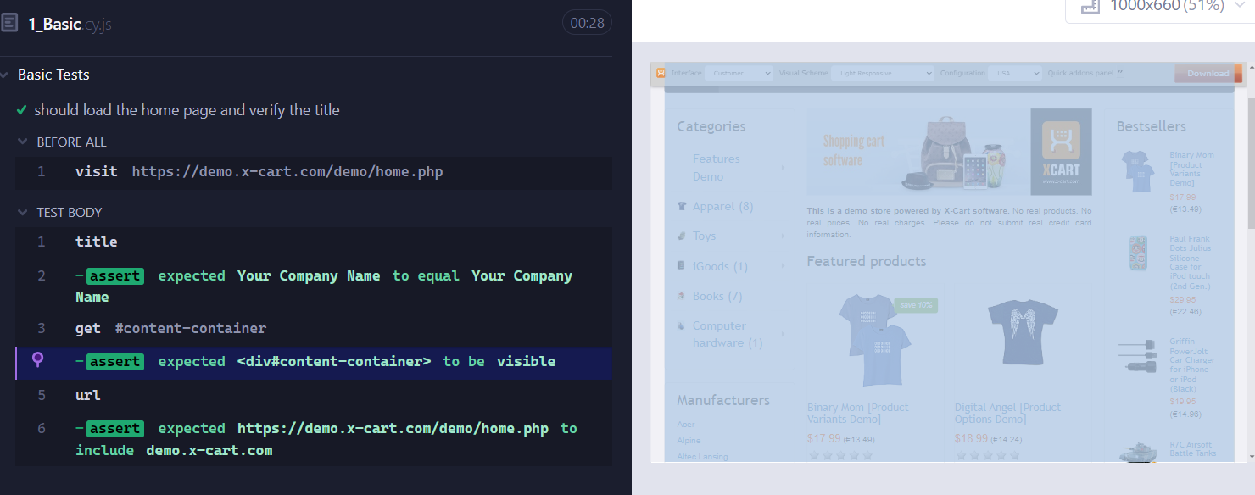
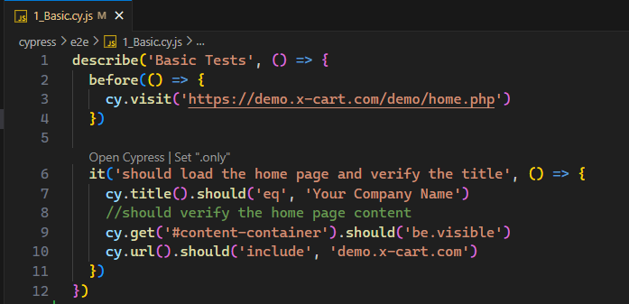
Output Obtained:
The page loaded as expected, with the title, URL, and main content all correctly displayed. This test verified that the initial page load is functioning correctly, setting the stage for further testing of functionality.

Slide 6
Functional Tests
Objective: Test the entire user journey, including logging in, searching for products, adding items to the cart, and completing the checkout process.
Steps:
Navigate to the home page and click the Sign In button to trigger the login flow.
Use the cy.login() custom command to log in with valid credentials.
Search for a product (e.g., "phone") using the search bar.
Verify that relevant product results (e.g., "Apple" phones) are displayed.
Add one of the displayed products to the cart.
Confirm that the product has been successfully added to the cart by verifying the cart status.
Proceed to the checkout page and confirm that the user can finalize the purchase by clicking the appropriate buttons.
Validate that a success message appears after completing the order.

Slide 7
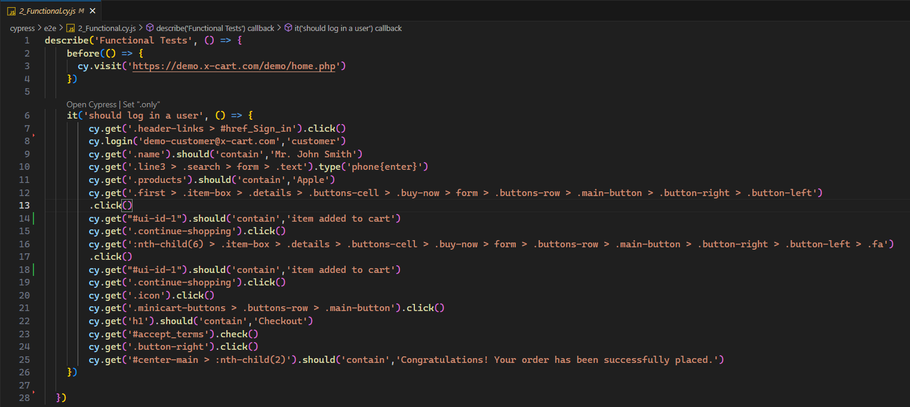
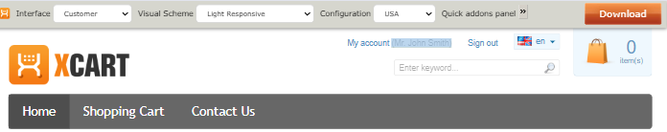
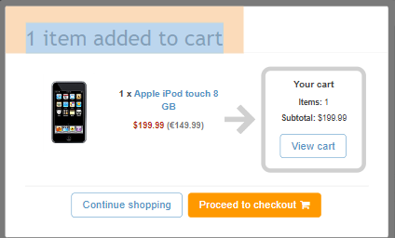
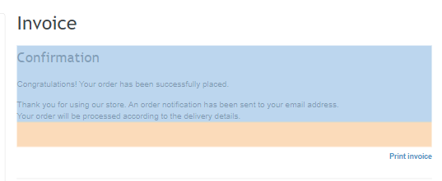
Output Obtained:
The test passed successfully. The user was able to log in, search for products, add them to the cart, and proceed through checkout to place an order. The confirmation message was displayed, confirming that the workflow functions as intended.

Slide 8
Edge Case Tests
Objective: Test how the application handles invalid form inputs and searches for non-existent products.
Steps:
Attempt to register for a new account with empty first name and last name fields.
Submit the form with an invalid email address and check for the error message.
Perform a product search for a non-existent item (e.g., "vadapaav") and observe the system's response.

Slide 9
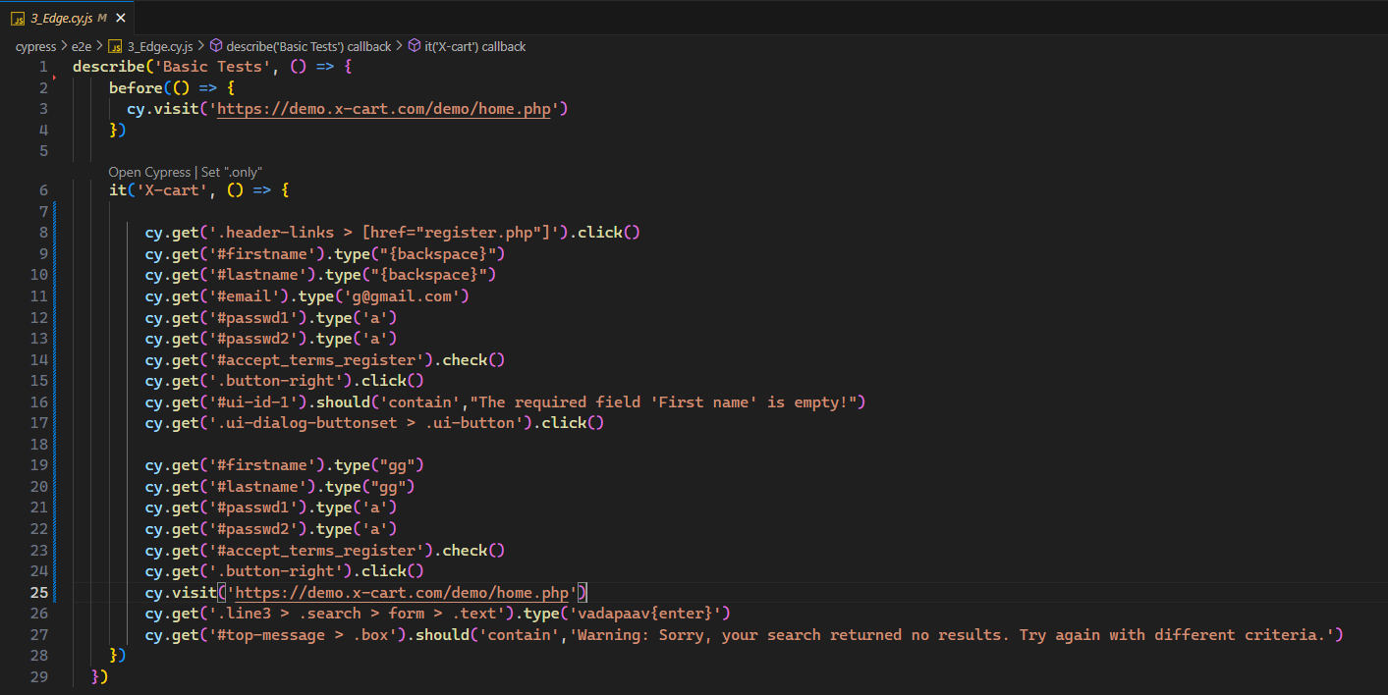
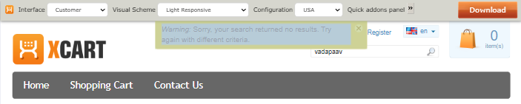
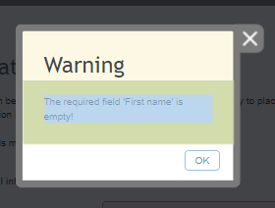
Output Obtained:
The test successfully validated the error messages for missing fields and invalid email addresses. The search for a non-existent product returned a clear warning, "Warning: Sorry, your search returned no results." This confirms that the system is robust in handling invalid inputs.

Slide 10
UI and Visual Tests
Objective: Ensure that key UI components such as the header, footer, and images are visible on the page.
Steps:
Visit the home page and check for the visibility of the header, footer, and product images.
Navigate through the site to verify consistency across different pages.
Click the sign-in button and open the login form.
Log in using the cy.login() custom command.
Verify that the user’s name is displayed in the header.

Slide 11
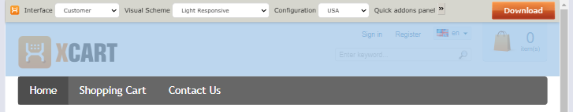
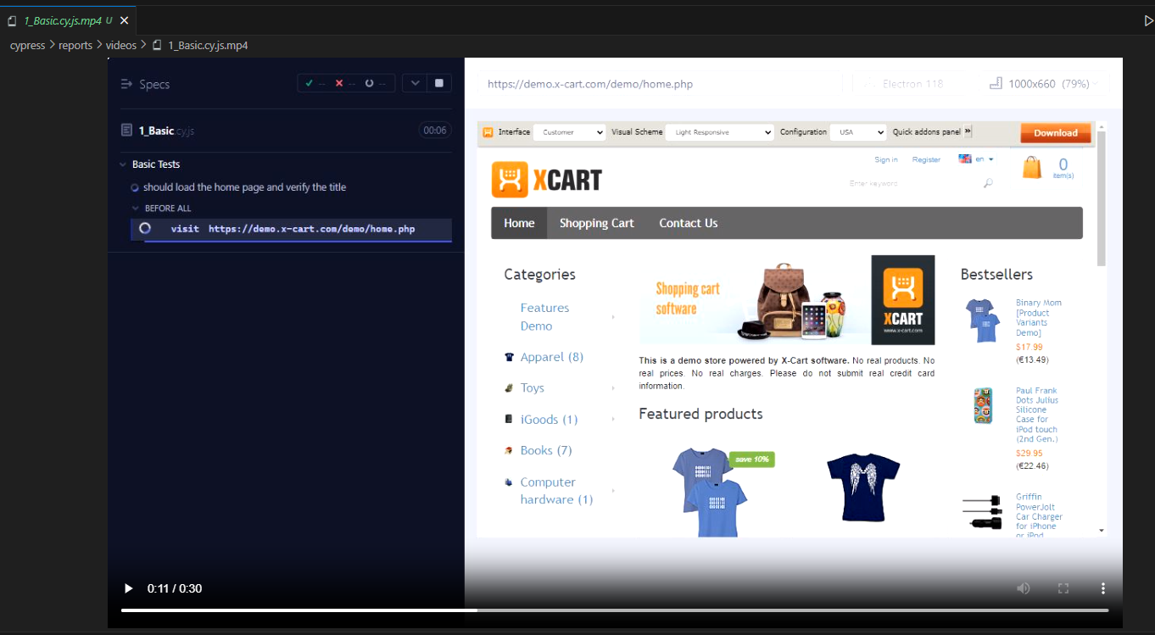
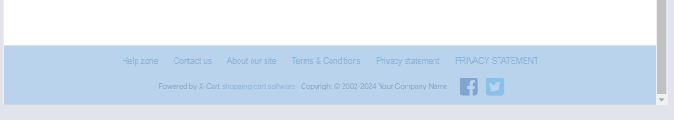
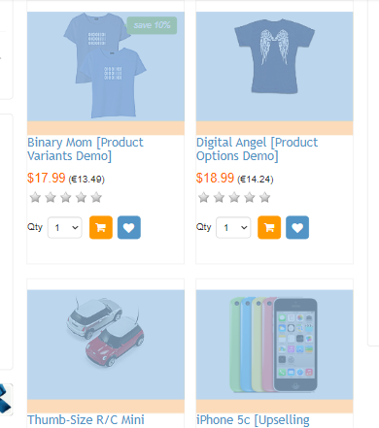
Output Obtained:
The test confirmed that the header, footer, and images were visible and consistent across all tested pages.

Slide 12
Custom Commands
Login Command
In this test suite, a custom command cy.login() is used to streamline the login process and simplify test cases that require user authentication. This custom command enhances test efficiency by reducing redundancy and making the login steps reusable across multiple tests.
Objective: Simplify the login process across various test cases.
Steps:
The custom command accepts email and password as arguments.
It automatically fills in the login form fields and submits the form, ensuring that the user is authenticated.

Slide 13
Output Obtained:
The custom login command worked as expected, and all test cases that relied on this command passed successfully.

Slide 14
CI/CD Integration with Cypress Testing using GitHub Actions
Objective
To establish a continuous integration and continuous deployment (CI/CD) pipeline using GitHub Actions, automating Cypress tests on each commit or pull request. The goal is to ensure the early detection of bugs and maintain code quality by running tests automatically.
Steps
Create a YAML file in the .github/workflows directory of your repository.
Define the workflow by specifying the event triggers such as push or pull_request. The pipeline is triggered whenever there is a new commit or pull request.
Install dependencies using Node.js and checkout the repository code.
Run Cypress tests using the cypress-io/github-action command. This runs all tests in headless mode by default, which is suitable for CI environments.
Report test results using GitHub Actions’ built-in reporting tools. GitHub Actions displays test results directly in the workflow interface, allowing developers to view the pass/fail status and error logs.

Slide 15
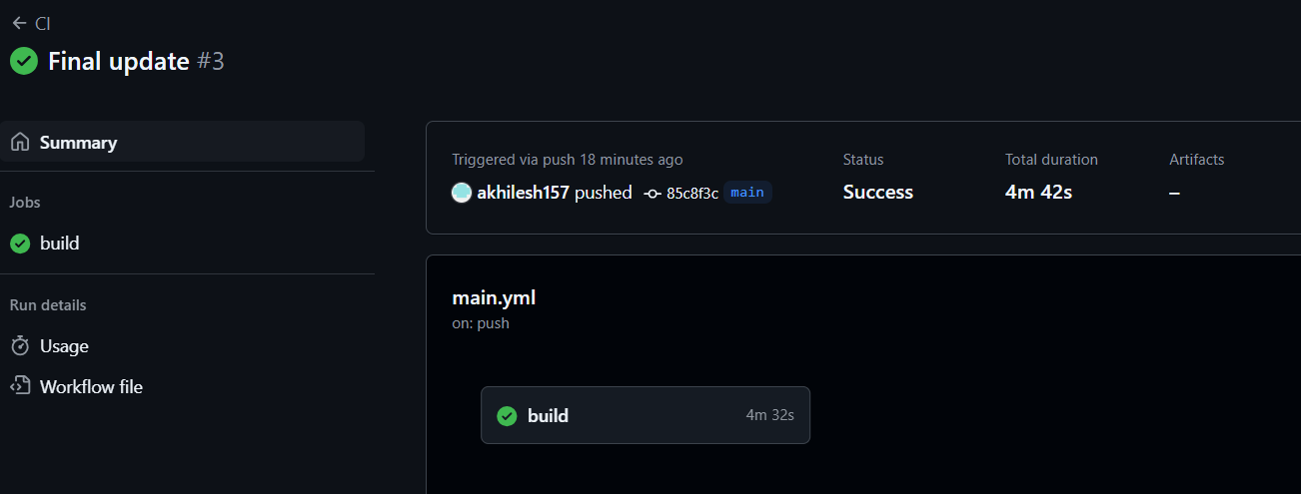
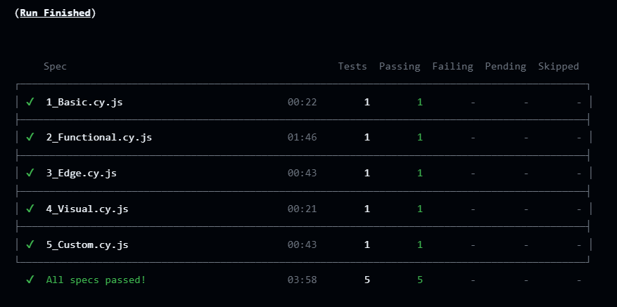
Output Obtained
The CI/CD pipeline runs automatically on each commit or pull request.
Cypress tests are executed without manual intervention, and the results are reported in real-time.
If tests pass, the workflow succeeds; if any tests fail, the workflow is marked as failed, providing immediate feedback to developers.

Slide 16
Generating Reports
Objective
To generate detailed and insightful test reports using Cypress and Mochawesome, enabling developers and testers to analyze test results, debug issues, and review the overall health of the test suite.
Steps
1. Install Mochawesome reporter packages
npm install --save-dev mochawesome mochawesome-report-generator cypress-mochawesome-reporter
2. Configure Cypress to use Mochawesome reporter in the cypress configuration file
Update the Cypress configuration file (cypress.json or cypress.config.js) to specify Mochawesome as the reporter.
3. Run the tests to generate the reports:
When Cypress tests are executed, Mochawesome will generate detailed HTML and JSON reports summarizing the test execution results.

Slide 17
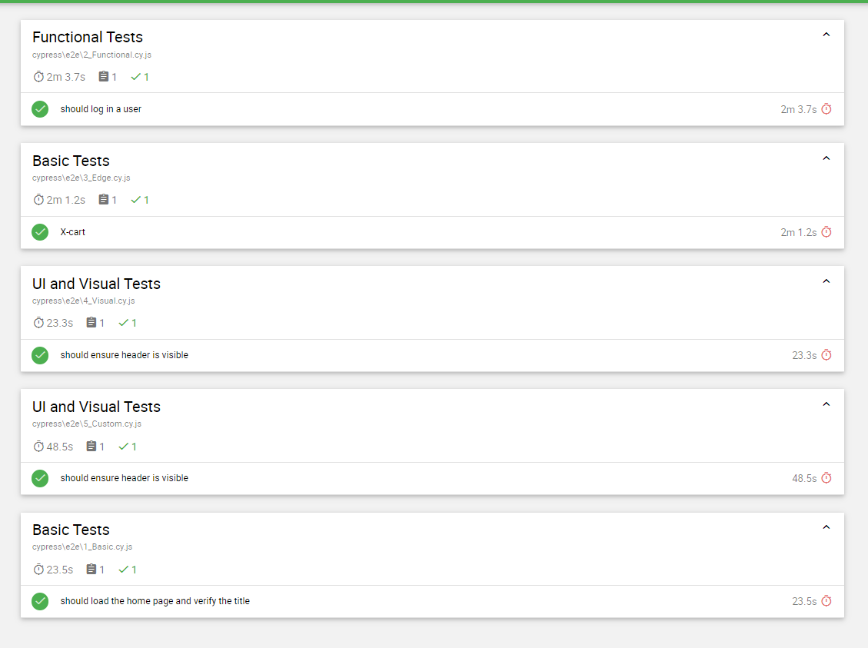
Output Obtained
Detailed Mochawesome reports were generated after running the Cypress tests, providing an easy-to-read HTML summary of test results. The reports included the pass/fail status of each test, error messages for failed tests, and attached screenshots where necessary.
The JSON report can be used for further automation or integration with other tools.

Slide 18
Challenges Faced
Environment Setup: Configuring GitHub Actions to run Cypress tests with all dependencies, especially setting up the correct Node version and caching.
Test Flakiness: Some tests were unreliable in the CI/CD pipeline due to network instability or race conditions in asynchronous UI operations.
Report Integration: Ensuring that the Cypress-Mochawesome reporter generated reports correctly in the CI/CD environment, as path issues sometimes led to missing reports.
Overcome methods
Environment Setup: Used pre-built GitHub Actions (like actions/setup-node and cypress-io/github-action) for smoother dependency management.
Test Stability: Added retries and better wait commands for asynchronous operations to reduce test flakiness.
Report Configuration: Adjusted the Cypress configuration to ensure correct report paths, and verified report generation using local tests before CI integration.

Slide 19
Future Aspects
Parallelization: Running tests in parallel to reduce the time taken for test execution in CI.
Cross-browser Testing: Expanding test coverage to include different browsers like Firefox and Edge within the CI pipeline.
Advanced Reporting: Integrating dashboards like Cypress Dashboard for real-time test monitoring and in-depth analysis.

Slide 20
Conclusion
The Cypress test suite developed for the X-Cart demo application offers a comprehensive evaluation of the system's functionality, user interactions, and visual elements. By covering both functional testing (such as user workflows) and non-functional aspects (such as UI consistency and error handling), this test suite ensures that the application is both reliable and user-friendly.
Basic Tests confirm the application's core functionality, ensuring that pages load correctly with the appropriate content and structure.
Functional Tests simulate key user journeys, such as logging in, searching for products, and checking out, ensuring that the system performs these critical tasks without issues.
Edge Case Tests validate how the application handles unexpected inputs, such as invalid form data or failed product searches, ensuring that the system remains robust and user-friendly even under non-ideal conditions.
UI and Visual Tests ensure that the application maintains a consistent and polished user interface, with all essential elements (headers, footers, images) visible and correctly displayed.

Slide 21
Thank you

